Slide 1
Linked Lists
_head
Next Node
Next Node
Next Node
Data 1
Data 2
Data 3
Von Yanis Ferecean und Noah Grundner

Slide 2
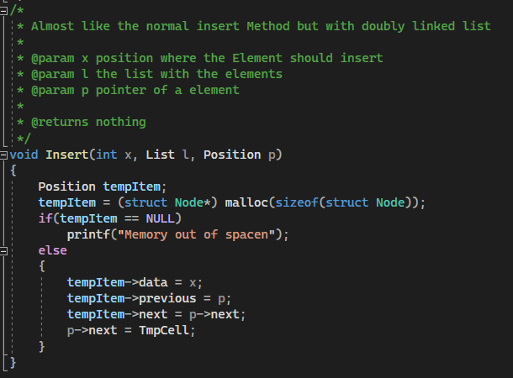
Double-Linked-Lists Insert

Slide 3
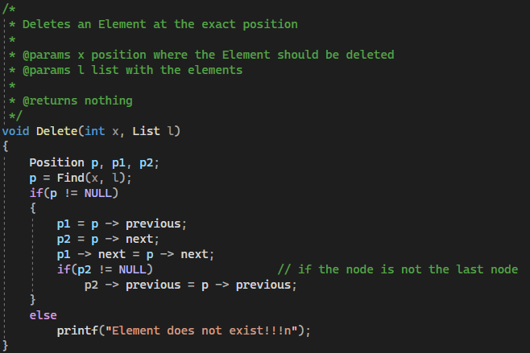
Double-Linked-Lists Delete

Slide 4
Linked Lists - Basics
A Linked Lists is a data structure, which saves its data non-sequentially
The beginning of the List is the head (list-start)
Each node of the list contains the address of the next node and the data of the node
The next-node of the last node is NULL (list-end)
_head
Next Node
Next Node
Next Node
Data 1
Data 2
Data 3

Slide 5
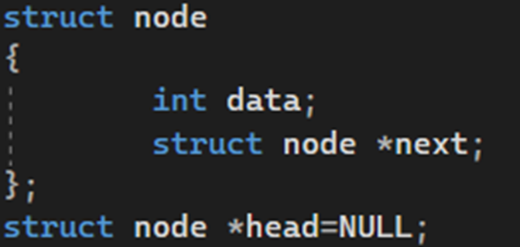
Linked List – Unidirectional
How create a unidirectional Linked-List:
Create a struct named “node”
Create the variables “data” and “next”
Implement a starting node named “head” and assign it to NULL (this will be the first node of the list)
_head
“my”
1921
“Name”
89122
“Yanis”
172891

Slide 6
Linked Lists - Insert
“is”
89122
_head
“my”
1921
“Name”
89122
“Yanis”
172891

Slide 7
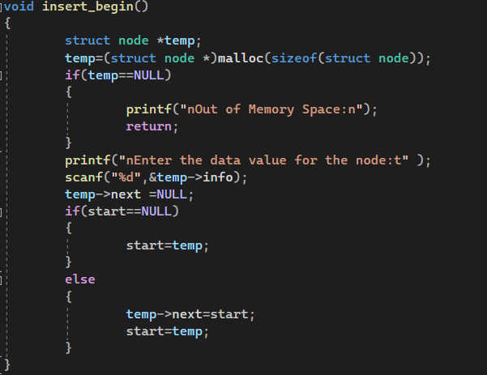
Linked Lists – Insert at the Beginning

Slide 8
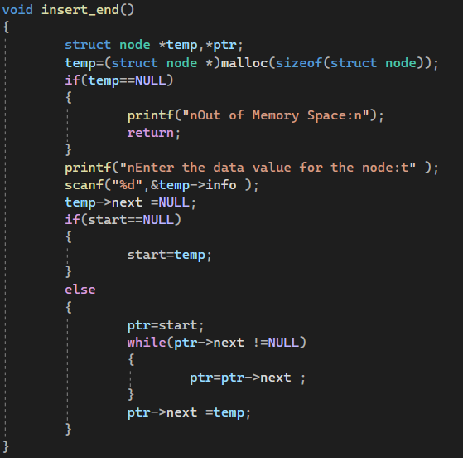
Linked Lists – Insert at the end

Slide 9
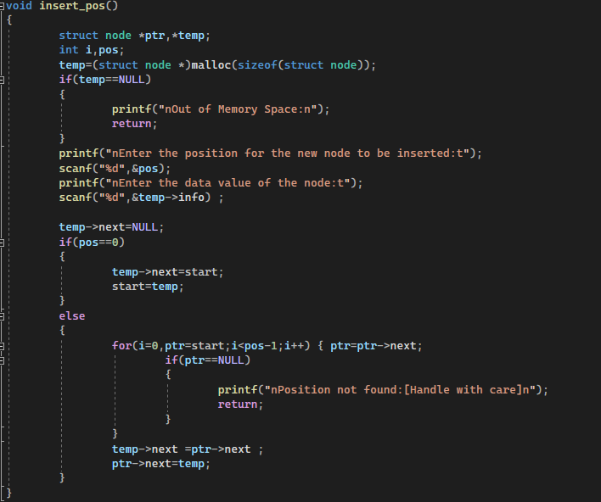
Linked Lists – Insert at a position

Slide 10
Linked Lists - Delete
_head
Next Node
Next Node
Next Node
Data 1
Data 2
Data 3

Slide 11
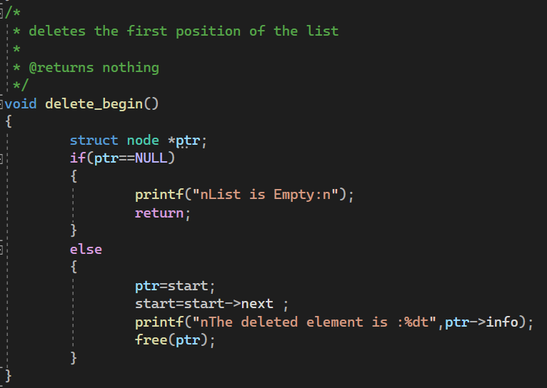
Linked Lists – delete at the beginning

Slide 12
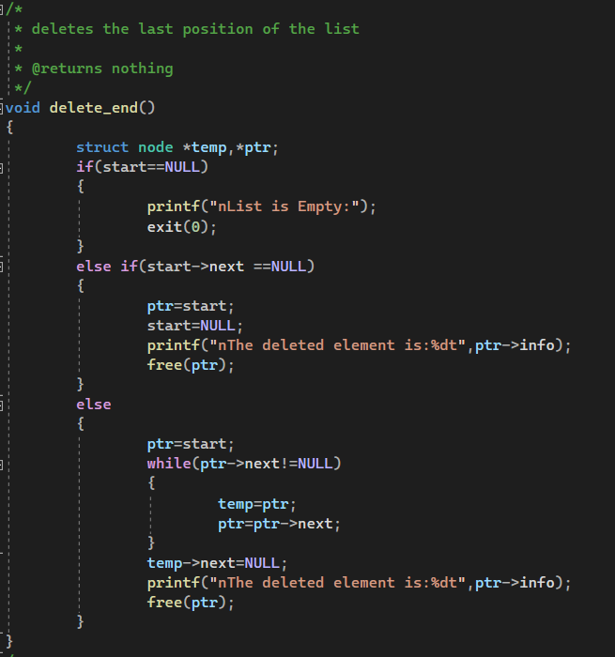
Linked Lists – delete at the end

Slide 13
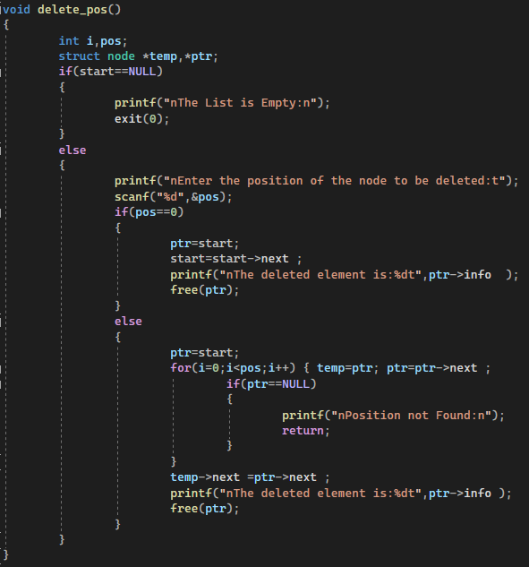
Linked Lists – delete at the position

