Slide 1
Testing how far exposure can be reduced
100 s
to
0.004 s
A known-truth water / plexiglass simulation for Brillouin spectroscopy
Question
Can spatial redundancy recover spectra after individual-pixel fitting fails?
Noise physics → BFS fitting → clustering → regional averaging
Brillouin spectroscopy noise-tolerance study
Notes:
Frame the study as a method-development question, not a claim about the final biological limit.
[Sources]
- Local experiment output: outputs/simulated_water_plexiglass/generated_four_stage_noise_grid.png

Slide 2
EXPERIMENTAL DESIGN
A known boundary makes every recovery step measurable
Cell Builder truth
Initial exposure sweep
100 s
1.00× noise
100% WATER
t
=
100
30 s
1.83× noise
m²
100% PLEXIGLASS
10 s
3.16× noise
Signal ∝ exposure
3 s
5.77× noise
30 × 30 pixels • 1 μm step • exact truth sidecar
1 s
10.0× noise
Relative shot noise ∝ 1/√t
0.3 s
18.3× noise
0.1 s
31.6× noise
02
Notes:
The boundary is intentionally simple: the goal is to isolate noise tolerance before returning to a cell geometry.
[Sources]
- simulator/generate_water_plexiglass_sweep.py
- simulator/resources/materials.json
- outputs/simulated_water_plexiglass/*_truth.npz

Slide 3
HOW NOISE IS CALCULATED
The simulator separates physical line broadening from detector noise
01
02
03
Thermal acoustic field
Laser phase noise
Detector chain
Acoustic density follows an Ornstein–Uhlenbeck process.
φ(t) = √ΔΩ · W(t)
Poisson shot noise
+ dark counts
Thermal fluctuations average over many coherence times; at realistic exposure they become negligible speckle.
A Brownian phase walk produces Lorentzian laser broadening. Widths add analytically to the material linewidth.
+ read noise
+ EMCCD excess noise (optional)
Exposure mainly changes detected Brillouin photons—and therefore the visible pixel-to-pixel scatter.
03
Notes:
Distinguish linewidth physics from visible detector scatter. Thermal noise sets the line; shot noise dominates these camera-like spectra.
[Sources]
- simulator/core/noise.py
- simulator/core/spectrum.py
- Oscar Nieves, Noise in Stimulated Brillouin Scattering, PhD thesis (2021), equations 3.12, 3.18, 3.23, 3.27, 5.13 and 5.14

Slide 4
BFS FITTING
At 0.1 s BFS is noisier, but no longer collapses toward zero
Corrected short-exposure behaviour
Lorentzian model
•
Only 0.1% of the 100 s photon budget remains.
I(ν) = A / [1 + ((ν − νB)/γ)²] + C
•
Elastic and Brillouin photons now both scale linearly with exposure.
Fit parameters
A amplitude
νB Brillouin frequency shift
γ half-width at half maximum
C baseline
Read noise remains fixed per acquisition, so pixel-level BFS estimates become visibly less precise.
•
•
The two fitted regions remain centred near 5.51 and 11.75 GHz rather than collapsing to the lower bound.
The earlier low-BFS expansion was a fixed-elastic-peak simulation artefact.
04
Notes:
Emphasise that the plotting range exposes fit failure. It is not a rendering bug and not proof that all spatial information has vanished.
[Sources]
- brillouin_fitting.py: lorentzian and fit_lorentzian_iterative
- simulator/core/scan.py: fit_scan
- outputs/simulated_water_plexiglass/half_water_half_plexiglass_noise_31.6228x.csv

Slide 5
GROUPING MATERIAL REGIONS
Clustering uses spectral shape, so it survives after single-pixel BFS fails
01
02
03
04
05
Fold
Trim
Normalise
Cluster
Match truth
Average Stokes and anti-Stokes sides
Remove Rayleigh tail; retain ≤13.3 GHz
Subtract baseline and L1-normalise each pixel
K-means with k = 2 on the full spectrum
Resolve label swapping against known material truth
Why it works
Water and plexiglass peaks are separated by ~6.24 GHz. Even when each peak centre is too noisy to fit precisely, the complete spectral shape still carries enough information to separate the two groups.
05
Notes:
This is deliberately an easy two-material case. The next experiment should reduce spectral separation and add mixed regions.
[Sources]
- analysis/generated_water_plexiglass_grid.py
- brillouin_preprocessing.py
- scikit-learn KMeans algorithm used locally

Slide 6
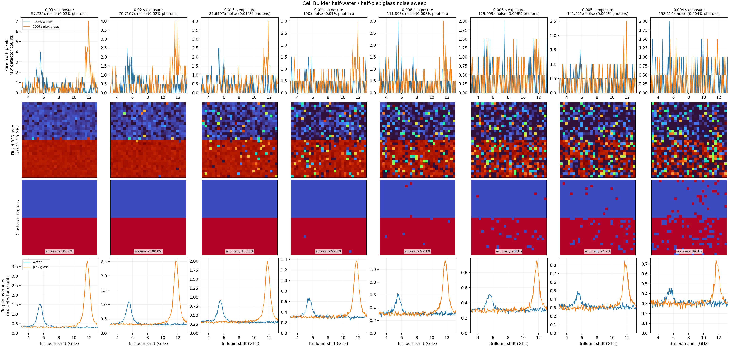
REGENERATING THE CURVES
Regional averaging reconstructs the peaks from many weak measurements
Average all spectra assigned to a region → independent noise falls approximately as 1/√N → refit or inspect the recovered material curve
06
Notes:
Read the figure by rows. At 0.1 s the pixel BFS map collapses, but clustering still finds the boundary and the averaged peaks remain visible.
[Sources]
- outputs/simulated_water_plexiglass/generated_four_stage_noise_grid.png
- analysis/generated_water_plexiglass_grid.py

Slide 7
WHY THIS IS PRACTICAL
Regional recovery could trade exposure for throughput
If the information can be accurately reproduced after grouping and averaging:
01
Reduce exposure time per pixel without immediately losing material-level spectra.
4–5 ms
02
Generate more samples—or scan larger fields—in the same instrument time.
observed boundary in this binary test
03
Use known-truth simulations to choose an exposure before committing biological samples.
Next decision
04
Define acceptance thresholds for region accuracy, BFS error and Lorentzian fit quality.
What is the shortest exposure that remains reliable for less-separated biological materials?
05
Validate the selected exposure on real repeated scans before adopting it experimentally.
07
Notes:
End with a proposal: retain the workflow, but move from a binary easy case to progressively harder material separations and mixed boundaries.
[Sources]
- outputs/simulated_water_plexiglass/manifest.csv
- outputs/simulated_water_plexiglass/generated_four_stage_noise_grid.png

Slide 8
PARAMETER AUDIT • 1 OF 2
Every stochastic and acquisition control used in the limit test
Parameter
Value used
Where it enters
Status
Exposure time
0.030 → 0.004 s
Signal + dark accumulation
Test variable
Temperature
300 K (26.85 °C)
Thermal signal scaling
Plausible ambient
Thermal speckle modes
Auto: t / coherence time
Gamma-distributed OU power
Physics-derived
BFS jitter / slow drift
0 MHz rms
Per-pixel common shift
Disabled to isolate SNR
Random seeds
20260824 + level index
All stochastic draws
Recorded / reproducible
PSF FWHM
0.60 μm
Boundary mixing
Plausible confocal spot
Grid / step
30 × 30 / 1 μm
900 spectra per scan
Experimental design
Temperature scaling
Enabled
Material peak area ∝ T
Thermal model
Conserve peak area
False
Material efficiencies retained
Realistic brightness contrast
Drift = 0 is an intentional controlled-test assumption—not a claim that the real laser has zero drift.
08
Notes:
The limit test isolates photon statistics. A later robustness study should sweep measured laser drift rather than inventing it.
[Sources]
- simulator/core/scan.py
- simulator/core/noise.py
- simulator/generate_water_plexiglass_sweep.py
- NIST temperature reference: https://www.nist.gov/pml/owm/si-units-temperature

Slide 9
PARAMETER AUDIT • 2 OF 2
Optical response and detector values are explicit—and not equally validated
Optical and spectral response
Photon and detector chain
Parameter
Value
Evidence status
Parameter
Value
Evidence status
Laser wavelength
720 nm
Back-solved assumption
Brillouin photon rate
1900 counts s⁻¹
Calibrated to local scans
Scattering angle
180°
Backscatter geometry
Elastic peak
30,000 counts @ 15 s
Calibrated; scales with t
Laser linewidth
0.10 MHz FWHM
Plausible narrow laser
Dark/background rate
0.12 count ch⁻¹ s⁻¹
Conservative effective value
Spectrometer Lorentzian
0.040 GHz FWHM
Model choice
Read noise
0.8 count rms / read
Plausible with EM gain
Spectrometer Gaussian
0.400 GHz FWHM
Fit to local line shape
Excess noise factor
1.0
Photon-counting idealisation
Elastic intrinsic width
0.030 GHz FWHM
Model choice
Baseline offset
0 count
Disabled
Frequency axis
−14.9 to +14.9 GHz
Matched local CSVs
Shot noise
Poisson(signal + dark)
Active
Fit markers
3.0 to 13.2 GHz
Expanded for PMMA
Digitisation
Round; clip at zero
Active
09
Notes:
The exact camera and laser models used experimentally are not yet documented in the repository. These values are defensible for simulation, but hardware datasheets should replace analogues.
[Sources]
- simulator/core/instrument.py
- simulator/core/spectrum.py
- simulator/README.md
- Oxford Instruments iXon Ultra specifications: https://andor.oxinst.com/downloads/uploads/andor-ixon-ultra-emccd-specifications.pdf
- Oxford Instruments EMCCD microscopy specifications (<1 e− with EM gain): https://andor.oxinst.com/products/ixon-emccd-cameras-for-life-science
- HighFinesse/TOPTICA LWA-100k: https://www.toptica.com/fileadmin/Editors_English/06_company/01_news/02_press/2019/20191206_HighFinesse_100k/LWA-100k_EN.pdf

Slide 10
WHAT “REALISTIC” MEANS HERE
The model is physically plausible; the instrument-specific audit is still required
SUPPORTED
PLAUSIBLE
NOT YET VALIDATED
Local frequency axis
Water / PMMA BFS
Peak-count calibration
Exposure scaling
Poisson statistics
300 K temperature
100 kHz laser linewidth
0.8-count read noise
0.6 μm PSF
Voigt response
Actual camera model
Measured dark/background rate
Measured laser drift
Instrument response split
720 nm wavelength
Record hardware specifications and dark frames; measure repeated-reference BFS drift; refit the simulator; then repeat the threshold sweep with replicates.
Required before claiming a real exposure limit
10
Notes:
This is the defensible conclusion: realistic enough to test algorithms and design calibration experiments, not yet sufficient to claim the instrument's true minimum exposure.
[Sources]
- simulator/README.md: calibration tiers and caveats
- Oxford Instruments iXon Ultra specifications: https://andor.oxinst.com/downloads/uploads/andor-ixon-ultra-emccd-specifications.pdf
- HighFinesse/TOPTICA LWA-100k: https://www.toptica.com/fileadmin/Editors_English/06_company/01_news/02_press/2019/20191206_HighFinesse_100k/LWA-100k_EN.pdf

