Slide 1
Final result
By Noah HOogenboom

Slide 2
Image downscaling and conversion
QuPath
Downscale with constant factor

Slide 3
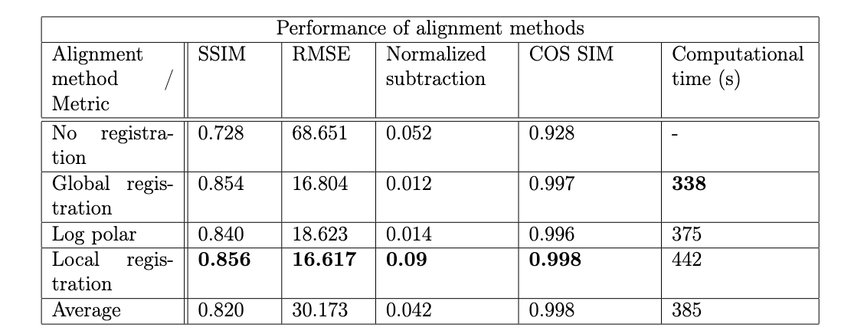
Image alignment
Global from CODA
Log Polar
Local form CODA
SIFT

Slide 4
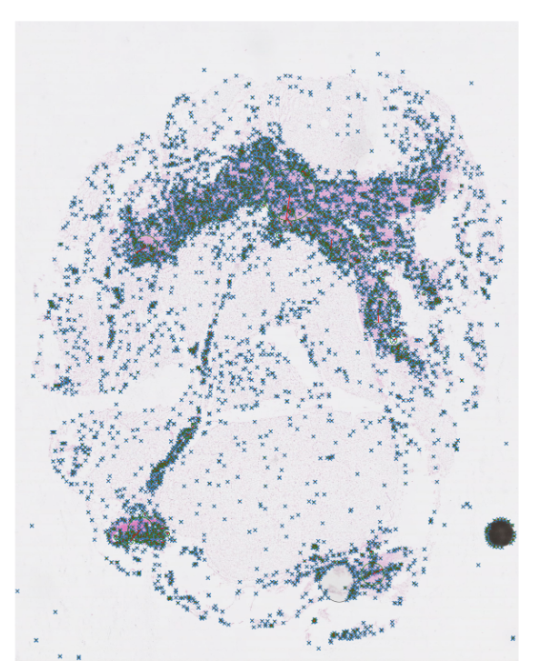
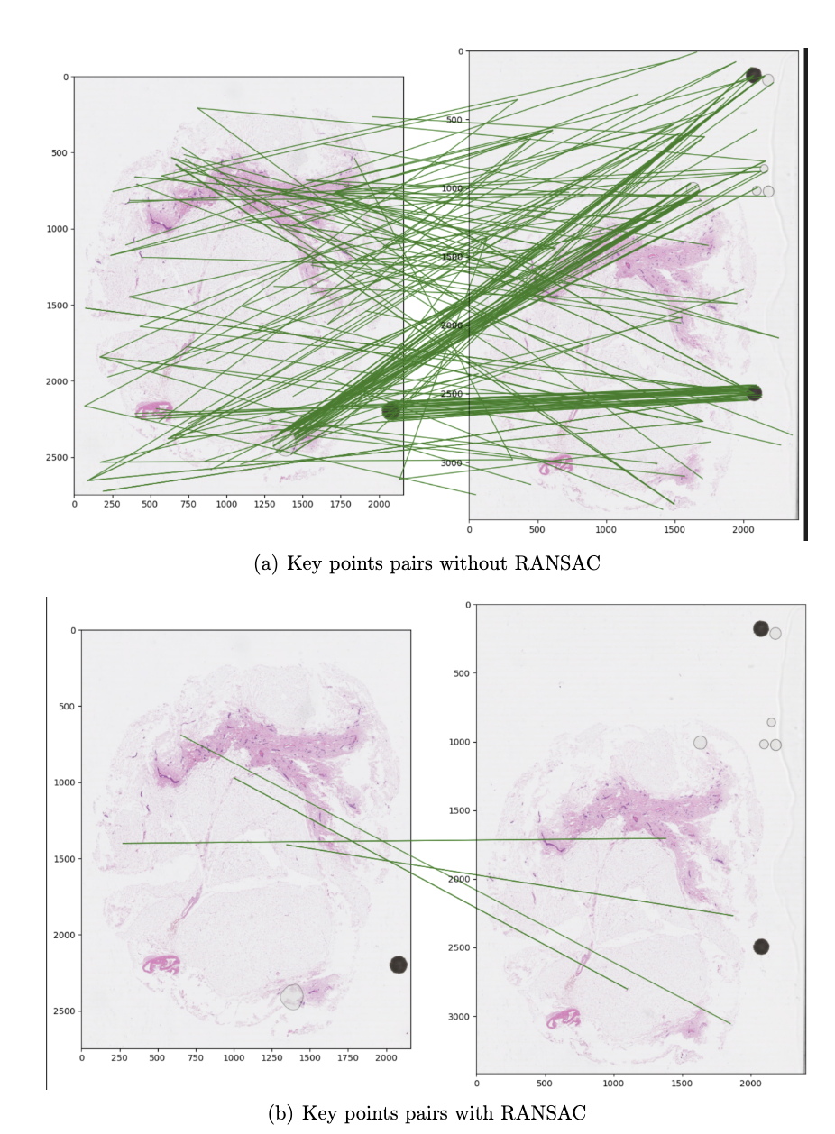


Slide 5
Deeplearning and cell classification
GeoJSON → XML
ResNet50

Slide 6
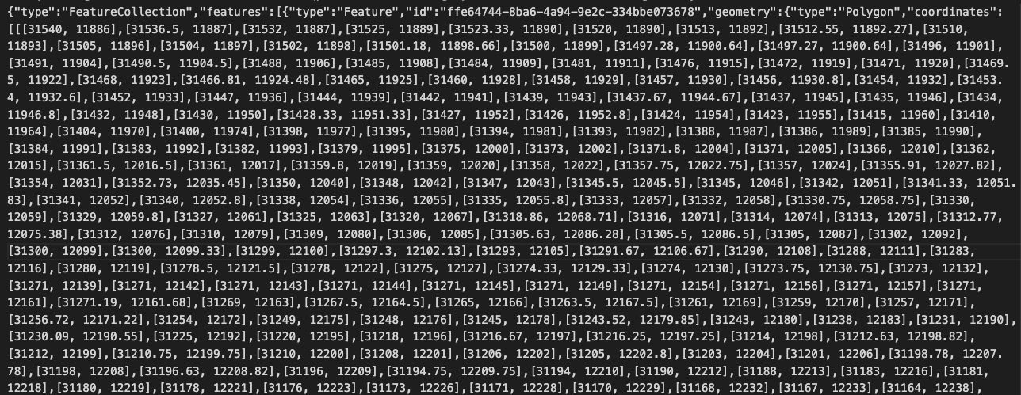

Slide 7
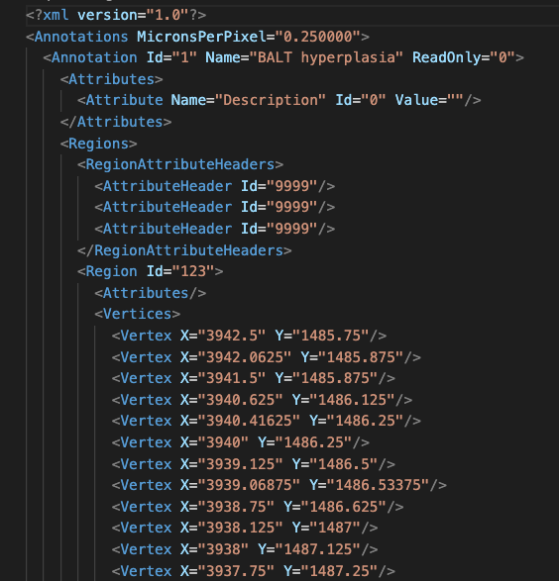

Slide 8
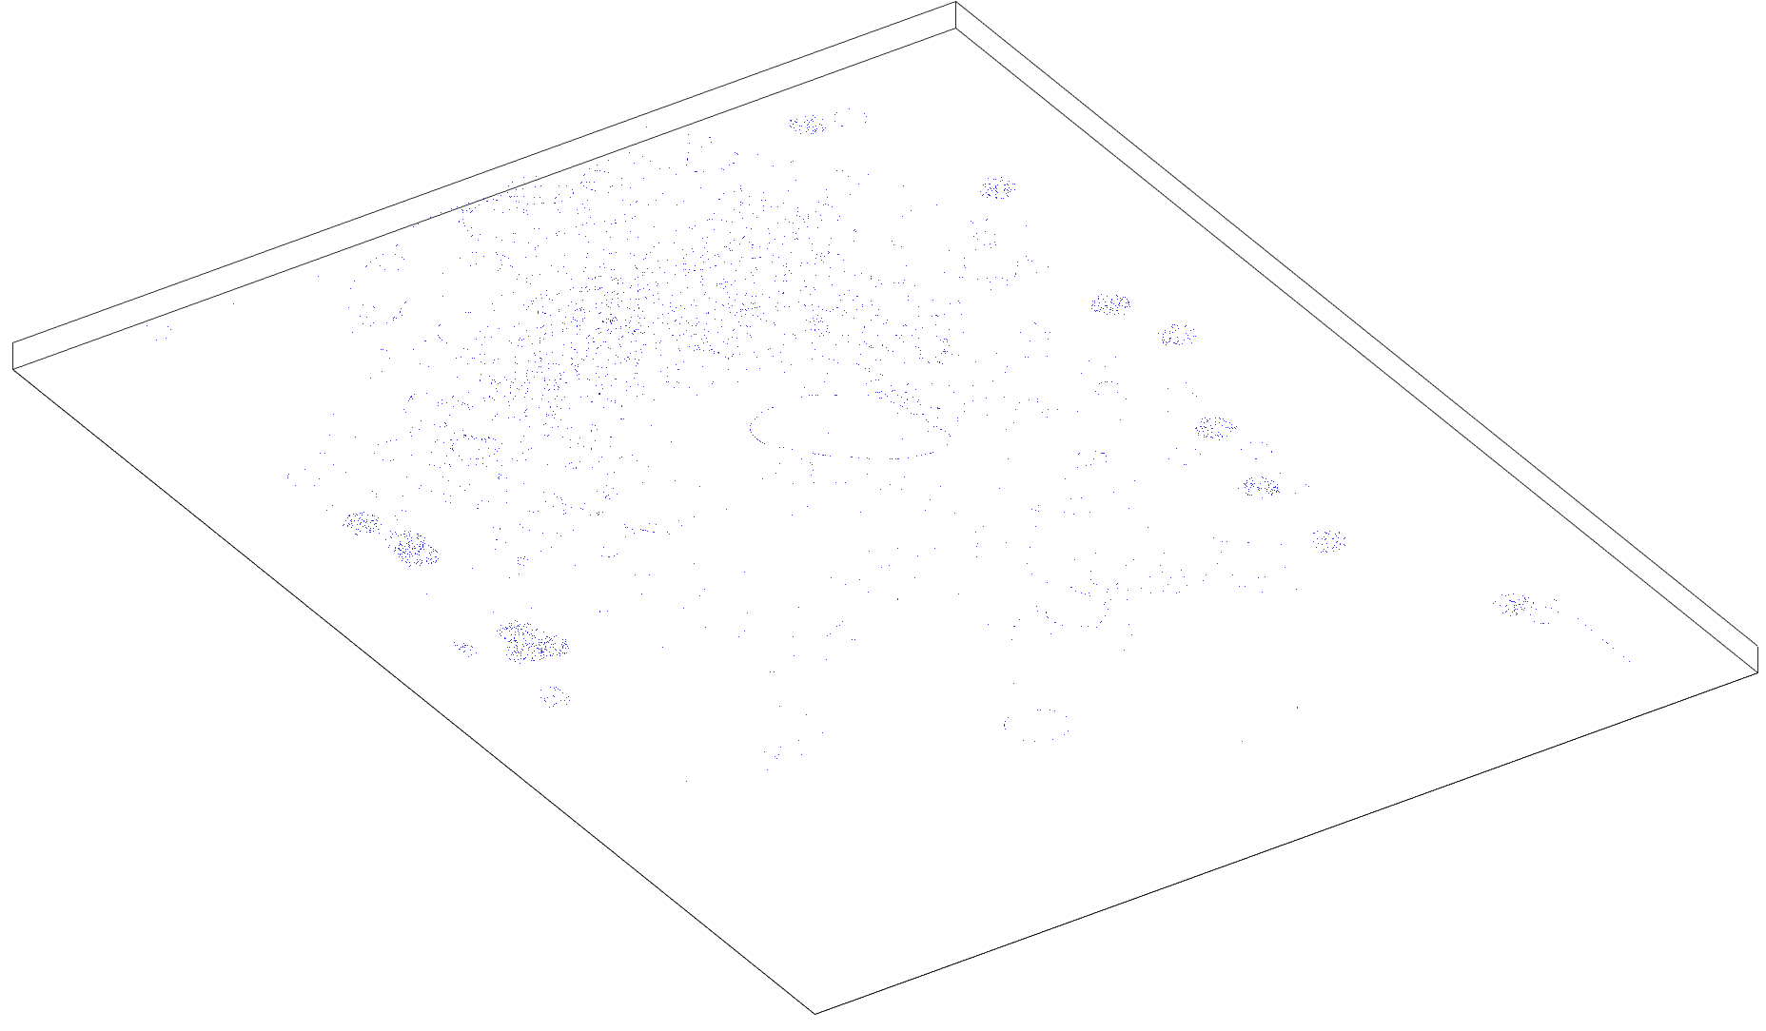
3D image

Slide 9
ADVice
Global alignment
Don’t use matlab!

