Slide 1

MY YELLOW
PROCESSES OF OBJECT ORIENTED SOFTWARE DEVELOPMENT
PAGES
NEW! ONLINE FORMAT
PERSONAL CONTACT MANAGER
GROUP 8
COP4331
Notes:
Nick - Hello, we are team 8 and this is our project called My Yellow Pages, which is a web application for managing your contacts.

Slide 2
Team Introduction
Project Manager - Nicholas Piazza
Frontend - Andrew Martin, Joe Hoang
API - Jason Torres, Patrik De Quevedo
Database - Noah Albert
Notes:
All

Slide 3












Tech Stack
Frontend: JavaScript, CSS, HTML
API: PHP
Database: mySQL
Supporting Technologies
Gantt Chart: Google Sheets Version Control: Github Communication: Discord Diagrams: Google Drawings
Notes:
AJ:
"For our project, we used the standard tech stack provided. On the front end, we worked with JavaScript, CSS, and HTML, while using PHP for our API and MySQL as our database solution.
Our team relied primarily on Discord for communication and hosted the majority of our meetings there. We also used GitHub for code sharing and collaboration throughout the development process.
To ensure thorough testing and documentation, we utilized both Postman and SwaggerHub. Additionally, several Google tools were used for planning, scheduling, and creating diagrams, which helped keep our project organized and on track."

Slide 4
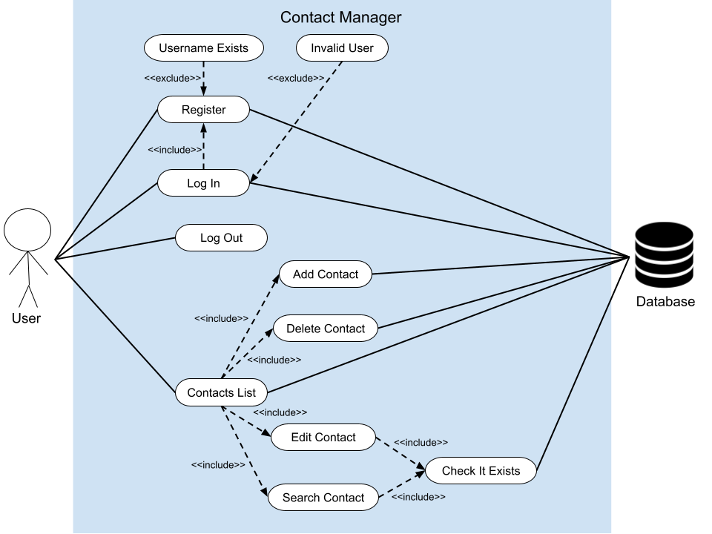
Use Case Diagram
Use Case Diagram
Notes:
Jason

Slide 5
What Went Right/Wrong: Project Manager
What Went Right:
Satisfactory communication
Everyone contributed
What Went Wrong:
Meeting time conflicts
Workflow pacing
Notes:
Nick:
Good communication:
Everyone was responsive
Everyone was able to discuss problems professionally
Everyone was able to give feedback respectfully
Everyone contributed:
Everyone was able to do their parts well
Different teams collaborated well on issues
Bus insurance
Meeting Time Conflicts:
Everyone has different schedules, so we had to spend more time planning when to meet
Workflow Pacing:
Trying to figure out if we were on track or behind

Slide 6
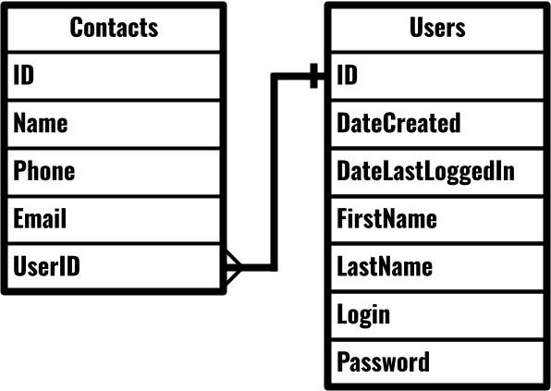
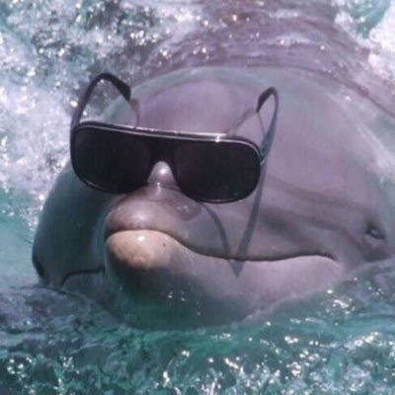
Entity Relationship Diagram
Notes:
Noah

Slide 7
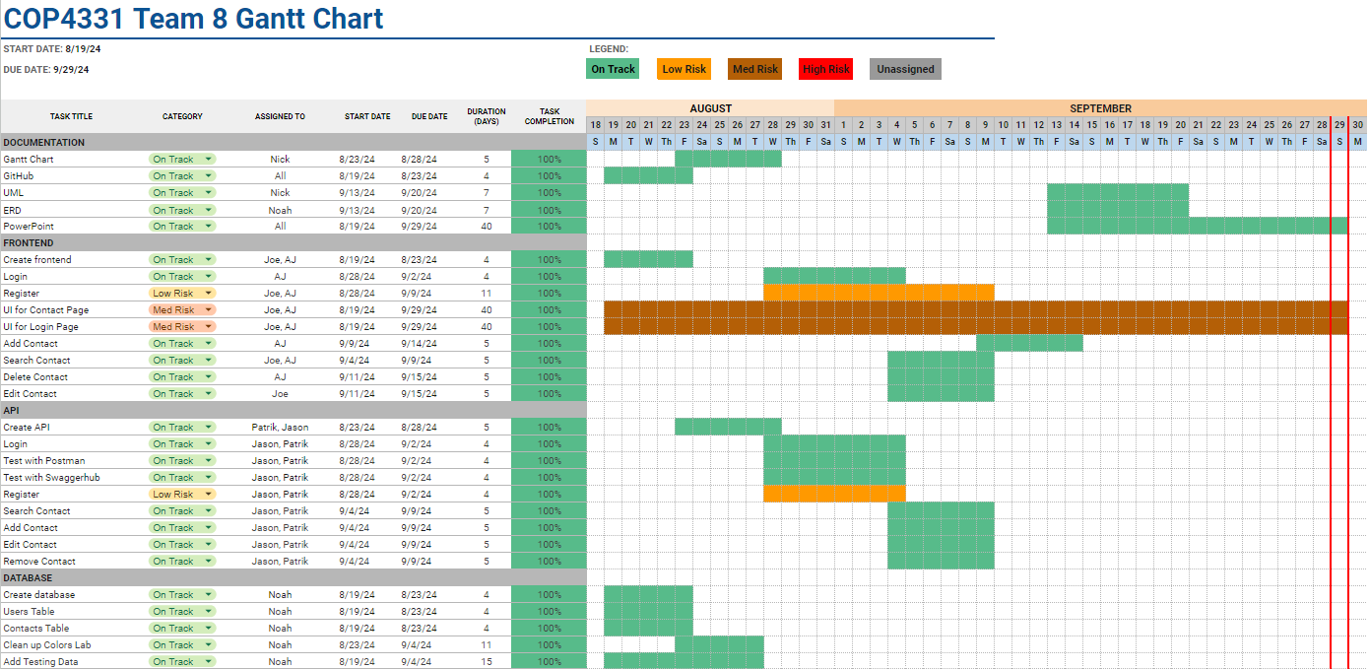
Gantt Chart
Notes:
Nick

Slide 8
What Went Right/Wrong: Database
What Went Right:
Database Creation
Table Creation
Team Communication
Database Cleanup
What Went Wrong:
Color Table Confusion
Table Name Casing
Notes:
Noah

Slide 9
What Went Right/Wrong: API
What Went Right:
Using the colors lab to build the contact files
Using all the technologies
What Went Wrong:
Delete Contacts would delete all the contacts that a user had
Update Contacts would update all the contacts that a user had
Notes:
Patrik

Slide 10
What Went Right/Wrong: Frontend
What Went Right:
Division of work
Proper communication
Understanding what is needed
Steady Progress
No stagnations or problems
What Went Wrong:
Testing Issues
One server
Notes:
Joe, AJ

Slide 11
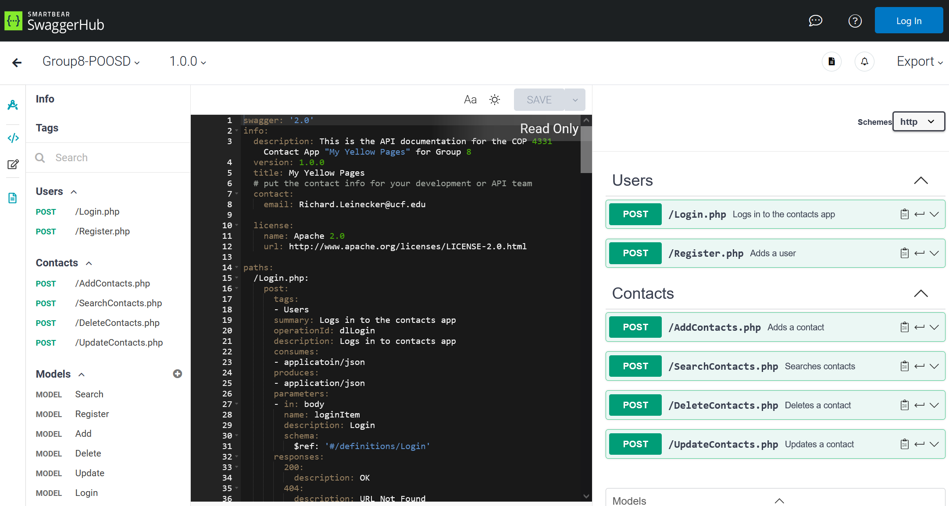
SwaggerHub Demo Link
SwaggerHub Documentation
Notes:
Jason

Slide 12
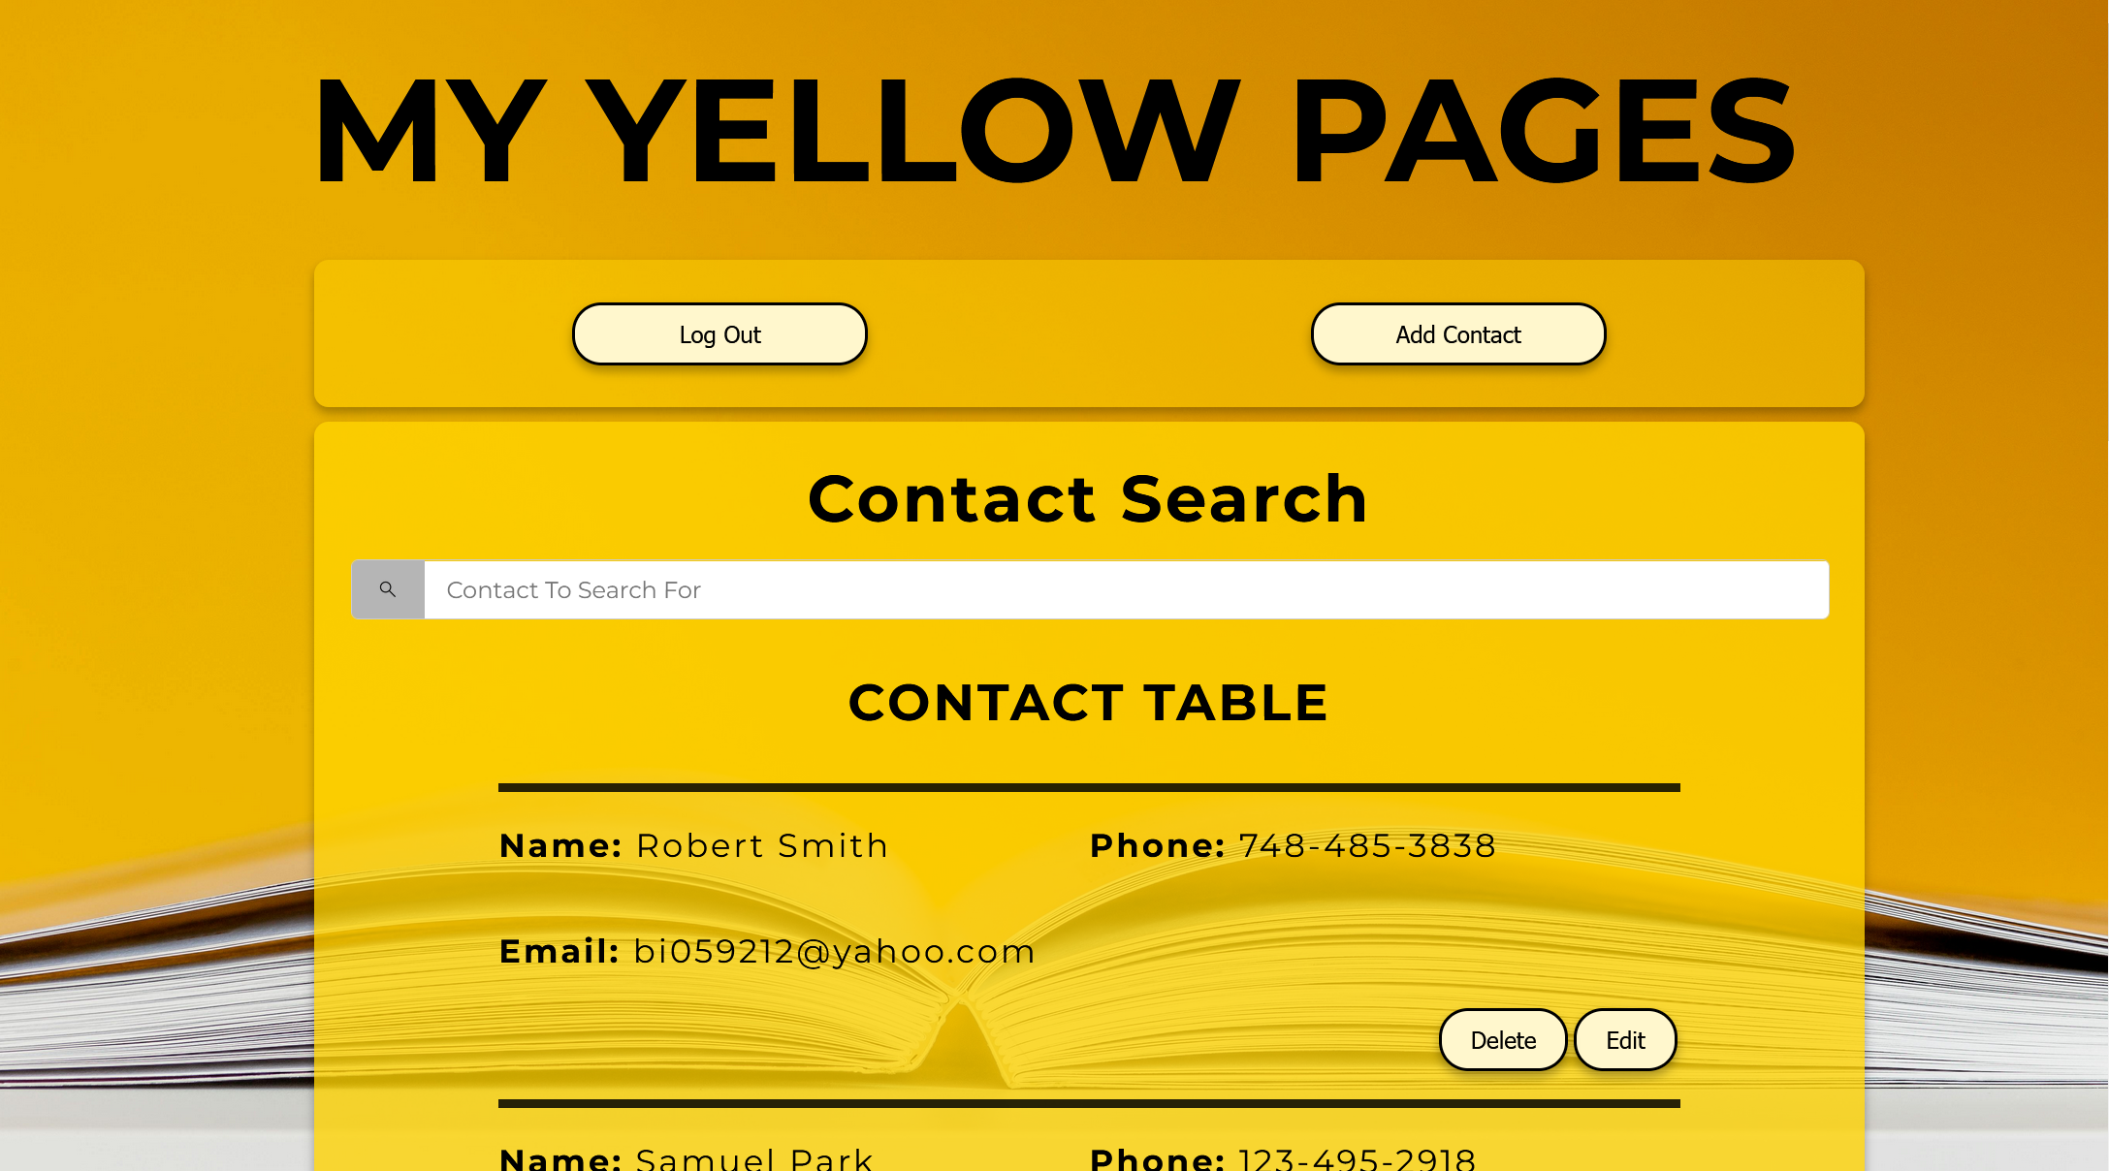
Website Demo Link
Website Link

Slide 13
Any Questions?

