Slide 1
A Spectral Method for Improved Phylogenetic Inference
Ariel Jaffe
Noah Amsel
Boaz Nadler
Joseph Chang
Yuval Kluger

Slide 2
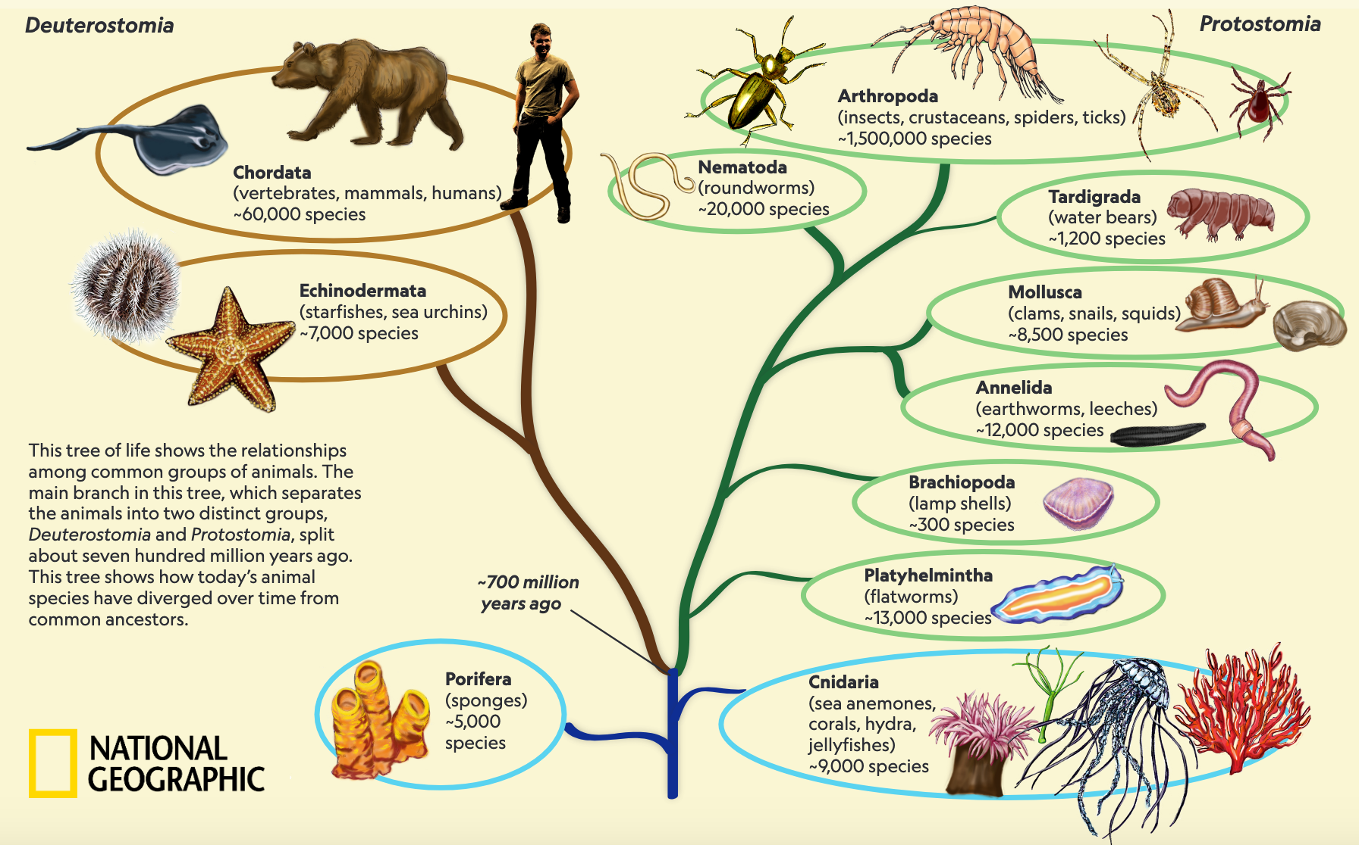
What is Phylogenetics?
Notes:
We can describe evolution history with a tree
Used in evolutionary biology, medicine, …
Finding the right tree is not always easy
We’re going to present a new method for inference on tree models. To make this more concrete…
Are the tardigrades cousins of the arthropods or the mollusks? If you think that’s hard, try doing it for different strains of a rare virus.
Central to evolutionary biology, applications in healthcare
And there are other applications where models take the form of a tree

Slide 3
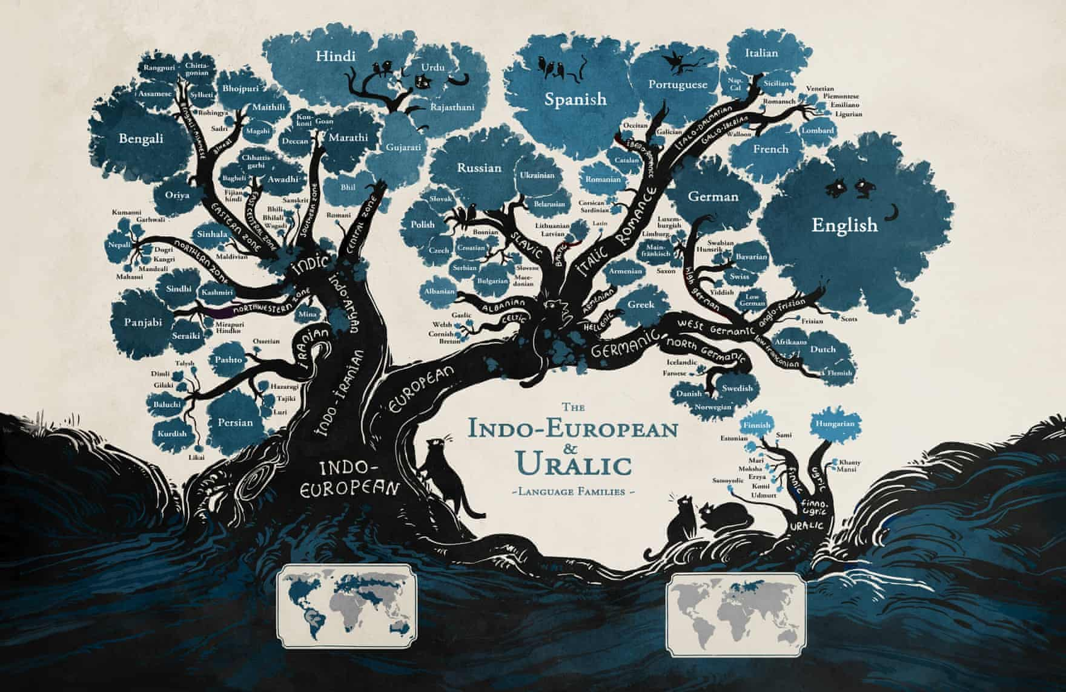
Notes:
Phylogeny isn’t just for biologists.
Making this tree took work! An entire field – historical linguistics – was invented to do it

Slide 4
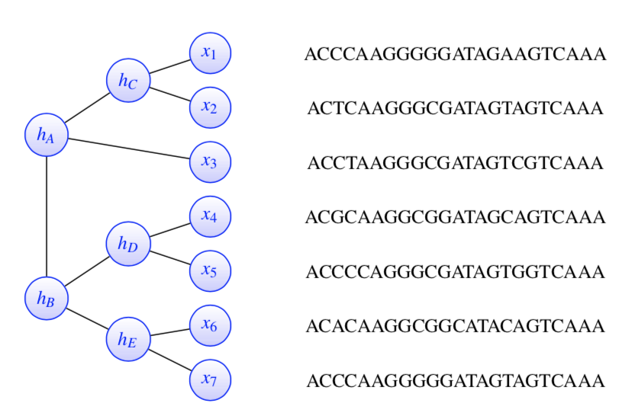
Assumptions
For each node, there are several traits (e.g. individual DNA base pairs)
Different traits are i.i.d.
Tree nodes form a Markov Random Field (conditional independence)
Node is independent of “siblings” given its “parent”
Trees are binary
Notes:
Detail of our model for how data is generated in the tree
The traits of a species are just the traits of its parent, + some randomness
Q: Is there a root? What’s a parent?
A: no not necessarily

Slide 5
Evolution = Latent Tree Model
Yes
Yes
🐠
No
No
No
p = 25 %
🐁
p = 5 %
p = 10 %
p = 10 %
Yes
🐴
🐿
🐡
Notes:
Consider a binary trait – either present or not (e.g., having fins?)
As we “evolve” the trait across each edge, there’s some probability that the trait will flip
Repeat this until all leaves have a trait
Whether the mouse transitions is independent of whether the pufferfish does
We start over for the next trait, independent of what happened with this trait
adenine (A), cytosine (C), guanine (G), thymine (T)

Slide 6
The Reconstruction Problem
Observe a set of traits at each leaf and reconstruct the tree structure that generated them
Typical application: DNA sequences where each base pair is a trait (so 4 states instead of 2)
Just try all possible trees and pick the one with the maximum likelihood?
4 species — 2 trees (unrooted)
50 species — quadrillions
NP-Hard
Notes:
Before: if we know the tree, we can generate some data. Now the reverse
How do we find a good tree without looking at so many possibilities?
Why is it latent tree model?
Well we can only observe the leaves
(We can’t go back in time and sample a dinosaur’s genome)

Slide 7
Distance Methods
Species with many traits in common are likely to be related
We can quantify the “distance” between any pair of species
Distance methods reconstruct the tree from a matrix of these pairwise distances
🐡
🐴 A C C G T G
🐿 A C C G T A
🐡 A A C T T C
50%
50%
🐴
🐿
17%
Notes:
Doing this naively results in a bias, since even completely independent species will have some similarities by chance.
As species get farther apart, the distance stops growing
adenine (A), cytosine (C), guanine (G), thymine (T)
Note: we don’t use the raw percentages, rather we use them to calculate “paralinear distance”

Slide 8
Neighbor Joining (Saitou & Nei, ’87)
The standard method — fast and accurate
58K citations
“Bottom-up” strategy: repeatedly combines pairs of similar nodes
🐴
🐴
🐡
🐿
🐡
🐴
🦈
🐿
🐴
🐿
🐡
🦈
🐿
🦈
Notes:
But how do we pick the pair of two “closest” nodes?

Slide 9
Our Method: Spectral Neighbor Joining
We propose a new criterion for deciding which pair to merge at each step
We define a similarity measure between pairs of taxa and construct a similarity matrix
Our criterion is based on the spectral properties of this matrix
Notes:
The would be the common ancestor of the squirrel and the horse
Observation: (in good group) if we look at any pair of one element inside the group and one element outside the group, the mouse will be in between
It’s in parenthesis because it’s latent – we don’t observe it, but we’re guessing that it exists in between the mammals and everything else
This is still a distance matrix, since we can cast the similarity matrix as a simple transformation of the distance matrix

Slide 10
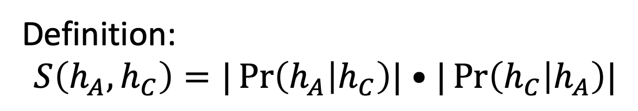
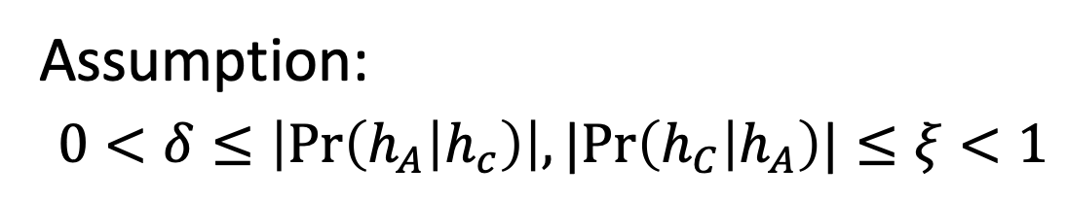


Similarity between adjacent nodes
Every edge has an associated transition matrix
$${\operatorname{Pr}\left(h_{A} | h_{c}\right)}_{\left\{GT\right\}}=Pr⁡(h_{A}=G |h_{C}=T)$$
$${\operatorname{Pr}\left(h_{C} | h_{A}\right)}_{\left\{TG\right\}}=Pr⁡(h_{C}=T |h_{A}=G)$$
Definition:
$$S\left(h_{A},h_{C}\right)=|\operatorname{Pr}\left(h_{A} | h_{C}\right)|•|\operatorname{Pr}\left(h_{C} | h_{A}\right)|$$
Assumption:
$0<δ≤\left|\operatorname{Pr}\left(h_{A} | h_{c}\right)\right|,|Pr\left(h_{C} | h_{A}\right)|≤ξ<1$
Notes:
In general, the forward and backward transition matrices can be different
In DNA there are four states, ACGT.
G and T are two states.
Guanine, thymine, ...
We multiply both because we want similarity to be symmetric
Note |•| means determinant
We don’t allow the measure to be 0 (which bars completely independent) or 1 (which bars completely deterministic)

Slide 11



Similarity between non-adjacent nodes
The similarity is multiplicative along the edges of the tree
$${\operatorname{Pr}\left(x_{1} | x_{3}\right)}_{\left\{GT\right\}}=Pr⁡(x_{1}=G|x_{3}=T)$$
$${\operatorname{Pr}\left(x_{3} | x_{1}\right)}_{\left\{GT\right\}}=Pr⁡(x_{3}=G|x_{1}=T)$$
$$S\left(x_{1},x_{3}\right)=|\operatorname{Pr}\left(x_{1} | x_{3}\right)\operatorname{Pr}\left(x_{3} | x_{1}\right)|$$
$$S\left(x_{1},x_{3}\right)=S\left(x_{3},h_{4}\right)S\left(h_{A},h_{c}\right)S\left(h_{c},x_{1}\right)$$
Notes:
We can actually estimate the similarity between two leaf nodes by simply estimate the transition matrix between them
Similarity decreases exponentially throughout the tree, since similarity is always strictly btwn 0 and 1

Slide 12















Similarity matrix
Between all pairs of leaf nodes
(these are the only nodes for which we have data!)
$$x_{1}$$
$$x_{2}$$
$$x_{3}$$
$$x_{4}$$
$$x_{5}$$
$$x_{6}$$
$$x_{7}$$
$$x_{1}$$
$$x_{2}$$
$$x_{3}$$
$$S=$$
$$x_{4}$$
$$x_{5}$$
$$x_{6}$$
$$x_{7}$$

Slide 13










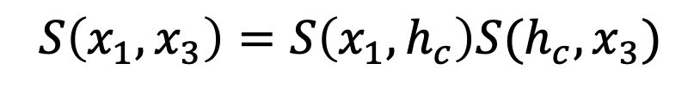


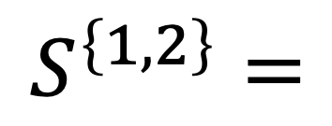









Key insight!
Every clan in the tree corresponds to a rank one submatrix in $S$
$$x_{3}$$
$$x_{4}$$
$$x_{5}$$
$$x_{6}$$
$$x_{7}$$
$$S\left(x_{1}, x_{3}\right)=S\left(x_{1}, h_{c}\right)S(h_{c}, x_{3})$$
$$h_{c}$$
$$h_{c}$$
$$x_{1}$$
$$x_{2}$$
$$x_{3}$$
$$x_{4}$$
$$x_{5}$$
$$x_{6}$$
$$x_{7}$$
$$x_{1}$$
$$x_{1}$$
$$x_{2}$$
$$x_{2}$$
$$x_{3}$$
$$S^{\left\{1,2\right\}}=$$
$$x_{4}$$
$$x_{5}$$
$$x_{6}$$
$$x_{7}$$
Notes:
As we are building up the tree, we only want to merge two subtrees if their leaves all together form a clan
A clan: all nodes in the clan are on one side of the edge, and all other nodes are on the other
BECAUSE SIMILARITY IS MULTIPLICATIVE ACROSS THE EDGES
Based on our assumption x1 and x2 are conditionally independent of all the other leaves, given h_c
So we can factor
Notation: S{1,2} is this submatrix

Slide 14










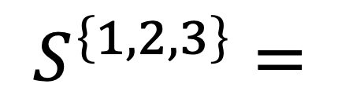






Key insight!
Every clade in the tree corresponds to a rank one submatrix in $S$
$$x_{4}$$
$$x_{5}$$
$$x_{6}$$
$$x_{7}$$
$$h_{A}$$
$$h_{A}$$
$$x_{1}$$
$$x_{2}$$
$$x_{3}$$
$$x_{4}$$
$$x_{5}$$
$$x_{6}$$
$$x_{7}$$
$$x_{1}$$
$$x_{1}$$
$$x_{2}$$
$$x_{2}$$
$$x_{3}$$
$$x_{3}$$
$$S^{\left\{1,2,3\right\}}=$$
$$x_{4}$$
$$x_{5}$$
$$x_{6}$$
$$x_{7}$$
Notes:
BECAUSE SIMILARITY IS MULTIPLICATIVE ACROSS THE EDGES

Slide 15




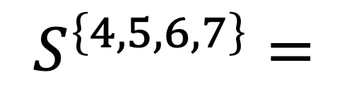


Key insight!
Every clade in the tree corresponds to a rank one submatrix in $S$
$$x_{1}$$
$$x_{2}$$
$$x_{3}$$
$$x_{4}$$
$$x_{5}$$
$$x_{6}$$
$$x_{7}$$
$$x_{1}$$
$$x_{2}$$
$$x_{3}$$
$$S^{\left\{4,5,6,7\right\}}=$$
$$x_{4}$$
$$x_{5}$$
$$x_{6}$$
$$x_{7}$$
Notes:
BECAUSE SIMILARITY IS MULTIPLICATIVE ACROSS THE EDGES

Slide 16



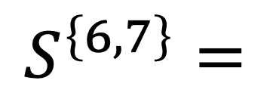

Key insight!
Every clade in the tree corresponds to a rank one submatrix in $S$
$$x_{1}$$
$$x_{2}$$
$$x_{3}$$
$$x_{4}$$
$$x_{5}$$
$$x_{6}$$
$$x_{7}$$
$$x_{1}$$
$$x_{2}$$
$$x_{3}$$
$$S^{\left\{6,7\right\}}=$$
$$x_{4}$$
$$x_{5}$$
$$x_{6}$$
$$x_{7}$$
Notes:
BECAUSE SIMILARITY IS MULTIPLICATIVE ACROSS THE EDGES

Slide 17







Key insight!
⇔
Do x6 and x7 form a clan?
Is this submatrix rank 1?
$$x_{1}$$
$$x_{2}$$
$$x_{3}$$
$$x_{4}$$
$$x_{5}$$
$$x_{6}$$
$$x_{7}$$
?
$$x_{1}$$
$$x_{2}$$
$$x_{3}$$
$$x_{4}$$
$$x_{5}$$
$$x_{6}$$
$$x_{7}$$
Notes:
If we don’t know the tree, we can still tell whether a set of nodes forms a clan
The question on the left reduces to the question on the right

Slide 18











Key insight!
⇔
Do x4 x5 x6 and x7 form a clan?
Is this submatrix rank 1?
$$x_{1}$$
$$x_{2}$$
$$x_{3}$$
$$x_{4}$$
$$x_{5}$$
$$x_{6}$$
$$x_{7}$$
?
$$x_{1}$$
$$x_{2}$$
$$x_{3}$$
$$x_{4}$$
?
$$x_{5}$$
$$x_{6}$$
$$x_{7}$$
Notes:
Works for clans of any size

Slide 19

How to tell if a submatrix is rank 1?
Similarity matrix is estimated from data, so it is not exact
Even the “good” submatrices are only approximately rank 1
So we use the second singular value as a measure of “rank 1-ness”
$σ_{2}≈0$ means the submatrix is nearly rank 1

Slide 20
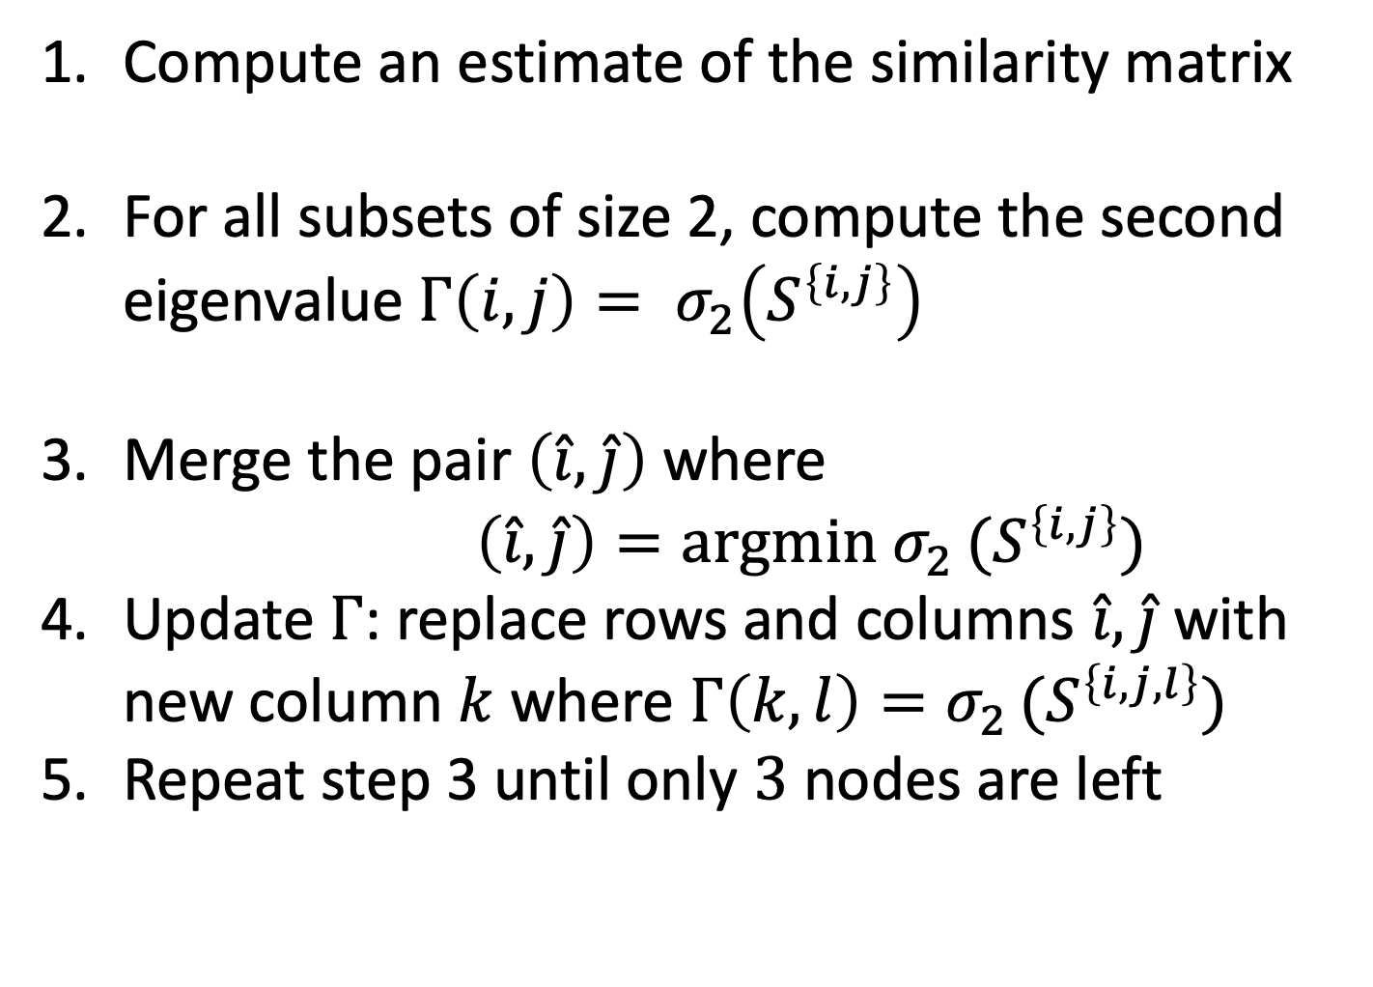
Spectral Neighbor Joining Algorithm
Compute an estimate of the similarity matrix
For all subsets of size 2, compute the second eigenvalue $Γ\left(i,j\right)= σ_{2}\left(S^{\left\{i,j\right\}}\right)$
Merge the pair $\left(\hat{i},\hat{j}\right)$ where $\left(\hat{i},\hat{j}\right)=argmin σ_{2 }(S^{\left\{i,j\right\}})$
Update $Γ$: replace rows and columns $\hat{i},\hat{j}$with new column $k$ where $Γ\left(k,l\right)=σ_{2 }(S^{\left\{i,j,l\right\}})$
Repeat step 3 until only $3$ nodes are left
Notes:
REMEMBER IT IS BOTTOM UP
Continue merging the pair of CLANS which have the lowest score

Slide 21
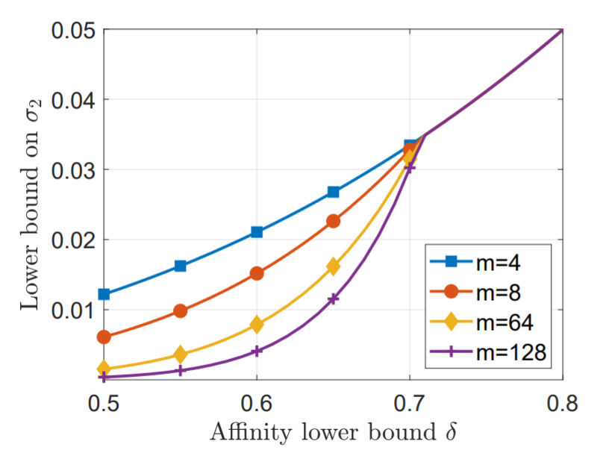
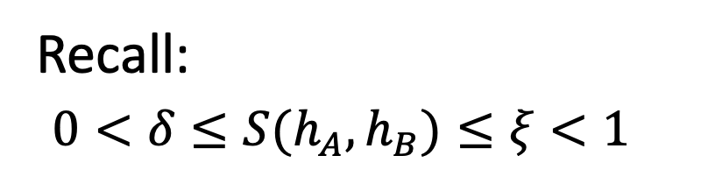
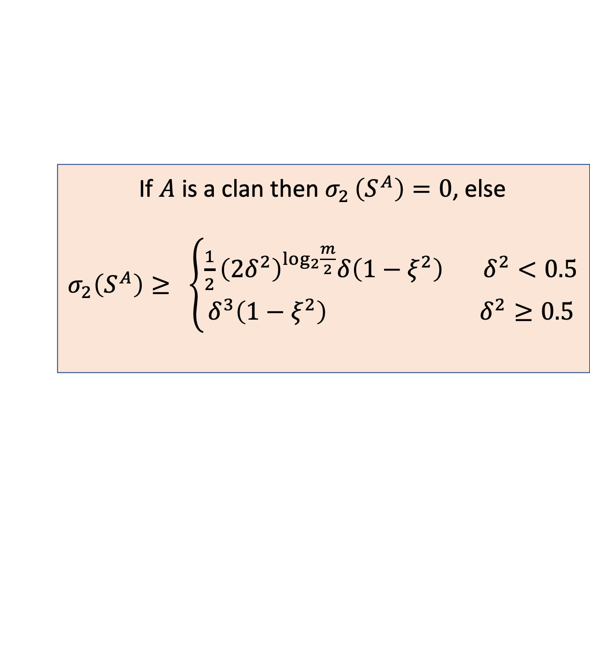

Consistency of SNJ:
Recall:
$0<δ≤S(h_{A}, h_{B})≤ξ<1$
Let $S^{A}$ be a submatrix corresponds to a set of taxa $A:$
If $A$ is a clan then $σ_{2 }\left(S^{A}\right)=0$, else
$σ_{2}\left(S^{A}\right)≥ \left\{\begin{aligned}\frac{1}{2}{\left(2δ^{2}\right)}^{\log_{2}{\frac{m}{2}}}δ\left(1−ξ^{2}\right) δ^{2}<0.5 \\ δ^{3}\left(1−ξ^{2}\right) δ^{2}≥0.5\end{aligned}\right.$
Notes:
Sigma 2 is 0 for all correct clans and strictly greater than 0 otherwise
Discuss the formula:
As the delta goes to 0 or xi goes to one, the problem because harder.
This fits the formula because true clans are harder to tell apart
There’s NO dependency on the number of taxa unless delta is low
Delta 0.5 is like a mutation rate of 8% between adjacent nodes (which is pretty high!)

Slide 22
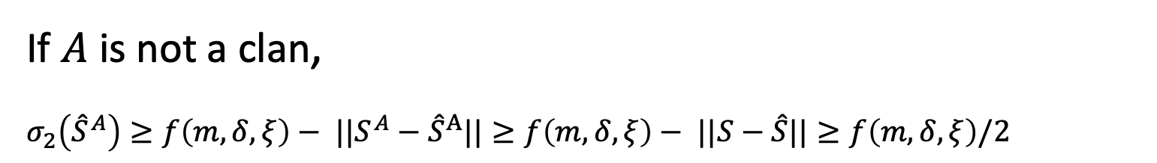
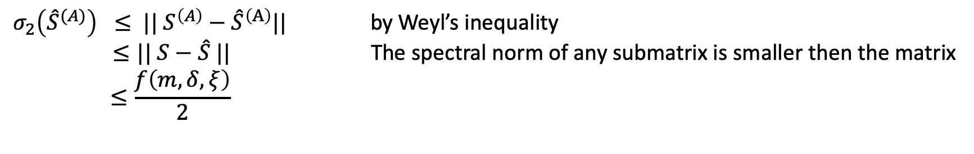
Consistency of SNJ:
If $||S−\hat{S }||≤f\left(m,δ,ξ\right)$/2 then SNJ outputs the correct tree
Proof: If $A$ is a clan
$σ_{2}\left({\hat{S}}^{(A)}\right) ≤ || S^{\left(A\right)}−{\hat{S}}^{\left(A\right)}||$ by Weyl’s inequality
$≤|| S−\hat{S} ||$ The spectral norm of any submatrix is smaller then the matrix
$$≤\frac{f\left(m,δ,ξ\right)}{2}$$
If $A$ is not a clan,
$σ_{2}\left({\hat{S}}^{A}\right)≥f\left(m,δ,ξ\right)− |{|S}^{A}−{\hat{S}}^{A}||≥f\left(m,δ,ξ\right)− ||S−\hat{S}||≥f\left(m,δ,ξ\right)/2$
Notes:
Call that curve f
Where S is the true similarity matrix (the one used to generate the data) and S bar is the estimate
REPLACE S IN THE PROOF WITH S HAT

Slide 23

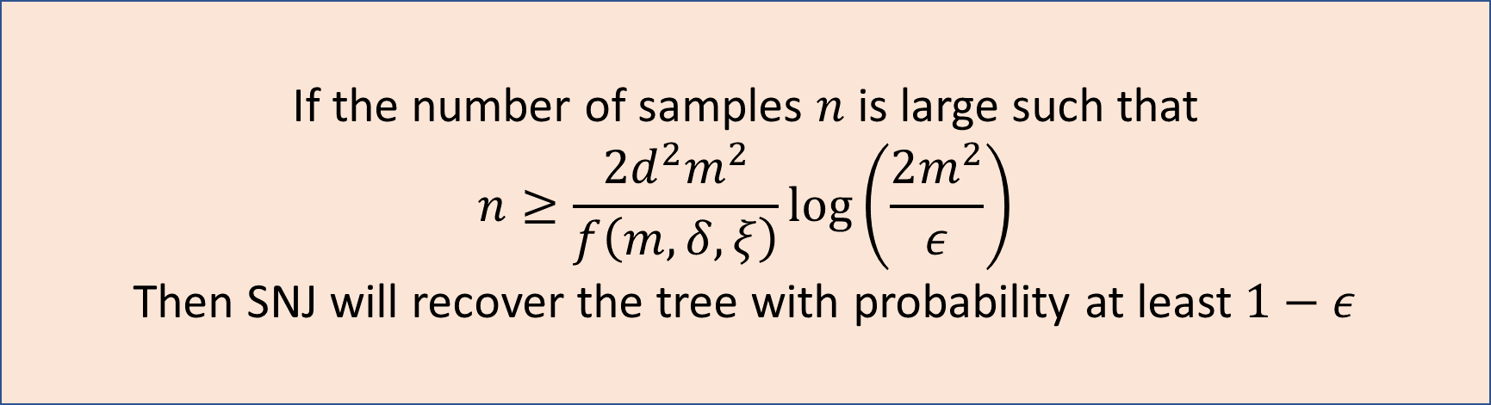
Finite sample guarantee (Jukes Cantor model)
Combining the consistency results with a concentration bound over$||S−\hat{S}||$ yields the following guarantee
If the number of samples $n$ is large such that
$$n≥\frac{{2d}^{2}m^{2}}{f\left(m,δ,ξ\right)}log\left(\frac{2m^{2}}{ε}\right)$$
Then SNJ will recover the tree with probability at least $1−ε$
Notes:
Jukes cantor model tells us what our transition matrices should look like (e.g., transition probabilities to any OTHER state are all equal)
Assuming Jukes Cantor we get concentration of an individual score
By union bound we get concentration of the whole matrix

Slide 24
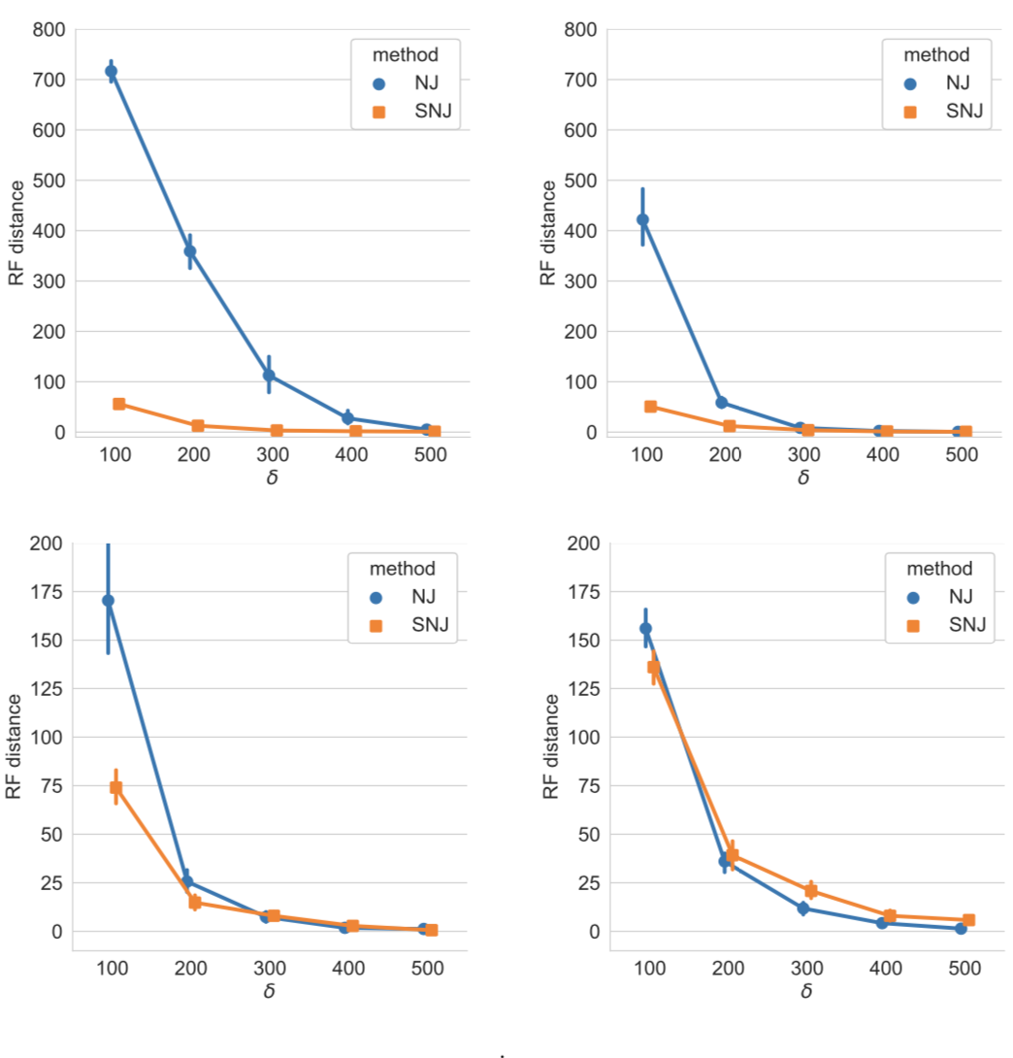

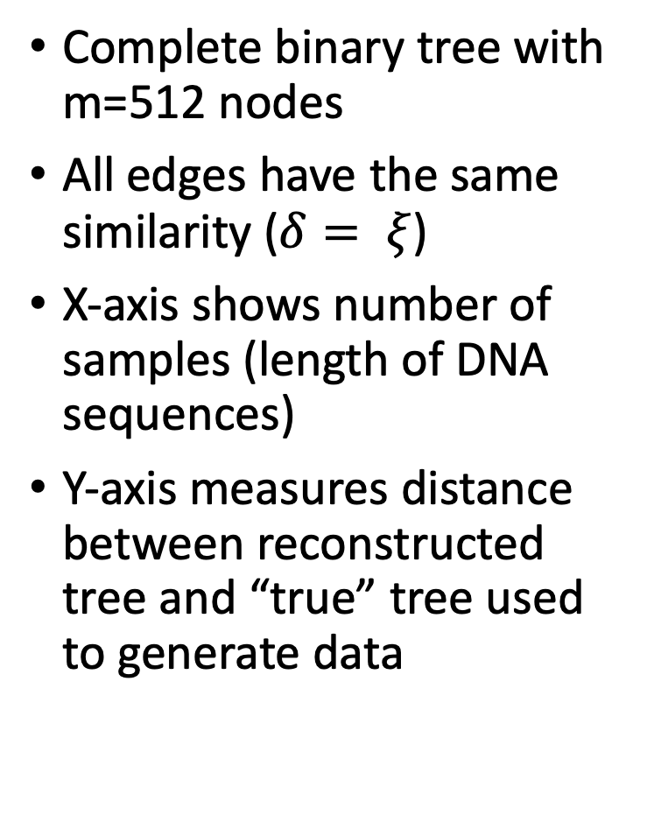



Results — Empirical
Complete binary tree with m=512 nodes
All edges have the same similarity ($δ= ξ$)
X-axis shows number of samples (length of DNA sequences)
Y-axis measures distance between reconstructed tree and “true” tree used to generate data
$δ=$ 0.75
$δ=$ 0.8
n
n
$δ=$ 0.85
$δ=$ 0.90
n
n
Notes:
Provide more data => similarity scores more accurate => performs better
This is hard! If p = 25%, even the closest pairs (two hops) are only 62% similar!
We’re plotting the probability that the method outputs a perfect tree — that means making 98 correct decisions in a row
You can get close to perfect with much fewer samples
HOW MANY TRIALS? > 30
Also you can see from the error bars that it’s pretty concentrated

Slide 25
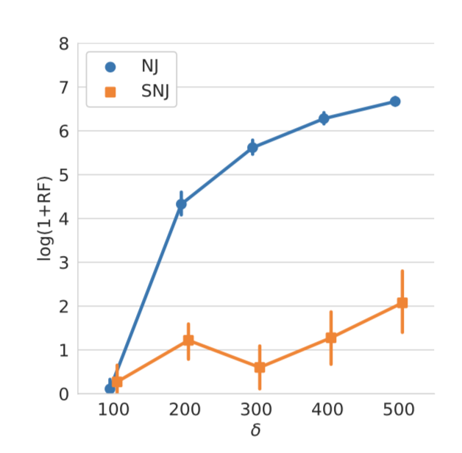
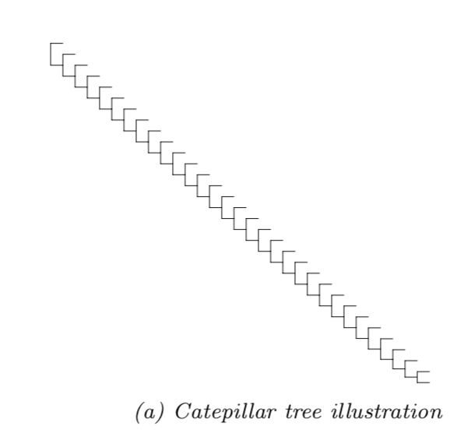
Results — Empirical
For a so-called “caterpillar tree” our method vastly outperforms NJ (note the logarithmic scale)
Notes:
Caterpillar tree is challenging!
In general our advantage is in the most challenging cases

Slide 26
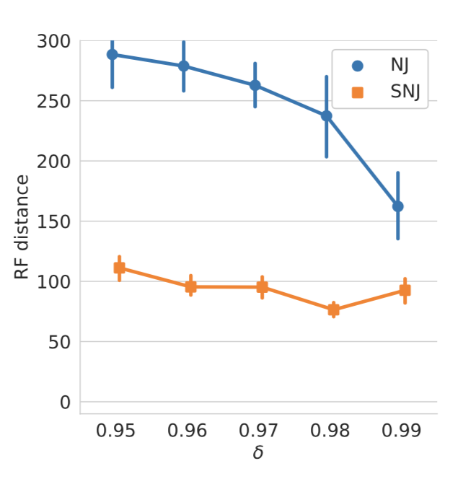
Results — Empirical
More natural looking trees (Kingman coalescent model)

Slide 27
Thank you!

