Slide 1
Perovskite band structure analysis and prediction regarding to water splitting
Yiming Sui
Jimin Qian
Xueqiao Zhang

Slide 2
Our project -Part I
Band gap range
band location
Formation energy
Finding the common features between sorted
screening
Listing
statistics
Display the sorted perovskite and their corresponding band structure via schematic diagram

Slide 3
Our project -Part II
screening
dataframe
Sort out perovskites with BG over 0
Substances and their corresponding band gap energy
Selecting the best combination of features
Label: bandgap
Certain
Regression method
Features: the characteristics of compounds
Derived predictive model
features
List all
combination possibilities
Volume electronegativity etc…

Slide 4
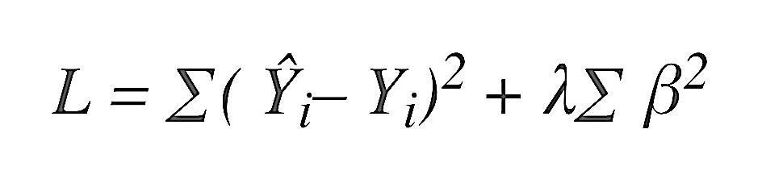
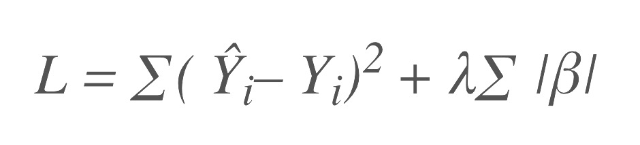
Background
Linear Ridge Regression:
Linear Lasso Regression:
Kernel Ridge Regression:
min
min

Slide 5
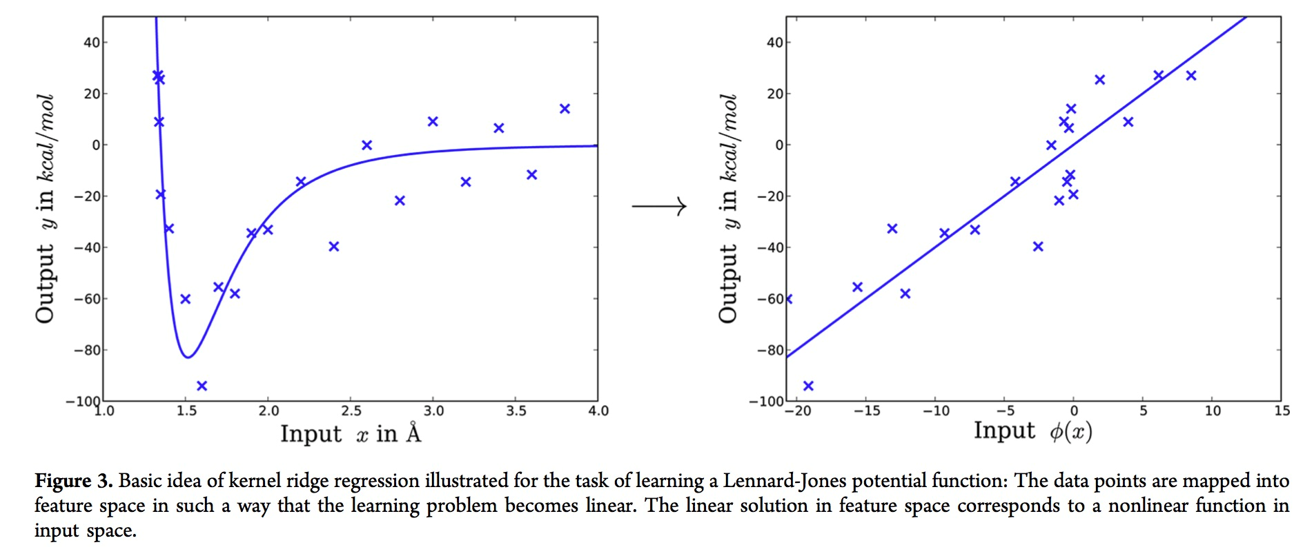

Slide 6
Linear vs Kernel Ridge Regression
Trade-off between efficiency and flexibility

Slide 7



Kernel Ridge Regression
General form of KRR:
Cost function:
Solution:

Slide 8
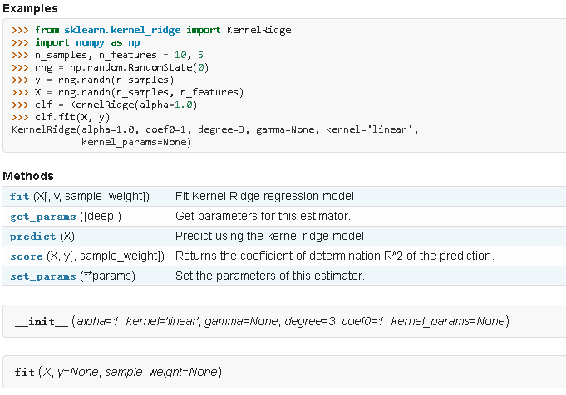
Kernel Ridge Regression
PAIRWISE_KERNEL_FUNCTIONS

Slide 9
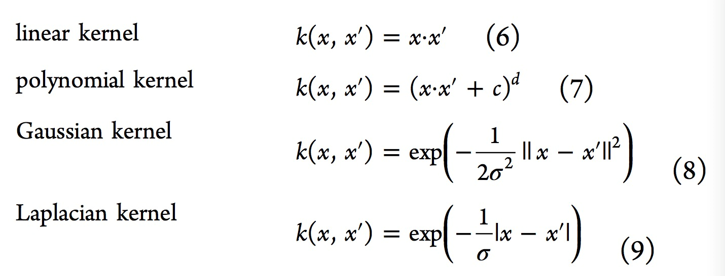
Kernel Ridge Regression
Kernel:

Slide 10
Thanks!

