Slide 1
Exploring the Capabilities of Classifier-Free Guidance in Recommendation Tasks
Master's Defense
Noah Buchanan
Dept. Of EECS, University of Arkansas
Thesis Advisor: Dr. Susan Gauch
Committee Members: Dr. Brajendra Panda, Dr. Lu Zhang
Dept. Of CSCE, University of Arkansas

Slide 2
Outline
Motivation and Main Objectives
Related Work
Our Approach
Experiments
Results
Conclusion
Future Work

Slide 3
Motivation
Generative Recommenders
Generative Recommenders infer user interaction probabilities for datasets involving:
Reviews of movies, shows, e-commerce
Primarily based on VAE and GAN implementations
Important task but limited by VAE and GAN limitations
Limited research into few-shot and zero-shot scenarios
Notes:
Basically any item or object or experience you could recommend to a user based on their history or the history of similar users, so both collaborative or content-based filtering, and functionally they're just like a regular recommender system.
Limitations of VAE: tradeoff between tractability and representation, GAN: mode collapse when training.
Few-shot and zero-shot scenarios are a common problem especially for content-based filtering as new users with no historical interaction data are a common occurrence.

Slide 4
Motivation
DiffRec
DiffRec is a recent diffusion recommender system
Generative recommender
Shows promising performance as the first of a few
Denoising network architecture remains largely unexplored
Little to no zero-shot or few-shot capabilities reported
Pseudo-guidance only
Notes:
This is also the implementation of a diffusion recommender system that I decided to base my improvements upon.
The handful of diffusion-based recommender systems out, and to clarify there's 4 to my knowledge that have been made in the last year, none of them utilize a technique I'm going to talk about in the next slide. This is all without the drawbacks on VAE or GANs
The denoising network has had lots of research in general when it comes to image diffusion models since this is their main use case, but on sequenced data such as user interactions there has been not nearly as much looking into this. This remains largely unexplored because of the recency of diffusion recommender systems
They have non-conditional pseudo guidance as I like to call it. Pseudo-guidance, as I coined, is just partially noised data, instead of fully noised data they opted for this and to use the faint resemblance of the sequence of data to personalize it for new recommendations, no external guidance into the denoising network, just noisy data.

Slide 5
Motivation
Classifier-Free Guidance
Classifier-free guidance is a recent technique
We train two models:
One conditionally via guidance
Another unconditionally
These two models share parameters
Major benefit of this is we do not need a pre-trained classifier
Guidance = personalization
Notes:
Classifier-free guidance is a recent technique from diffusion applications otuside of recommendation that has brought success. Mainly in the image domain this has been used since this is the main use case for diffusion models as things are now.
Since they share parameters they technically are not separate models but that is the language that the creator of classifier-free guidance used so that is what I will use. The way we combine these both is by having dropout for the external guidance being provided to the denoising network, we regulate the amount of dropout by a new hyperparameter, p_uncond, that determines the ratio of the data to be dropped in each batch, usually its around .2.
Obviously, as I mentioned before, DiffRec has no external guidance so we cannot implement classifier-free guidance as is, I will get to how we tackle that in a later slide.
Do not need a pre-trained classifier to guide the diffusion process towards a class.
Since conditional diffusion models use classifier-guidance in the past to guide the denoising process towards whatever the classifier is trained to classify, we can't really change what we are trying to generate on the fly using this method, this is obviously a pretty big problem for recommendation since each users preferences are different, there are workarounds obviously since we have diffusion recommender systems, like for instance, pseudo-guidance, but not using pseudo-guidance and also not using classifier-guidance are simply not options for this type of task thus we need a new method, which has just presented itself to us.
Guidance in recommendation for a conditional diffusion model can essentially be equated to personalization of a recommendation.

Slide 6
Motivation
Zero Shot and Few Shot
An extremely common and ever-present problem for recommender systems
Diffusion recommender systems have no current work done for this scenario
Classifier-free guidance could provide us with this capability
Notes:
Zero shot and few shot refer to when we need to make recommendations for a user that has very little to no historical interaction data to work with, thus it is difficult to make a recommendation because we have no data to work with and no similar users to compare them to.
Since these are a relatively new technique as I mentioned earlier the investigation into few shot and zero shot hasn’t really begun.
Our hypothesis however, is that classifier-free guidance could provide us with this capability.

Slide 7
Main Objectives
Improve the performance of diffusion recommender systems using classifier-free guidance
Contribute to the discussion of denoising network architecture for diffusion recommender systems
Contribute to the few-shot zero-shot problems

Slide 8
Related Work
VAE and GAN's introduced as a type of generative AI some years after AI recommendation is born. Kingma, Welling, 2013. Goodfellow et al., 2014.
The combination of generative AI and AI recommendation was introduced shortly after using both VAE and GAN's to create some of the first generative recommenders. Liang et al., 2018. Gao et al., 2020.

Slide 9
Related Work
First paper to introduce diffusion models in 2015, aimed to attack the weak points of VAE and GAN's. Sohl-Dickstein et al., 2015.
First major adoption of diffusion following the release of this paper. Ho et al., 2020.
Diffusion dominated image generation and became the de-facto state-of-the-art in class-conditional generation. Ho et al., 2021. Dhariwal, Alex, 2021.
Notes:
This first paper was heavily inspired by nonequilibrium thermodynamics as this idea of diffusion is what gives these models their namesake.
As I'm sure you’ve probably heard the buzz about these models in recent years, they really are dominating anything related to image generation and even other areas like super resolution.

Slide 10
Related Work
As a result of this mass success and the ongoing research into generative AI, we find ourselves at the intersection following the first diffusion recommender system. Wang Wenjie et al., 2023.
Other implementations followed after the introduction of diffusion-based recommender systems. Wang Yu et al., 2023. Z. Li et al., 2023. Lin et al., 2023.
Notes:
The previous paper mentioned on the last slide was a major adoption by research, the stable diffusion paper was a major adoption by the public in general when people started getting to use fast and extremely effective text-to-image models.
The stable diffusion paper borrowed techniques from the latent space in autoencoders and utilized it in the diffusion process to reduce computation costs.
This paper is also the one we based our modifications upon.

Slide 11
Related Work
Classifier guidance introduced previously, modifies diffusion models to guide them becoming class-conditional. Dhariwal, Alex, 2021. Salimans et al., 2016.
Classifier-free guidance attempts to have the same effect as classifier guidance but without a dedicated classifier. Ho et al., 2022.
Notes:
Additionally, it's been shown that for these class-conditional diffusion models that utilized classifier guidance, data that can be classified well by a classifier scores higher on perceived perceptual quality, which all lends to a higher-quality image generation model for that class the classifier is trained to identify.
This method does have a limitation though, when we want to condition the diffusion model on a certain class we need a pre trained classifier specifically for that task, which is pretty inconvenient.

Slide 12
Observations from Related Work
Diffusion models are a new type of generative AI dominating image generation
VAE and GANs are capable of recommendation
Diffusion recommender systems are introduced via the previous two observations
None of the diffusion recommender systems implement classifier-free guidance
Notes:
Putting together some observations from the related work we can see that:

Slide 13
Our Approach
Our approach consists of two major components
The first is the diffusion process
Remains relatively the same
Consists of forward and reverse diffusion
The second is the denoising network
Utilized within the reverse diffusion process
Core to the idea of diffusion
Notes:
The diffusion process is not altered drastically since we only really tinkered with the reverse process.

Slide 14
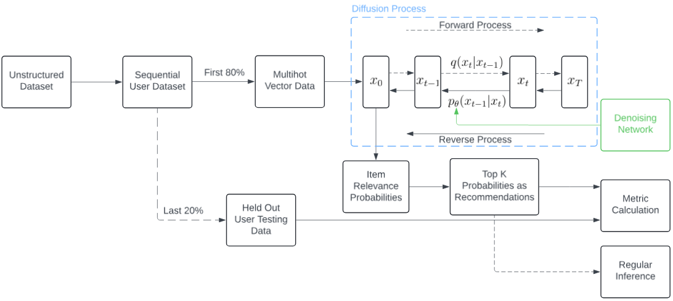
Our Approach
Notes:
Here is a diagram to explain the process we take.
The previously mentioned diffusion process is outlined in blue and the denoising network is highlighted in green as a part of the reverse process.

Slide 15
Our Approach
Forward Diffusion Process
Forward process can be described as follows:
Normal/Gaussian distribution
Both variables present in normal distribution are determined by the scheduler depending on the timestep
Mean
Variance
Notes:
So I'm just going to describe the formulas used to calculate the output at each timestep in the forward and reverse process to explain the diffusion process and then get into the changes we made.
Since these are Markov transitions, the next output depends on the previous.

Slide 16
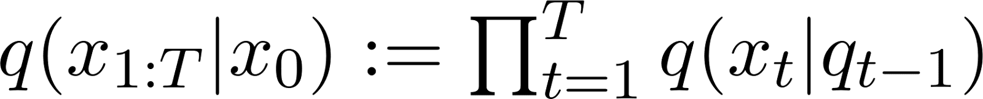
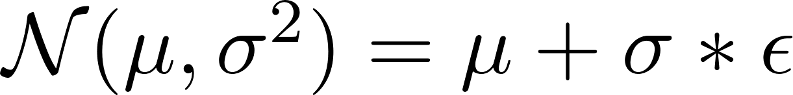
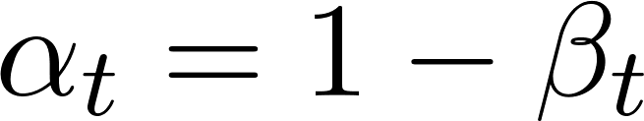
Our Approach
Forward Diffusion Process
Entire amount of noise for the forward pass can be described as:
We can use the reparameterization trick to calculate the noise at any step:
Notes:
A convenience of the forward approach involving no AI and purely based off of a schedule of markov transitions we can determine ahead of time, in this case a linear schedule, we can calculate any timestep we need, including the final, in one formula from the beginning with some small notation changes that are used by the original authors that introduced this.

Slide 17
Our Approach
Reverse Diffusion Process
Conversely, we can describe a step in the reverse process as:
Which translates to:
Notes:
We can't calculate the reverse process all in one step obviously.
This episilon with theta for weights is the output of our denoising network.

Slide 18
Our Approach
Adding Classifier-Free Guidance
The original implementation cannot use classifier-free guidance
Guidance through the semblance of the data left after noise is applied
Authors argued this mimicked the noisy nature of real user interactions
In order to implement classifier-free guidance we preserve data
The data after the forward pass and the un-noised version are both fed to the denoising network
Notes:
This is the pseudo-guidance I talked about earlier.
The interactions are considered noisy because not every item a user interacts with or rates highly would be something they would rate highly again
We don't preserve the data in the forward process obviousluy because that still needs to be noised, but we keep an un-noised version of that same data to act as conditioning for the reverse process

Slide 19
Our Approach
Adding Classifier-Free Guidance
Training the model to be capable of both conditional and un-conditional generation requires dropout
Zero out 20% of each batch of guidance
We have some options for applying this guidance
Guidance via concatenation
Guidance via cross-attention
Notes:
This dropout is specifically on the guidance so that 80% of the data has guidance and 20% does not.
We do this by simply zeroing out 20% of each batch of the guidance, this 20% dropout is chosen randomly from the batch.

Slide 20
Our Approach
Adding Classifier-Free Guidance
This implementation used guidance via concatenation
At this point we can put it all together:
Fully noise batch in forward diffusion process
Keep un-noised iteration of batch (guidance)
Create zero-gradients for 20% of samples in guidance
Concatenate guidance and batch
Feed into denoising network to receive enhanced noise predictions
Notes:
After some testing we found that concatenation worked the best for this implementation specifically.

Slide 21
Our Approach
Denoising Network Architecture
The architecture is relatively simple
Does not follow an autoencoder structure
Concatenate guidance and data batch run through a custom embedding layer of varying size depending on dataset size vector output
Hyperbolic tangent activation functions
Data batch normalization before concatenation
Notes:
Technically speaking the concatenation guidance method could be considered a network architecture choice.
The autoencoder structure, or something like a U-net is typically used when were talking about the denoising network of diffusion image generators but obviously that’s not the case here.
The vector output depends on the size of the dataset or more specifically the number of unique items since its basically a heatmap output of potential recommendations, like a multihot heatmap vector
For pretty much every dataset we worked with we did not need a very large embedding layer, say somewhere around 1000 neurons usually.

Slide 22
Experiments
Datasets
A varying size of datasets were used
Some provided by the authors of the original work
Some provided by Amazon review data
MovieLens 1 Million Dataset
1 million movie ratings
6000 users
4000 movies
Notes:
The MovieLens dataset was the main one I experimented with when finding what had the best performance and I found that generally the improvements did transfer to other datasets.

Slide 23
Experiments
Datasets
The datasets have clean and noisy configurations
Clean = reviews > 4 on a 5 point rating scale only
Noisy = keep all reviews regardless of rating
Noisy data is less ideal
The results for the noisy Yelp dataset will not be included due to hardware requirements
Notes:
Datasets from the original implement had clean and noisy configurations.
Noisy is especially less ideal when you factor in that there is no triplet loss or something of that nature to account for both positive and negative reviews in any way so all the reviews are used equally to create recommendations. Basically used to test the robustness of the method but is not something I expanded on very far myself.

Slide 24
Experiments
Datasets
MovieLens and Yelp both have numeric ratings
We know what constitutes a "hit"
More difficult if we don't have numeric ratings to work with
The Amazon datasets we used don't have numeric ratings
We instead make a naïve assumption that the data is clean
In practice we experienced no problems as a result of this naïve approach
Notes:
And that is because for these datasets that have numeric ratings provided we can define whatever we want a hit to be, in our case a rating of 4 or above on a 5 point scale
We do this because we don’t know exactly what constituted a positive review when they made this dataset so we have to make a naïve assumption here

Slide 25
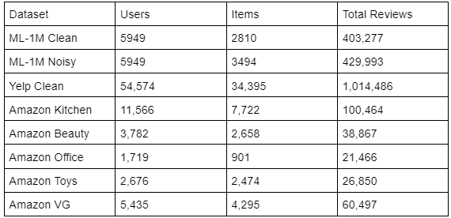
Experiments
Datasets
Notes:
A quick overview of every dataset we used.

Slide 26
Experiments
Pre-Processing
Interactions are sorted by user and then timestamp
All ratings 3 and below will already have been dropped
Index 1-k belong to user 1's k interactions at this point
The last 20% of each interaction sequence is removed and placed into the testing dataset
During runtime we transform this format into a sparse format
Multi-hot vectors to represent item interactions for a user
3 and below AND missing reviews for items all represented by 0's
Notes:
Obviously, this only applies to the datasets where have the numeric ratings.
At this point the data is no longer chronologically sorted but we do that beforehand so that we are correctly identifying "future" events based on past events, even if the multi-hot vectors are no longer in any sort of chronological order.
It wouldn’t make sense to randomly grab 20% of the interactions to test the model or even worse grab the first 20% of the reviews a user made and use future reviews to train and predict the first 20%.

Slide 27
Experiments
Experimental Configurations
Not all of the changes made were entirely beneficial
Rule of thumb was found for denoising network architecture
Less was more
Lots of changes did not remain in the final implementation
Cross-attentive conditioning as opposed to concatenation
Self-attention on the input sequence
More layers and more neurons
Custom embedding model for the guidance prior to concatenation
Notes:
Less was more so much that increasing neuron count or layer count generally decreased performance. I have my hypotheses for why this was the case but it's not entirely important just that this was found to be factually true, at least for this implementation.
Hypothesis is that due to the iterative nature of the reverse process having a very large model would overfit since its taking small steps and not predicting all the noise at once.
This is mostly because of the rule we found.

Slide 28
Experiments
Experimental Configurations
Numerical rating aware system also resulted in a failure
Multi-hot vector input but with actual ratings
Did not perform was well as expected
As a result, settled on a seemingly simple implementation
Achieved far better results than any other configuration tested

Slide 29
Results
Training Configuration
For all datasets we save the highest-performing model on testing data based on nDCG @ K = 10
All metrics described we calculated based on K @ [1,5,10,20]
Trained on each dataset until the performance on testing data stopped improving for nDCG @ 10
Hyperparameter configuration for both including embedding size are the same, p_uncond set @ 0.2
Notes:
We originally had higher values of K but after some deliberation settled on the importance of low values for this because the average user is not going to search through 50 or 100 potential recommendations but rather the first 20 at most.
Testing data in this case would be the 20% of heldout user data in the users chronologically sorted interaction sequence.
A typical user is not going to search through 50 or 100 recommendations to find something of substance therefore these values are more practical from an actual performance standpoint.

Slide 30
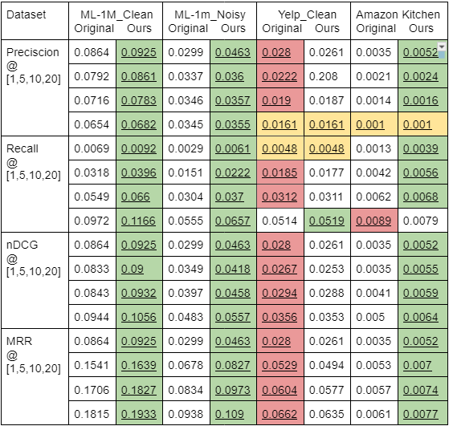
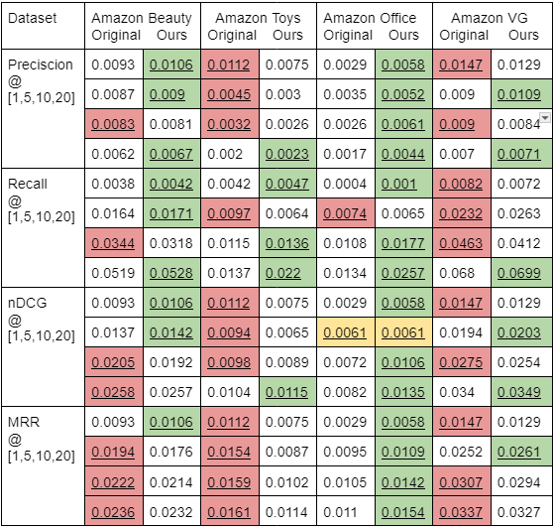
Results
Training Results
Notes:
Underlined values are where the opposing method is beaten or tied.

Slide 31
Results
Training Results
Outperforms the original In 84 of the 128 categories
When our method is beaten it does not appear to be by a sizeable margin
The same cannot be said the other way around
On smaller sparser datasets, we achieve noticeably better results
Higher percentage increase from original to our method when testing only on sparse
Notes:
This is on all datasets for each metric and all values of k for each metric.
We even achieve performance that is sometimes beating the original by a factor of 2 if not more.
This lends to the credibility of few-shot and zero-shot scenarios. We have no zero-shot examples to draw from but it would make sense due to our model being trained conditionally, and unconditionally at the same time, unconditionally in this case being essentially zero-shot since there is zero guidance.

Slide 32
Results
Regular Datasets
Ours
0.0349 Precision 36%
0.0319 Recall 11%
0.0368 nDCG 7%
0.0881 MRR 19%
Original
0.0256 Precision
0.0288 Recall
0.0344 nDCG
0.0741 MRR
Notes:
This is on all datasets for each metric and all values of k for each metric.
We even achieve performance that is sometimes beating the original by a factor of 2 if not more.
This lends to the credibility of few-shot and zero-shot scenarios. We have no zero-shot examples to draw from but it would make sense due to our model being trained conditionally, and unconditionally at the same time, unconditionally in this case being essentially zero-shot since there is zero guidance.

Slide 33
Results
Sparse Datasets
Ours
0.0047 Precision 104%
0.0094 Recall 42%
0.0074 nDCG 45%
0.0092 MRR 35%
Original
0.0023 Precision
0.0066 Recall
0.0051 nDCG
0.0068 MRR
Notes:
This is on all datasets for each metric and all values of k for each metric.
We even achieve performance that is sometimes beating the original by a factor of 2 if not more.
This lends to the credibility of few-shot and zero-shot scenarios. We have no zero-shot examples to draw from but it would make sense due to our model being trained conditionally, and unconditionally at the same time, unconditionally in this case being essentially zero-shot since there is zero guidance.

Slide 34
Conclusion
In this work, we build upon the intersection of two existing domains using existing techniques that have yet to be adapted to this specific task and provide insight on a topic that has yet to be explored at all
Implementing classifier-free guidance which has not been adapted from regular diffusion models into diffusion recommender systems
Make one of the first contributions to the architecture of denoising networks for recommender systems specifically

Slide 35
Conclusion
Our experiments were performed on MovieLens 1 Million, Yelp, and a variety of Amazon review datasets
Our method showed a tangible improvement over the original in almost all metrics for most datasets
We provide a doorway to few-shot and zero-shot recommendation for diffusion recommenders
To the best of my knowledge, this is the first diffusion recommender system to implement classifier-free guidance
Notes:
Yelp dataset being the sole exception for these improvements.

Slide 36
Future Work
Some potential areas that could be expanded on in the future:
Numerical rating-aware diffusion recommender system
Transformer denoising network
Further exploration into few-shot and zero-shot
Notes:
I do believe a system like this could outperform one that is instead working with ratings that are classified as hits or misses. Potentially some implementation utilizing triplet loss to differentiate between the positive and negative reviews.
Vision transformer models for denoising have gained some popularity in image diffusion models, I think the potential for transferring this to recommendation tasks is there.
The few-shot and zero-shot were not explored as far as I wish I could have for the scope of this thesis but I do think the potential is there as it just makes perfect sense with classifier-free guidance as there is now more guidance so each interaction is more to work with and the potential to make recommendations without guidance at all is now a possibility.

Slide 37
Thank you for listening!

Slide 38
Questions and Comments?

