Slide 1
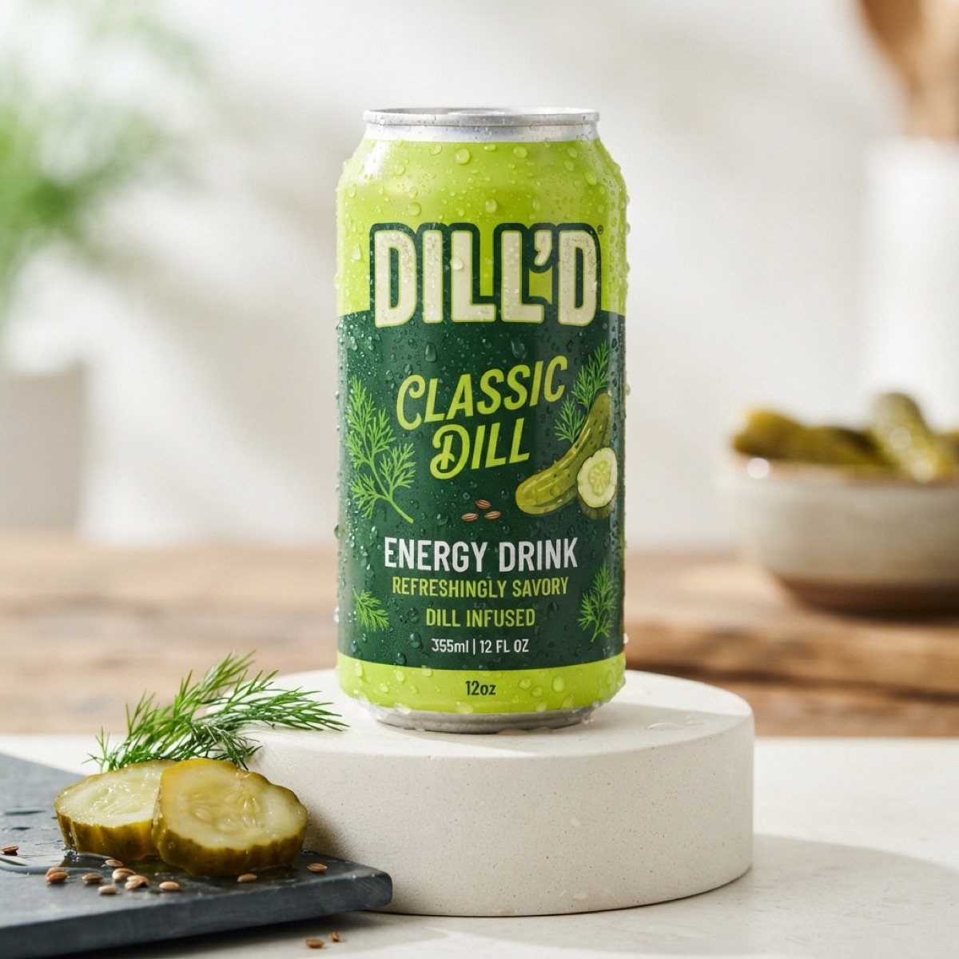

QUEBEC BORN
BRAND BOOK
May cause extreme dill-ness.
Brand identity, product, website, blog and SEO · 2026 edition
Notes:
Cover. DILL'D brand book: everything built for the brand, from identity to the live website, blog and SEO.

Slide 2
Contents
WHAT'S INSIDE
01
02
03
Brand
Identity
Product
Story, voice and personality
Logo, colour, type and UI kit
The four core flavours + Mystery Can
04
05
06
Website
Blog & SEO
Links & next steps
Structure, sections, motion and 3D
Brine Blog, metadata, schema, sitemap
Back links, social and launch checklist

Slide 3
Brand
01
Who DILL'D is, how it sounds, and why it exists.

Slide 4

Tastes amazing. Terrible for you.
BRAND STORY
We don't pretend otherwise.
Energy drinks spent twenty years selling wellness buzzwords, fake berry sweeteners and pastel gym cans.
DILL'D was cooked up at 2 AM in a Montreal food lab with one goal: turn real fermented pickle brine into unapologetic high-voltage rocket fuel. Sweet, salty, sour, and loud on purpose.
Est. 2024
180mg
6
Montreal, Quebec
caffeine per can
shipping regions
Notes:
Positioning: an honest, irreverent treat. The brand never claims to be healthy; that honesty is the hook.

Slide 5
Loud, honest, a little unhinged
PERSONALITY & VOICE
Loud
Honest
Weird
Dare-you
Massive type, acid colours, zero whispering. If it can be bigger, it is.
We say the caffeine number up front and call it a treat, not a health drink.
Pickle in a can is the joke. We lean in: brine puns, chaos, internet irony.
Every touchpoint is a challenge: try it, film it, survive Sour Blast.
SAY THIS
NOT THIS
“May cause extreme dill-ness.” “Pick your poison.” “Stay salty.”
“Clean, healthy hydration.” “Detox.” Any fake wellness claim.

Slide 6
Identity
02
Logo, colour, typography and the neo-brutalist UI kit from Google Stitch.

Slide 7
Two logos, one attitude
LOGO SYSTEM
PRIMARY: STICKER WORDMARK
SECONDARY: MASCOT LOCKUP
Nav bar, can label, favicon, social avatars.
Footer, blog hero, merch, stickers. Includes the tagline.
Notes:
Usage rules: keep the white sticker outline, never recolour the letters, keep clear space equal to the height of the apostrophe, never place on busy photos without the dark sticker backing.

Slide 8
The Brine Shock palette
COLOUR
Acid Lime
Brine Yellow
Deep Pickle
Charcoal Brine
Crisp Off-White
#C2E05A
#F2D14B
#18330F
#0D170A
#FAF9F5
194 · 224 · 90
242 · 209 · 75
24 · 51 · 15
13 · 23 · 10
250 · 249 · 245
CTAs, highlights, marquees
Deals, badges, secondary CTA
Cards, shelves, containers
Backgrounds, heavy type
Body copy, stickers
60% charcoal & pickle · 30% lime · 10% yellow. Lime is the shout, yellow is the wink.

Slide 9
Condensed shouting, clean reading
TYPOGRAPHY
DISPLAY · ANTON
BODY · SPACE GROTESK
MAY CAUSE EXTREME DILL-NESS
Aa Bb Cc 0123
Ingredient panels, articles, checkout and UI labels. Labels run bold, uppercase, tracked out 6–10%.
Always uppercase. Headlines, product names, section numbers, price tags. Web: Anton. Office fallback: Impact.
Stitch alternate: Luckiest Guy + Poppins for merch and stickers.

Slide 10
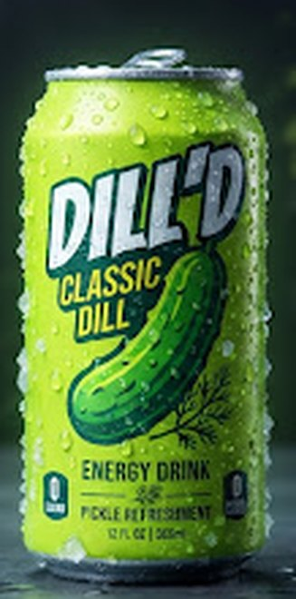
Neo-brutalist pop: hard shadows, sticker chips
UI KIT
BUTTONS
PRODUCT CARD
GRAB A CAN — $3.99
LOCK IT IN
Deep Pickle fill, 2px lime border, 16px radius, 6px hard shadow. Can floats centred; price in Anton.
Hard 3–6px black offset shadow. On press the shadow drops to 0 and the button shifts 3px: a physical click.
STICKER CHIPS
ORIGINAL
HABANERO
PUCKER X3
DROP 04
CLASSIC DILL
Full pills, tilted −3° to +4° like slapped-on decals.
$3.99
355ML / 12 FL OZ

Slide 11
Product
03
Four core flavours at $3.99, plus one Mystery Can a month.

Slide 12
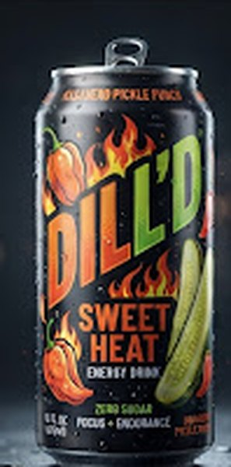
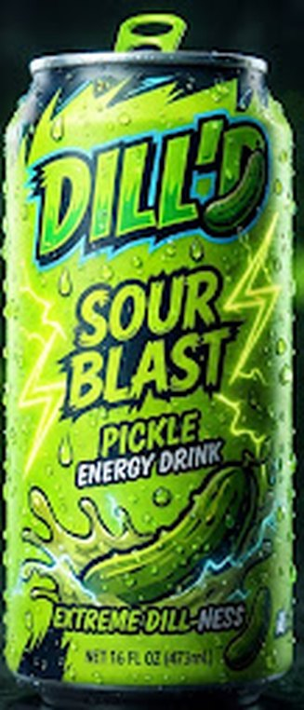
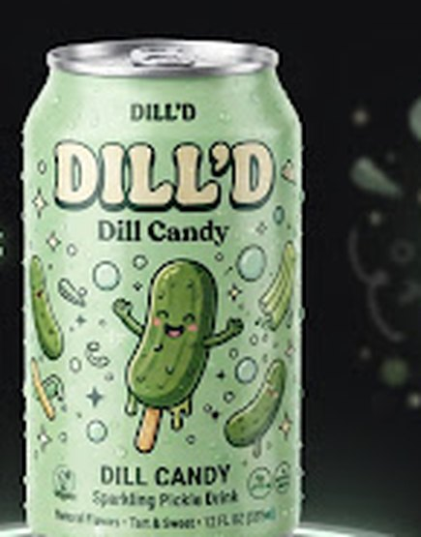
Pick your poison
THE CORE VAULT LINEUP
ORIGINAL
HABANERO
PUCKER X3
SWEET FIZZ
CLASSIC DILL
SWEET HEAT
SOUR BLAST
DILL CANDY
Crisp, salty-sweet cucumber dill punch.
Habanero honey and garlic brine.
Triple-fermented sour pickle surge.
Candied pickle syrup with a fizzy rush.
$3.99 · 180MG
$3.99 · 180MG
$3.99 · 180MG
$3.99 · 180MG

Slide 13
Brine specs + Mystery Can
SPECS & THE MONTHLY DROP
180mg
460mg
DROP 04 · LIMITED
caffeine per can (Canada max)
sodium from real brine
WASABI BRINE FIZZ
$4.50 · 5,000 cases worldwide
355ml
0%
One new flavour every 30 days
VIP drop list gets the link 2 hours early
Sold out = vaulted forever, no re-runs
Live countdown on the homepage
12 fl oz can
fake berry flavourings

Slide 14
Website
04
A 3D, scroll-driven one-pager plus a static blog, built with React, Three.js and GSAP.

Slide 15
One page, seven sections, plus the blog
SITE ARCHITECTURE
01
02
03
04
05
06
07
HOME
SCIENCE
STORY
FACTS
SHOP
DROP
TIKTOK
dilld.ca/ → the menu maps 1:1 to these sections, in scroll order.
/blog/
/blog/<article>/
/privacy/ · /terms/ · /accessibility/
Brine Blog index + category filter
5 SEO articles
Legal pages from the footer
Stack: React 19 · TypeScript · React Three Fiber · GSAP + ScrollTrigger · Lenis · Vite (multi-page build)

Slide 16
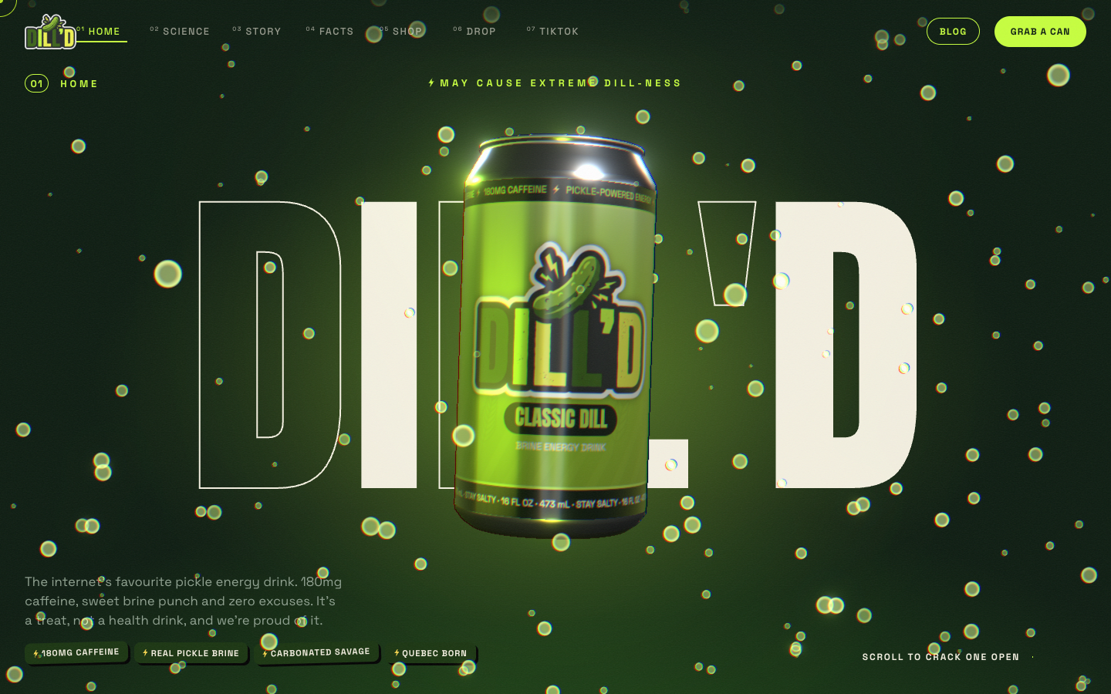
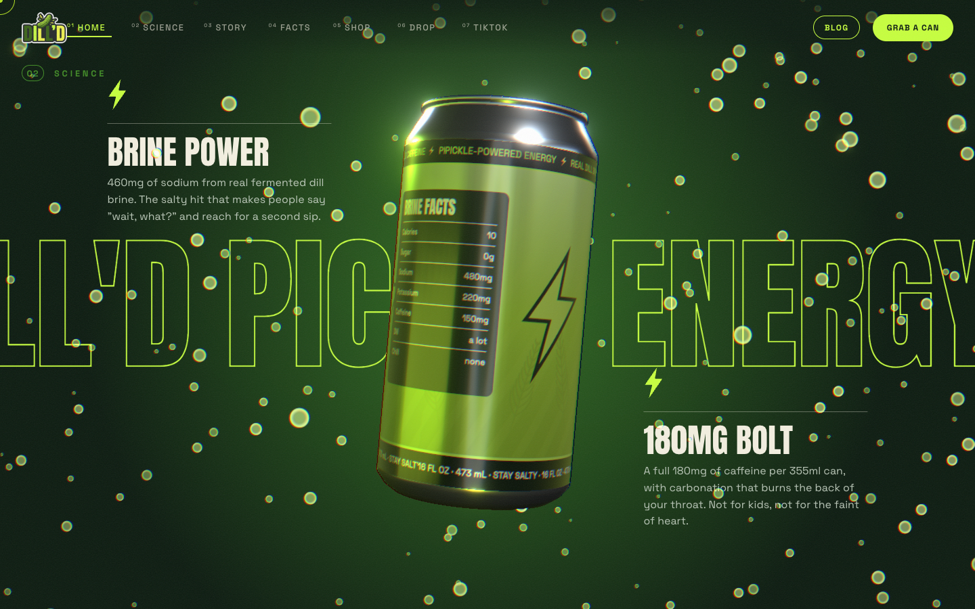
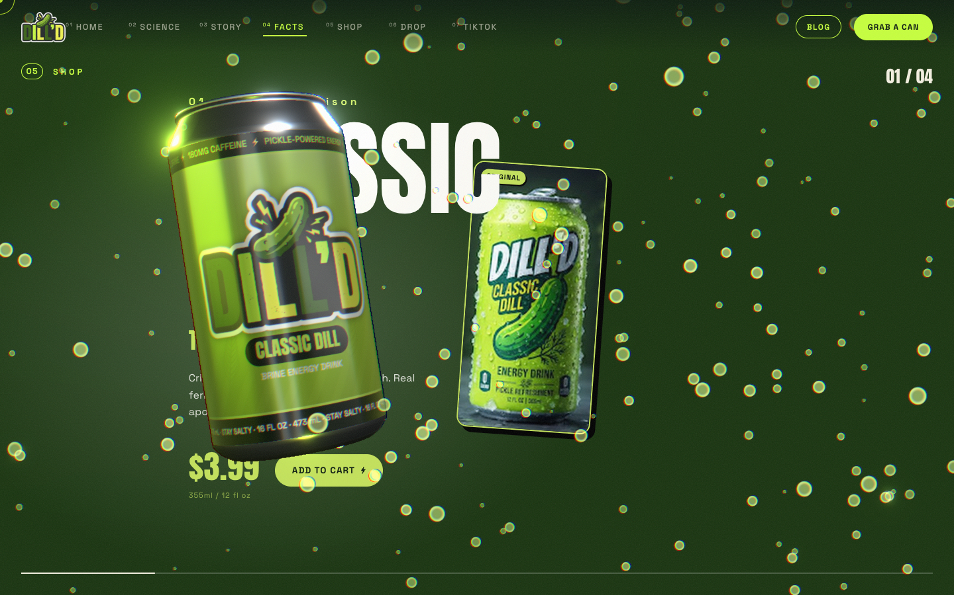
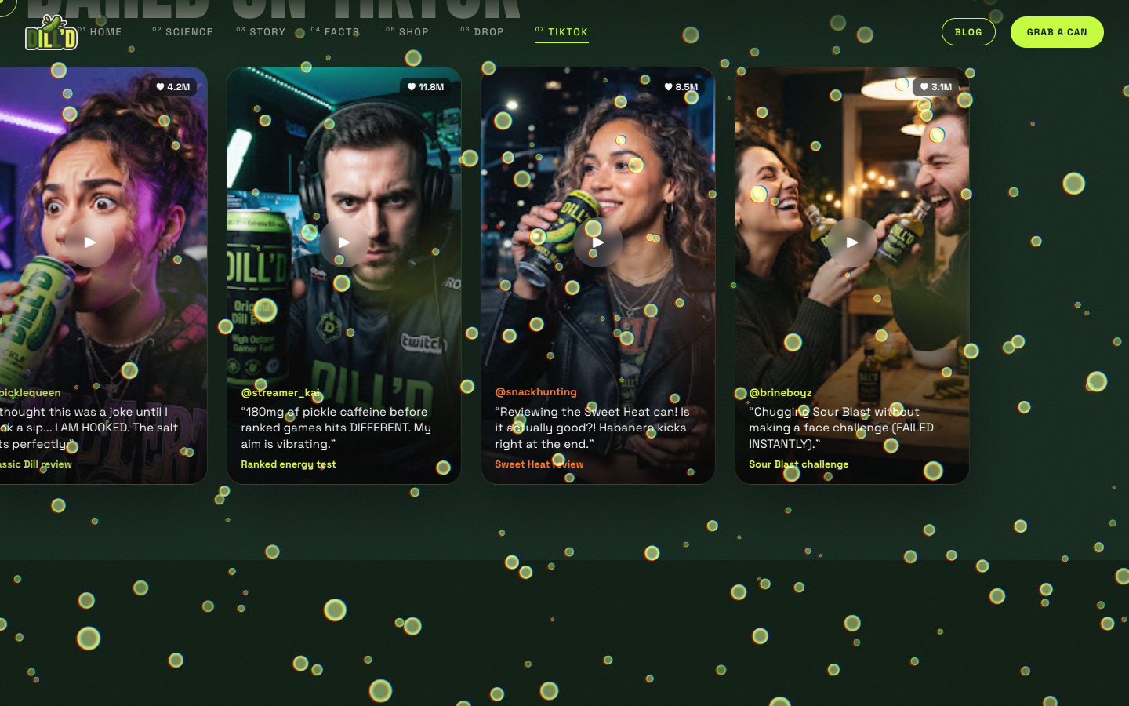
Every scroll does something
HOMEPAGE EXPERIENCE
01 Home: 3D can + exploding wordmark
02 Science: pinned sliding headlines
05 Shop: horizontal run, label swaps
07 TikTok: reaction cards fly in

Slide 17
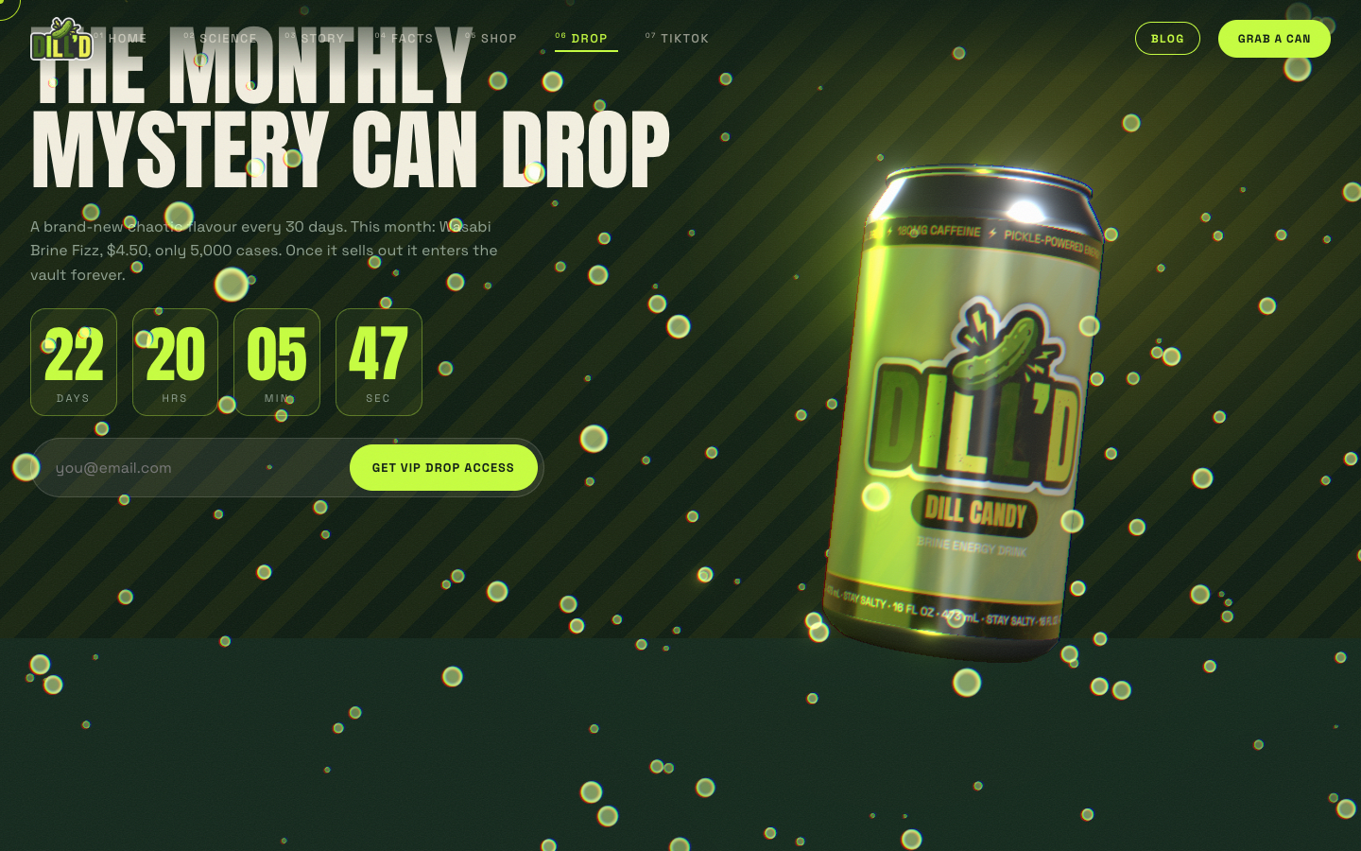
Graphics, motion and transitions
MOTION & 3D
Procedural 3D can, built in code, with the real logo painted on each flavour label
Electric brine shader: lightning arcs fire on scroll moments and flavour swaps
Bloom and chromatic aberration react to scroll speed
Loader counter, split-letter reveals, circle-mask wipes
Velocity marquee, magnetic buttons, custom cursor
Blog: char-drop headlines, card tilt, reading progress bar
Reduced-motion users get the calm version automatically.

Slide 18
Blog & SEO
05
Static, crawlable articles and full technical SEO so Google can find DILL'D.

Slide 19
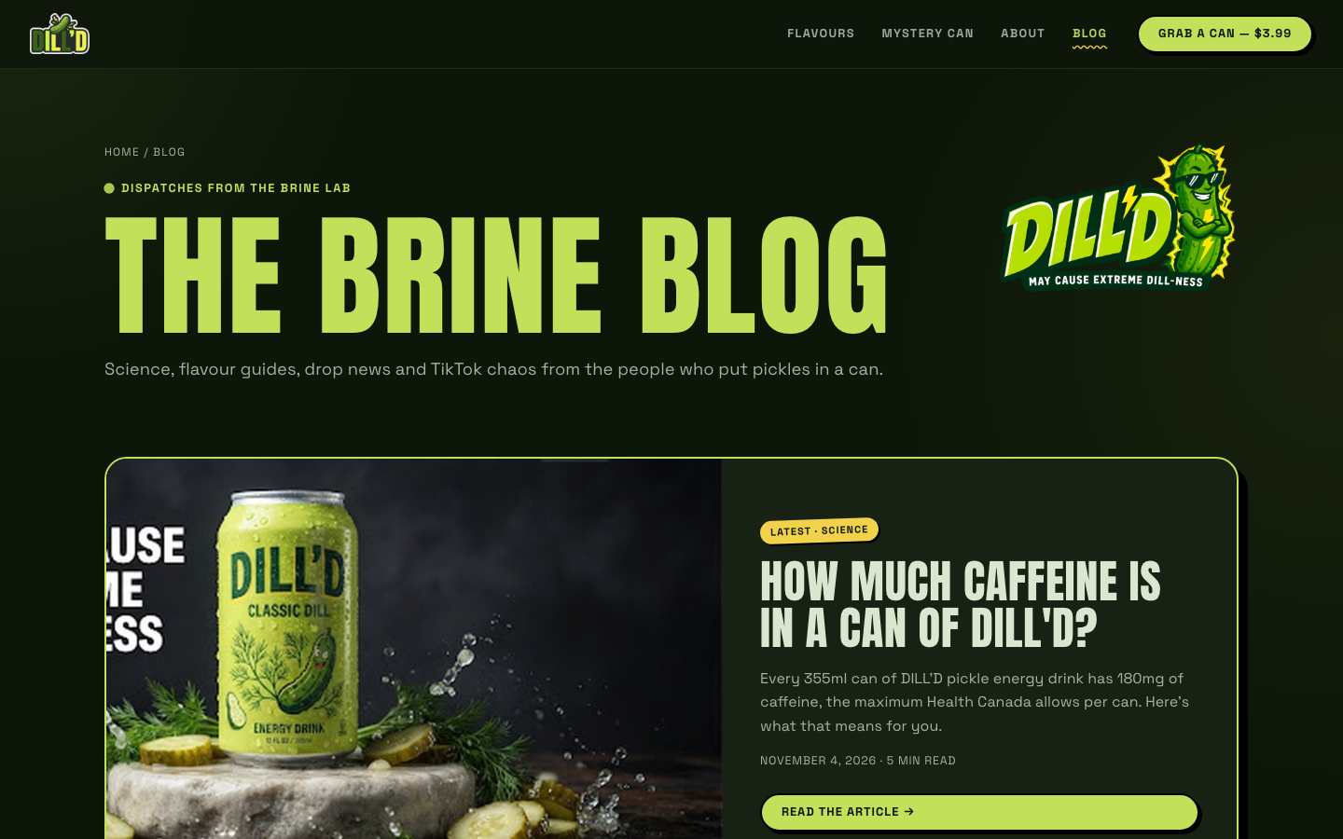
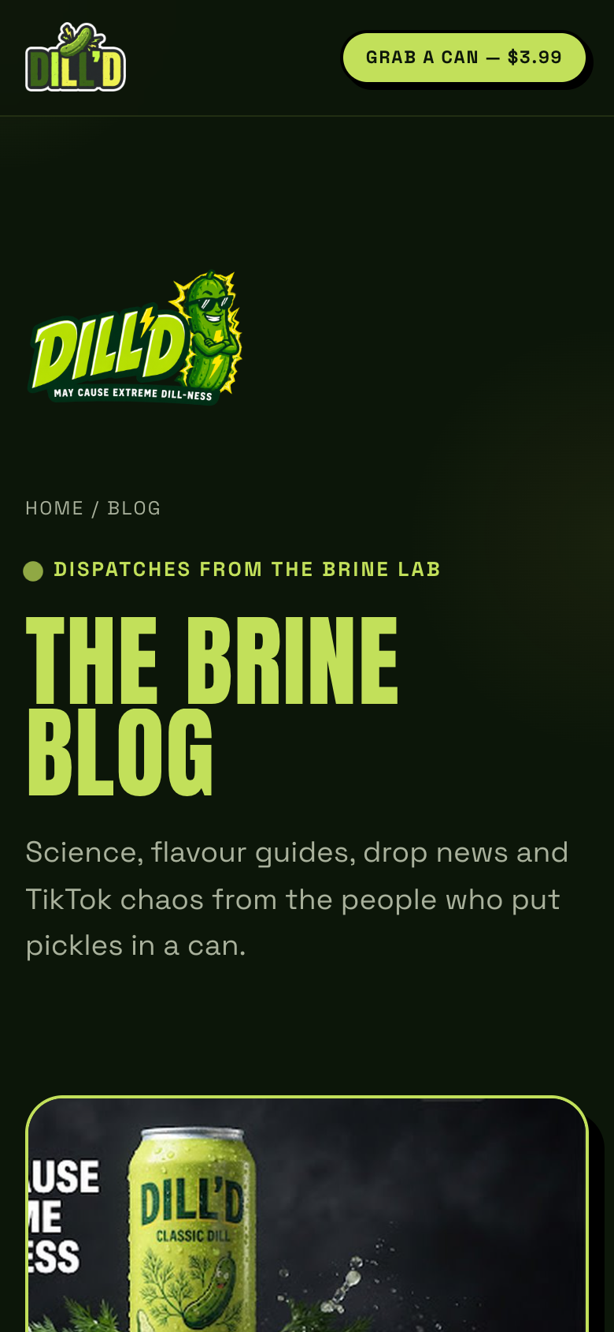
Five articles, each aimed at a search
THE BRINE BLOG
ARTICLE
TARGET KEYWORD
How much caffeine is in DILL'D?
180mg caffeine
Every flavour, ranked mild → unhinged
pickle energy drink
How the Mystery Can Drop works
limited edition energy drink
The #DillDChallenge
DillDChallenge
Does pickle juice help cramps?
pickle juice cramps

Slide 20
Built so Google gets it on the first crawl
TECHNICAL SEO
✓
Titles & descriptions
✓
Structured data
Unique per page, titles ≤ 65 chars, descriptions ≤ 160 (all 10 pages pass).
JSON-LD: Organization, WebSite, Product + Offer ×4, Blog, BlogPosting, BreadcrumbList.
✓
Crawlable HTML
✓
Sitemap & robots
Blog and legal pages are pre-rendered static HTML; the 3D homepage ships a text fallback.
sitemap.xml (10 URLs + images), robots.txt, RSS feed, canonical URL on every page.
✓
Social cards
✓
Internal links
Open Graph + Twitter cards with a 1200×630 can photo; web manifest and app icons.
Articles link to the shop, drop and facts sections, and to each other.

Slide 21
Title & meta for every page
METADATA PLAN (FROM THE COURSE SEO TEMPLATE)
Page | <title> | Len | Desc len
Home | DILL'D Pickle Energy Drink | 180mg Caffeine, Real Dill Brine | 60 | 152
Blog | The Brine Blog: Pickle Energy Drink News | DILL'D | 49 | 139
Caffeine | How Much Caffeine Is in DILL'D? 180mg, Explained | 48 | 142
Flavours | Pickle Energy Drink Flavours, Ranked Mild to Unhinged | 53 | 144
Mystery Can | How the DILL'D Monthly Mystery Can Drop Works | 45 | 137
TikTok | The #DillDChallenge: Inside TikTok's Sourest Dare | 49 | 151
Cramps | Does Pickle Juice Help Muscle Cramps? What the Science Says | 59 | 147
Full sheet with H1, H2, H3 and keywords for all 10 pages: DILLD_SEO_Title_et_Meta.xlsx

Slide 22
Links & next steps
06
Footer back links, social handles and the launch checklist.

Slide 23
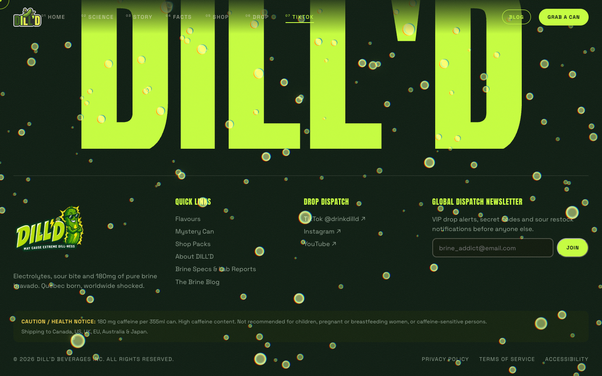
Every page links back home
BACK LINKS (FROM THE STITCH FOOTER)
QUICK LINKS
Flavours · Mystery Can · Shop Packs · About DILL'D · Brine Specs & Lab Reports · The Brine Blog
SOCIAL
TikTok @drinkdilld · Instagram · YouTube
LEGAL
Privacy Policy · Terms of Service · Accessibility
Same footer on the homepage, blog, articles and legal pages, plus the newsletter signup and the caffeine notice.

Slide 24
Next steps
BEFORE LAUNCH
01
DOMAIN
02
SEARCH CONSOLE
03
SHOP
Buy the domain and update SITE_URL in site.config.mjs (currently dilld.ca).
Verify the site in Google Search Console and submit sitemap.xml.
Connect real checkout (Shopify / Stripe) to the Add to cart buttons.
04
SOCIAL
05
FACTS
06
ANALYTICS
Claim @drinkdilld on TikTok, Instagram and YouTube so the footer links resolve.
Confirm the nutrition numbers and claims with the real formula before printing cans.
Add analytics and track drop-list signups as the main conversion.

Slide 25
DON'T JUST HYDRATE —
DILL UP.
github.com/NoahBall25/dilld
Stay salty.

