Slide 1
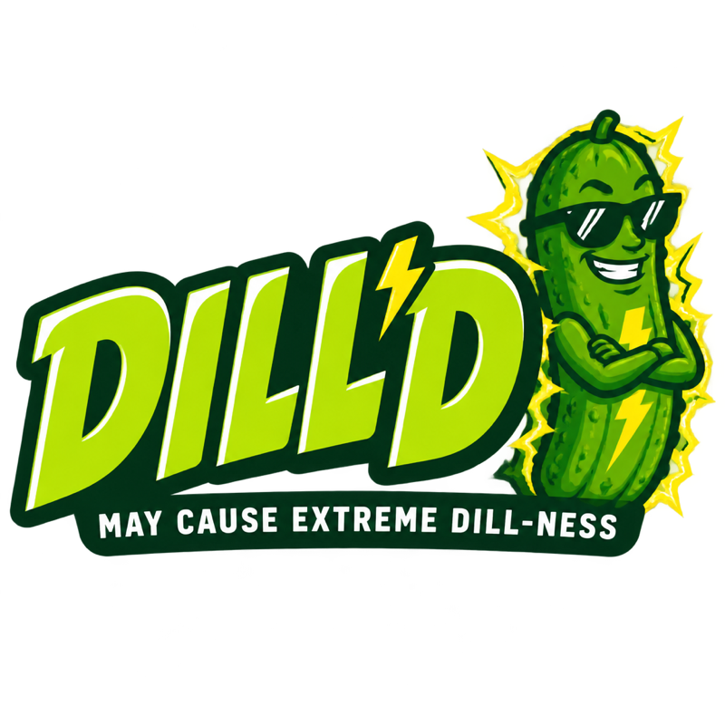
BRAND BOOK
By: Noah Shoot-Fugère

Slide 2




DILL'D puts real pickle brine in an energy drink can
WHO WE ARE
A pickle energy drink brand born in a Montreal food lab.
Every can mixes real fermented dill brine with 180mg of caffeine. It is sweet, salty and sour, and we sell it as a loud treat, not a health drink.
WHAT WE SELL
WHO IT IS FOR
WHERE
HOW TO BUY
Four core flavours at $3.99 (355ml), plus one limited Mystery Can a month
Gen Z and young adults who love sour snacks, dares and TikTok trends
Online from Quebec, shipping to Canada, US, UK, EU, Australia and Japan
Order singles or a mixed 12-pack on the website; VIPs get drops 2 hours early

Slide 3
Our slogan: “May cause extreme dill-ness.”
TAGLINE
May cause…
…extreme dill-ness.
THE PROMISE
THE PROMISE
We are upfront like a warning label: 180mg caffeine, a treat, not for kids. No fake wellness claims.
Real fermented dill brine you can actually taste: sour, salty, loud. Every flavour, every can.
WHY IT MATTERS
WHY IT MATTERS
Energy drink buyers distrust health buzzwords. Honesty is our hook and our safety line.
It puts our name inside the joke and dares people to try it, which is what makes it shareable.
Why it works: it reads like a product warning, makes people laugh, and ends on the flavour that makes us different.

Slide 4
Our brand colours and what they stand for
BRAND COLOURS
Acid Lime
Brine Yellow
Deep Pickle
Charcoal Brine
Crisp Off-White
REPRESENTS
REPRESENTS
REPRESENTS
REPRESENTS
REPRESENTS
Energy
Freshness
Loudness
Fun
Urgency
Optimism
Real brine
Nature
Depth
Boldness
Night energy
Contrast
Honesty
Clarity
HEX #C2E05A
RGB 194, 224, 90
CMYK 13, 0, 60, 12
HEX #F2D14B
RGB 242, 209, 75
CMYK 0, 14, 69, 5
HEX #18330F
RGB 24, 51, 15
CMYK 53, 0, 71, 80
HEX #0D170A
RGB 13, 23, 10
CMYK 43, 0, 57, 91
HEX #FAF9F5
RGB 250, 249, 245
CMYK 0, 0, 2, 2

Slide 5
Two typefaces: one shouts, one explains
TYPOGRAPHY
ANTON for titles and headlines
SPACE GROTESK for body text
Aa
MAY CAUSE EXTREME DILL-NESS.
ABCDEFGHIJKLM
abcdefghijklm 0123
Real fermented dill brine and 180mg caffeine.
Tall, condensed and always uppercase. It hits like a warning label and reads from across a store or a phone feed. (PowerPoint fallback: Impact.)
A clean, slightly quirky sans for ingredients, articles and checkout. It keeps the loud brand easy to read.

Slide 6
Competitors
Pickle Juice® · GURU Energy · Van Holten's

Slide 7
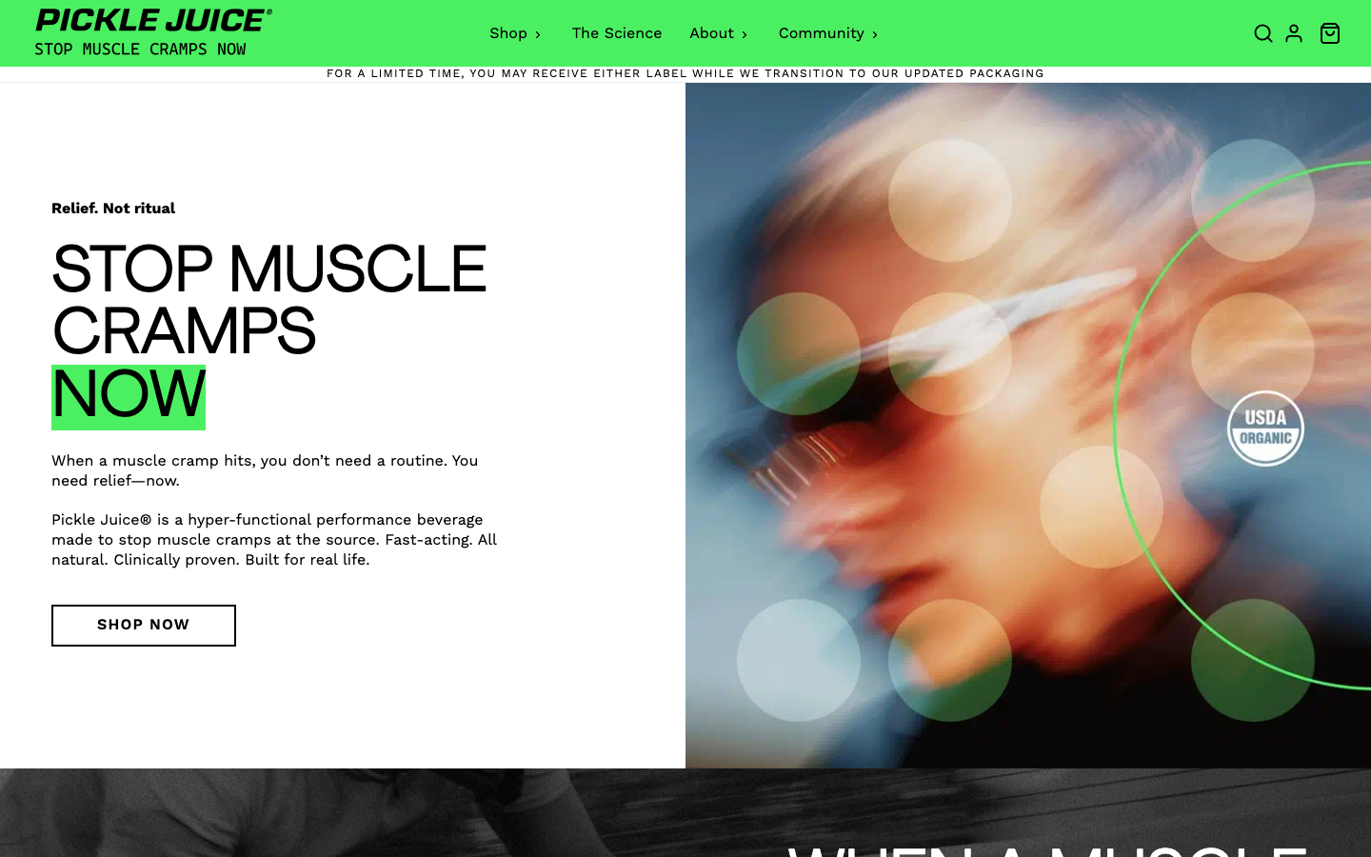
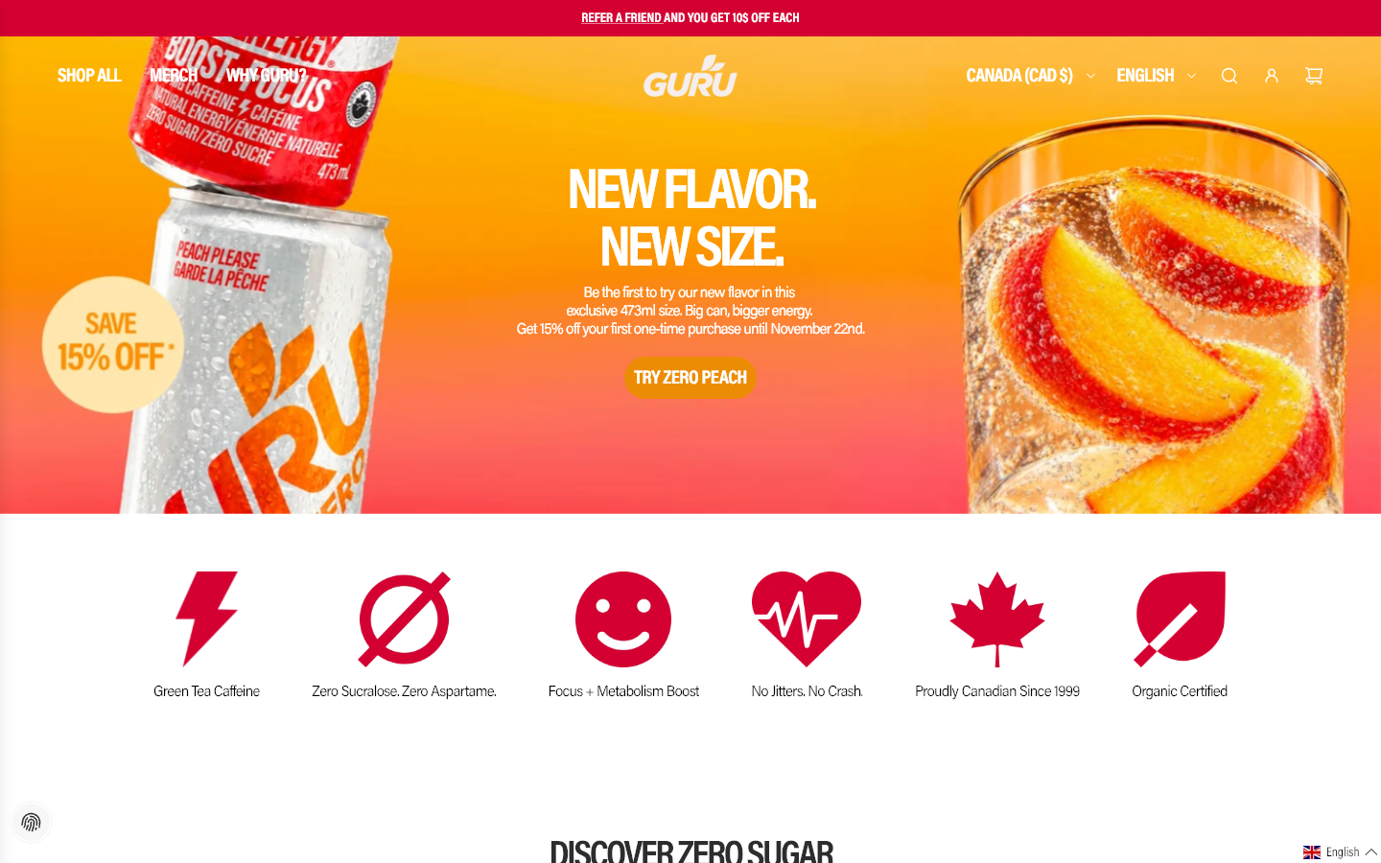
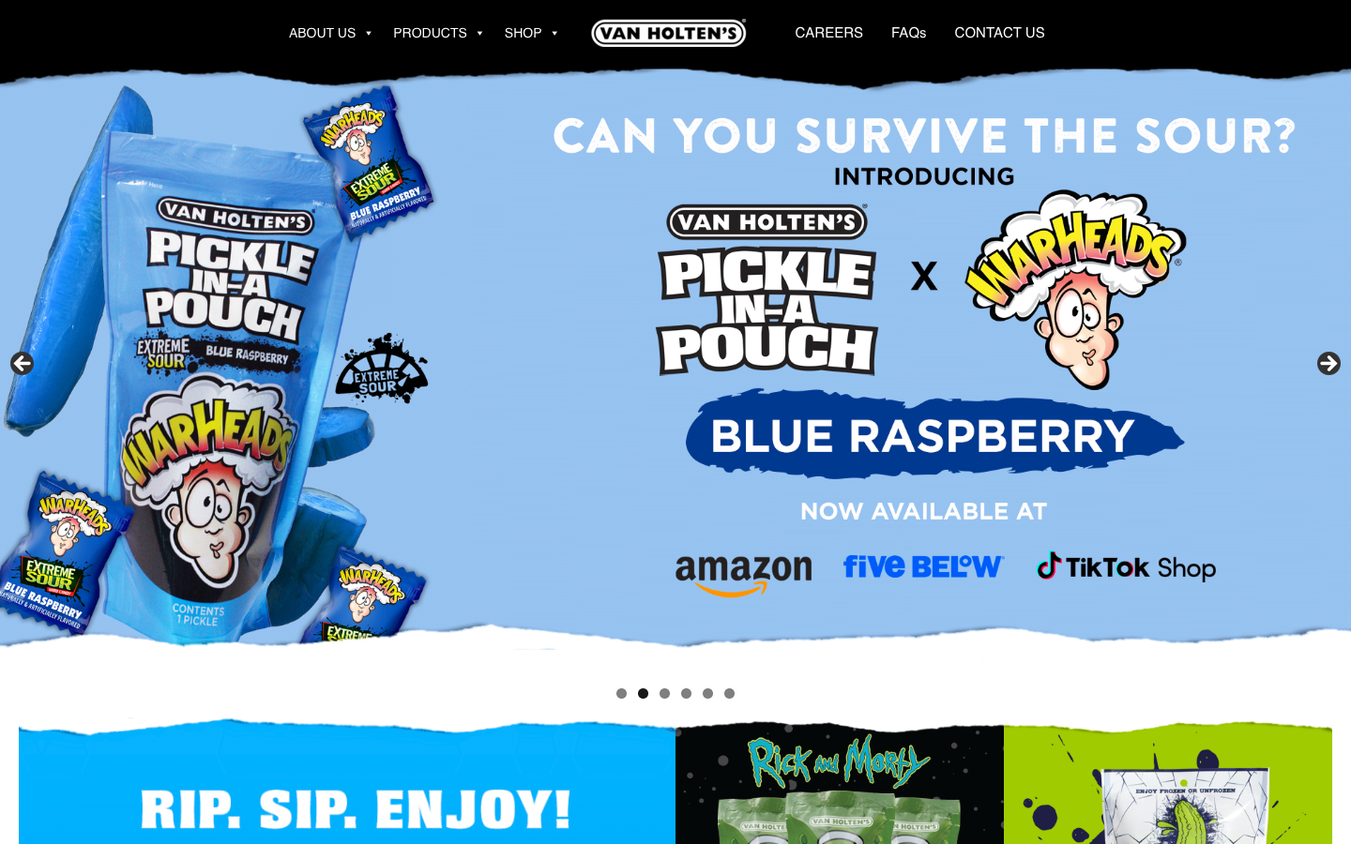
Competitors
THE THREE BRANDS CLOSEST TO US
Pickle Juice®
GURU Energy
Van Holten's
Pickle-brine sports shots
Montreal energy drink
Pickles & brine snacks
One sells pickle brine without caffeine, one sells caffeine without brine, one sells pickles as a fun snack. DILL'D sits in the middle of all three.

Slide 8





1. Pickle Juice®
COMPETITOR
BUSINESS MODEL
PRODUCT
CLAIMS
Performance drink brand sold online and in big retailers like Walmart
Pickle-brine shots (2.5 oz) and bottles, made to stop muscle cramps
USDA Organic, sugar-free, caffeine-free, 10× the electrolytes of sports drinks
PRICING
CUSTOMERS
MAIN EDGE
About US$1.60–1.90 per 2.5 oz shot; 12-packs about US$20–32
Athletes and active people who get cramps
Clinically proven cramp relief and the original pickle-brine drink
picklepower.com | “Stop Muscle Cramps Now. Relief, not ritual.”

Slide 9
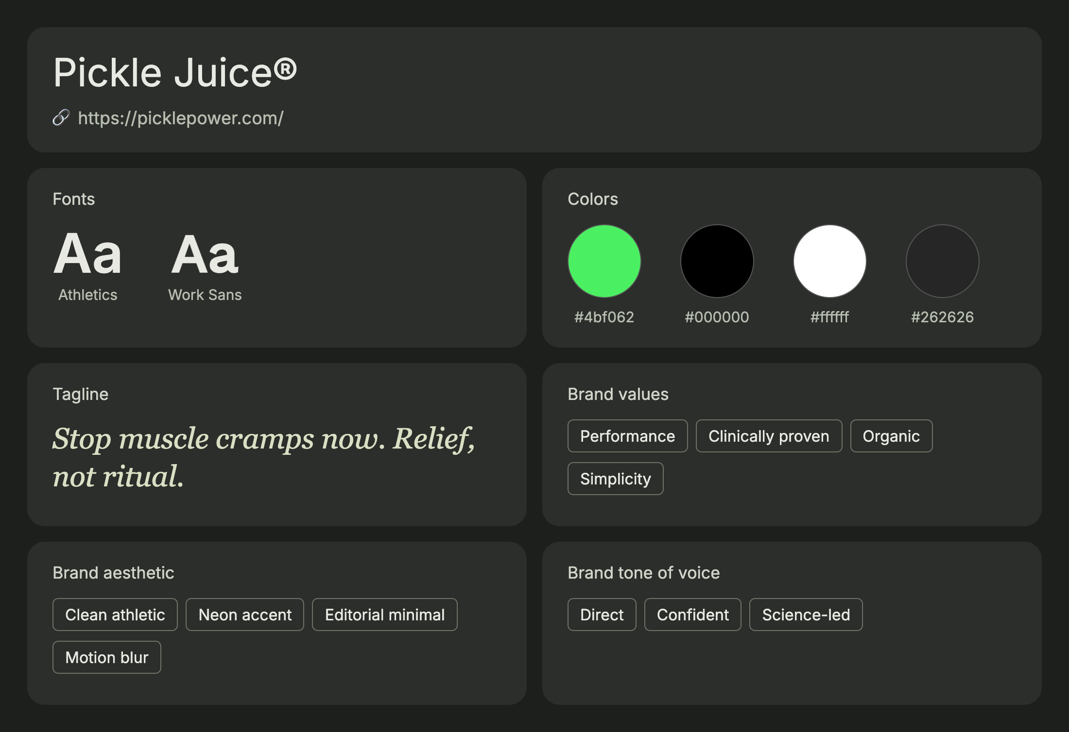
Above the waterline
PICKLE JUICE® — HOMEPAGE & BRAND DNA
Homepage screenshot, November 2026

Slide 10

2. GURU Energy
COMPETITOR
BUSINESS MODEL
PRODUCT
CLAIMS
Canadian energy drink brand in grocery, Costco and online
Organic energy drinks in 355ml and new 473ml cans, incl. Zero Sugar
Green tea caffeine, organic, zero sucralose or aspartame, no crash
PRICING
CAFFEINE
MAIN EDGE
About $3.99 CAD per 355ml can (Canadian retailers)
140mg per 355ml can
Proudly Canadian since 1999 with wide national distribution
guruenergy.com | “Natural energy drinks for sustained energy.” | Based in Montreal

Slide 11
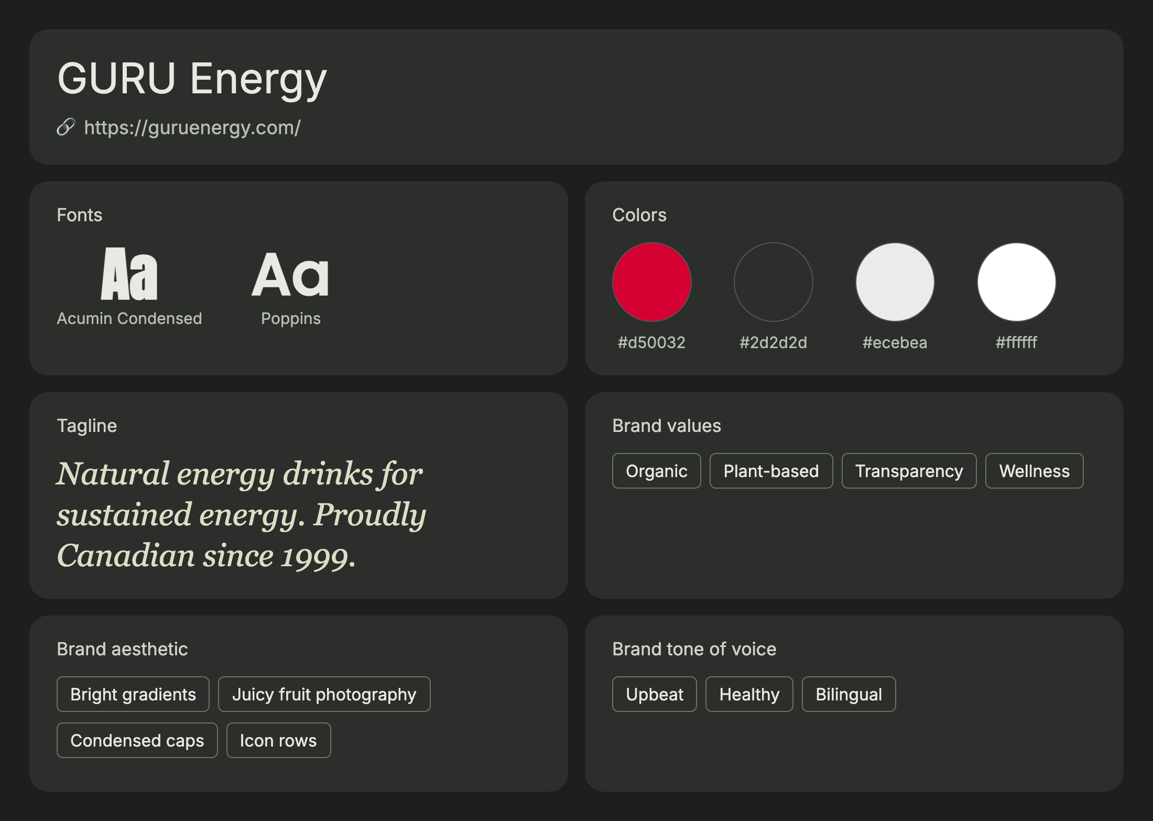
Above the waterline
GURU ENERGY — HOMEPAGE & BRAND DNA
Homepage screenshot, November 2026

Slide 12

3. Van Holten's
COMPETITOR
BUSINESS MODEL
PRODUCT
COLLABS
Pickle snack brand sold on Amazon, Five Below and TikTok Shop
Pickle-in-a-Pouch, Pickle-Ice brine freeze pops and Pickleback
Pop-culture tie-ins like Warheads Extreme Sour Blue Raspberry
PRICING
CUSTOMERS
MAIN EDGE
Pickle-Ice launched at $0.49 per 2 oz pop, $2.99 per 8-pack (SRP)
Kids, teens and snackers who love sour and novelty
“More extreme flavors than any other on-the-go pickle brand”
vanholtenpickles.com | “Can you survive the sour?”

Slide 13
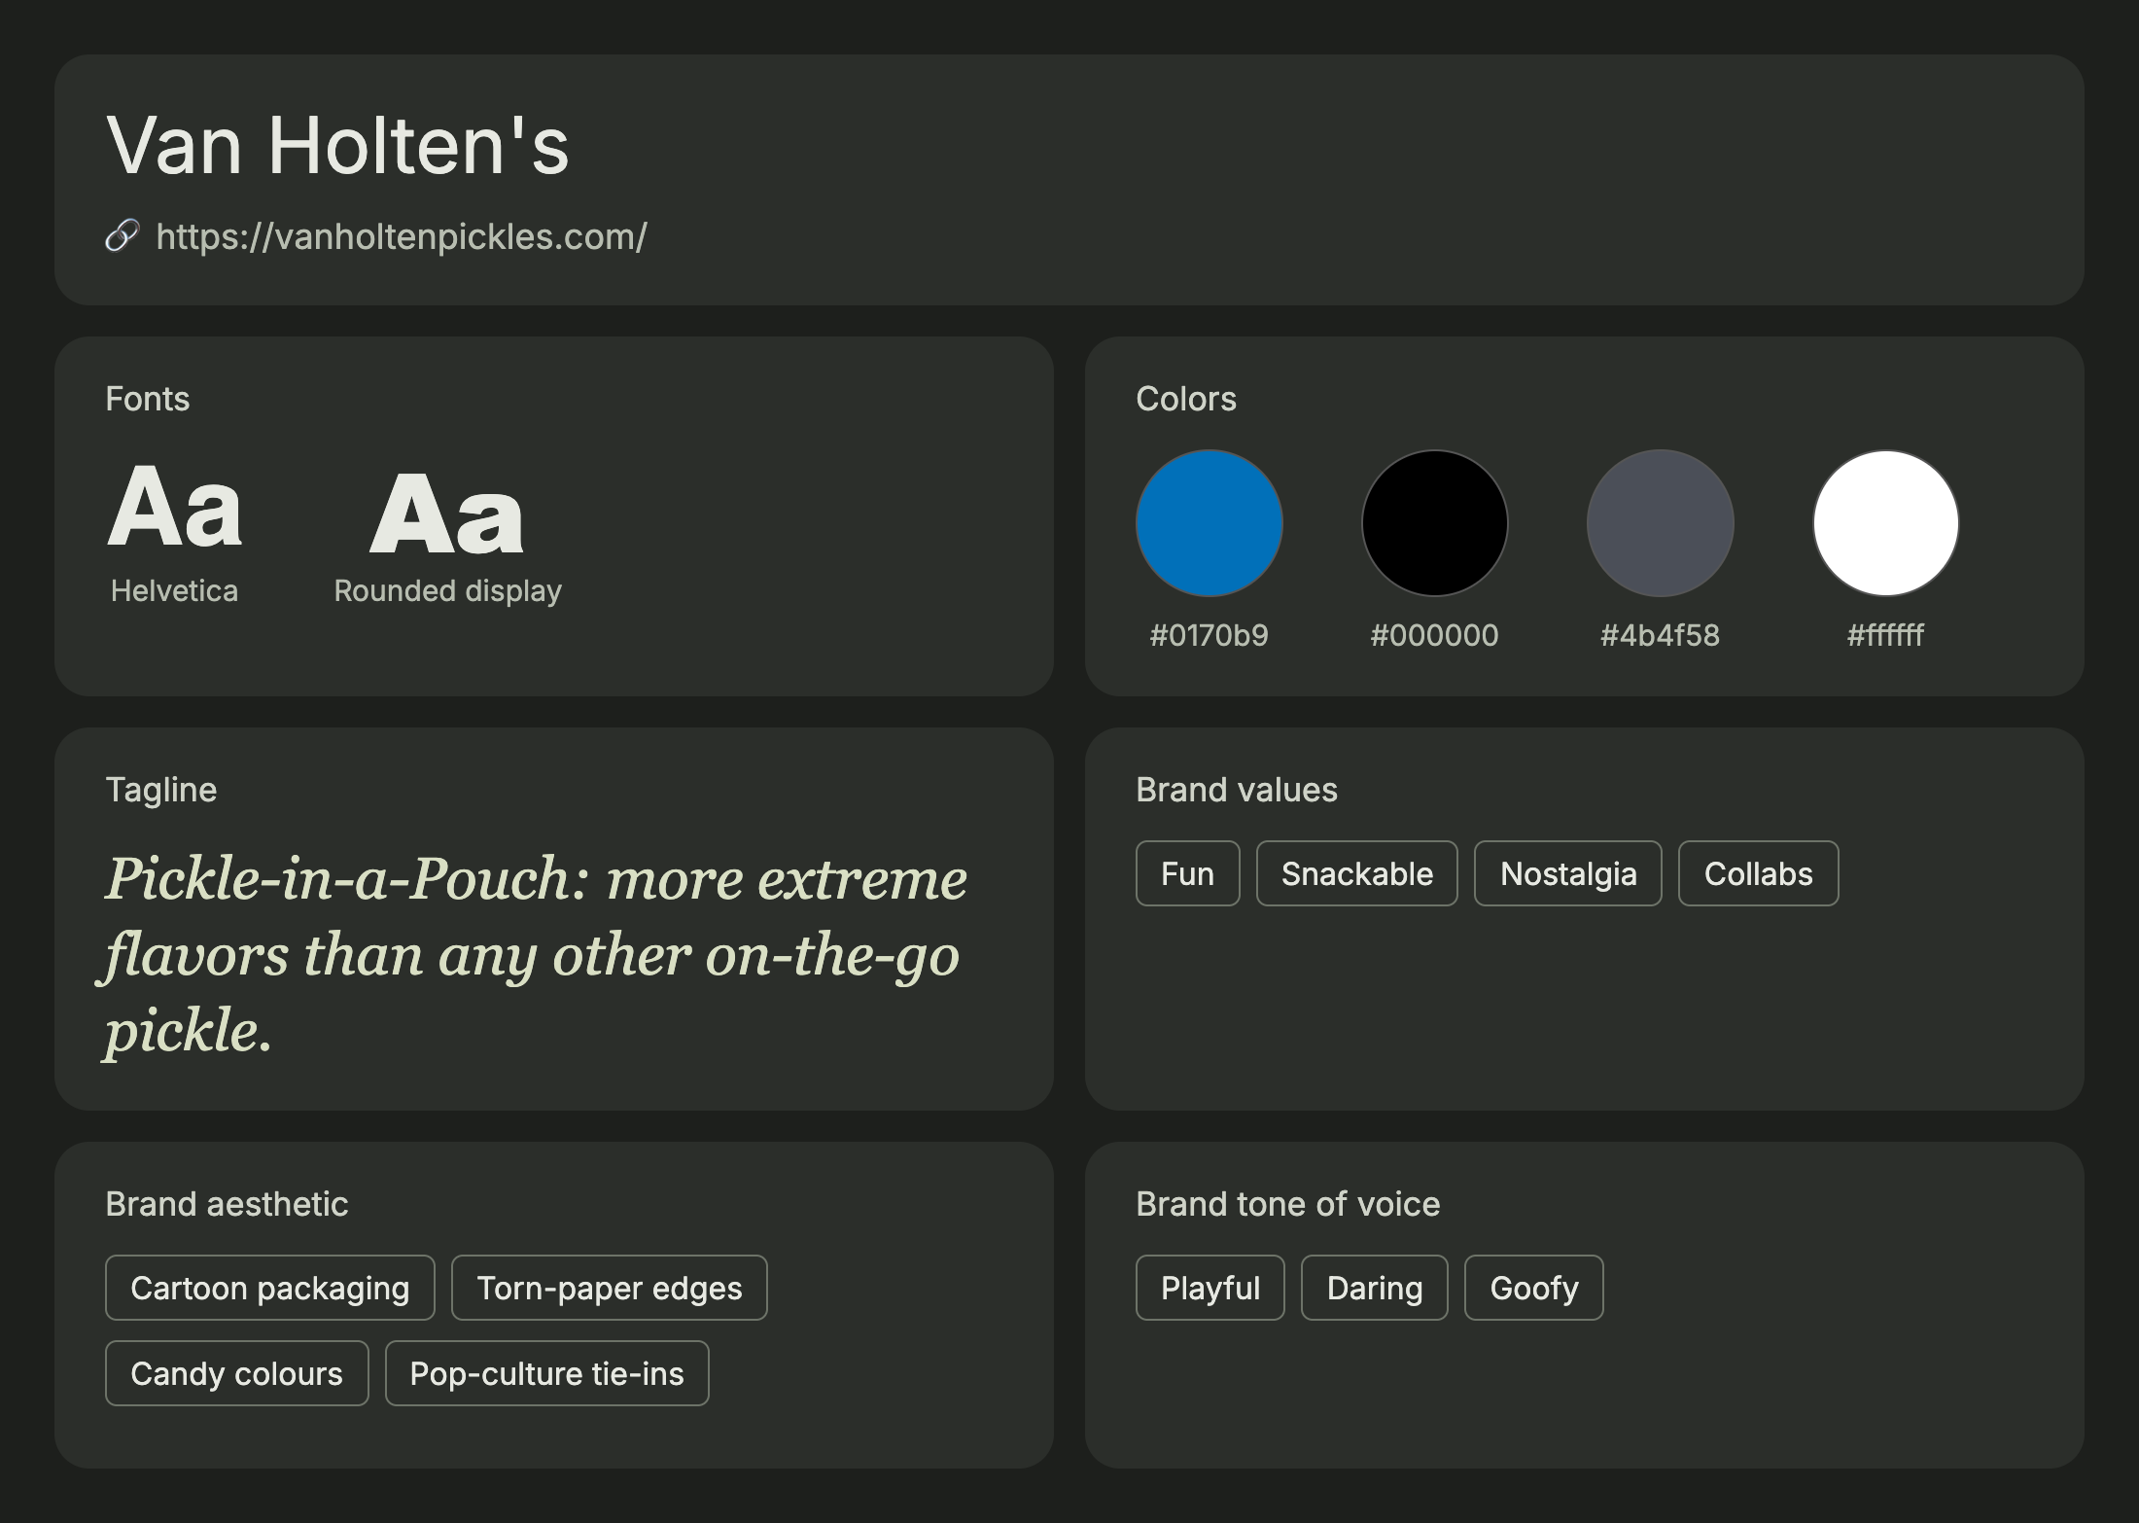
Above the waterline
VAN HOLTEN'S — HOMEPAGE & BRAND DNA
Homepage screenshot, November 2026

Slide 14
Product and price comparison
PRODUCT AND PRICE COMPARISON
 | DILL'D | Pickle Juice® | GURU | Van Holten's
Product | Pickle energy drink | Pickle-brine shot | Organic energy drink | Pickle snack + brine pops
Size | 355ml can | 2.5 oz (74ml) shot | 355ml / 473ml can | 2 oz pop / single pickle
Caffeine | 180mg | 0mg | 140mg (355ml) | 0mg
Real pickle brine? | Yes, fermented dill | Yes | No | Yes
Price per unit | $3.99 CAD | ~US$1.60–1.90 | ~$3.99 CAD | $0.49 pop (SRP)
Flavours | 4 + monthly Mystery Can | Original, Extra Strength + | Many fruit flavours | Many “extreme” flavours
Limited drops | Monthly, vaulted forever | No | New flavour launches | Collab editions
Where sold | Online, ships to 6 regions | Retail + online | Grocery, Costco, online | Amazon, Five Below, TikTok Shop
Positioning | Loud treat, honest | Performance / recovery | Healthy energy | Fun snack
Conclusion: DILL'D is the only one that combines real pickle brine with energy-drink caffeine. We price the same as GURU ($3.99) and well above a pickle shot, so the brand has to earn it with flavour and fun.

Slide 15


Three things we offer that no competitor does today
OUR EDGE
01
02
03
Pickle brine + caffeine in one can
A monthly Mystery Can drop
Dare culture built in
A real energy drink that tastes like a pickle: sour, salty, 180mg caffeine.
One secret flavour every 30 days, limited cases, vaulted forever. VIPs get the link 2 hours early.
The #DillDChallenge turns every first sip into a video. The brand voice is honest: a treat, not a health drink.
GAP TODAY
GAP TODAY
GAP TODAY
Pickle Juice and Van Holten's have brine but no caffeine; GURU has caffeine but no brine.
None of the three runs a monthly limited flavour with a VIP list and countdown.
Pickle Juice and GURU sell performance and wellness; Van Holten's targets kids' snacking.
Source: competitor websites and public retail listings, November 2026

Slide 16
SEO Meta-Descriptions
Title, meta description, H1–H3 and keywords for every page of dilld.vercel.app

Slide 17
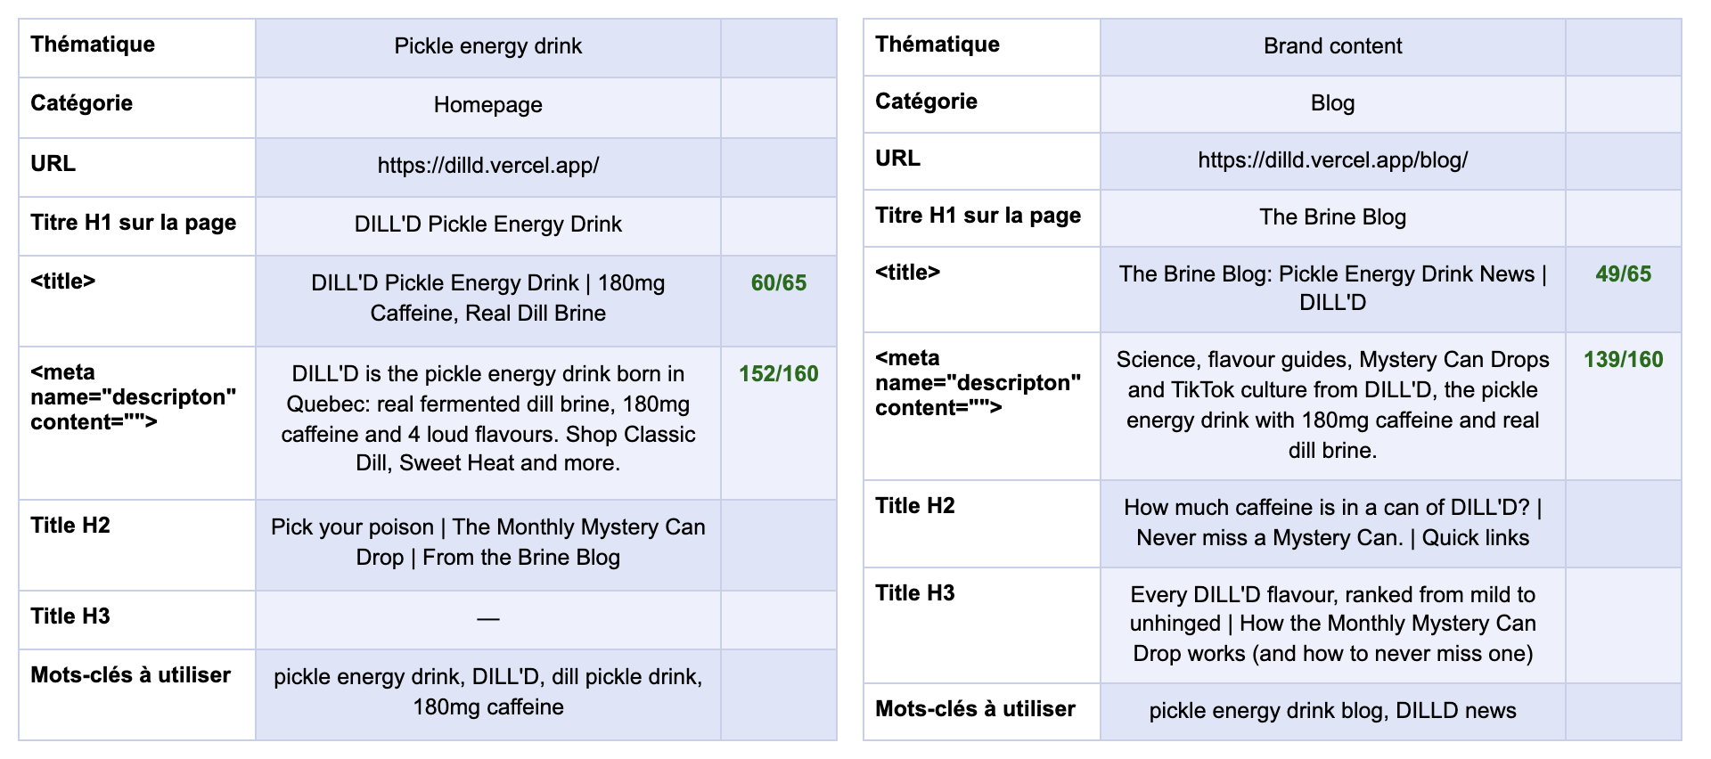
Homepage & Brine Blog
SEO META-DESCRIPTIONS · PAGES 1–2

Slide 18
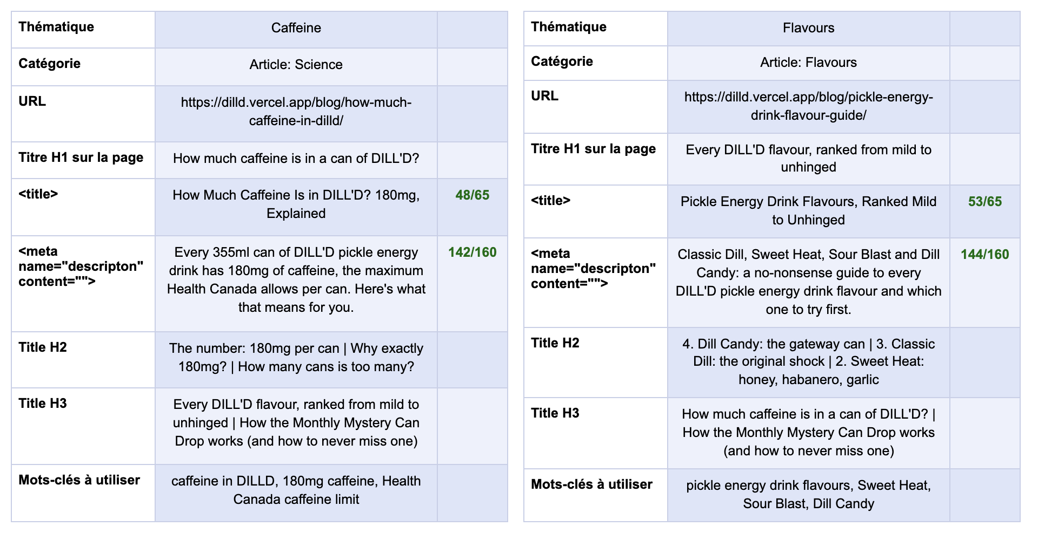
Blog articles
SEO META-DESCRIPTIONS · PAGES 3–4

Slide 19
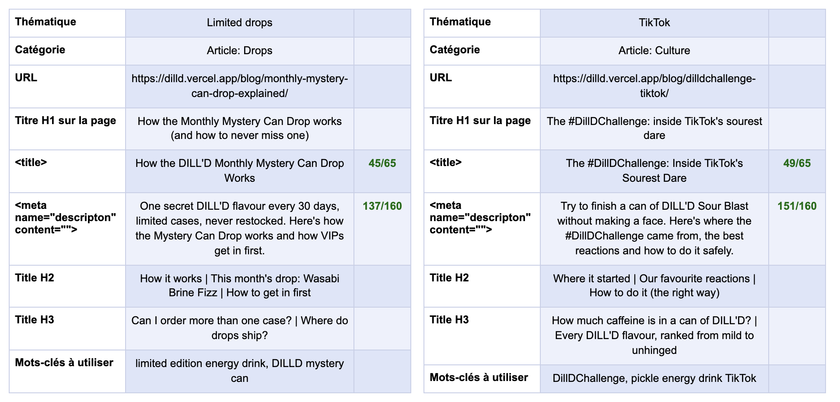
Blog articles
SEO META-DESCRIPTIONS · PAGES 5–6

Slide 20
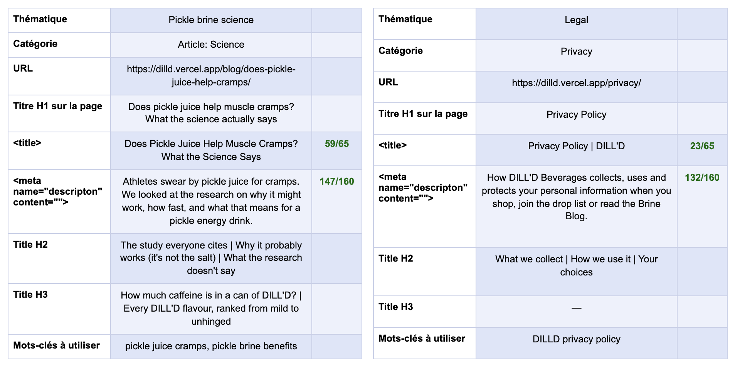
Blog article & privacy policy
SEO META-DESCRIPTIONS · PAGES 7–8

Slide 21
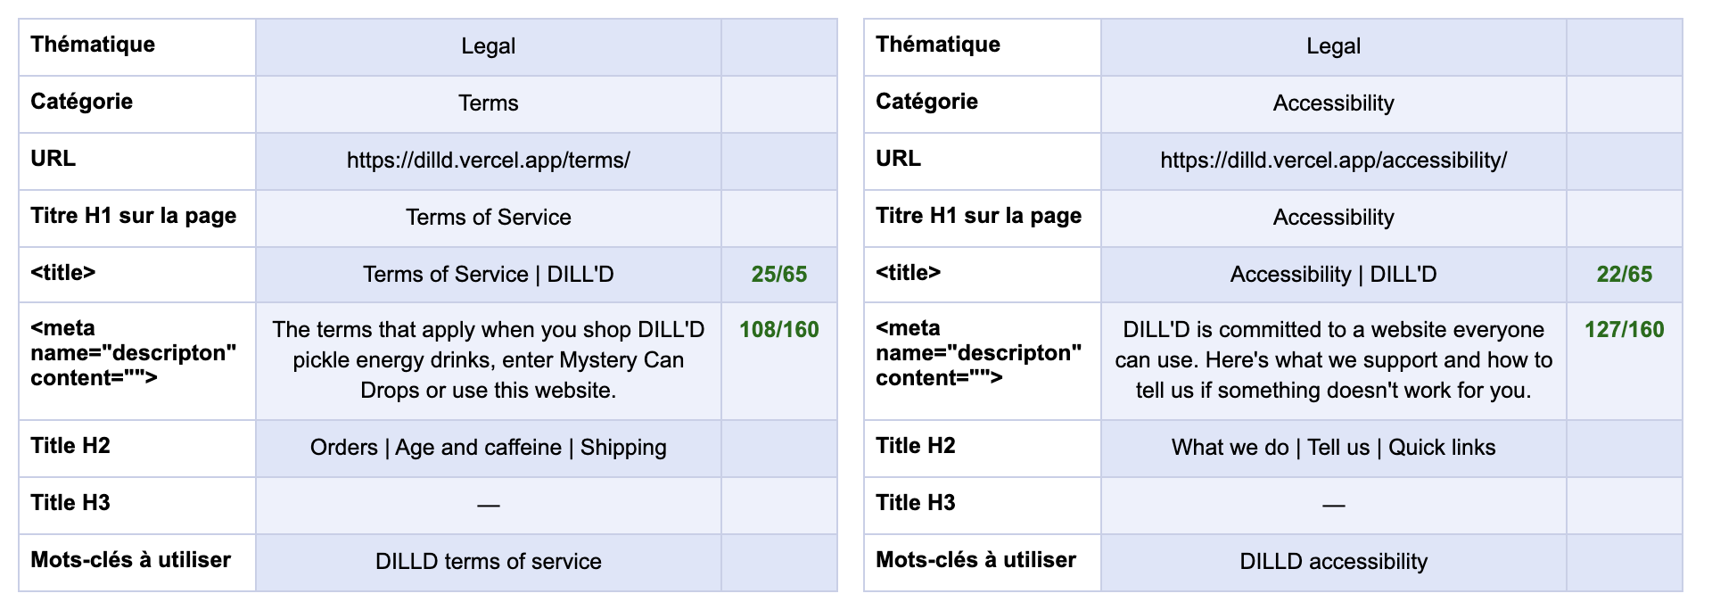
Terms & accessibility
SEO META-DESCRIPTIONS · PAGES 9–10

Slide 22
12 keywords we want to rank for
KEYWORDS
pickle energy drink
dill pickle drink
pickle juice energy drink
pickle brine drink
sour energy drink
energy drink Quebec
Montreal energy drink
180mg caffeine drink
pickle soda
limited edition energy drink
weird energy drink flavours
pickle juice electrolytes
Lime = main keywords used in page titles. All 12 are spread across the homepage, blog articles and meta descriptions.

Slide 23
DILL'D can work if we win the niche online first
COULD THIS BUSINESS WORK?
WHY IT CAN WORK
WHAT COULD STOP IT
Proven demand on both sides: Pickle Juice sells brine, GURU sells energy drinks in Quebec.
Pickle flavour is trending; Van Holten's x Warheads shows sour novelty sells.
Made for TikTok: the first sip is the content.
Monthly drops create urgency and repeat visits.
Health Canada rules: 180mg is the cap per can, with caution labels.
Polarising taste: many people will try it once and stop.
Shelf space is ruled by Red Bull, Monster and GURU.
Novelty can fade once the trend cools.
Verdict: a good idea, if we launch online with TikTok and monthly drops, build a loyal fan base, then move into Quebec dépanneurs and grocery.

Slide 24
3 Marketing Examples
Instagram post · Website banner · Newsletter header

Slide 25
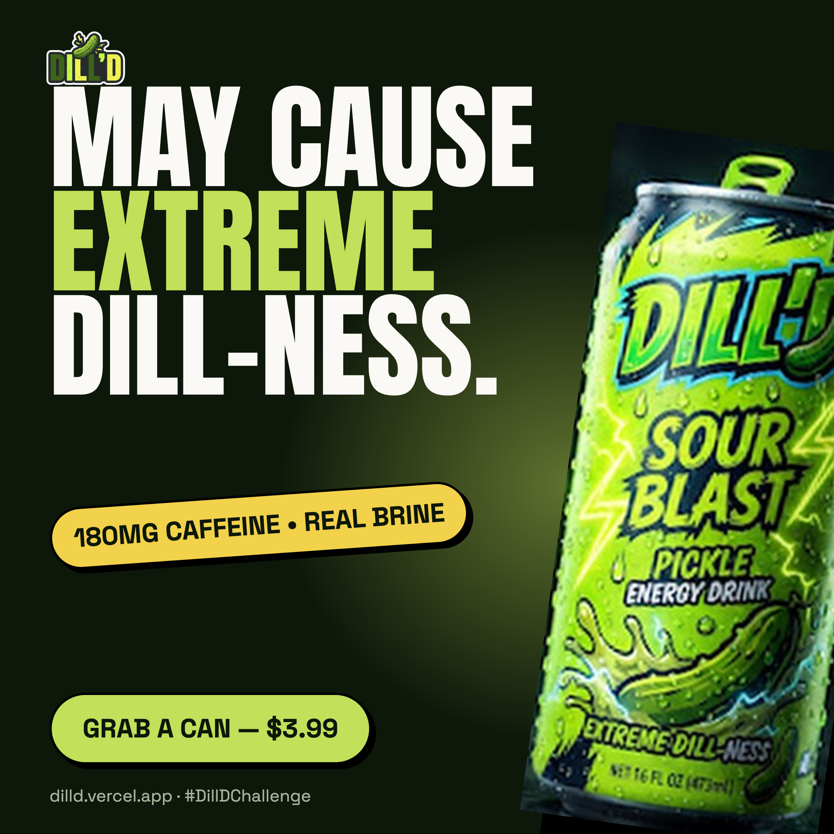
Instagram post (1080 × 1080)

Slide 26
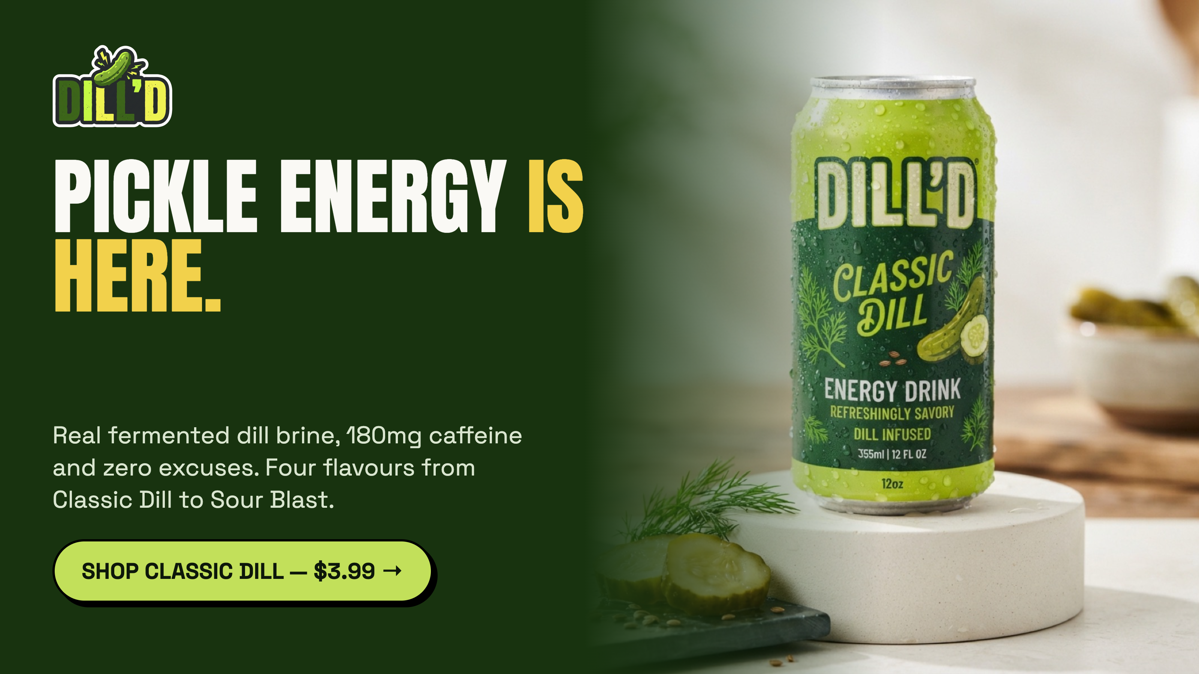
Website banner (16:9)

Slide 27
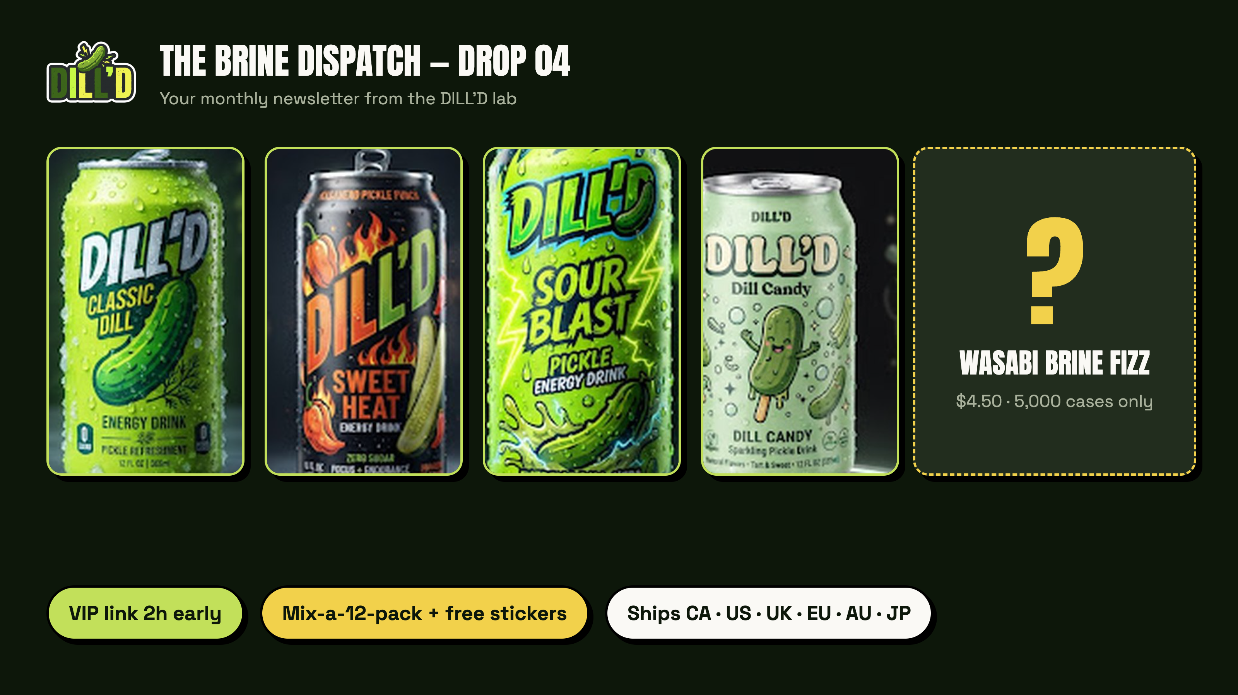
Newsletter header: The Brine Dispatch (16:9)

