Slide 1
Count Dracalories
App developed by:
Noah Bernays, Blake Hina, Erin Murphy, and Joe Ward
“Do you like JSON objects? Then this app is for you!”
- Blake Hina
“BU students should be flocking to download this essential app.”
- Joe Ward
“It’s true.”
- Erin Murphy
“Doubles as a way to check what’s on the menu before you get to the dining hall!”
- Noah Bernays

Slide 2
Slide 1
Table of Contents:
General Overview of App.......................................Slide 2
Where Meal Data Comes From..............................Slide 3
How User Interacts with App.................................Slide 4
Where Data is Stored After Clicking......................Slide 5
What Happens After App Receives Meal Data…...Slide 6
Calendar View.........................................................Slide 7
Front End................................................................Slide 8
Accomplishments....................................................Slide 9

Slide 3
Slide 2
General Overview of App
The Count Dracalories App is a sleek and intuitive way to record the number of calories
the user consumes. The user clicks on the meal that he or she is eating, and then at whichever
Boston University dining hall he or she is eating at. A drop-down menu of meal items then shows up. After clicking the food item, the user is informed of how many calories that food item
contained, and the item and calorie information are stored in the calendar.
If the user is not eating at a B.U. dining hall, he or she may input a food item or calorie amount
manually, and it will similarly be stored in the calendar.
The user may click on the calendar to view their calorie intake for a certain day, as well as view
their “Calories To Date” beginning from the first input.

Slide 4
Where Meal Data Comes From
Slide 3
BU’s host server
Our server
5
4
3
JavaScript code
2
Menu
JSON OBJECT
1
Count Dracalories
6
Step 1: User clicks “Marciano Dining Hall”
Step 2: JS code on our server runs, and asks BU’s server for dining website info
Steps 3 & 4: Server retrieves info from the website
Step 5: JS code receives the HTML info and parses using Cheerio, a Node module
Step 6: JS code creates a JSON object of the meal data, which the app can read from our server

Slide 5
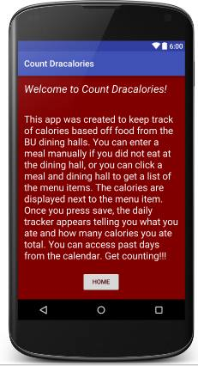
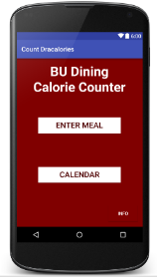
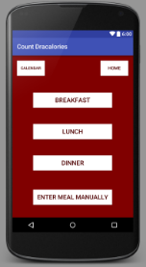
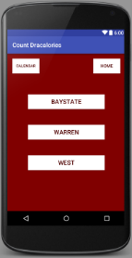
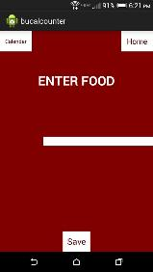
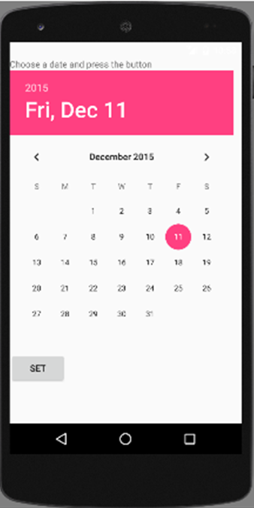
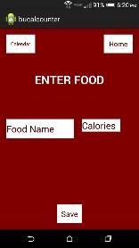
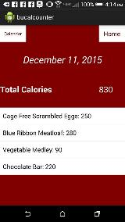
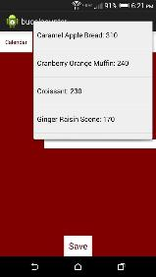
Slide 4
How User Interacts with App

Slide 6
Slide 5
Where Data is Stored After Clicking
Once a food item is clicked:
Item’s calorie amount is added to the TotalCalorieCount variable
Item and its calories are stored in daily view within the calendar
A view for each of the 8 classes
TotalCalorieCount += calories
Wow! A cranberry orange muffin is that many calories?!

Slide 7
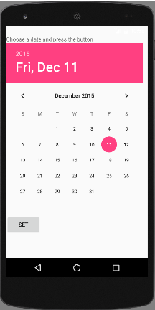
Slide 7
Calendar View
The Calendar view was created using Andriod’s DatePicker.
Basic calendar with an overhead view of the date, month and year selected.
Calendar opens up to the current date and the date can be changed by pressing a different date and by using the arrow keys to change the month.
Pressing the “Set” button takes the user to the calorie count for that day.

Slide 8
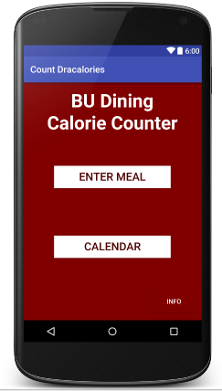
Slide 8
Front End
The front end design was created with 3 main ideals in mind. We wanted to make the app intuitive, appealing,
and useful so the user would want to download our app. Download it today!

Slide 9
Accomplishments
Slide 9
Successfully scraped a web page and parsed HTML
Created a sleek-looking and useful app
Learned how to work effectively with other group members
Split up tasks according to individuals’ strengths
Adhered to deadlines
Had a great time filming a funny and promotional video for our app

Slide 10
Thank you, and Happy Eating! Download today!
Slide 10

