Slide 1
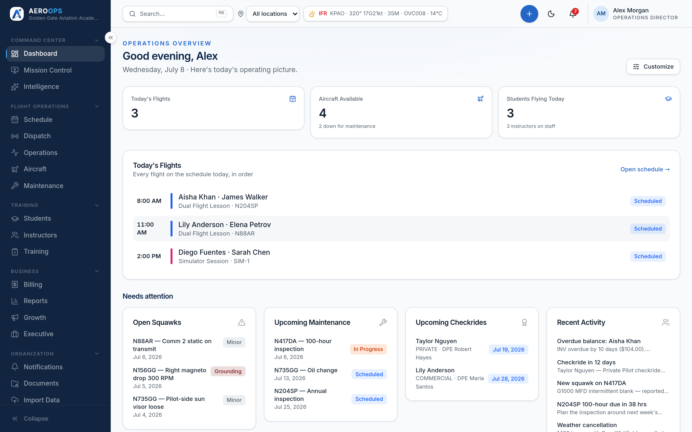
FOR YOUR PART 141 ACADEMY
AEROOPS
Stage checks, checkride readiness, and audit-ready training records.
Part 141 Flight School

Slide 2
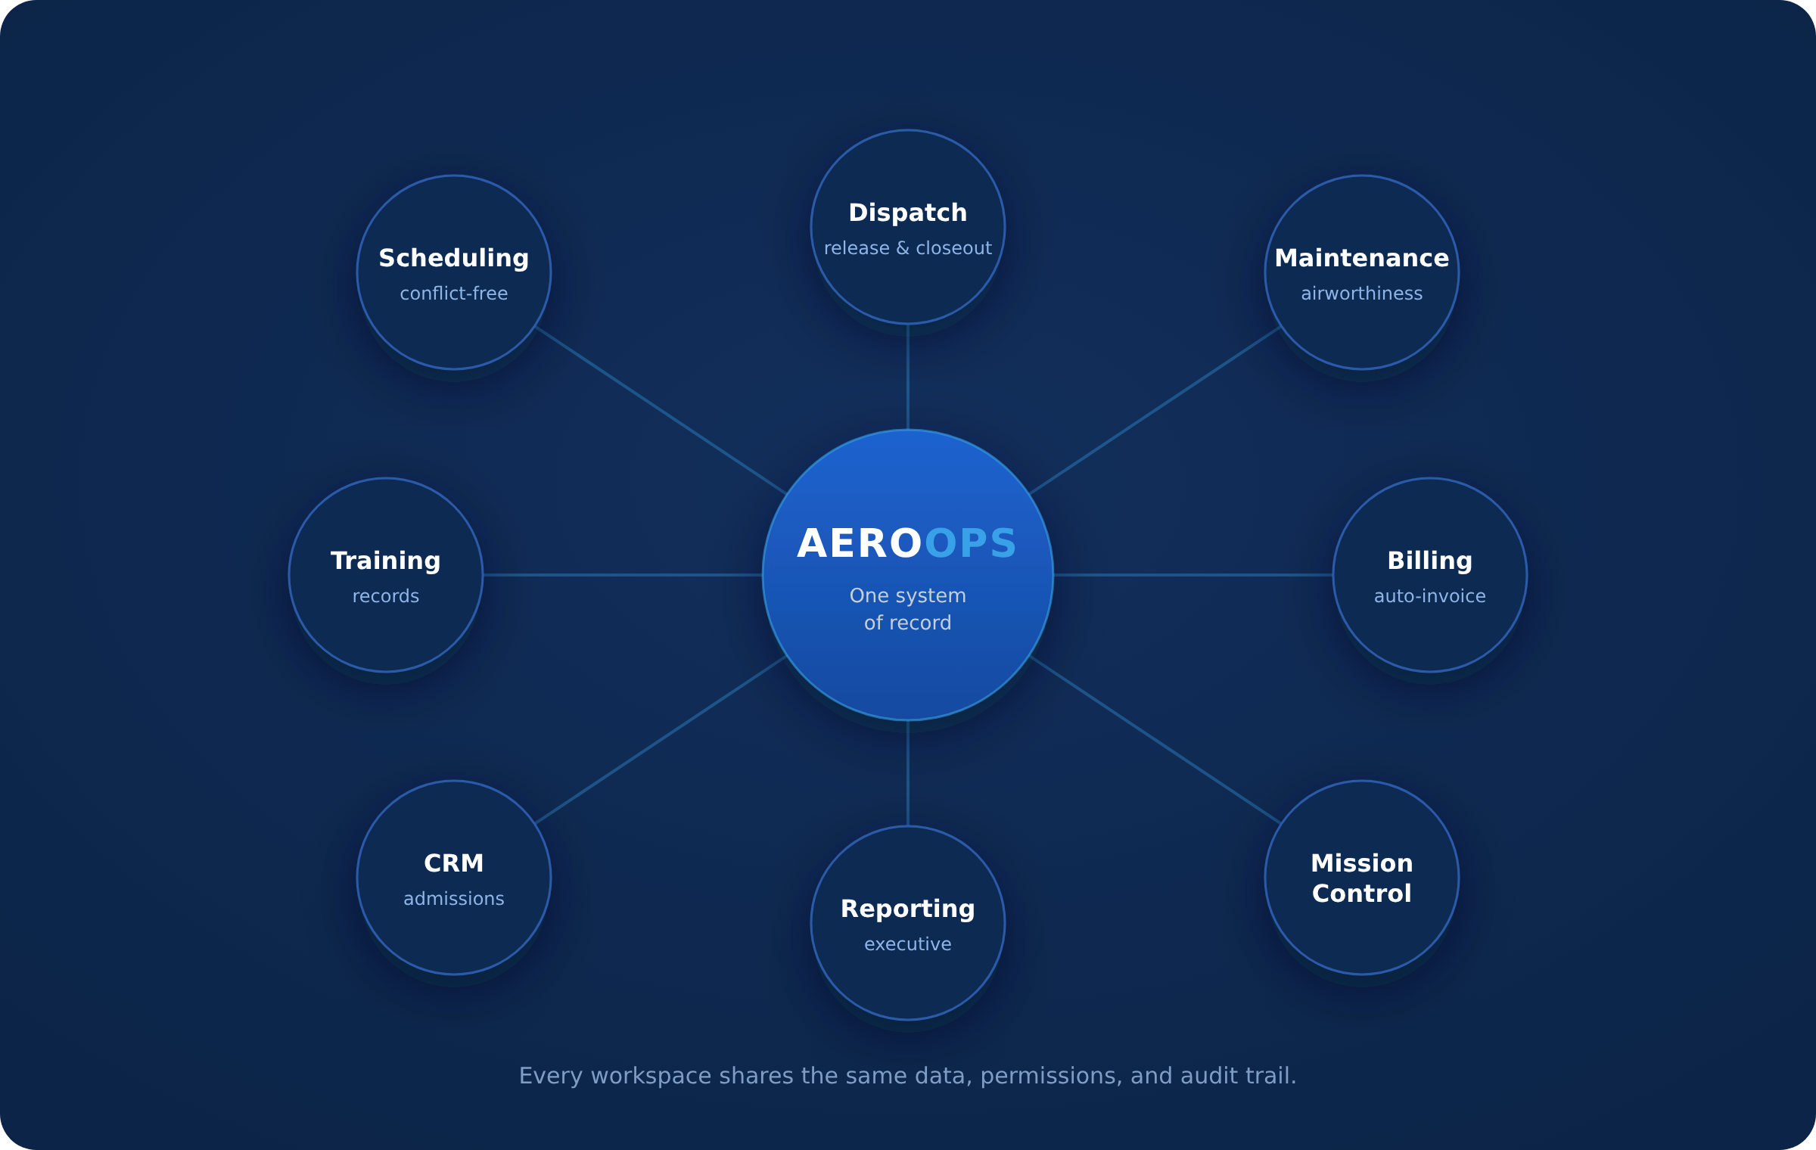
MISSION
One system. One truth.
Small aviation runs on whiteboards, dispatch binders, and five tools that don't talk to each other. AeroOps makes the connected version the easy version.
AEROOPS

Slide 3
THE PROBLEM
Fragmentation is the enemy
Every seam between tools is where money and safety leak out.
Revenue leaks
Airworthiness by memory
Training opacity
Compliance anxiety
Flights that closed but were never billed.
The overdue inspection no spreadsheet flagged.
Readiness as tribal knowledge, not a record.
The FSDO conversation starts from recollection.
AEROOPS

Slide 4
WHY AEROOPS
An operating system, not an app
Scheduling, dispatch, maintenance, training, and money as one continuous, auditable motion — what airlines have had for decades.
AEROOPS

Slide 5
PLATFORM OVERVIEW
Everything the operation touches
One login. One picture. One record.
Fly — Scheduling · Dispatch · Operations · Mission Control
Maintain — Squawks · Work orders · Return-to-service · Parts
Teach — Students · Instructors · Checkride readiness
Bill — Invoices · Payments · Receivables
Know — Reports · Executive view · Explainable insights
AEROOPS

Slide 6
DASHBOARD
What needs me today
The morning triage, answered before the first click.
Today's flights, at a glance.
Needs Attention — squawks, inspections, checkrides, activity.
Fleet status and weather for the active location.
Personalized: every viewer sees only what their role should.
AEROOPS

Slide 7
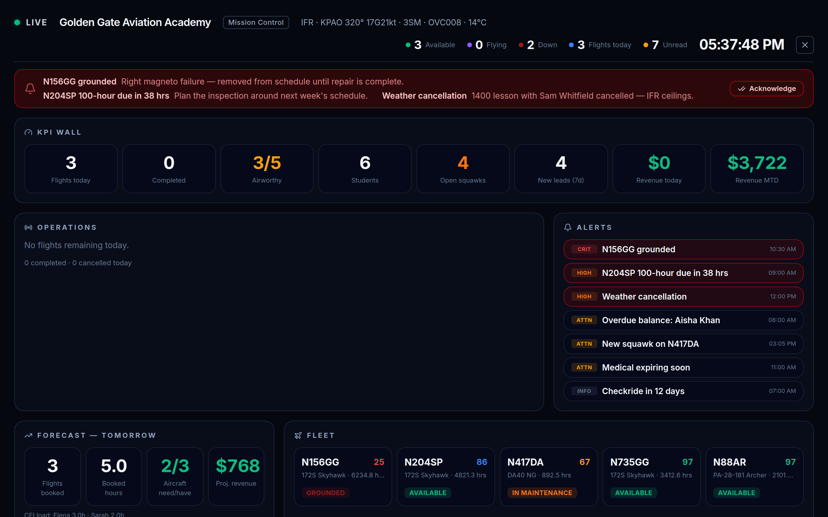
MISSION CONTROL
The operation on the wall
A live, full-screen operations picture for the front desk and the ops room.
Real-time flight, fleet, and weather panels.
The audit timeline as a first-class surface — not a log file.
TV mode and scenes for the dispatch wall.
AEROOPS

Slide 8
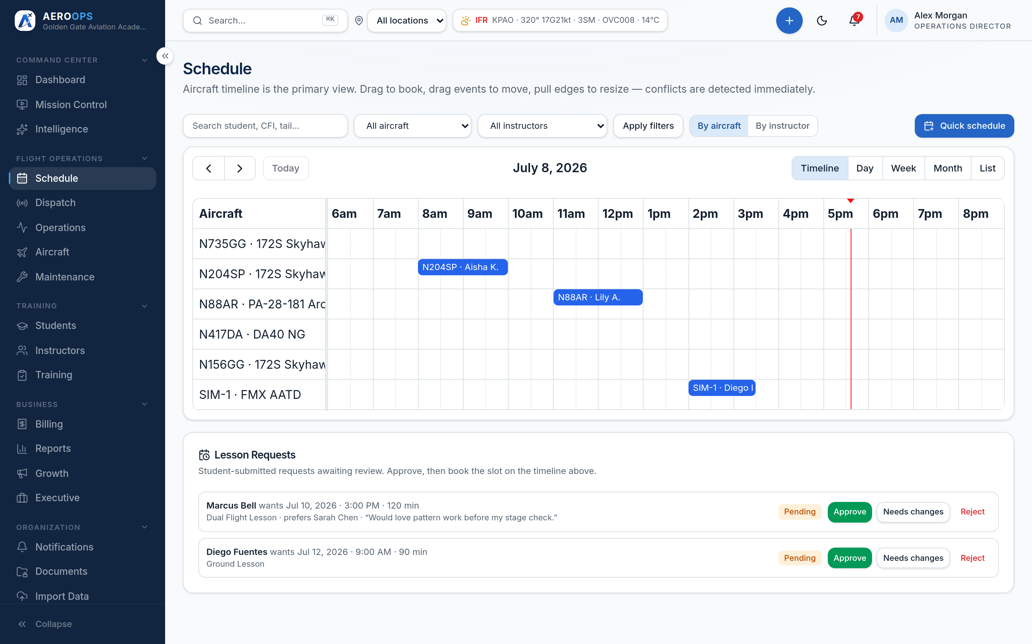
SCHEDULING
Book it once, everywhere
The schedule that knows the airplane, the instructor, and the student.
Conflicts caught before they're saved.
Aircraft, instructor, student, and resource on one axis.
Grounded aircraft can't quietly stay on the schedule.
AEROOPS

Slide 9
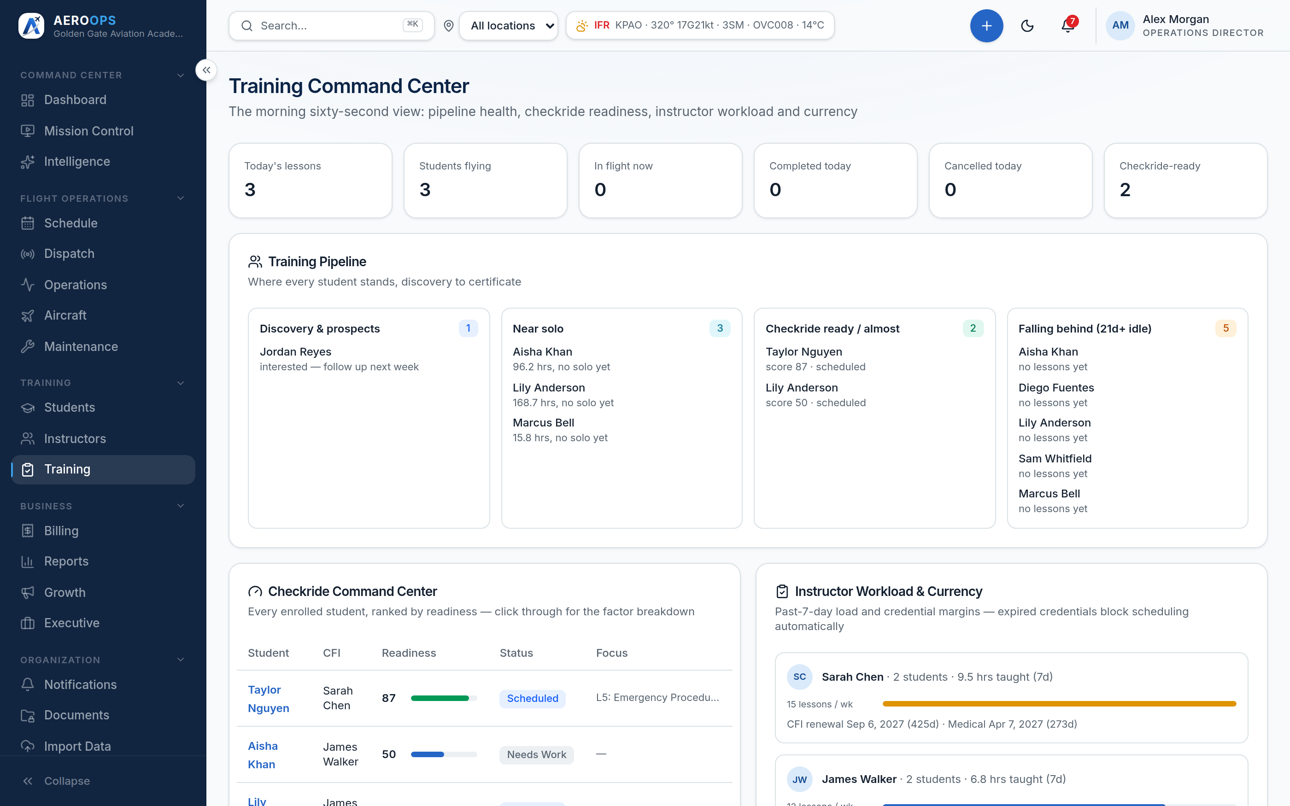
TRAINING
The training pipeline, in the system
Readiness with reasons — not reconstructed from memory.
Students, instructors, stage checks, and checkride queue in one place.
Endorsements and currency on the record, not in a spreadsheet.
Lesson records that follow the student through the syllabus.
AEROOPS

Slide 10
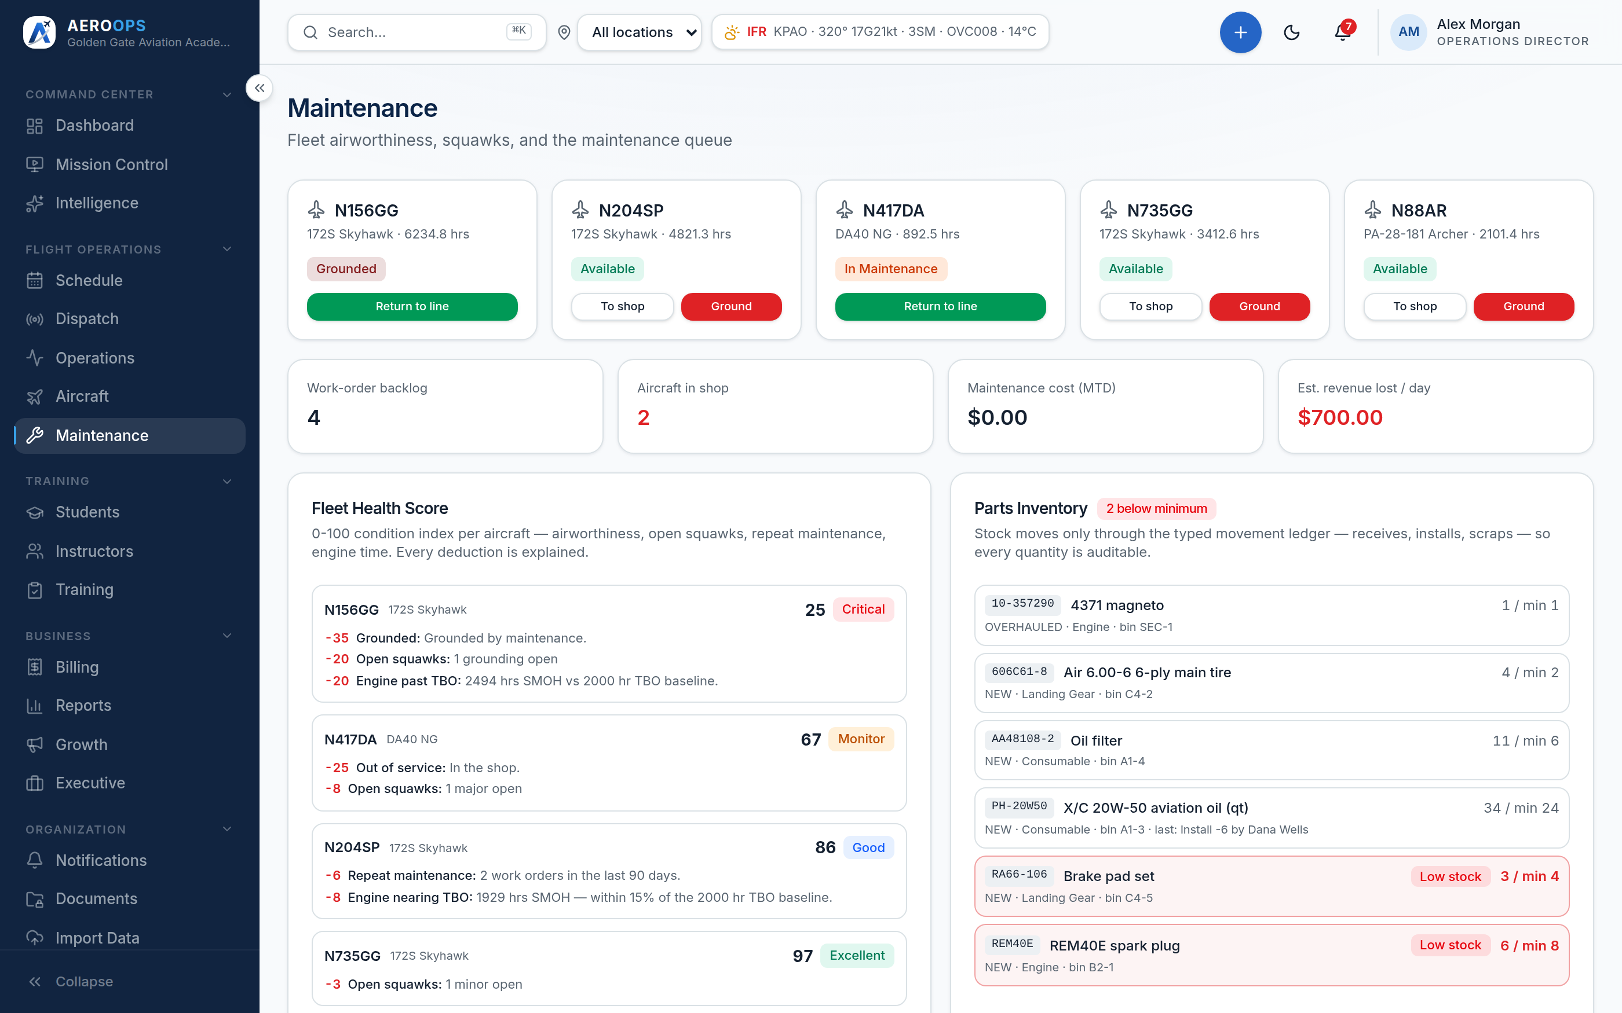
FLEET & MAINTENANCE
Airworthiness the system enforces
Squawk → work order → return-to-service, with parts you can audit.
Squawks ranked by airworthiness impact.
Signed return-to-service on the record.
Parts movement as a typed, traceable ledger.
Ground an aircraft and see the blast radius.
AEROOPS

Slide 11
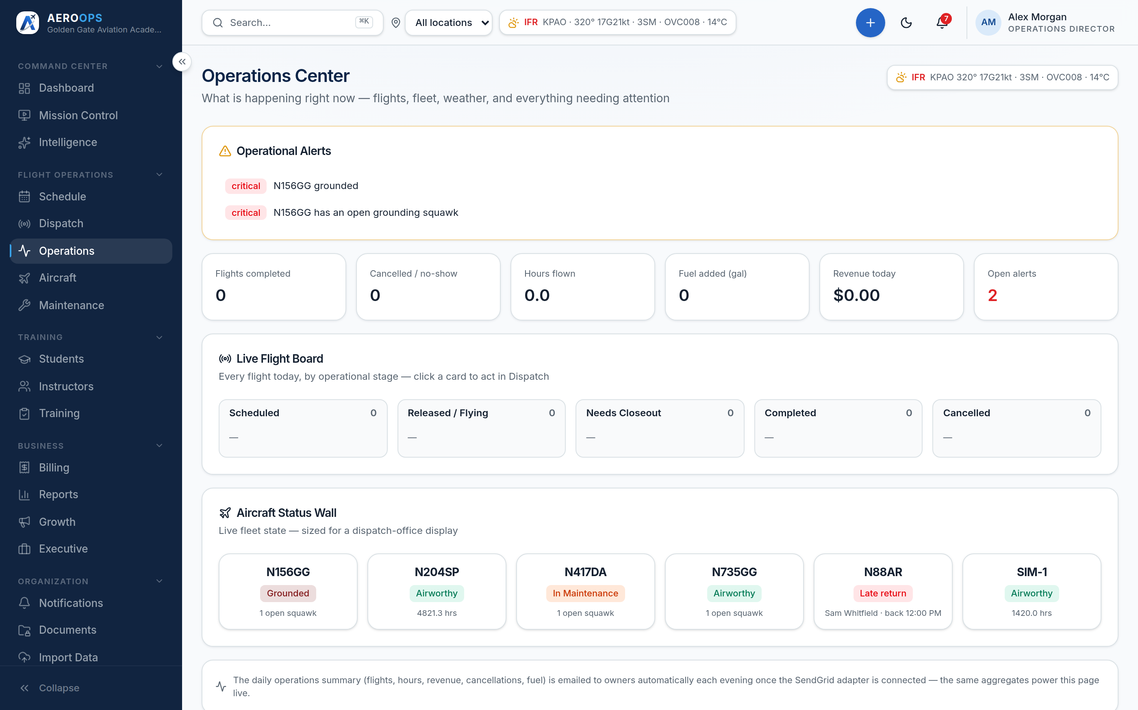
OPERATIONS
The day, in motion
Release, watch, resolve, close out — without phone-tag.
Live releases and returns from one board.
Status that's always truthful across schedule and maintenance.
Conflicts and grounding impact surfaced before they bite.
AEROOPS

Slide 12
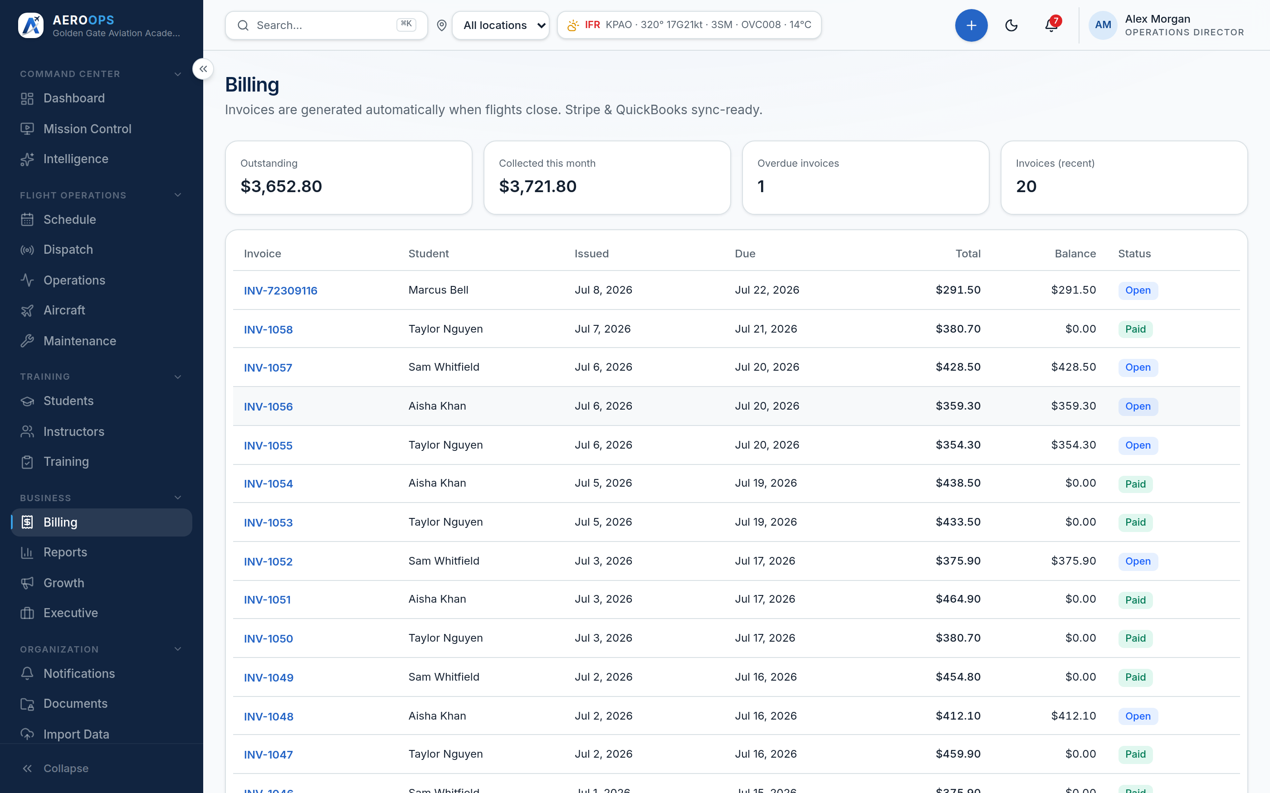
BILLING
Money that reconciles itself
Invoices, payments, and receivables built into the operation — not bolted on.
One invoice per flight, generated at closeout.
Money is exact by construction (Decimal, never float).
Receivables aging and payment records in the tenant.
Card processing on invoices is on the roadmap (Stripe adapter).
AEROOPS

Slide 13
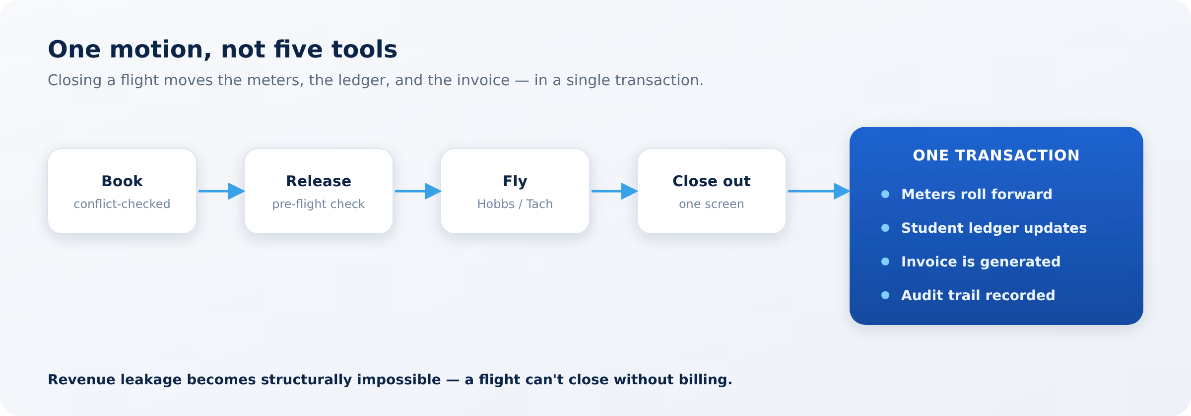
THE FEATURE MOMENT
One motion. No leak.
The flight closes. The meters move. The invoice exists — atomically. If any step fails, none of it commits.
AEROOPS

Slide 14
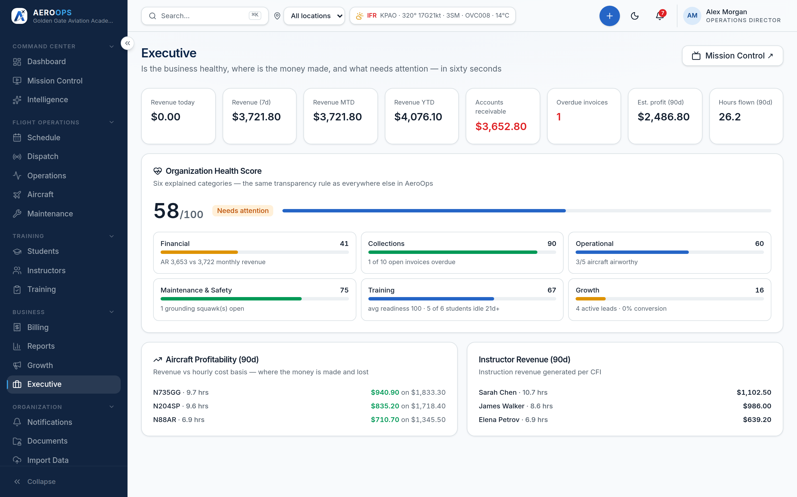
REPORTS
Numbers you can defend
Executive reporting with the reasons behind every figure.
Revenue, utilization, and instructor productivity.
Executive view for the owner and the board.
An immutable audit trail underneath every number.
AEROOPS

Slide 15

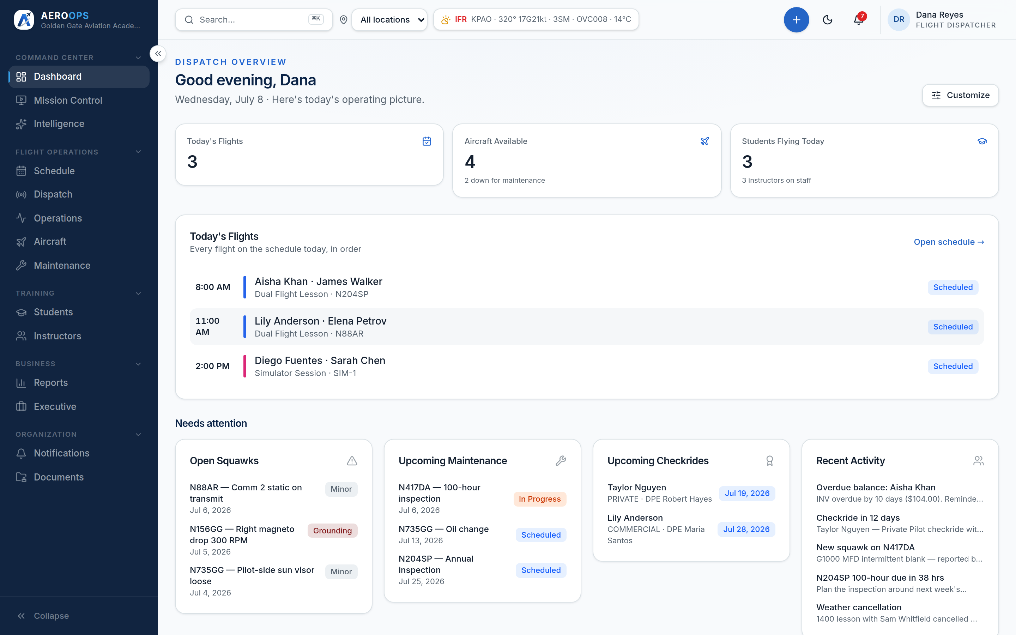
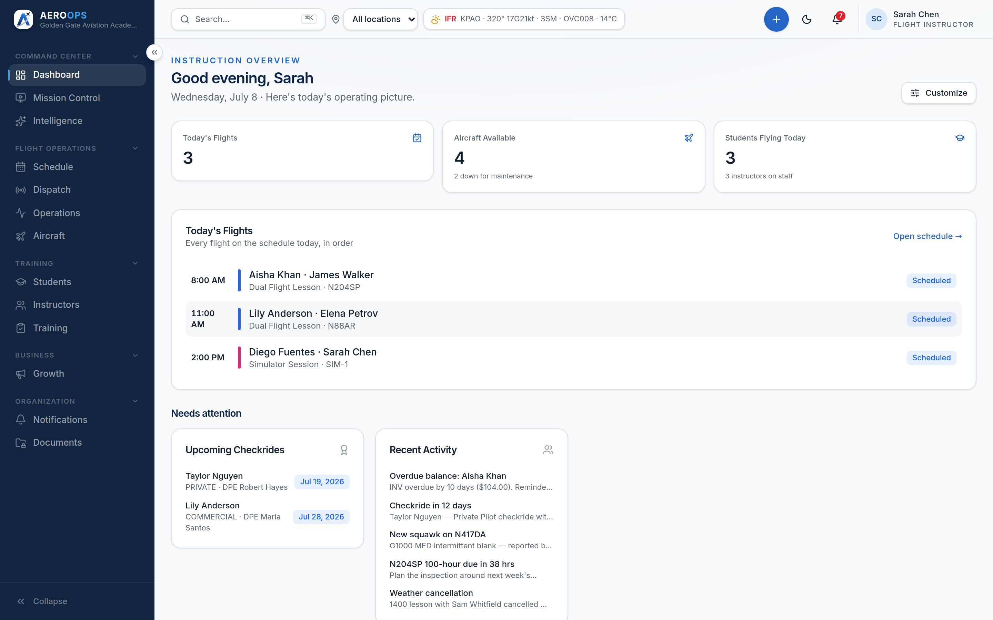
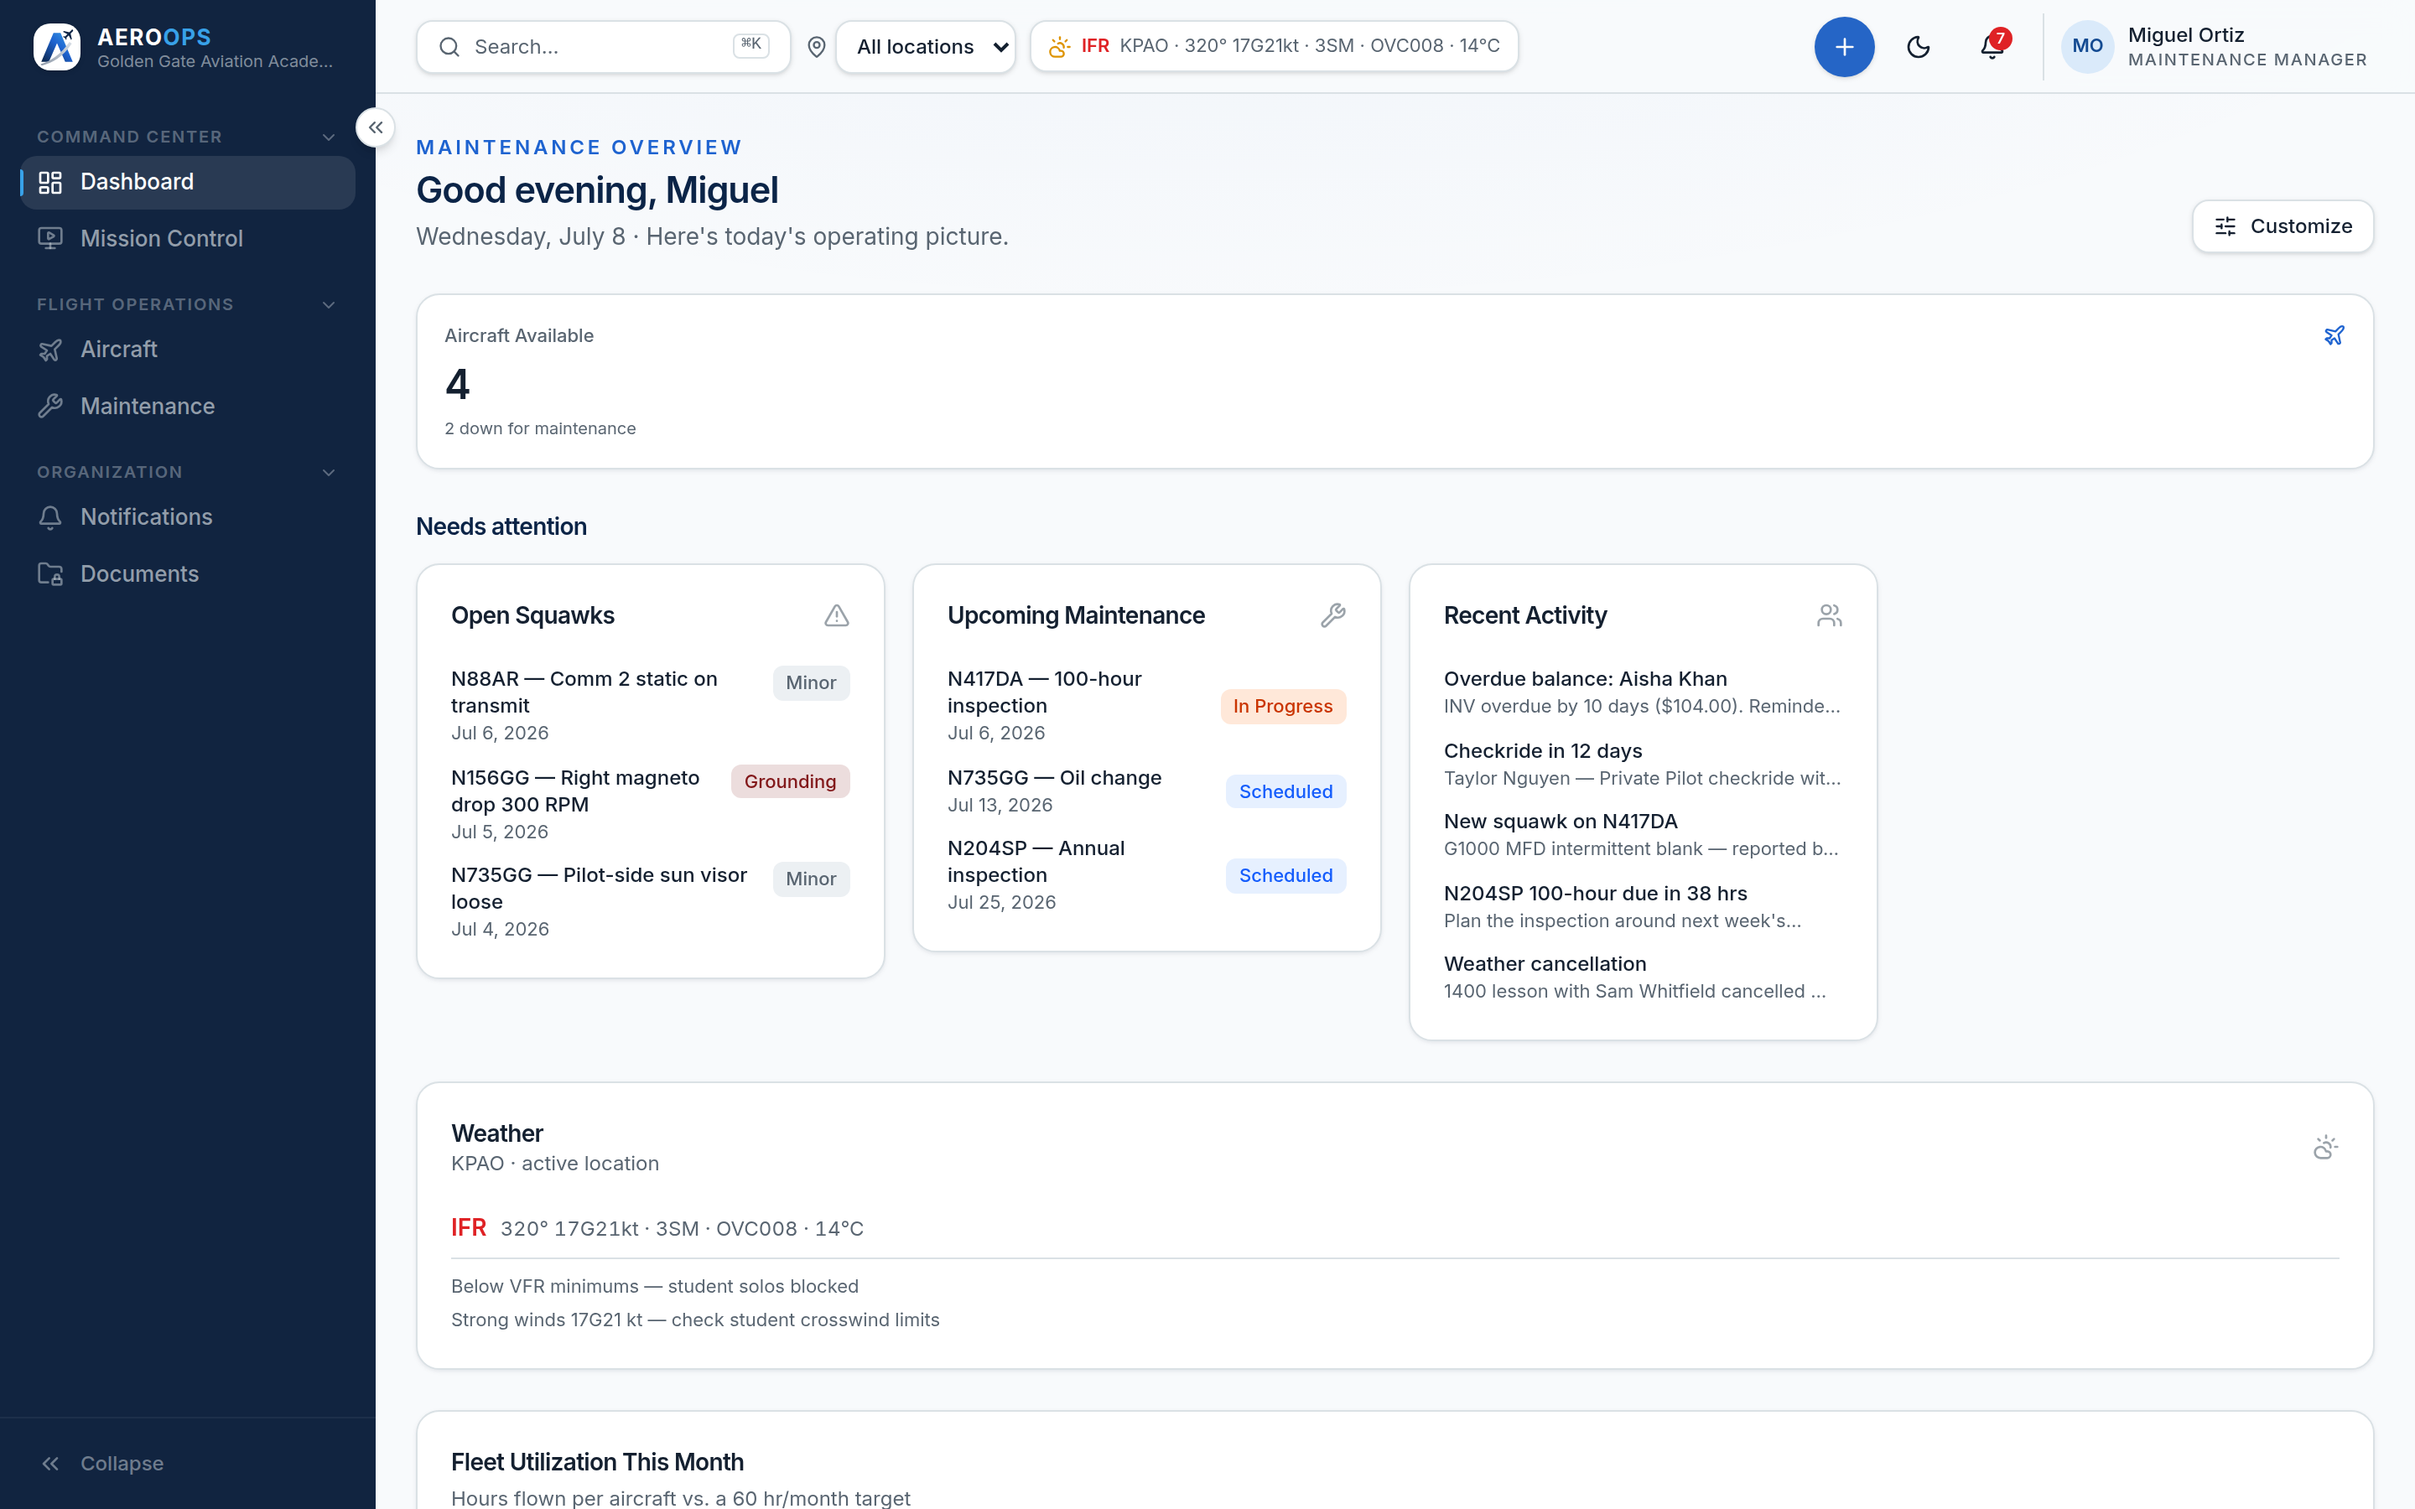
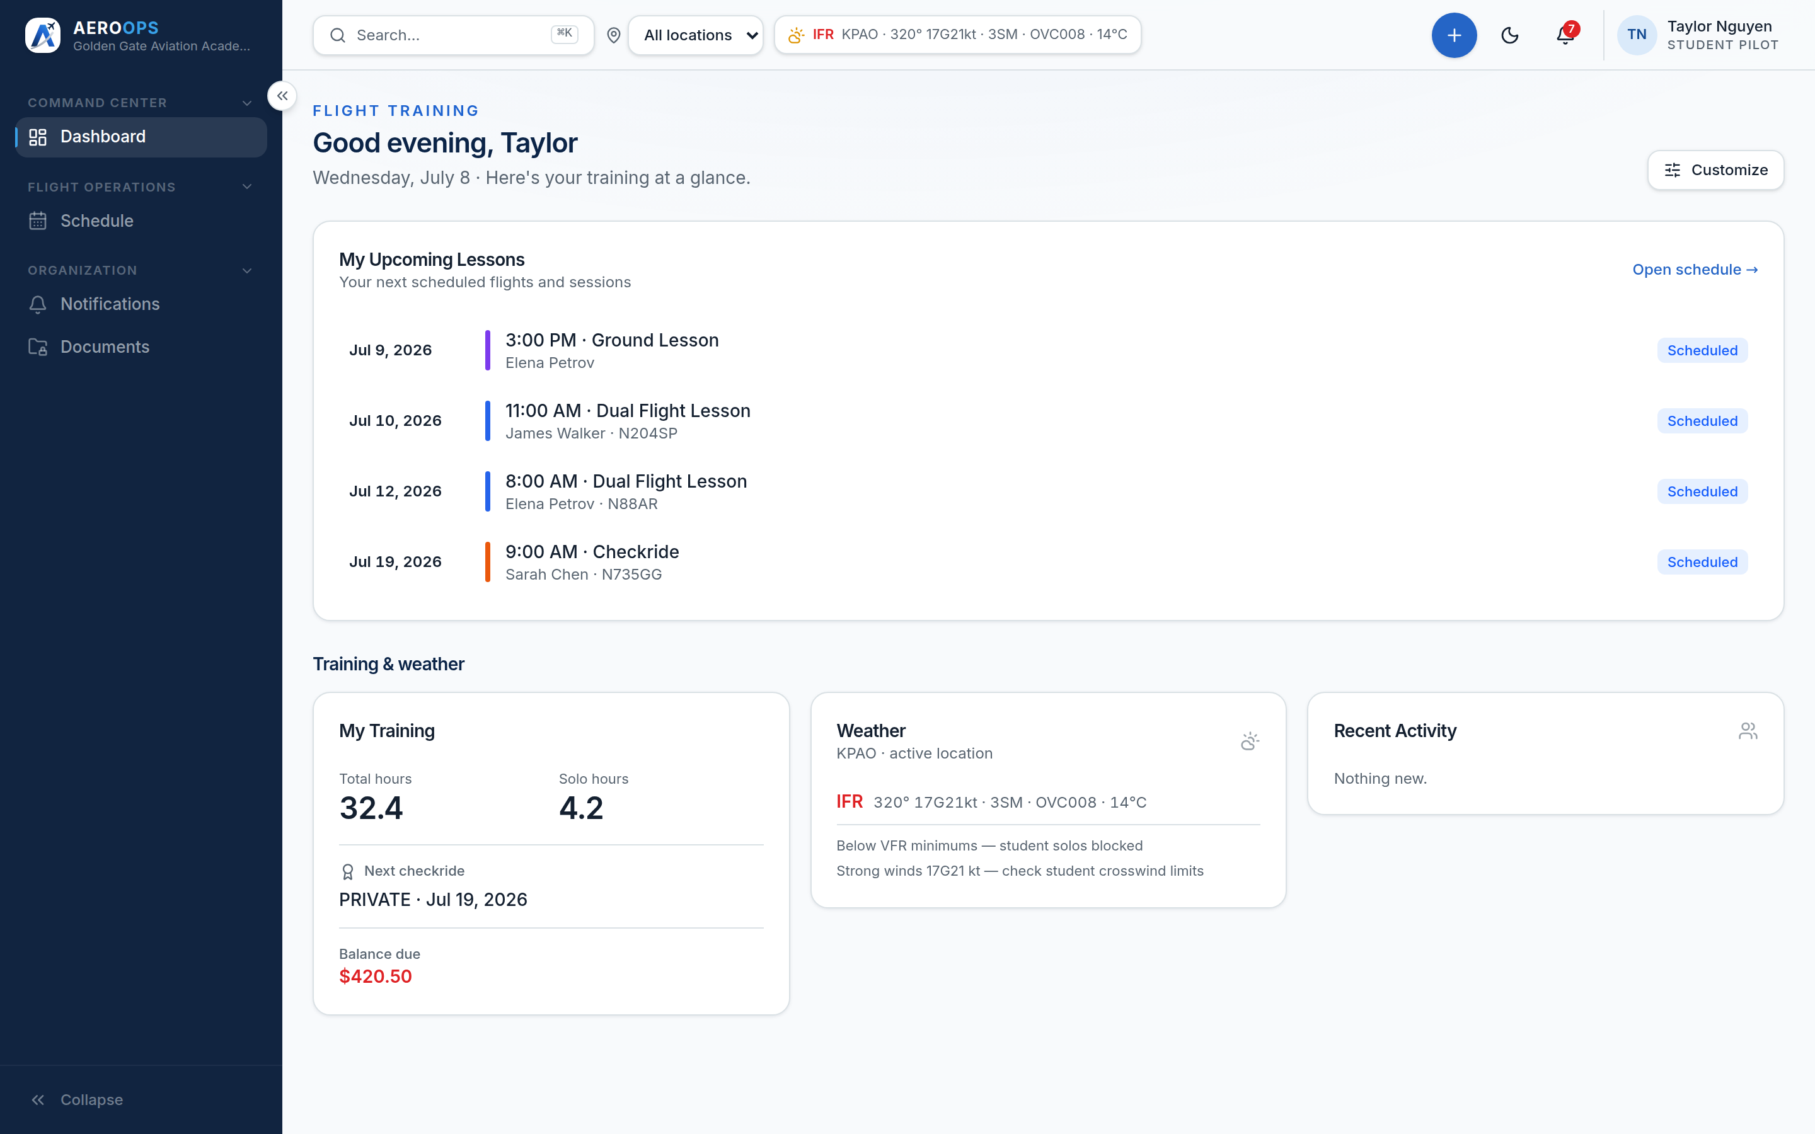
ROLE-BASED EXPERIENCE
One product. Every seat.
Personalized by permission — never hardcoded by title. No one sees data their role shouldn't.
Account Owner
Operations Director
Chief / Flight Instructor
Flight Dispatcher
Maintenance Manager
Student Pilot
AEROOPS

Slide 16
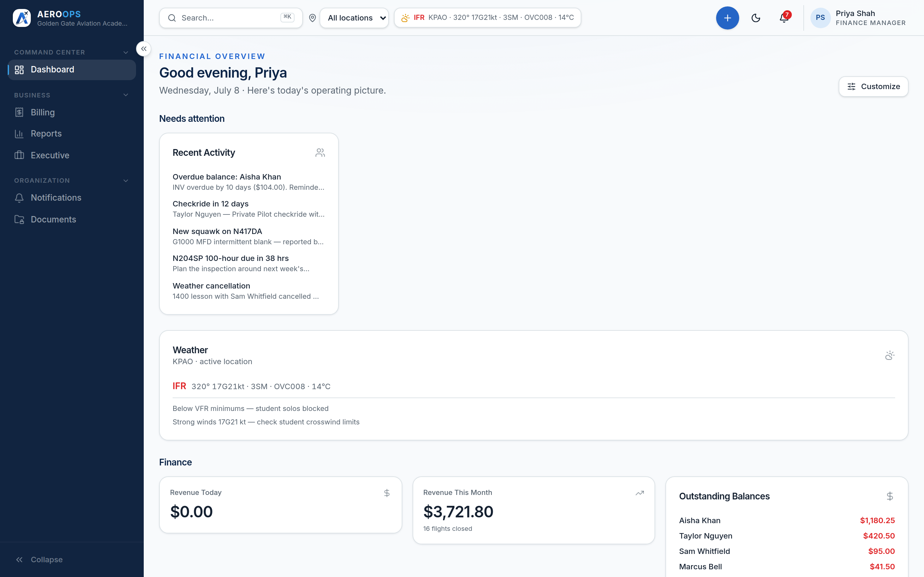
CUSTOMIZATION
Fits your operation
Configure the product to the operation without a consultant.
Toggle dashboard widgets per user.
Role-driven navigation and custom-role templates (Registrar, Front Office, Safety Officer…).
School branding, time zone, and multiple locations.
AEROOPS

Slide 17
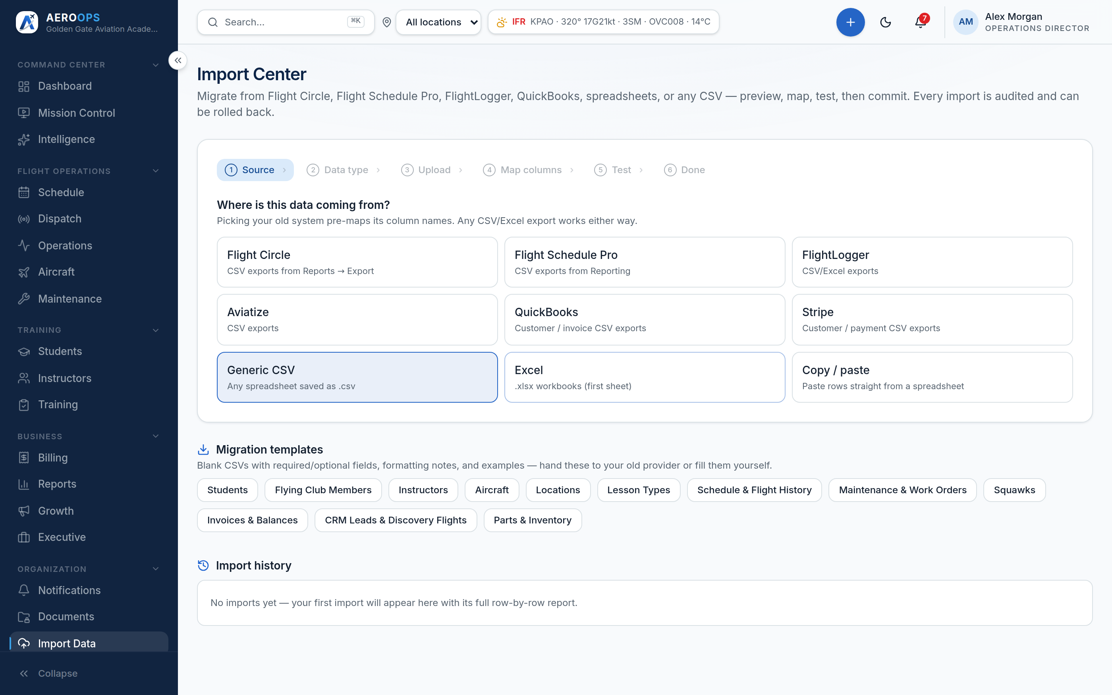
MIGRATION
Bring your data. Roll it back.
The Import Center is why switching isn't scary.
Presets for Flight Circle, Flight Schedule Pro, FlightLogger, QuickBooks.
Map → test (a real, rolled-back run) → commit → rollback manifest.
Public API v1 and signed webhooks for what comes next.
AEROOPS

Slide 18
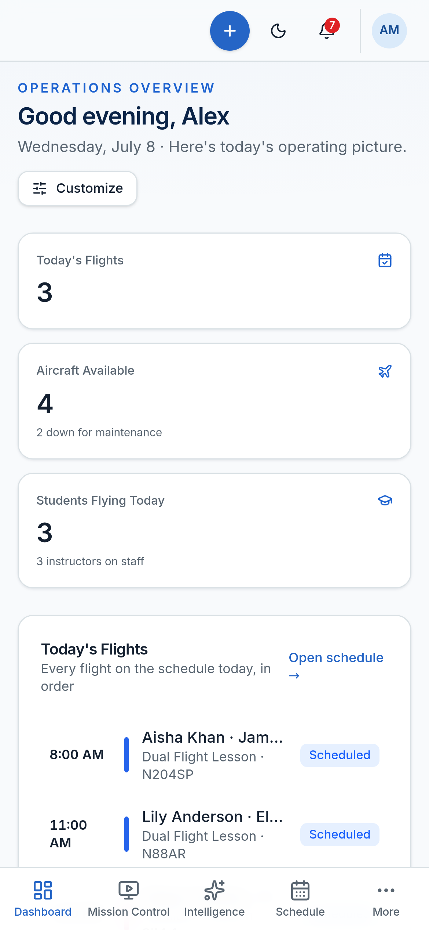
MOBILE
The operation in your pocket
A responsive, installable app — for the ramp, the desk, and the couch.
Installable PWA: add to home screen, works on phone and tablet.
Bottom navigation and full light/dark parity.
Every role's view, sized for the device.
Installable PWA today; native app-store wrappers are on the roadmap.
AEROOPS

Slide 19
WHY SCHOOLS CHOOSE AEROOPS
Adopt it in an afternoon
Built for the owner who is also the operations department.
One place
Billing by itself
Know tonight
No overhead
No re-entering a flight into three systems.
Invoices happen at closeout, automatically.
What today made, before you go home.
No manual, no consultant, no back office.
AEROOPS

Slide 20
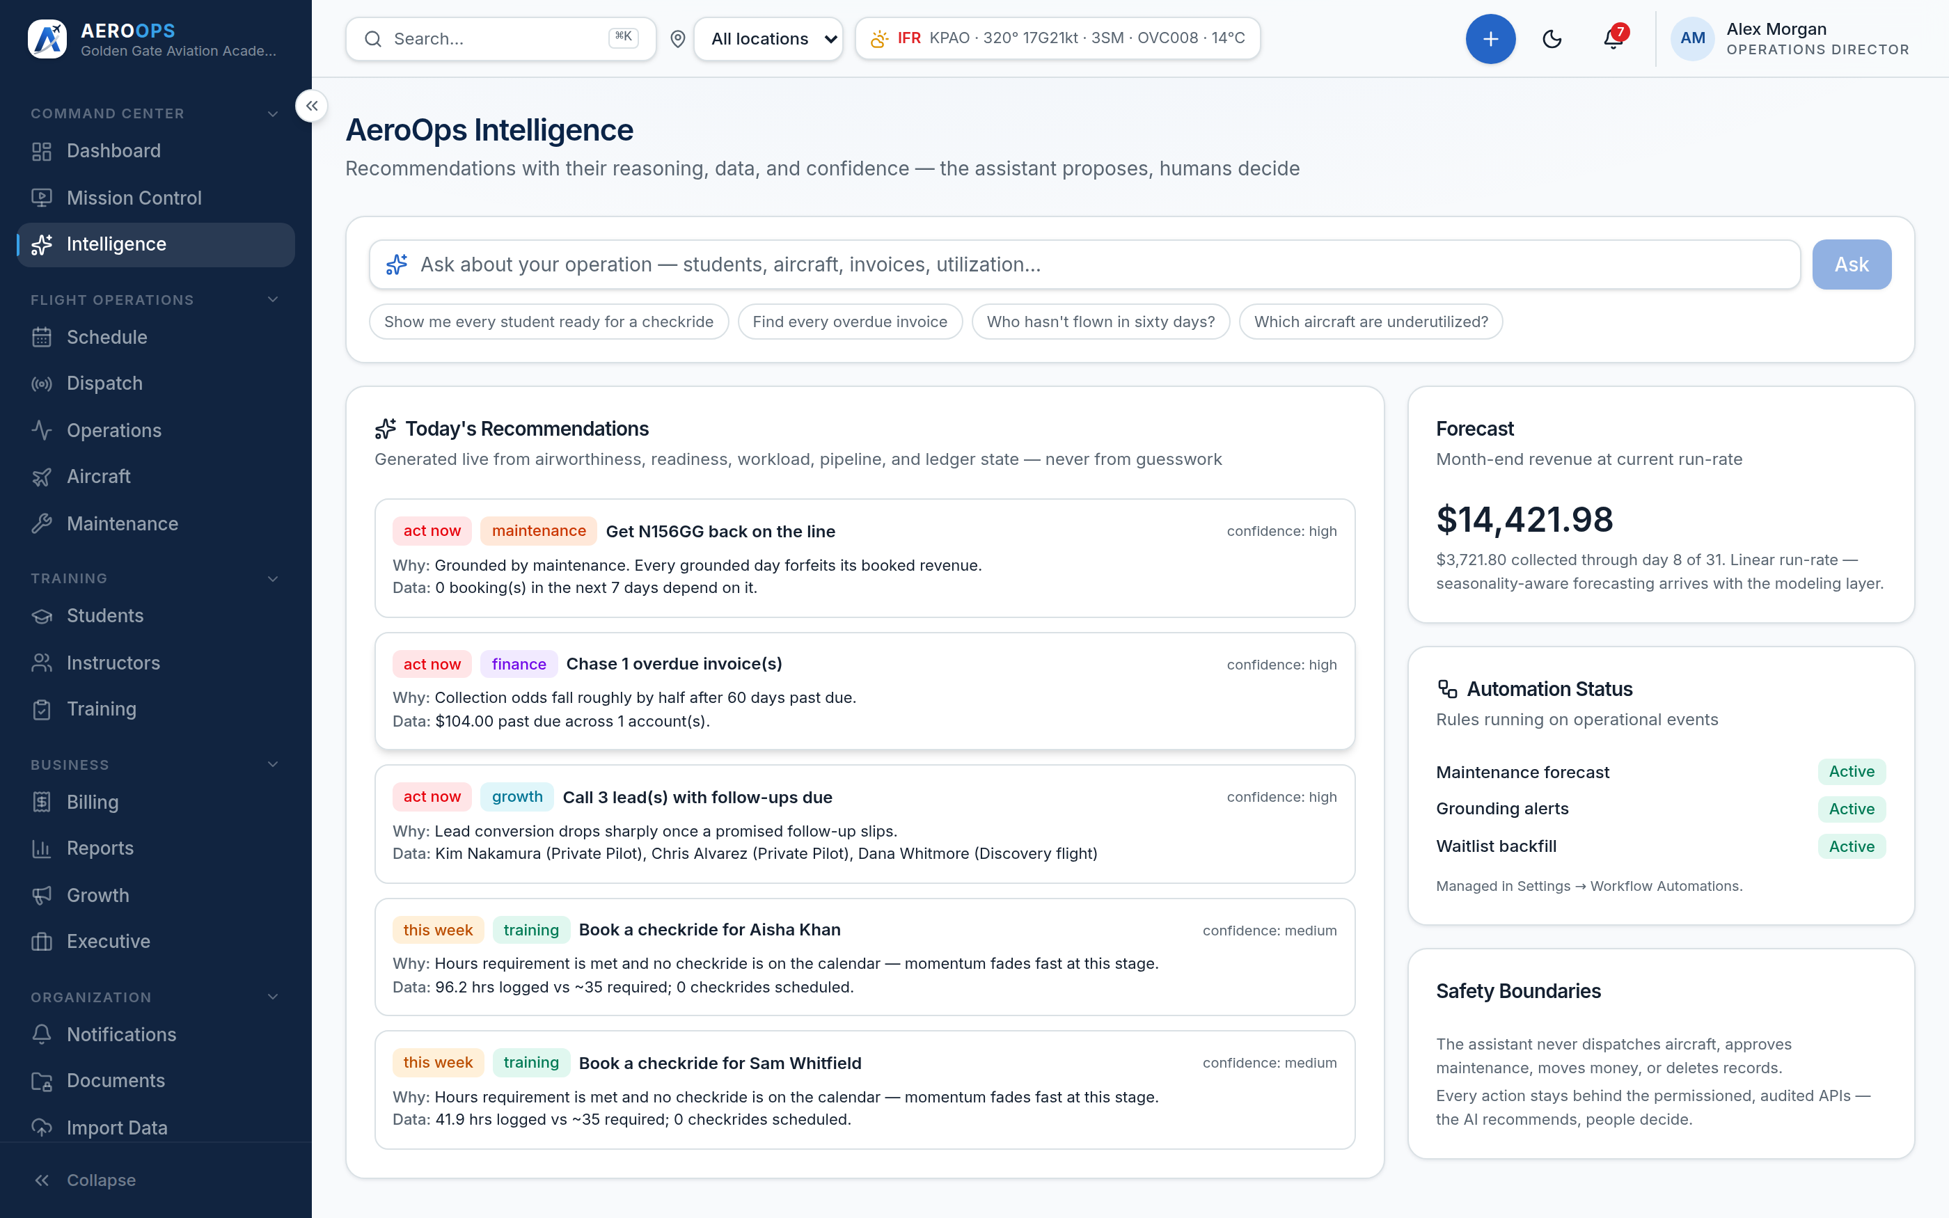
PROOF & TRUST
Explainable by construction
Trust is the product.
Every conflict, readiness score, and insight shows its reasons.
The audit trail is immutable — never rewritten, never skipped.
AI advises; it never acts. Mutations require a permissioned human.
Multi-tenant isolation enforced from the session, never the client.
AEROOPS

Slide 21
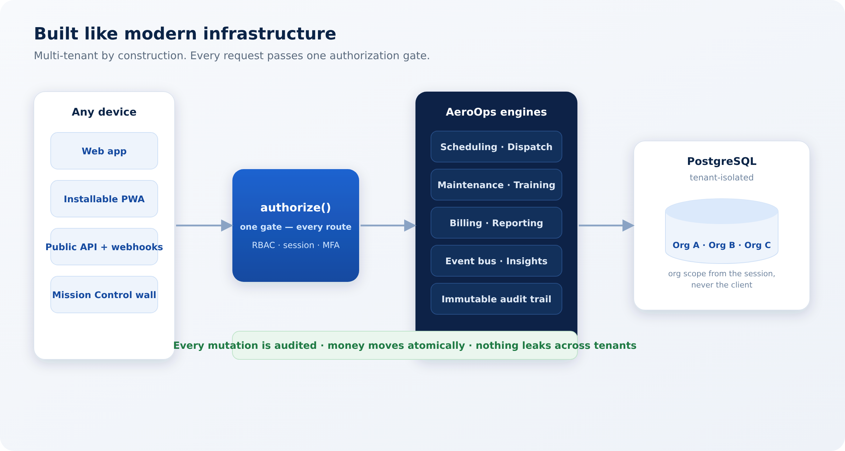
SECURITY & ARCHITECTURE
Enterprise-grade underneath
Multi-tenant by construction, one authorization gate, an immutable audit trail, and an atomic money path.
AEROOPS

Slide 22
ROADMAP — CLEARLY FUTURE
The seams are already built
We're plugging adapters into existing seams. Everything here is roadmap.
ROADMAP
Delivery Email & SMS notifications, web push.
ROADMAP
Payments Stripe subscriptions and card-on-invoice.
ROADMAP
Live weather Real METAR/TAF (simulated today).
ROADMAP
Documents Cloud file storage with signed URLs.
ROADMAP
Operational intelligence Airworthiness forecasting, currency guards, live AI narration.
AEROOPS

Slide 23
PRICING PHILOSOPHY
Priced for the operation you are
Modern SaaS economics — no consultant, no hostage fees.
Transparent
Self-serve
Grows with you
Per-aircraft / per-seat, published — not negotiated in the dark.
Onboard in an afternoon; a real import path out of any competitor.
Scale shouldn't punish you — pricing grows with the operation.
Transparent pricing — contact us.
AEROOPS

Slide 24
Run the operation, not the paperwork.
See your school on AeroOps.
Request a demo · aerops.io

