Slide 1
BU Class Scheduler
Save your tears on registration day, you’ll need them when the semester starts!
by Noah Cherry, Rishav De, Pranet Sharma, Aya Kasseem

Slide 2
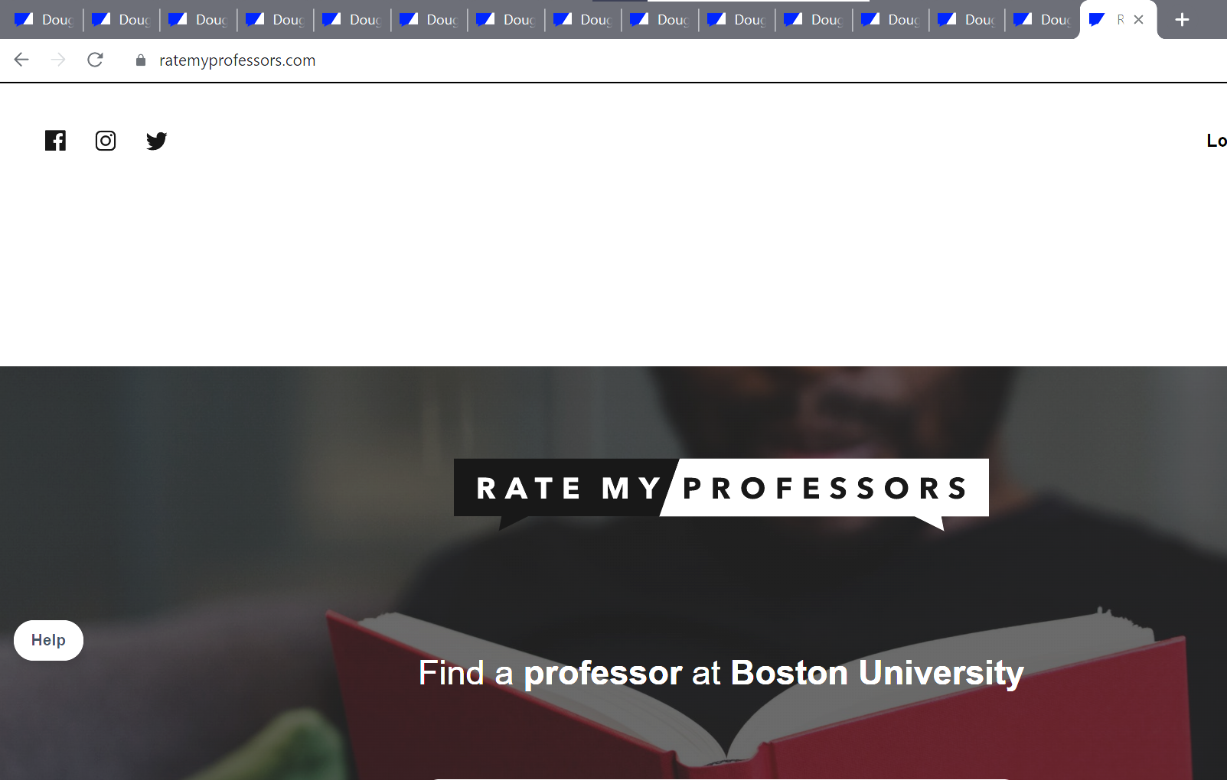
PURPOSE
What is the goal of the BU Class Scheduler?
Using an integrated web scraper and API, the scheduler takes a list of classes as input from the user and using a custom algorithm builds them a possible schedule for the selected semester with the highest average professor rating and no time conflicts
Students often spend hours comparing dozens of rate my professor pages with the classes offered by BU to create the optimal schedule. By using the class scheduler, students can expedite the process from hours to seconds.

Slide 3

Rate My Professor API

Slide 4
Getting Professor Information
API
Creates an API object using the RMP school id
Uses Pre existing repository for API call
API call returns dictionary of attributes
Professor name, rating, ID, Department, etc
Integrated Methods
Search Professors by last name
Get average professor rating based on last name
Output average professor ratings in a CSV file

Slide 5
Getting Professor By Last Name
Getting Professor ID
Iterates through dictionary of professors to find professor with input name
If multiple professors with the same name are found program prompts user for professors departments
Returns the professor ID
Getting Professors Average Rating
Accesses the entry with the ID returned by searchProfessor and returns the overallRating attribure
5

Slide 6
School ID and Professor ID from URL
School ID
Professor ID
6

Slide 7
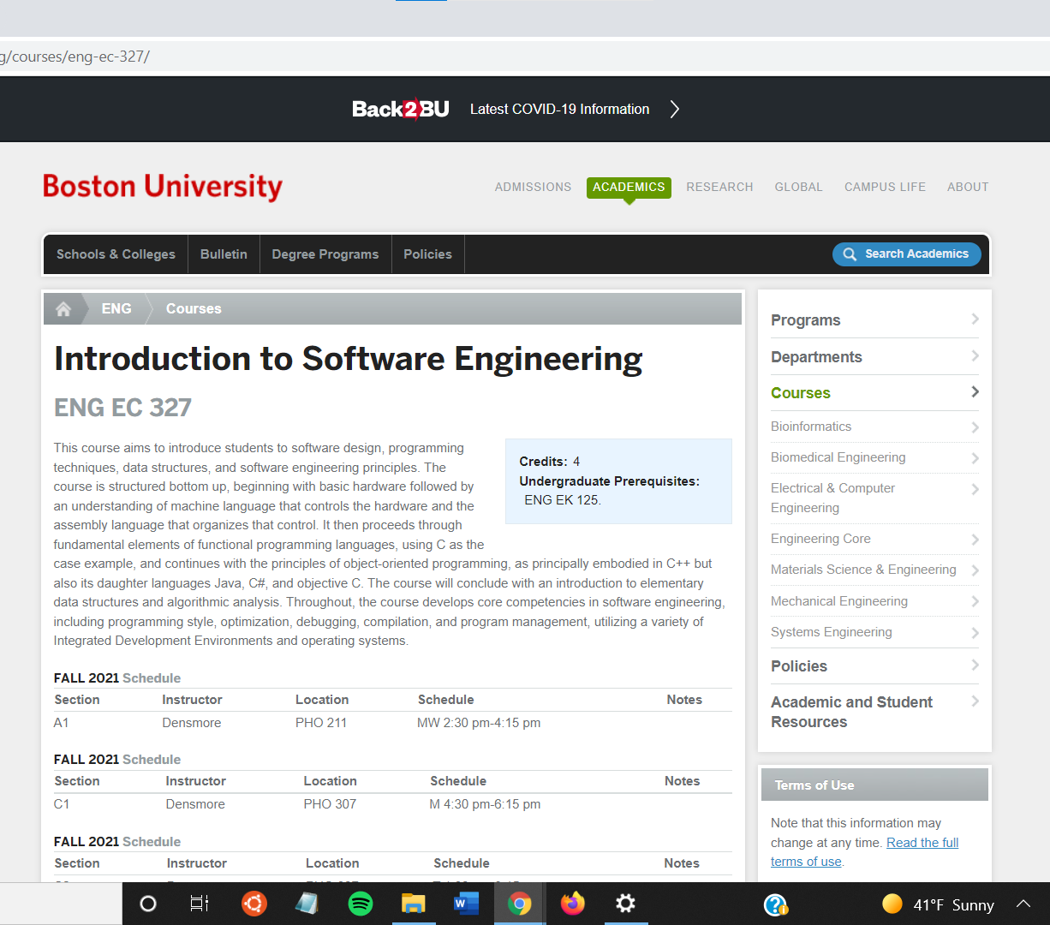
BU Course Website Web Scraper

Slide 8
Obtaining User Input and URL Generation
User Input
Obtains User input through the console in the form of the Class Code
URL Generation
Based on the inputted class code the URL for the website is generated
The BU course URLs follow a simple pattern which makes it possible to generate the URL with just the class code

Slide 9

How the URL Generation Works
College Name
Course Code
9

Slide 10
Scrubbing of Data and File Output
Data Scrubbing
The Data scraped is stored in the form of Dataframes
The Dataframes are indexed into and the required information is stored in the required list.
File Output
The information is then written to a csv file using a csv.writer() function.
The format for the output file was determined based on the requirements of the algorithm

Slide 11
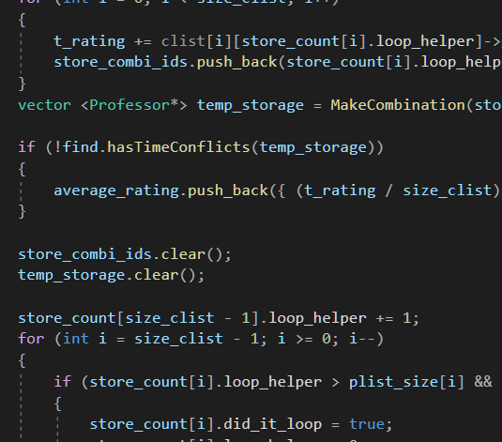
The
Algorithm Process

Slide 12
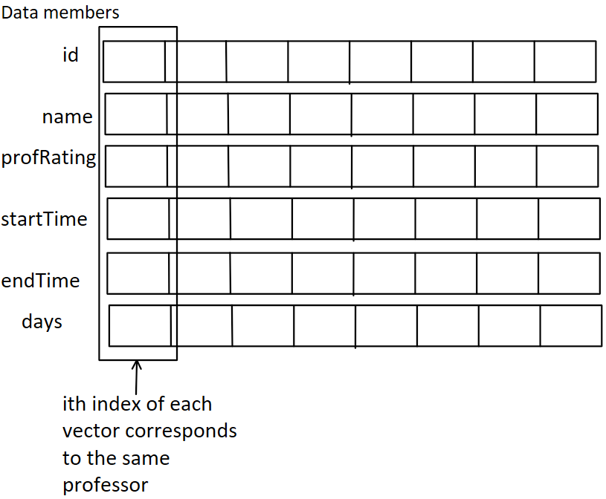
Reading from the .csv file
Done through the FileIn class whose data members are vectors of equal lengths representing the course ID, name, rating, timings, and days of classes of professors.
The class has a ReadFromFile function that will read from a .csv file (given its name) into the data members of the FileIn class.

Slide 13
Finding time conflicts
Time conflicts are detected using a hasTimeConflicts() function that takes a vector of pointers to professors as arguments and checks whether or not the professors’ classes have time conflicts.
The function calls a getSameDay() function that will return a vector where each element is a vector of pointers to professors teaching on the same day.
Those vectors are then checked individually for time conflicts by checking if any class starts after and ends before another class happening on the same day.

Slide 14
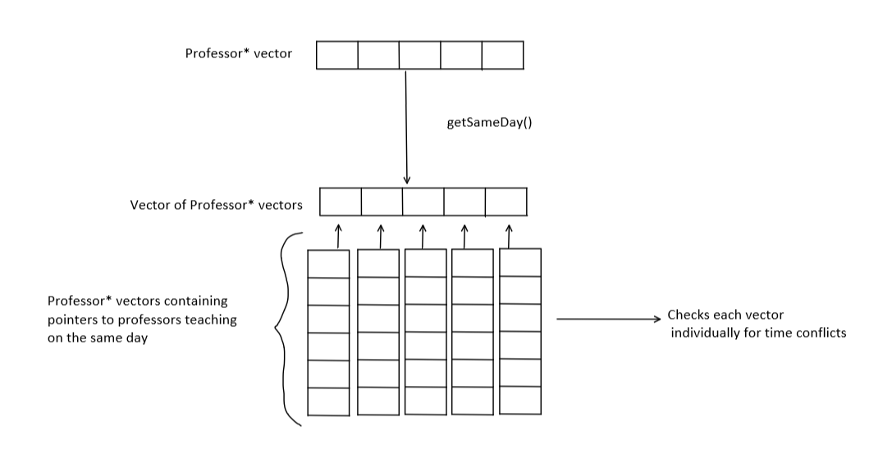
How the hasTimeConflicts function works
14

Slide 15
Creating the data structure for the Algorithm
The code uses the vectors returned from the FileIn class to create the data structure, which is a vector of vector of Professor pointers.
It uses the addNode() function of the Professor class to create a vector of Professors who teach the same course and then puts these vectors into each index of a vector of vectors for each class to make the structure.
The format of the data structure is explained in the next slide.

Slide 16
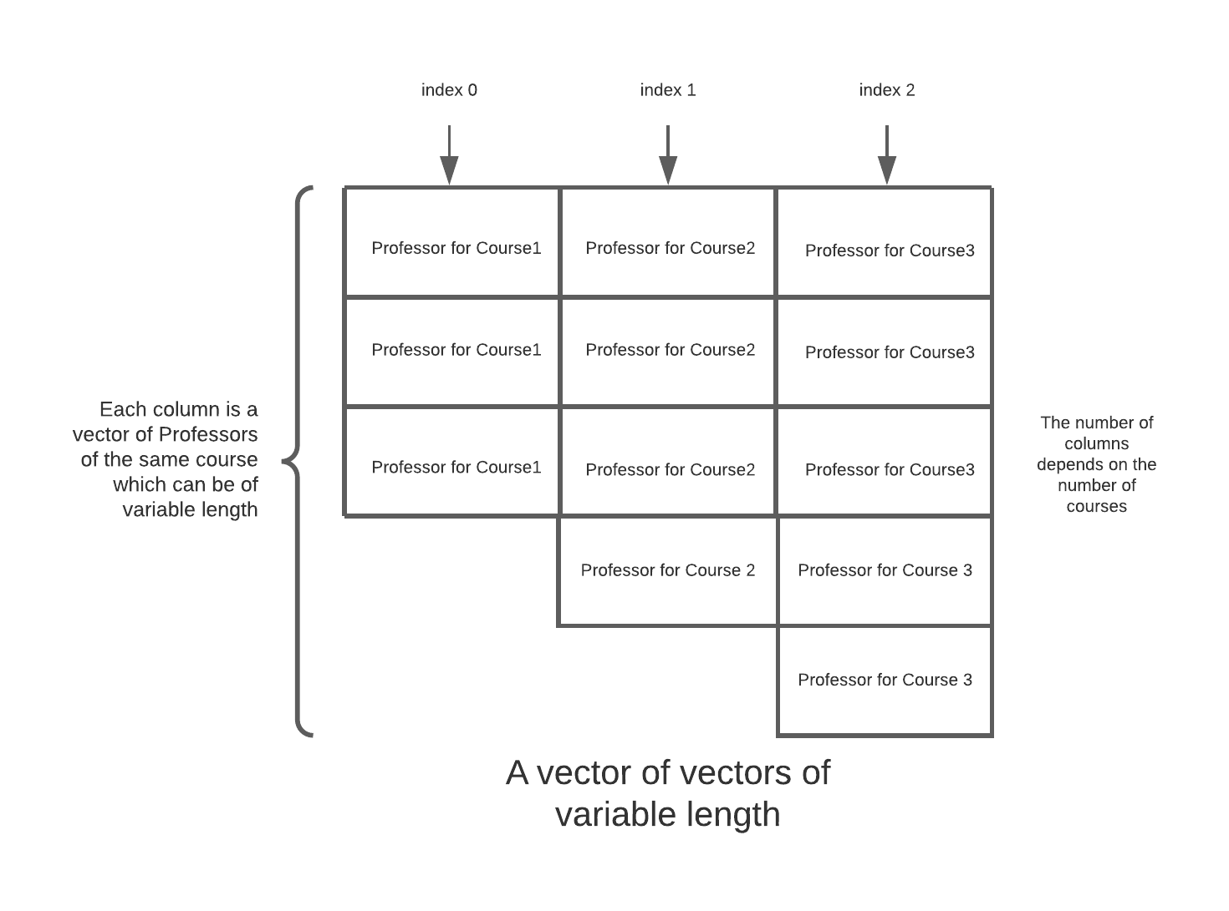
Final data structure

Slide 17
Using data structure to find best case schedule
The Course class uses the CalcAverages() function and returns a vector of structs, where the structs contain a vector of Professors and their average rating. The vector of Professors in the struct contains one Professor from each course.
Using in built sorting algorithms for the vectors, we can find which struct in the vector of structs has the highest average rating.
The CalcAverage() function also checks for time conflicts using the hasTimeConflicts() function.

Slide 18
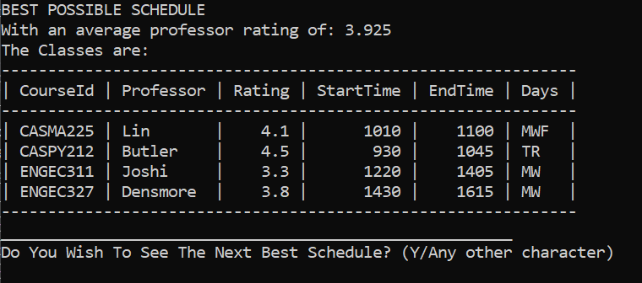
Displaying the output in console GUI
Using VariadicTable.h by friedmud on GitHub, we can display the output in form of a table.

Slide 19
END

