Slide 1

Nmap & Metasploit in Ethical Hacking
Presented by: Noah Grennan

Slide 2
Career Aspiration
I aspire to become an ethical hacker to help protect systems and networks from malicious attacks. Ethical hacking involves legally breaking into computers and devices to test an organization's defenses.
• It helps organizations improve their security by identifying vulnerabilities before malicious hackers can exploit them. (White-Hat)

Slide 3
Presentation Overview
This presentation discusses two essential tools that ethical hackers would use: Nmap and Metasploit
Discussing the tools in debth
Demo at the end on both tools

Slide 4
Using both Nmap and Metasploit
• Reconnaissance – Gathering information about the target.
• Scanning – Discovering open ports and services.
• Gaining Access – Exploiting vulnerabilities.
• Maintaining Access – Ensuring continued access.
• Covering Tracks – Hiding evidence of the hack.

Slide 5
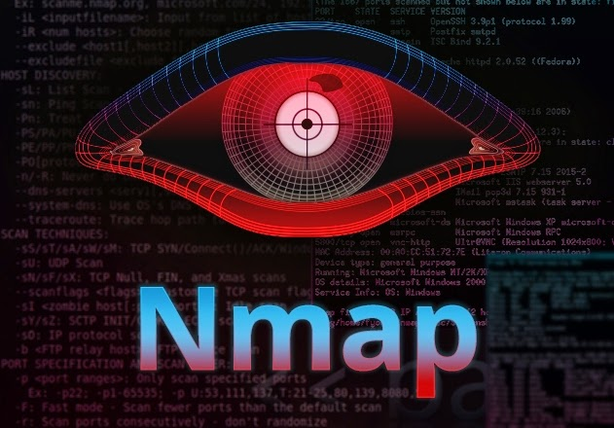
Nmap Overview
Nmap (Network Mapper) is a free and open-source tool used for network discovery and security auditing. It's essential during the reconnaissance and scanning phases.

Slide 6
Nmap Key Features
• Host discovery
• Port scanning
• OS detection
• Service version detection

Slide 7
Nmap Key Commands
Syntax is: sudo nmap –O [target IP-address}
Sudo for root privliages
-O for Opartating system detection
Other Examples
Nmap –sP [target} ←prefoms a ping only scan
Nmap –sS [target] ← spoofs ip; untraceable
Nmap -6 [target] ← scan Ipv6 target

Slide 8
Nmap Real-World Usage
Nmap is considered one of the most valuable tools in a cybersecurity professional’s toolkit for initial scanning and reconnaissance. [Source: Simplilearn]
Using Nmap to find open ports which could allow to find ftp, ssh, http, and https servers and more.
Zenmap is graphical version while nmap is command line based.

Slide 9
Metasploit Overview
Metasploit is a penetration testing framework used to develop and execute exploit code against a remote target. It's key during the exploitation and post-exploitation phases.
Using Mfsconsole we can search for vulnerability's and set it to the Rhost.

Slide 10
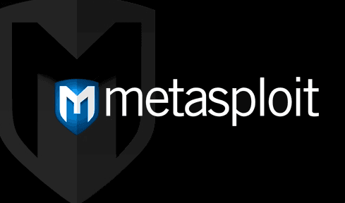
Metasploit Key Features
• Exploit modules
• Payloads
• Auxiliary modules
• Post-exploitation modules

Slide 11
Metasploit Real-World Usage
Metasploit enables ethical hackers to simulate real-world attacks and test system defenses. [Source: UpGuard]
Open Source and Actively Developed – Metasploit is preferred to other highly paid penetration testing tools because it allows accessing its source code and adding specific custom modules.

Slide 12
Nmap Demonstration
• In this demo, we'll perform a network scan using Nmap.
• We'll identify live hosts, open ports, and services.

Slide 13
Metasploit Demonstration
• In this demo, we'll use Metasploit to exploit a vulnerable machine.
• We'll show how to use an exploit and deliver a payload.
• Post-exploitation steps will also be demonstrated.

Slide 14
Combining Nmap and Metasploit
• Nmap results provide valuable data for targeting in Metasploit.
• Workflow: Scan with Nmap → Analyze results → Launch exploit in Metasploit.
• Integration increases efficiency and accuracy in penetration testing.

Slide 15
Legal and Ethical Aspects
• Ethical hacking requires proper authorization from system owners.
• Unauthorized access is illegal and punishable by law.
• Ethical hackers must follow a code of conduct and act responsibly.

Slide 16
Recap and Future Steps
• Ethical hacking is vital for cybersecurity.
• Nmap and Metasploit are powerful tools for reconnaissance and exploitation.
• Next steps: Continue learning, practice in labs, and obtain certifications like CEH.

