Slide 1
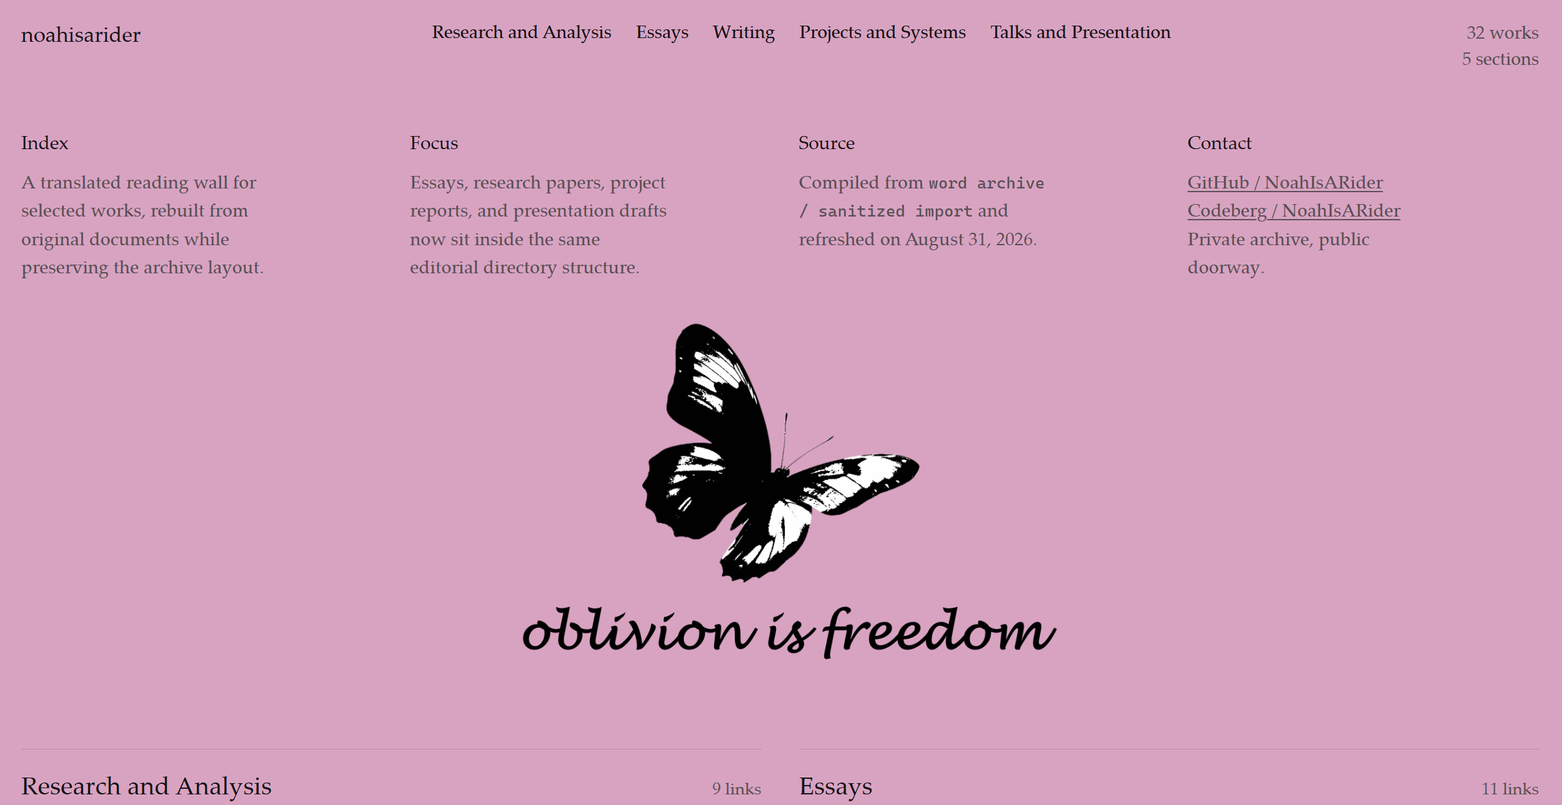
PART I 在线艺术展示
oblivion is freedom

Slide 2
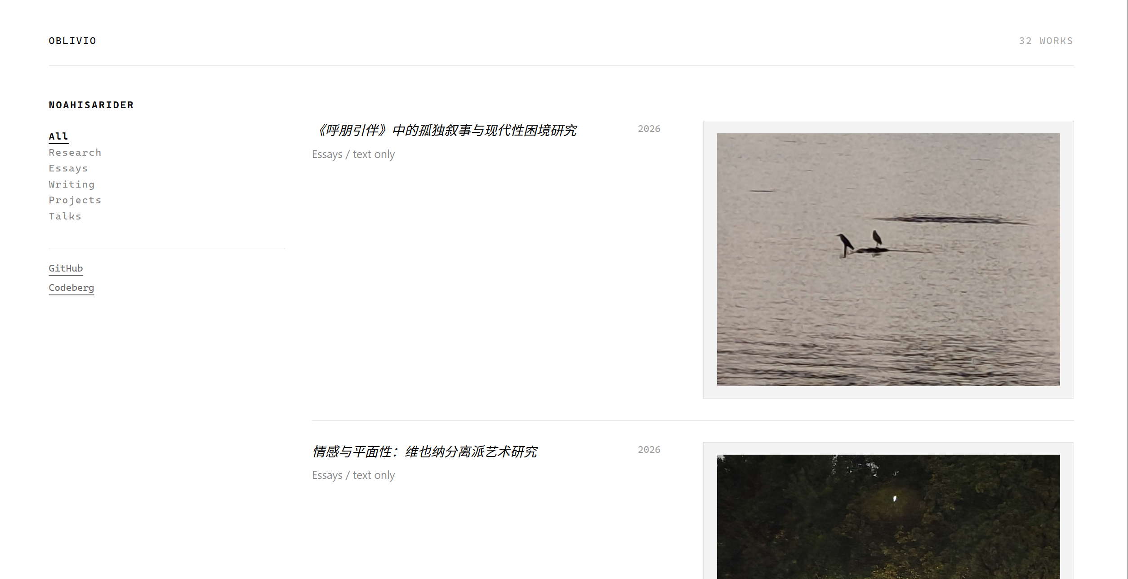
Selected Works | oblivion is freedom

Slide 3
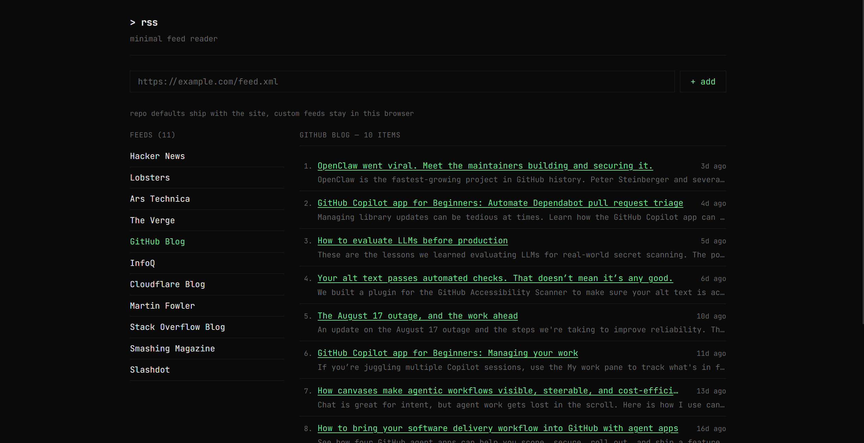
GeekRSS

Slide 4
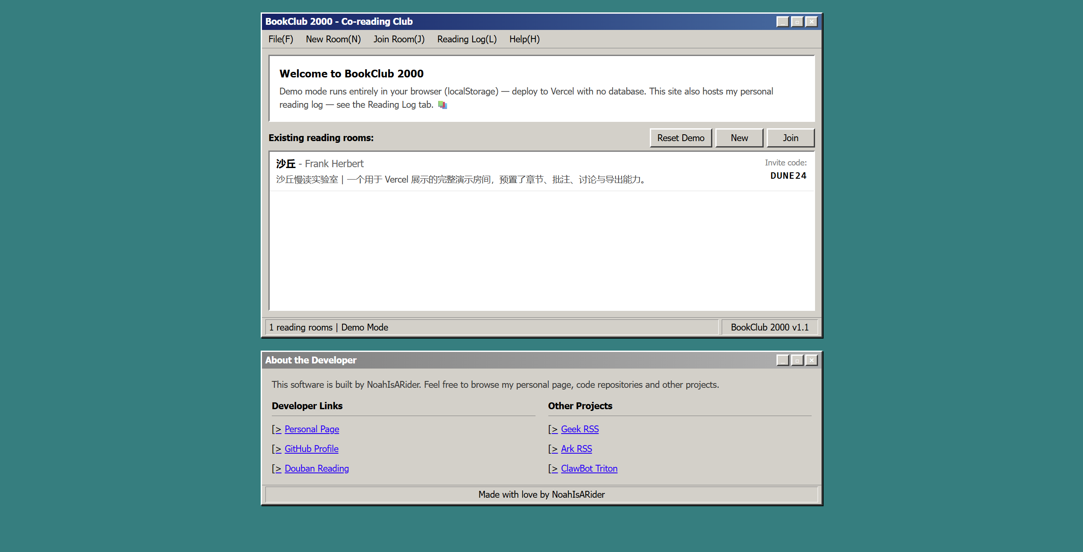
BookClub 2000 - Co-reading Club & Reading Log

Slide 5
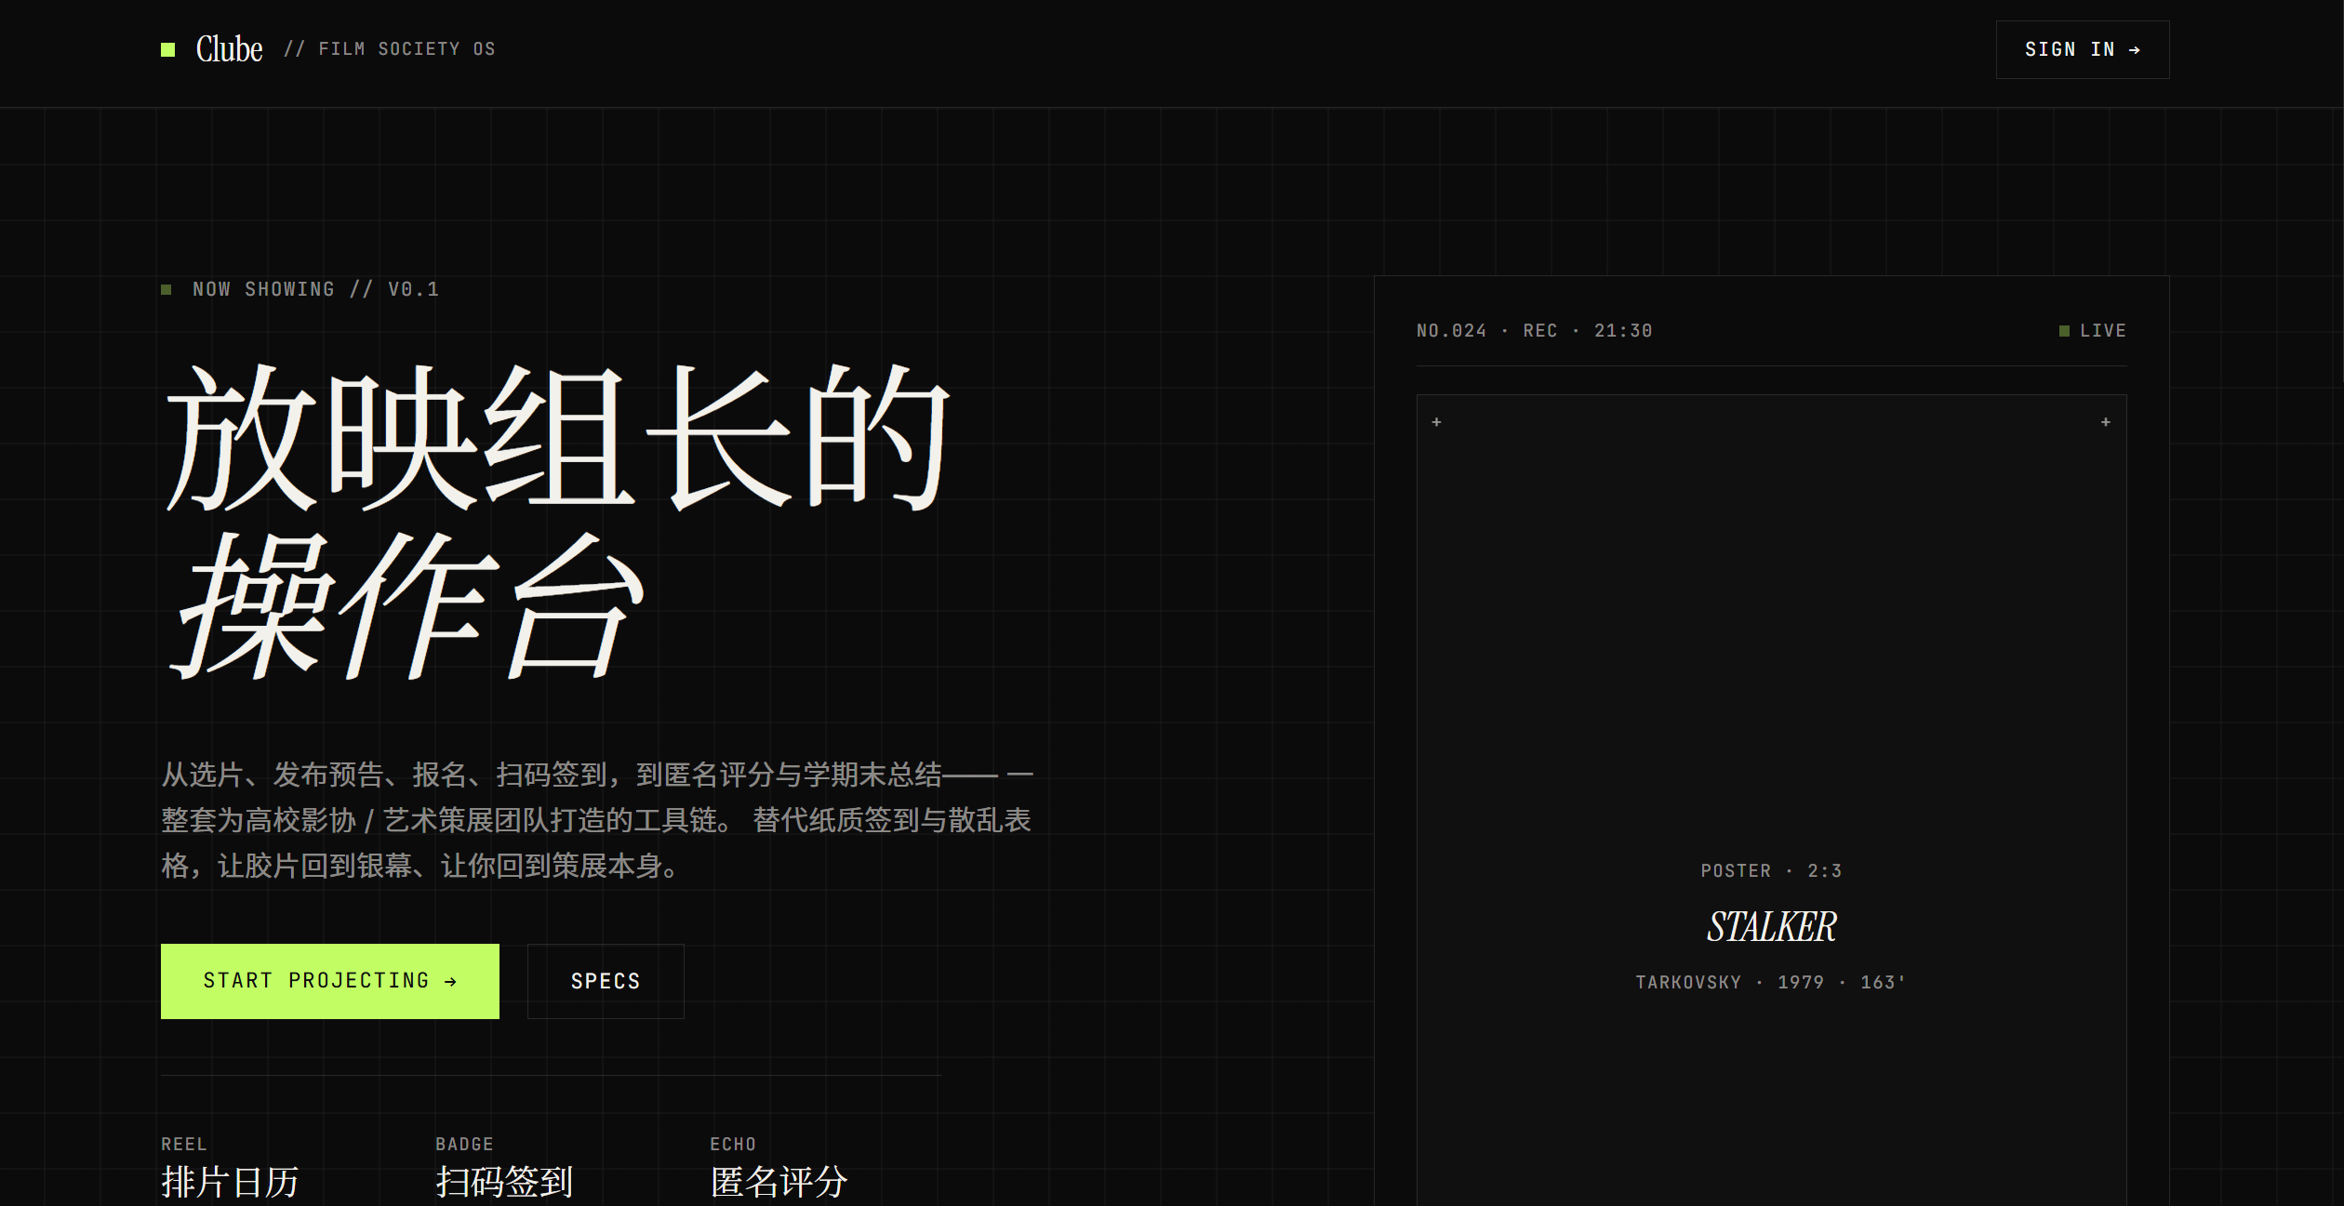
Clube · 影协放映助手

Slide 6
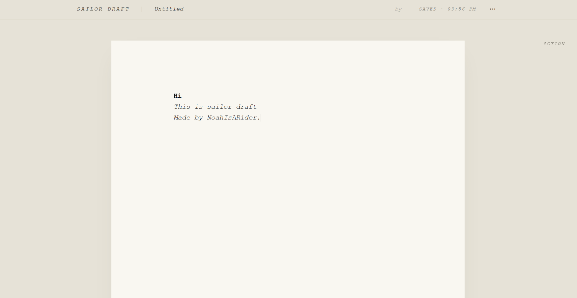
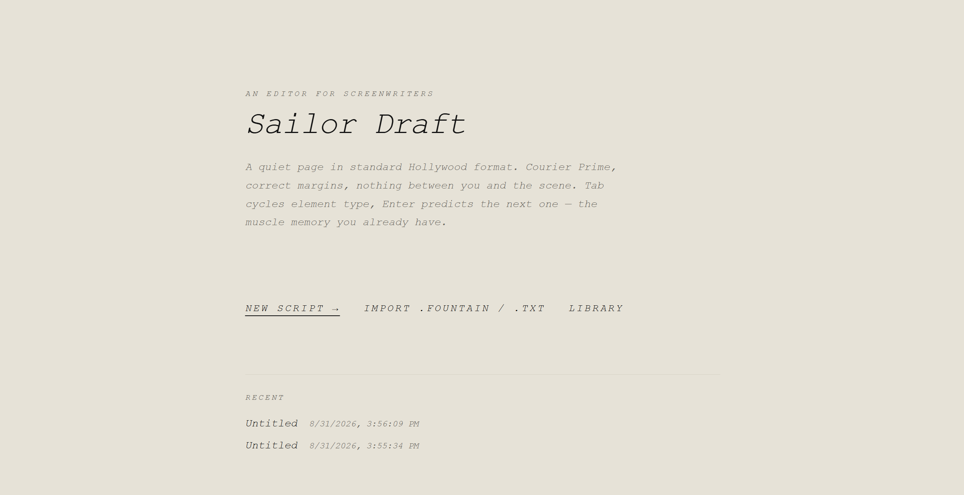
Sailor Draft — Screenwriting, unadorned

Slide 7
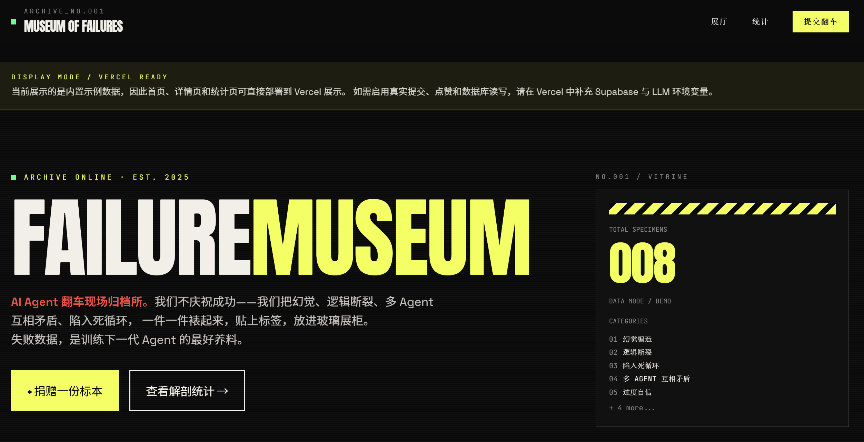
失败案例博物馆 · MUSEUM OF AI FAILURES

Slide 8
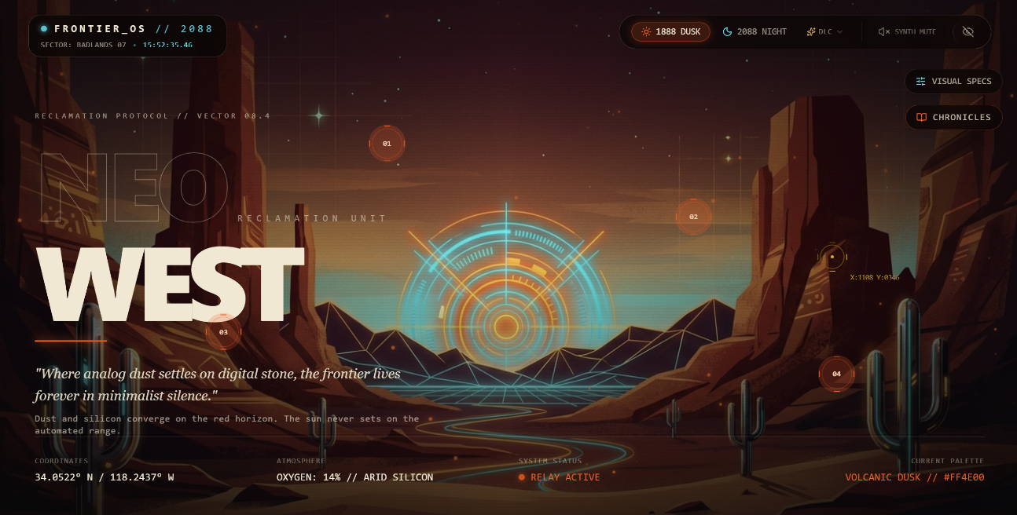
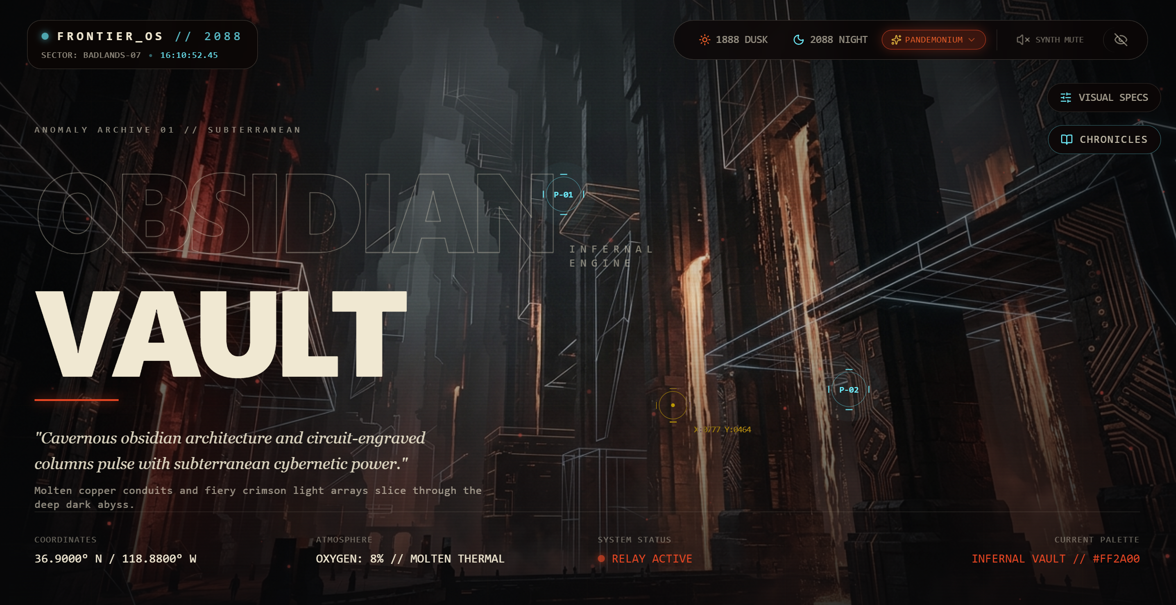
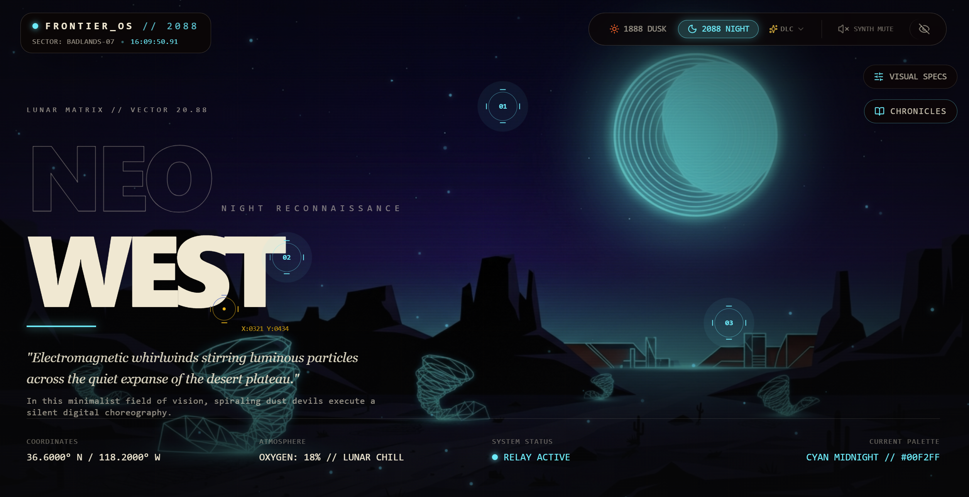
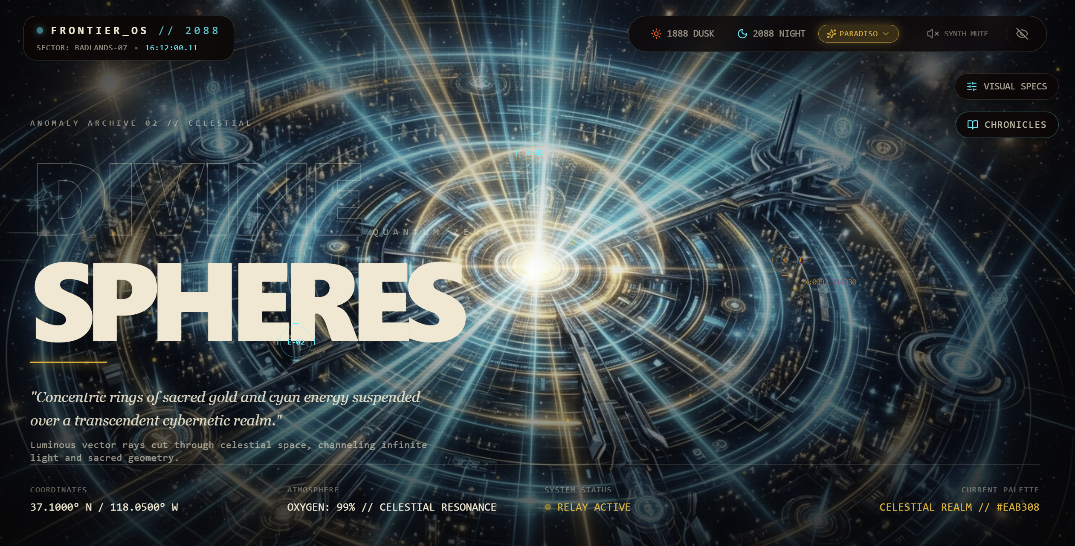
NEOWEST

Slide 9


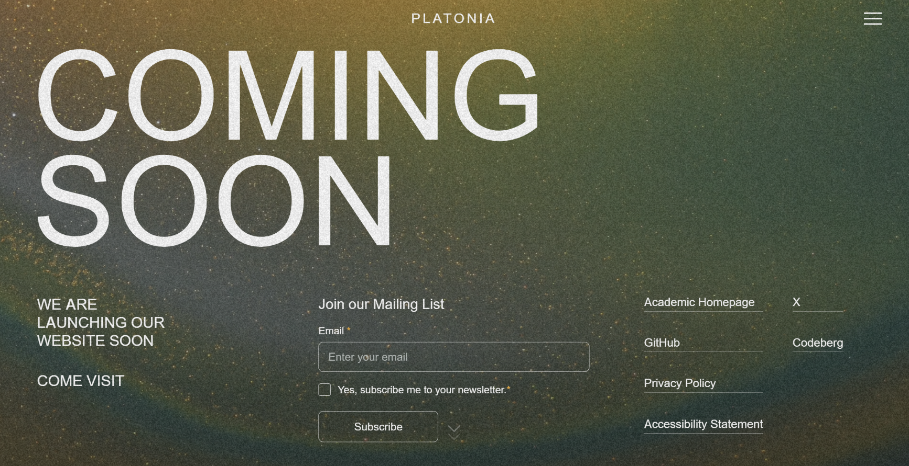

Home | platonia

Slide 10
PART II 课程作业与平面设计展示
Asynchrounous Threads Tasks
Plan-Execute Workflow
Multi Agent
Write and Execute
Python Code
Read and Analyze Documents
Use API to Monitor The Stock Market
Perform Multi-Modal Tasks Like Analyzing A Video
Power Pools
Register
Planner Agent
Execute Agent
Python Agent
Document
Agent
Stock
Agent
Multi-Modal Agent
Browser Workflow
Browser Agent
Proxy Agent
MCP
Draw A Plan
Browser Agent
Short-Term Memory
Success->Compress
Fail->Retry
Do The Plan
Long-Term
Memory

Slide 11
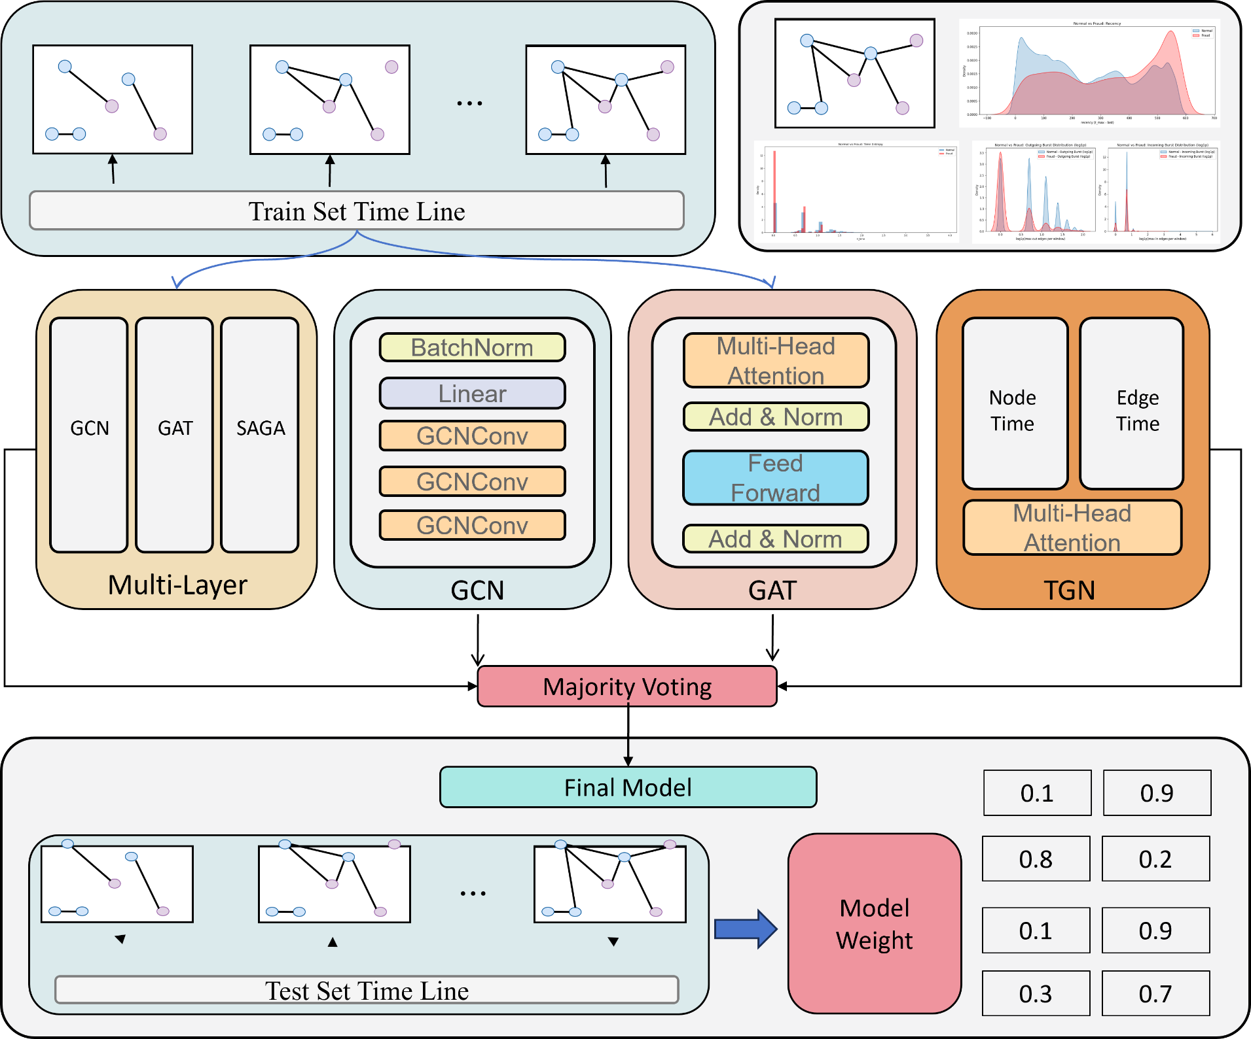

Slide 12
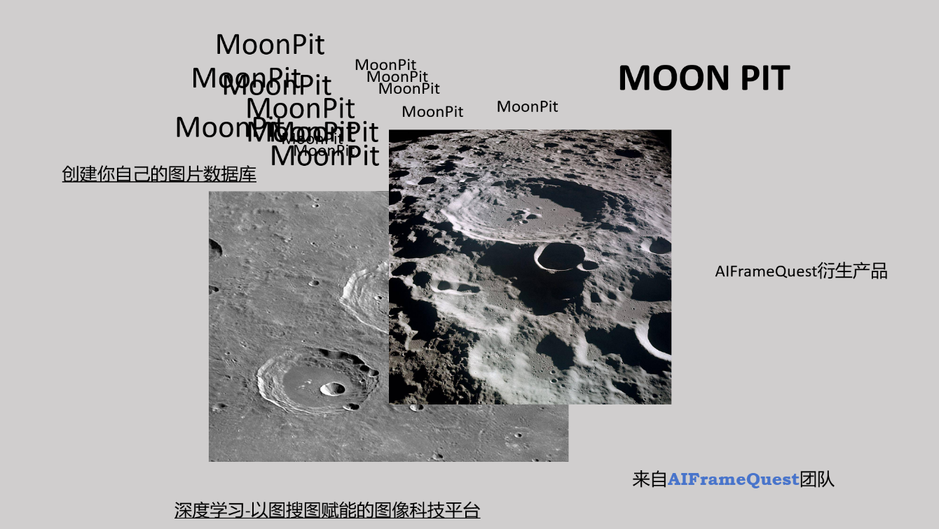
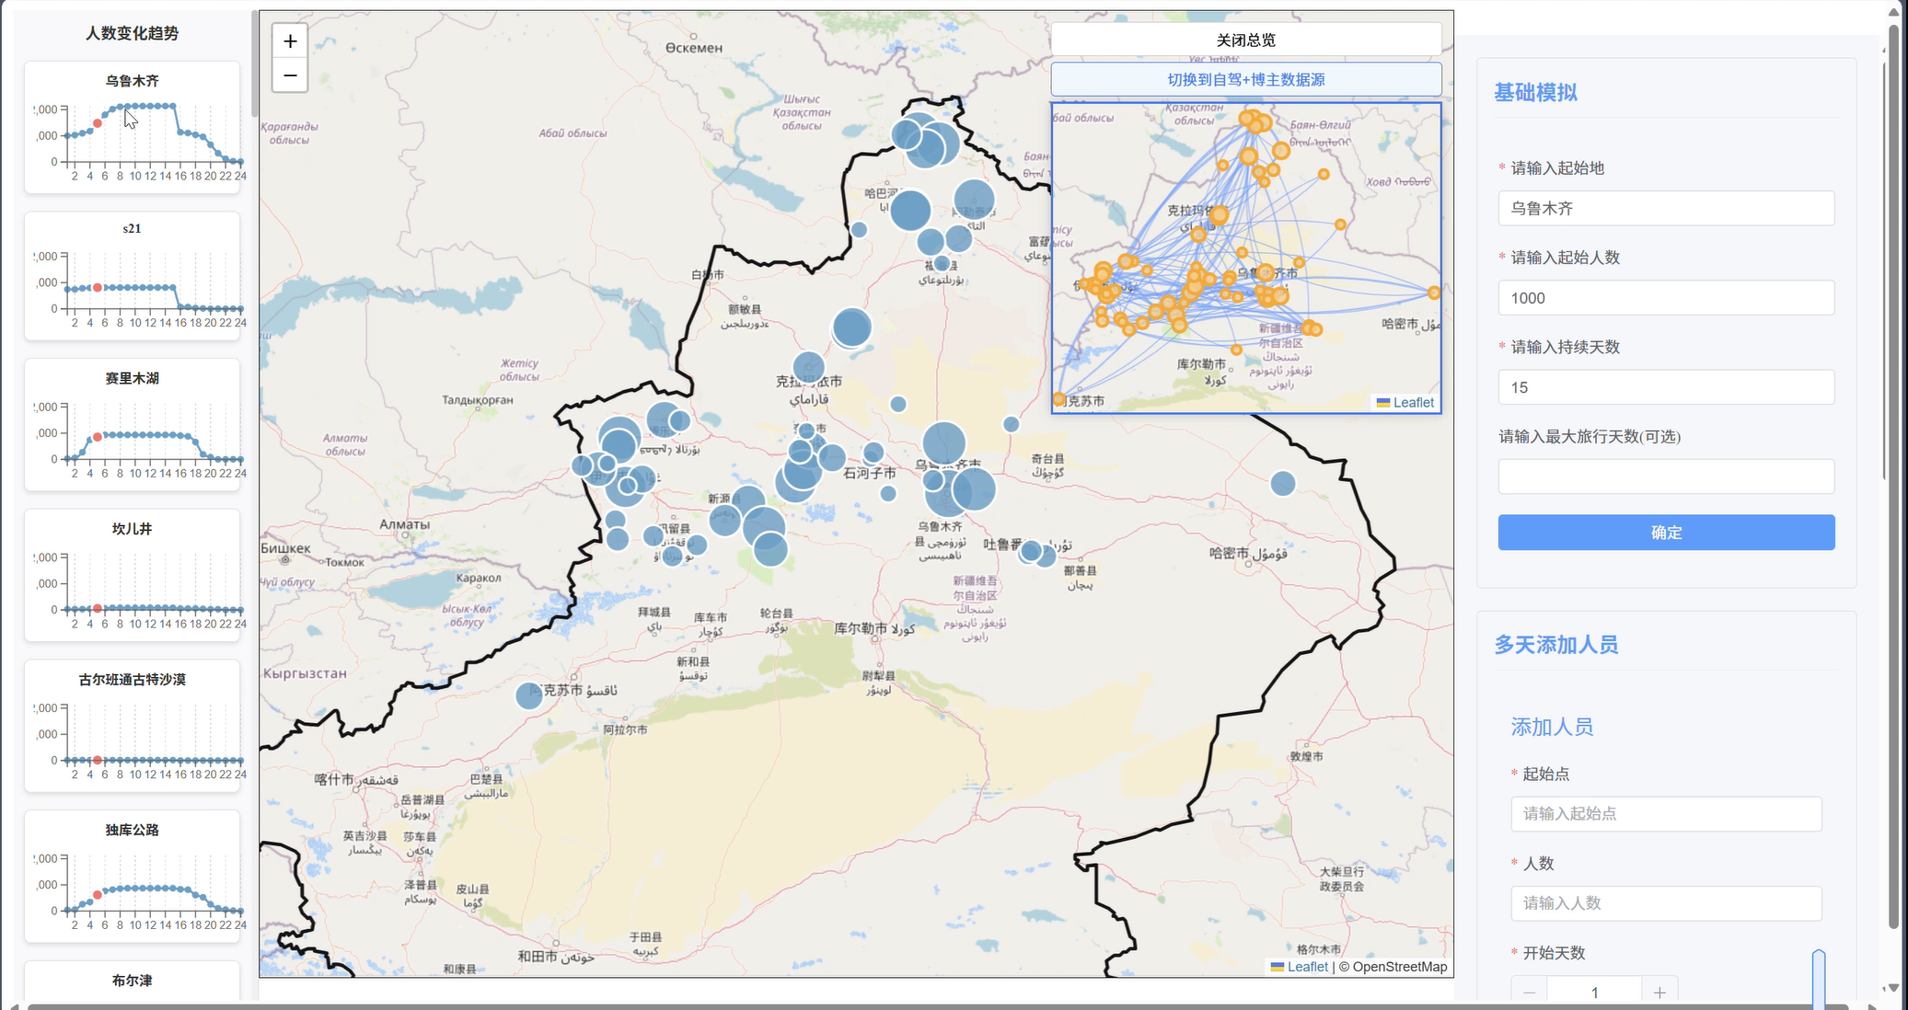



Slide 13


Slide 14
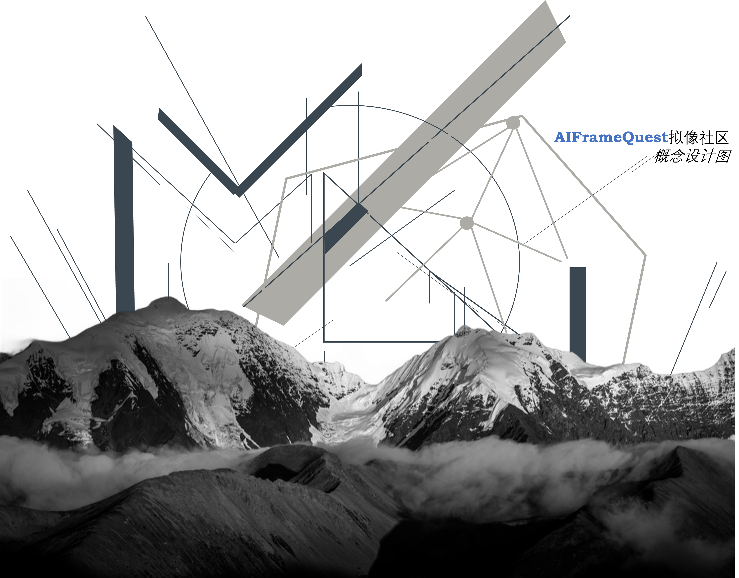
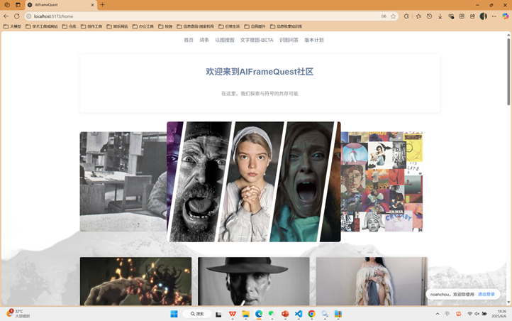
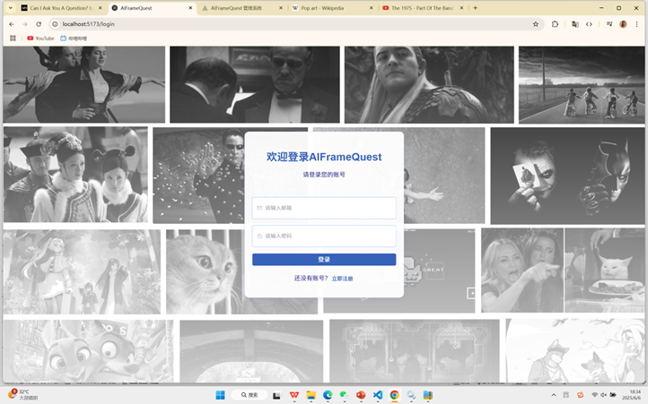
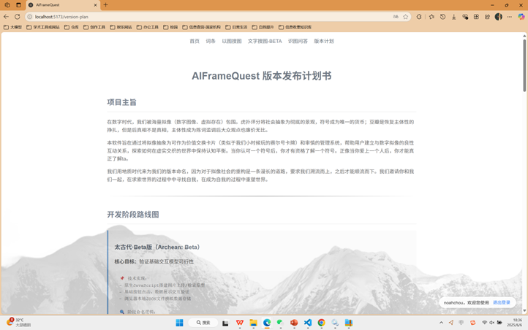

Slide 15

世界水深火热，而 在买鞋

Slide 16

IT’S NOT SPORT，IT’S A BATTLE
Spring Summer 26 by AntaGonists

Slide 17
SS26
生存指南
09 June, 2026
ANTA X ANTAGONISTS
世界水深火热，而我们在买鞋
成为利维坦：安踏OS战略管理展示

Slide 18


马赫临界
马赫临界
马赫临界
马赫临界
永别了，马赫临界
ANTAGONISTS
ANTAGONISTS
ANTAGONISTS
ANTAGONISTS
ANTAGONISTS
ANTAGONISTS

Slide 19
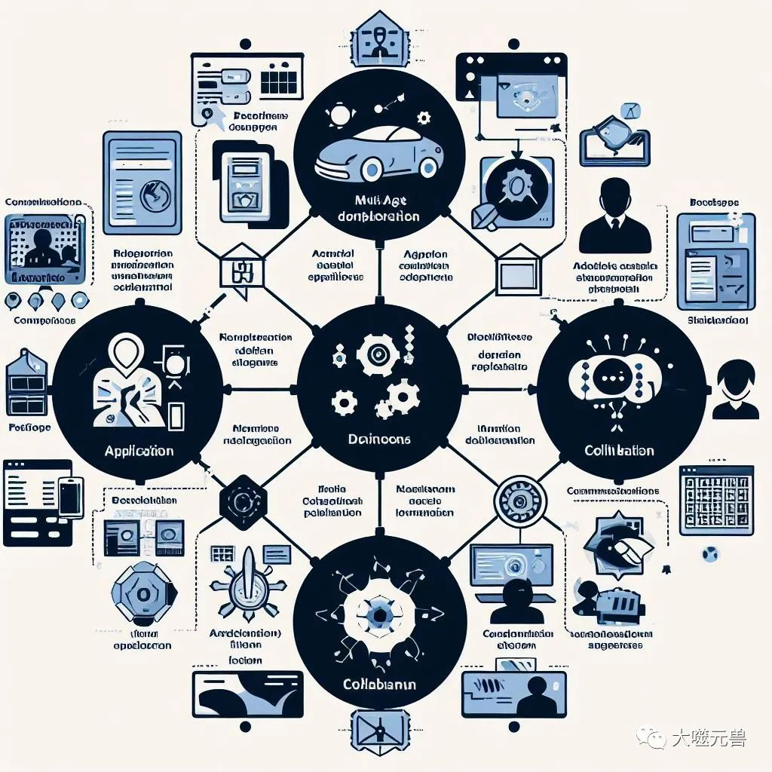

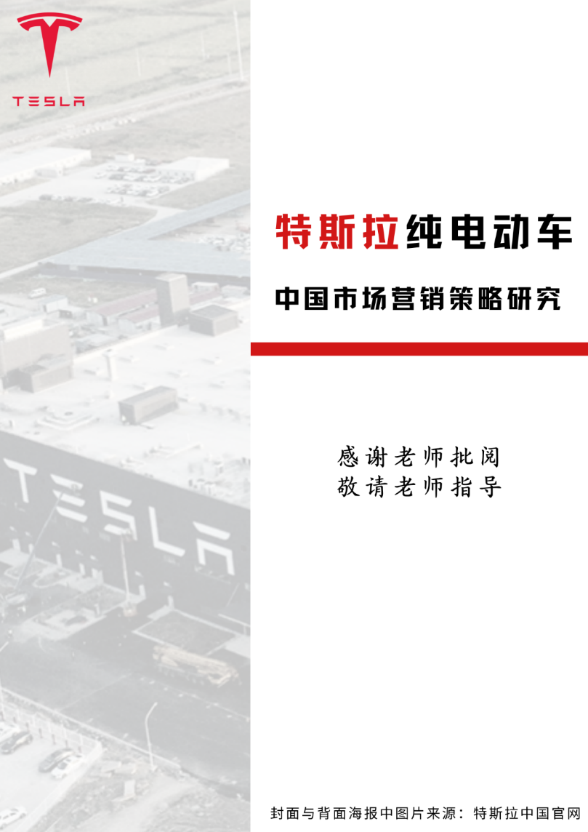
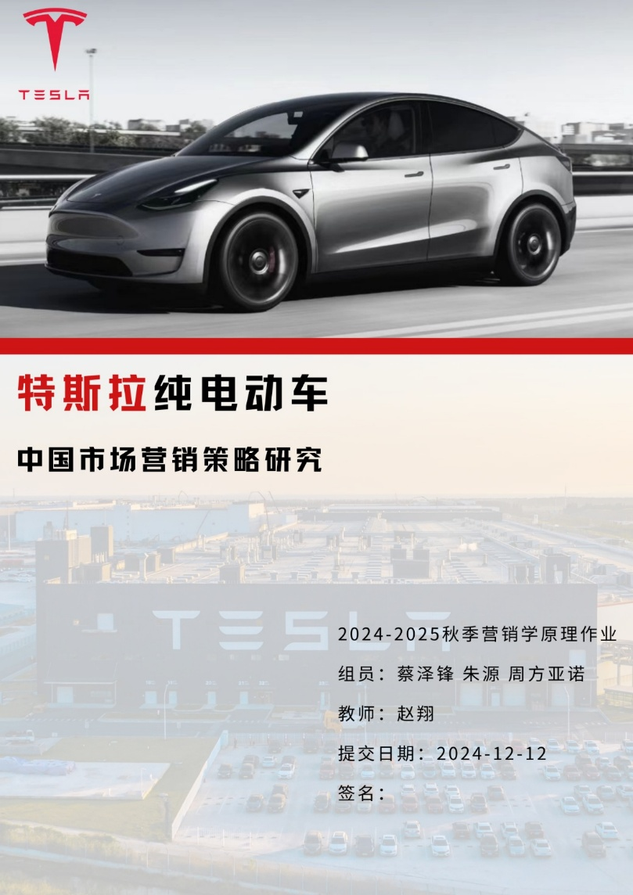
MATCHAFLOW

