Slide 1
DSP - Project 2
Noah Lutz

Slide 2
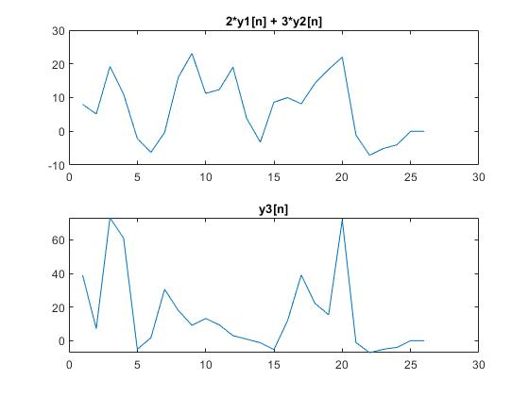
Part 1 - Blackbox Systems
System 1 - Linearity
Inputs:
x1[n] = cos(n*pi/3)
x2[n] = cos(n*pi/4)
x3[n] = 2*x1[n] + 3*x2[n]
Outputs:
y1[n] = system1(x1[n])
Y2[n] = system1(x2[n])
ycombined[n]= 2*y1[n] + 2*y2[n]
y3[n] = system1(x3[n])
Classification: Non-linear

Slide 3
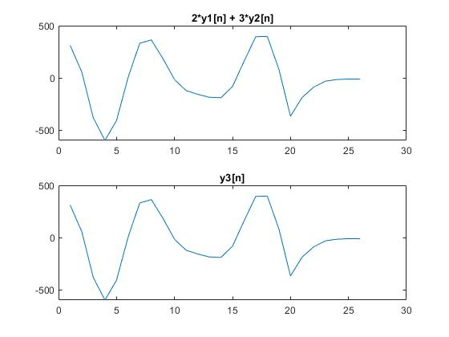
Part 1 - Blackbox Systems
System 2 - Linearity
Inputs:
x1[n] = cos(n*pi/3)
x2[n] = cos(n*pi/4)
x3[n] = 2*x1[n] + 3*x2[n]
Outputs:
y1[n] = system2(x1[n])
Y2[n] = system2(x2[n])
ycombined[n]= 2*y1[n] + 2*y2[n]
y3[n] = system2(x3[n])
Classification: linear

Slide 4
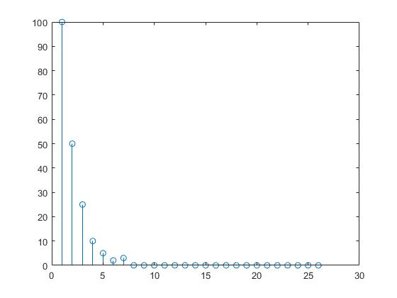
Part 1 - Blackbox Systems
System 2 - Impulse Response
Inputs:
x[n] = δ[n]
Outputs:
h[n] = y[n] = system2(x[n])
Classification: FIR

Slide 5
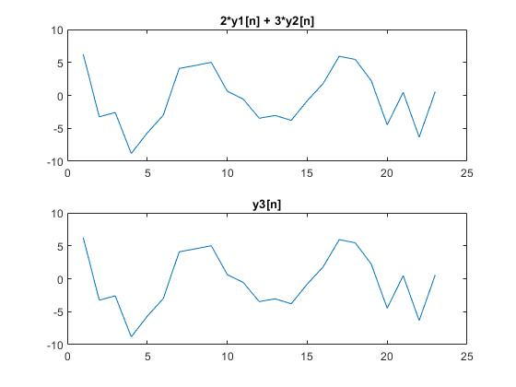
Part 1 - Blackbox Systems
System 3
Inputs:
x1[n] = cos(n*pi/3)
x2[n] = cos(n*pi/4)
x3[n] = 2*x1[n] + 3*x2[n]
Outputs:
y1[n] = system3(x1[n])
Y2[n] = system3(x2[n])
ycombined[n]= 2*y1[n] + 2*y2[n]
y3[n] = system3(x3[n])
Classification: linear

Slide 6
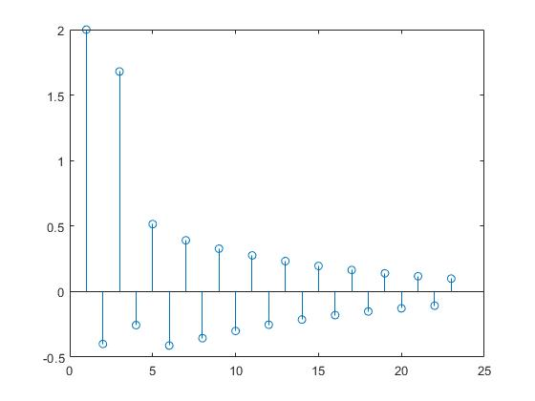
Part 1 - Blackbox Systems
System 3 - Impulse Response
Inputs:
x[n] = δ[n]
Outputs:
h[n] = y[n] = system3(x[n])
Classification: IIR

Slide 7
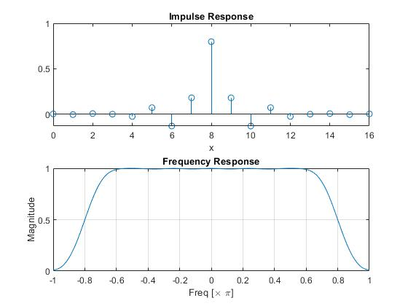
Part 2 - Cascade Filters
Filter 1 - Low Pass
Classification: Low Pass FIR

Slide 8
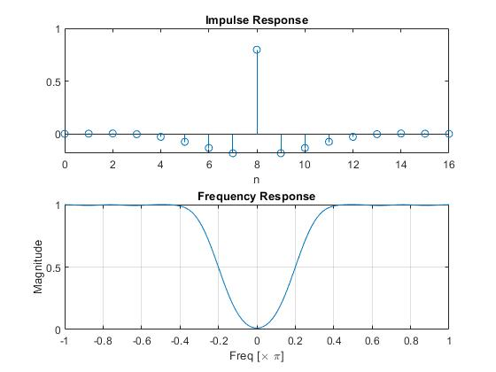
Part 2 - Cascade Filters
Filter 2 - High Pass
Classification: High Pass FIR

Slide 9
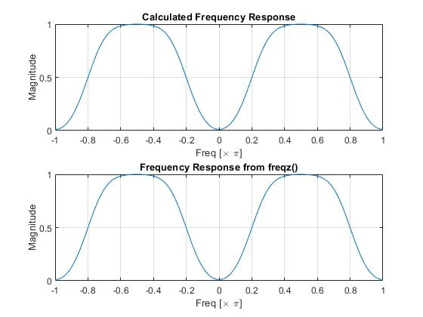
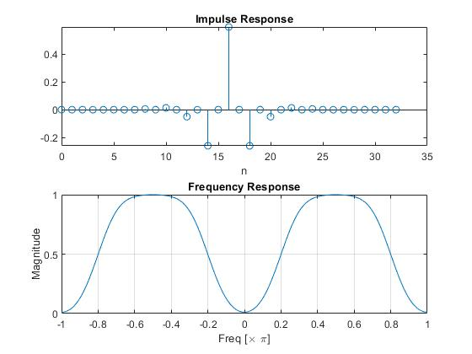
Part 2 - Cascade Filters
Filter 3 (Cascade of 1 & 2) - Band Pass
Classification: Band Pass FIR

Slide 10
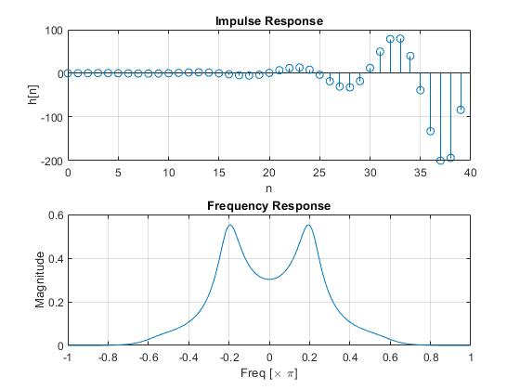
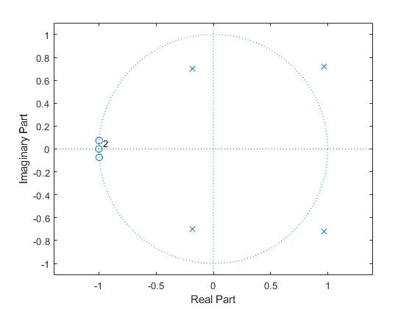
Part 3 - IIR Filter
Zeros:
-0.9973 ± j0.0733
-1.0 ± j0.0
Poles:
0.9669 ± j0.7209
-0.1817 ± j7006

Slide 11
Part 4 - FIR Filter Design
Specs:
0 - 0.2pi : >-20dB
0.35pi - 0.65pi < -1dB
0.8pi - pi: >-20dB
Filters Tried (Order)
10, 11, 12

Slide 12
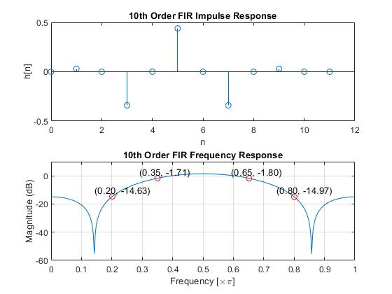
Part 4 - FIR Filter Design
10th Order
Specs:
0 - 0.2pi : >-20dB
0.35pi - 0.65pi < -1dB
0.8pi - pi: >-20dB
10th order does not meet spec

Slide 13
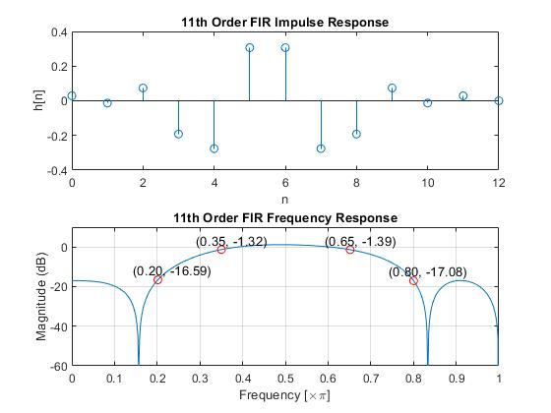
Part 4 - FIR Filter Design
11th Order
Specs:
0 - 0.2pi : >-20dB
0.35pi - 0.65pi < -1dB
0.8pi - pi: >-20dB
11th order does not meet spec

Slide 14
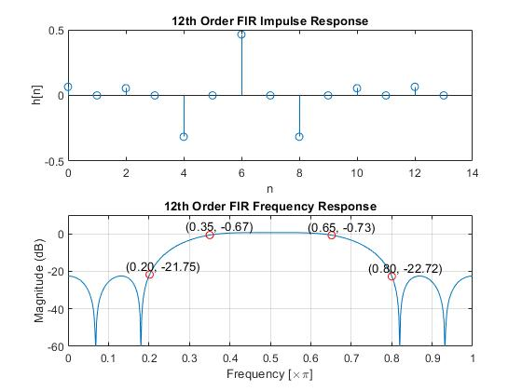
Part 4 - FIR Filter Design
12th Order
Specs:
0 - 0.2pi : >-20dB
0.35pi - 0.65pi < -1dB
0.8pi - pi: >-20dB
12th order does meet spec

Slide 15
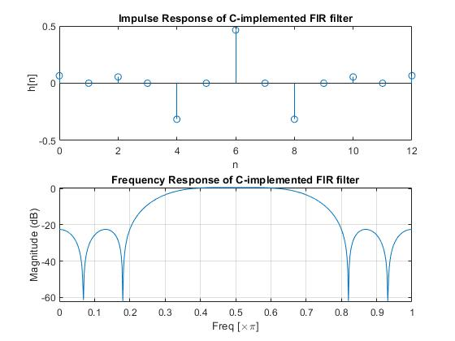
Part 5 - 12th Order FIR Filter
C Implementation
Specs:
0 - 0.2pi : >-20dB
0.35pi - 0.65pi < -1dB
0.8pi - pi: >-20dB
12th Order (same filter as slide before)
Same response as filter from previous slide

