Slide 1


Coding Challenge System

Slide 2
Agenda
Purpose
Scope and Users
Demo
Future Enhancements
Retrospective and lessons learnt

Slide 3
Purpose
Allow teachers to create coding challenges to test the knowledge of their students on specific subjects in programming
Allow students to challenge their coding skills by solving a programming-based problem

Slide 4
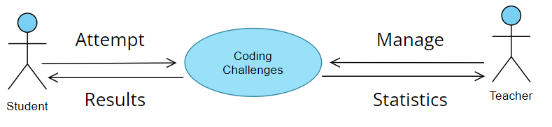
Scope and Users
u
Scope of the system:
Heritage Teachers
Teachers create coding challenges and test cases to validate Students' solutions
Teachers see statistics for coding challenges attempted by Students
Heritage Students
Students run test cases against their code and submit their final solution
Students save their current progress on a challenge
System support multiple languages for a coding challenge

Slide 5
Demo
Student:
View New Challenges
View Attempt Challenge page
Teacher:
View Challenges
Create & Edit Challenges

Slide 6
System Roadmap
By the end of Dev Project 2:
Teachers being able to make test cases
Students being able to do challenges fully
Statistics report for challenges/students
Students having access to a history of their attempted challenges
Automatic saving for coding progress
Future enhancements:
Challenges that are set to multiple languages
Have students personally select what coding language they want to do a challenge in
Students entering a result only, as an option

Slide 7
Retrospective & Lessons learnt
What went well?
Getting most of the functionality working
Team dynamics
Peer reviewing
What did not go so well?
Breaking down work into tasks
Tasks were missed and not detailed enough
What were the lessons learnt?
Ask for help when stuck
The Definition of done
Importance of proper tasking and organizing the backlog

Slide 8
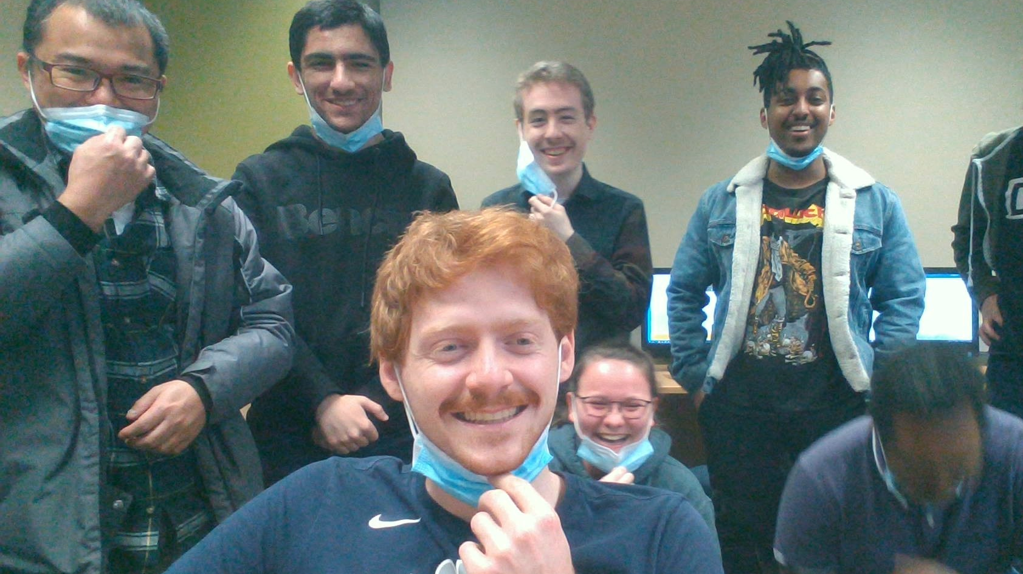
Q/A

