Slide 1
Coding Challenge System (CCS) Sprint 1 Review
By the CCS team
Emmanuelle, Alex, Abe, Arsen, Noah, Zhaojiang, and Nahom

Slide 2
Agenda
Previous commitments
Changes Made
DEMO
Revision on previous commitments
Next Steps
Q/A

Slide 3
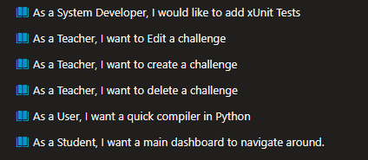
Previous Commitments

Slide 4
Changes Made
Teacher:
Re-designed:
Create and Edit challenges pages
The warning popup message for deleting a challenge has been updated
Student
Re-designed:
Home page

Slide 5
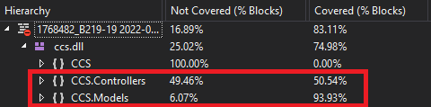
Changes Made cont.
Test cases (72% code coverage)
Created/Updated documentation items
And other small design changes that we will demo

Slide 6
DEMO

Slide 7
Previous Commitments

Slide 8
Next Steps
Creating a challenge with parameters and test cases.
Ability for Teacher to “Test” test cases
Hosting our compiler API on csdev (currently on uxdev)
Display test case results when student attempts a challenge
Other design improvements down the road

Slide 9
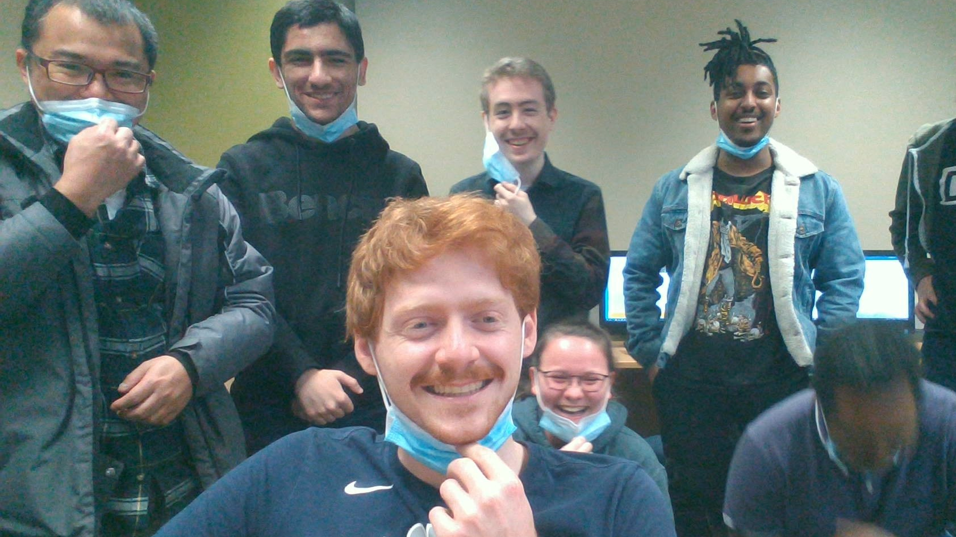
Thank You
Questions & Answers?

