Slide 1
Coding Challenge System (CCS) Sprint 2 Review
By the CCS team
Emmanuelle, Alex, Abe, Arsen, Noah, Zhaojiang, and Nahom

Slide 2
Agenda
Previous commitments
Changes Made
DEMO
Revision on previous commitments
Next Steps
Q/A

Slide 3
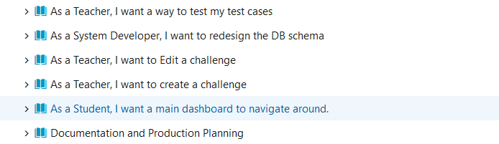
Previous Commitments

Slide 4
Changes Made
Teacher:
Create/Edit challenges pages are using tabs
Testing test cases: Front end design complete
Replaced the “Required” column to “Name”
The parameters data types correspond to the challenge language
Adding/removing test cases and parameters, front end functionality

Slide 5
Changes Made cont.
Student
Home page is using tabs
Recent challenges table feature complete

Slide 6
DEMO

Slide 7
Previous Commitments

Slide 8
Next Steps
Ability for Teacher to “Test” test cases
Hosting our compiler API on csdev (currently on uxdev)
Display test case results when student attempts a challenge
Other design improvements down the road

Slide 9
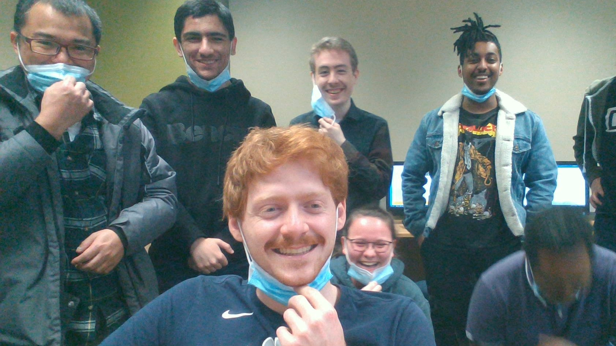
Thank You
Questions & Answers?

