Slide 1

Meta Transactions:
Gassless / Etherless / Subsidized
Transacting on Ethereum
CryptoCamp 2018
tagloyalty.com

Slide 2
Why Ether Exists?
Halting Problem:
“determining, from a description of an arbitrary computer program and an input, whether the program will finish running (i.e., halt) or continue to run forever.”
- https://en.wikipedia.org/wiki/Halting_problem

Slide 3



Story Time

Slide 4
{
// Required unless deploying a contract (in which case omit) to: addressOrName, // the target address or ENS name
// These are optional/meaningless for call and estimateGas nonce: 0, // the transaction nonce gasLimit: 0, // the maximum gas this transaction may spend gasPrice: 0, // the price (in wei) per unit of gas
// These are always optional (but for call, data is usually specified) data: "0x", // extra data for the transaction, or input for call value: 0, // the amount (in wei) this transaction is sending chainId: 3 // the network ID; usually added by a signer
}
Anatomy of an Ethereum Transaction
https://docs.ethers.io/ethers.js/html/api-providers.html#transaction-requests

Slide 5
{
// Required unless deploying a contract (in which case omit) to: addressOrName, // the target address or ENS name
// These are optional/meaningless for call and estimateGas nonce: 0, // the transaction nonce gasLimit: 0, // the maximum gas this transaction may spend gasPrice: 0, // the price (in wei) per unit of gas
// These are always optional (but for call, data is usually specified) data: "0x", // extra data for the transaction, or input for call value: 0, // the amount (in wei) this transaction is sending chainId: 3 // the network ID; usually added by a signer
}
Anatomy of an Ethereum Transaction
Hash it
https://docs.ethers.io/ethers.js/html/api-providers.html#transaction-requests

Slide 6
{
// Required unless deploying a contract (in which case omit) to: addressOrName, // the target address or ENS name
// These are optional/meaningless for call and estimateGas nonce: 0, // the transaction nonce gasLimit: 0, // the maximum gas this transaction may spend gasPrice: 0, // the price (in wei) per unit of gas
// These are always optional (but for call, data is usually specified) data: "0x", // extra data for the transaction, or input for call value: 0, // the amount (in wei) this transaction is sending chainId: 3 // the network ID; usually added by a signer
}
Anatomy of an Ethereum Transaction
Hash it
Sign it
https://docs.ethers.io/ethers.js/html/api-providers.html#transaction-requests

Slide 7
{
// Required unless deploying a contract (in which case omit) to: addressOrName, // the target address or ENS name
// These are optional/meaningless for call and estimateGas nonce: 0, // the transaction nonce gasLimit: 0, // the maximum gas this transaction may spend gasPrice: 0, // the price (in wei) per unit of gas
// These are always optional (but for call, data is usually specified) data: "0x", // extra data for the transaction, or input for call value: 0, // the amount (in wei) this transaction is sending chainId: 3 // the network ID; usually added by a signer
}
Anatomy of an Ethereum Transaction
Hash it
Sign it
Send to network
https://docs.ethers.io/ethers.js/html/api-providers.html#transaction-requests

Slide 8
{
// Required unless deploying a contract (in which case omit) to: addressOrName, // the target address or ENS name
// These are optional/meaningless for call and estimateGas nonce: 0, // the transaction nonce gasLimit: 0, // the maximum gas this transaction may spend gasPrice: 0, // the price (in wei) per unit of gas
// These are always optional (but for call, data is usually specified) data: "0x", // extra data for the transaction, or input for call value: 0, // the amount (in wei) this transaction is sending chainId: 3 // the network ID; usually added by a signer
}
Anatomy of an Ethereum Transaction
Hash it
Sign it
Send to network
Wait till mined
https://docs.ethers.io/ethers.js/html/api-providers.html#transaction-requests

Slide 9
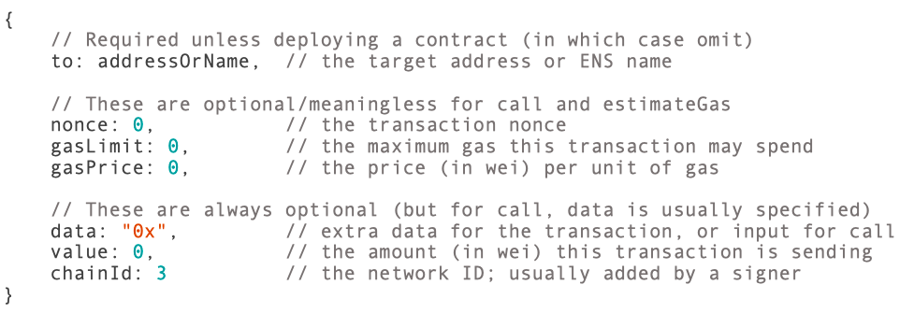
hash and sign
What if…
include as data in new transaction

Slide 10

What if…
Someone else foots the gas bill

Slide 11
Normal Tx
Meta Tx
Sign transaction
Protocol verifies signature
Contract verifies msg.sender
Protocol handles replay protection
Sign data
Contract verifies signature
Contract agnostic to msg.sender
Contract handles replay protection

Slide 12
Demo Time
https://github.com/NoahMarconi/metatransactions

Slide 13
mapping (address => uint256) private _nonces;

Slide 14
function payloadToSign(
address sender,
uint256 value,
address spender,
uint256 nonce
) public
view
returns (bytes32 payload)
{
return ECDSA.toEthSignedMessageHash(
keccak256(abi.encodePacked(
sender, // Token Owner.
address(this), // Token address (replay protection).
value, // Number of tokens.
spender, // Address being approved to spend.
nonce // Local sender specific nonce (replay protection).
))
);
}

Slide 15
function verifyApproval(
address sender,
bytes32 payload,
bytes signature
) public
pure
returns (bool)
{
address recoveredAddress = ECDSA.recover(
ECDSA.toEthSignedMessageHash(payload),
signature
);
return recoveredAddress == sender;
}

Slide 16
function metapprove(
address sender,
uint256 value,
address spender,
uint256 nonce,
bytes signature
) public returns (bool success) {
// Verify and increment nonce.
require(getNonce(sender) == nonce);
_nonces[sender] = _nonces[sender].add(1);
// Verify signature.
bytes32 payload = payloadToSign(sender, value, spender, nonce);
require(verifyApproval(sender, payload, signature));
// Standard approve.
require(spender != address(0));
_allowed[sender][spender] = value;
emit Approval(sender, spender, value);
return true;
}

Slide 17
To Note
Replay protection
Smart contract now responsible for work the protocol would have done for you.
Fees
Can charge a fee in ETH or in tokens.

Slide 18
Other Approaches
Merkle Root Redemption
See: https://blog.ricmoo.com/merkle-air-drops-e6406945584d?gi=5c1c7f05c466
One Time Address
See: https://medium.com/@weka/how-to-send-ether-to-11-440-people-187e332566b7

Slide 19
Further Reading
https://metatx.io/
https://eips.ethereum.org/EIPS/eip-1077
https://medium.com/coinmonks/gasless-transactions-f75382095c4f
https://github.com/jpitts/eth-community-discussions/blob/master/meta-transactions.md
https://tagloyalty.com

Slide 20
Thank You for you time today
We would love to hear from you
\\\\\\\\\
Morgan Kelly
647.402.1640
morgan@tagloyalty.com
Noah Marconi
647.669.5538
noah@tagloyalty.com

