Slide 1
Pass The Aux Walkthrough

Slide 2
Deck Contents
Install App
First Launch
Create Playlist
Etc.

Slide 3
Install App

Slide 5
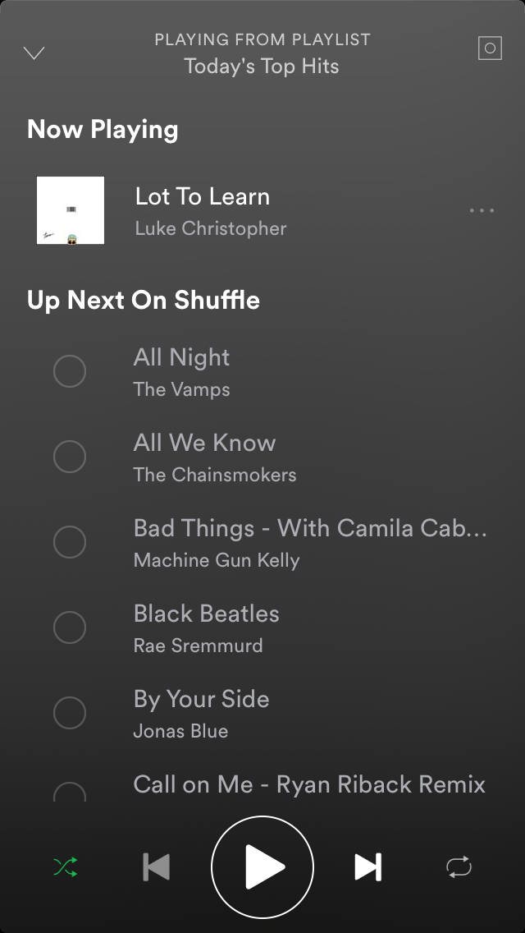
Install App Walkthrough

Slide 6
Install App Walkthrough
My Profile

Slide 7
Install App Walkthrough
My Profile

