Slide 1


Next-Gen Network Intrusion Detection
Self-Supervised Tabular Transformers & SwiGLU Architecture
By Noah Raupold, Mohammad Ayoubi, Jonathan Berwind

Slide 2
Project Objective
Goal: Develop a robust classifier for TCP network traffic anomalies
Input: Connection features (Duration, Service, Bytes, Flags)
Output: Classify traffic into 5 classes:
Normal (safe traffic)
DoS (Denial of Service)
Probe (Scanning)
U2R (Unauthorized Access to Local Superuser)
R2L (Unauthorized Access from Remote)

Slide 3
Data Analysis & Challenges
The Data Problem: Extreme Class Imbalance
Distribution Analysis: The dataset is highly skewed
Normal/DoS > 98% of data
U2R/R2L: <0.5%
Statistical Bias: Standard statistical models favor majority classes to minimize global loss
The Security Risk: High accuracy on “Normal” traffic masks the failure to detect critical intrusions (False Negatives)

Slide 4
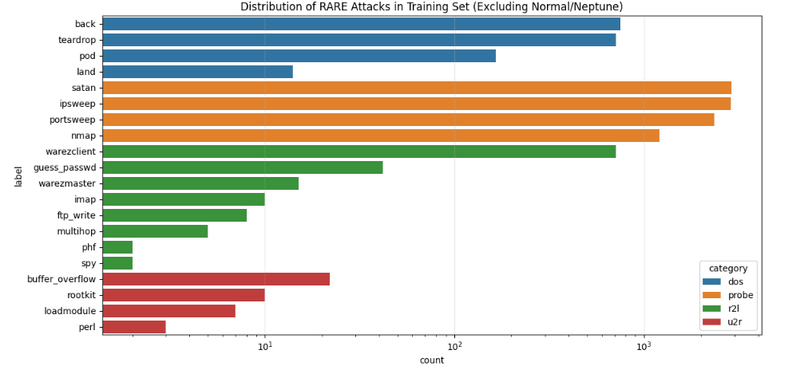
Imbalanced training Data

Slide 5
Baseline Analysis: Logistic Regression
Baseline Model: Logistic Regression
Global Accuracy: High accuracy
Recall on Minority Classes (U2R): <50%
Conclusion: The baseline model fails to generalize on sparse data. Accuracy is an unsuitable metric this specific security domain

Slide 6
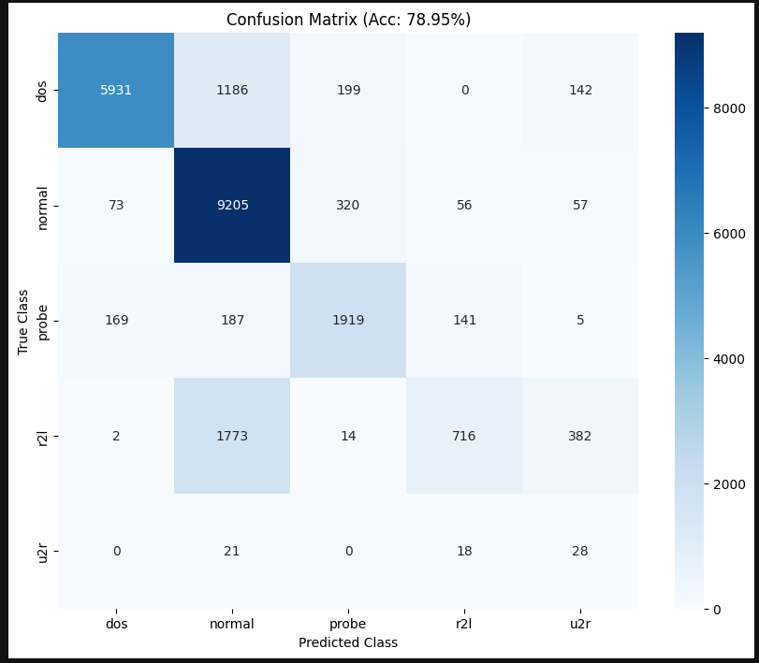
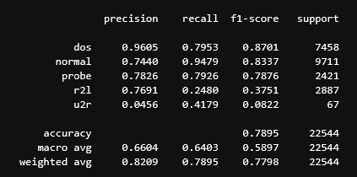
Baseline Analysis: Logistic Regression
Mathews Correlation Coefficient: 0.6934

Slide 7
Our Solution: Tabular Vision Transformer
Architecture Shift: Transition from linear models to Deep Learning with Attention Mechanisms
Core Model: Tabular ViT (Vision Transformer applied to tabular data)
Feature Embedding: Converting continuous and categorial features into dense vector embeddings
Self-Attention: Enabling the model to learn non-linear dependencies and context between features

Slide 8
Training Strategy: Self-Supervised Learning (DINO)
Method: DINO (Self-Distillation with no Labels)
Mechanisms: Teacher-Student Architecture
Input: Masked views of the data samples
Objective: The Student network minimizes the reconstruction loss against the Teacher’s output
Rationale: Allows the model to learn the intrinsic manifold of the data and robust feature representation without relying on the sparse labels of attack classes

Slide 9
Classification Head: SwiGLU Activation
Layer Design: Replacing standard ReLUI feed-forward networks with SwiGLU (Swish Gated Linear Units)
Mathematical Advantage:
Provides a gating mechanism to control information flow
Improves gradient flow and convergence on deep networks
Function: Filters noise in the laten representation before the final Softmax classification layer

Slide 10
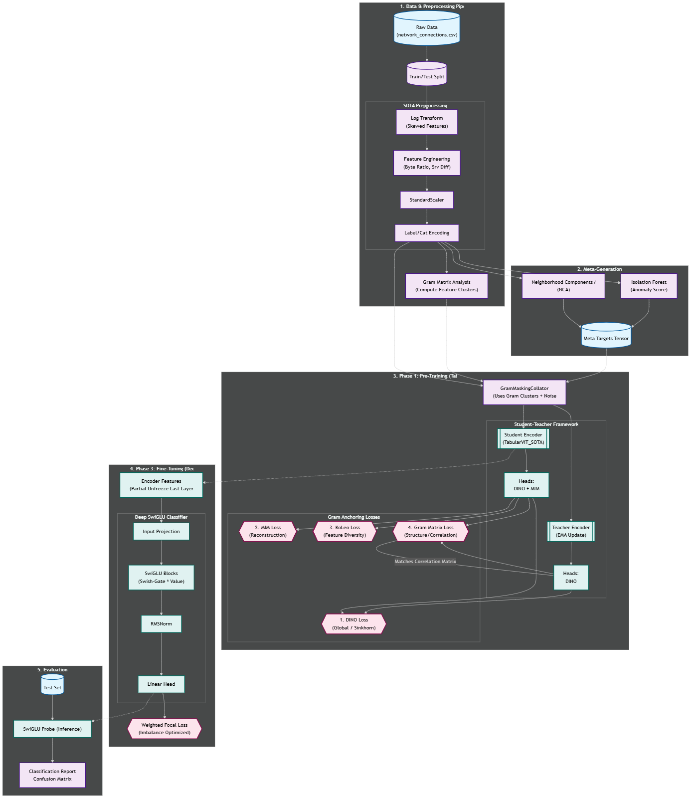
Pipeline

Slide 11
Model

Slide 12
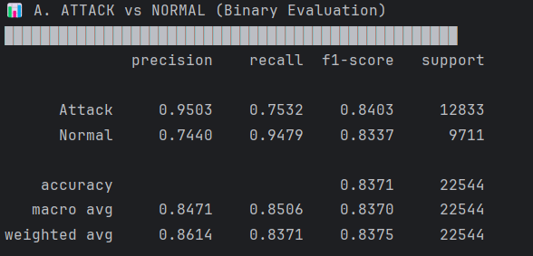
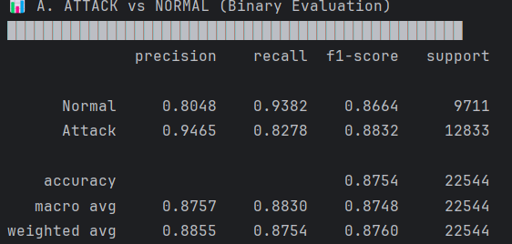
Binary Classification Metrics
Regression vs Dinov3

Slide 13
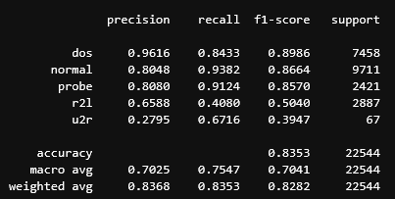
Evaluation & Perfomance Quality
Mathews Correlation Coefficient: 0.7578

Slide 14

Evaluation & Perfomance Quality

Slide 15
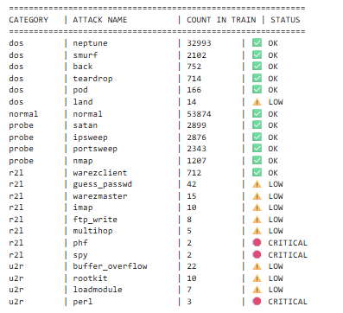
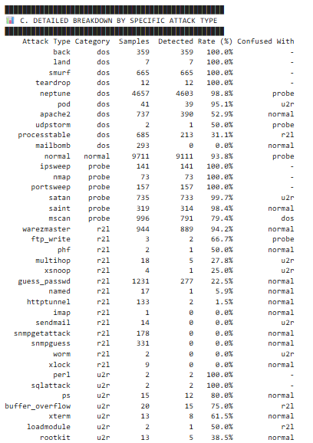
Attack Distribution in Training vs Attack

Slide 16
Advanced Task: Granularity Limitations
Experiment: Predicting 41 specific attack signatures vs. 5 broad categories
Observation: Model performance degrades on specific labels (Accuracy drop to 15%)
Cause: Data Sparsity: Several specific attacks appear <3 times in the dataset
→ Grouping attacks in semantic categories (DoS, U2R, etc.) is necessary for statistical robustness

Slide 17
Conclusion
Summary: Successfully implemented a State-of-the-Art Transformer architecture for NIDS
Key Finding: Self-Supervised Learning (SSL) significantly outperforms baselines in high-imbalance scenarios

Slide 18
Sources
https://github.com/NoahRau/AIandSec_Project3

