Slide 1
Kernel Operations
Noah Sherry

Slide 2

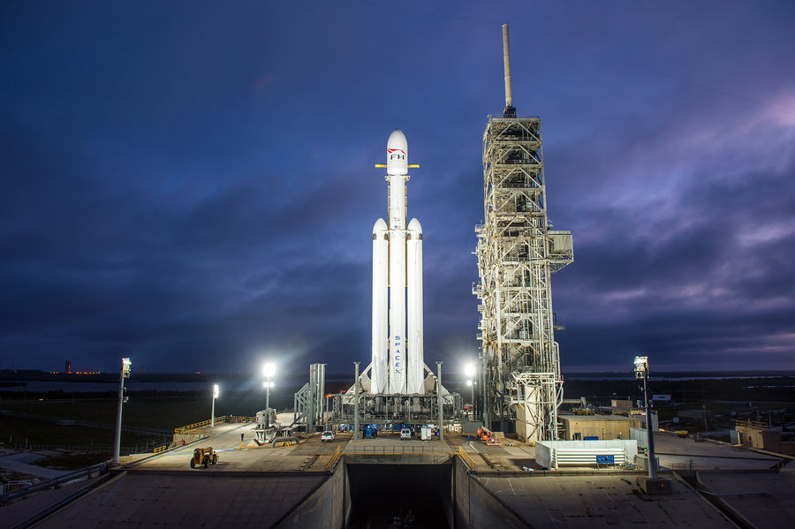
Input Images
image1.png
image2.png

Slide 3

Box Blur: 5x5
Develop and use a 5x5 box blur kernel.
Kernel: [[1,1,1,1,1],[1,1,1,1,1],[1,1,1,1,1],[1,1,1,1,1],[1,1,1,1,1]]
Implementation:
return cv2.filter2D(img, -1, kernel * (1/25))

Slide 4
Box Blur: Split Kernels
Develop and use 1x5 & 5x1 box blur kernels.
1x5 Kernel: [1,1,1,1,1]
5x1 Kernel: [[1],[1],[1],[1],[1]]
Implementation:
kernel_0 = np.float32(
[[1],[1],[1],[1],[1]]
) * (1/5)
kernel_1 = kernel_0[:,None]
kernel_mix = kernel_0.dot(kernel_1)
return cv2.filter2D(img, -1, kernel_mix)

Slide 5
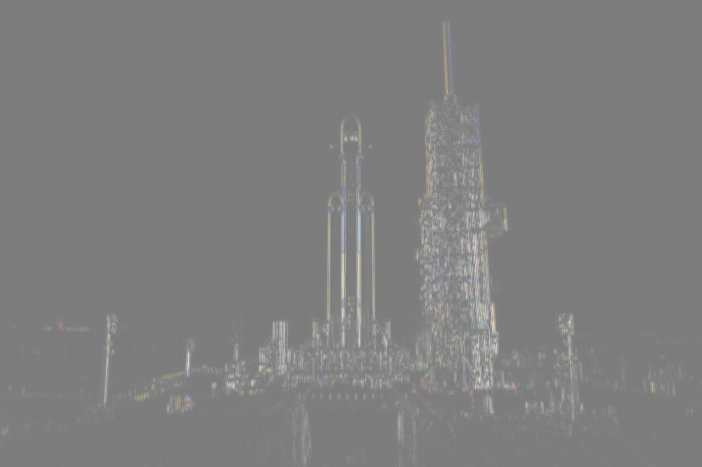
Box Blur: Diff
Create an image difference of the images produced from the previous slides.
Implementation:
image1 = img1*1.0
image2 = img2*1.0
dif = np.abs(image1-image2)
dif -= dif.min()
dif += dif.max()
dif += 255
return np.uint8(dif)

Slide 6
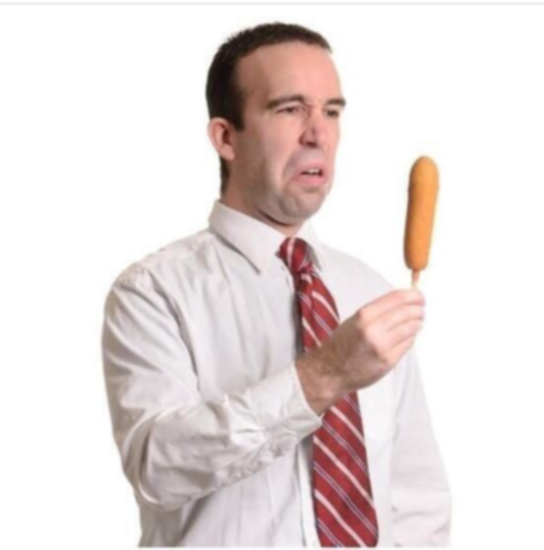
Gaussian Blur: 5x5
Develop and use a 5x5 gaussian blur kernel.
Kernel: [[1,4,6,4,1],[4,16,24,16,4],[6,24,36,24,6],[4,16,24,16,4],[1,4,6,4,1]]
Implementation:
return cv2.filter2D(img, -1, kernel * (1/256))

Slide 7
Gaussian Blur: Split Kernels
Develop and use 1x5 & 5x1 Gaussian blur kernels.
1x5 Kernel: [1,4,6,4,1]
5x1 Kernel: [1],[4],[6],[4],[1]
Implementation:
kernel_0 = np.float32(
[[1],[4],[6],[4],[1]]
) * (1/16)
kernel_1 = kernel_0[:,None]
kernel_mix = kernel_0.dot(kernel_1)
return cv2.filter2D(img, -1, kernel_mix)

Slide 8

Gaussian Blur: Diff
Create an image difference of the images produced from the previous slides.
Implementation:
image1 = img1*1.0
image2 = img2*1.0
dif = np.abs(image1-image2)
dif -= dif.min()
dif += dif.max()
dif += 255
return np.uint8(dif)

Slide 9
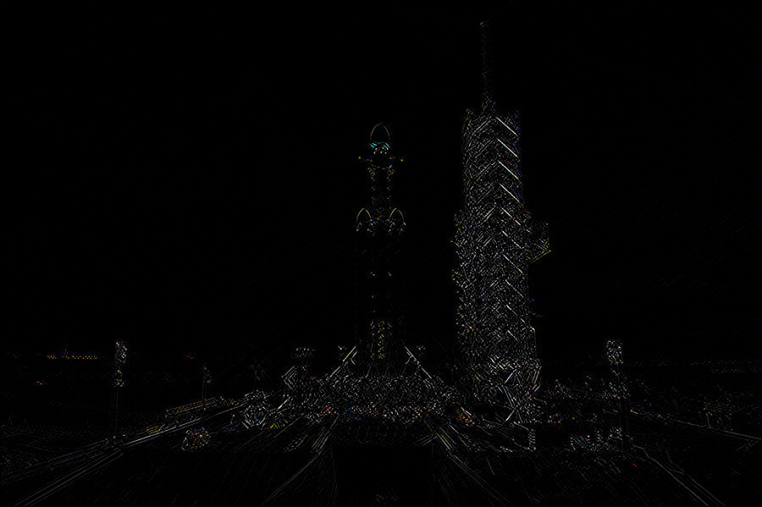
Edge Filter
Develop and implement 3x3 diagonal edge detection kernel
Kernel: [[1,0,-1],[0,0,0],[-1,0,1]]
Implementation:
kernel = np.float32([[1,0,-1],[0,0,0],[-1,0,1]])
return cv2.filter2D(img, -1, kernel)

Slide 10
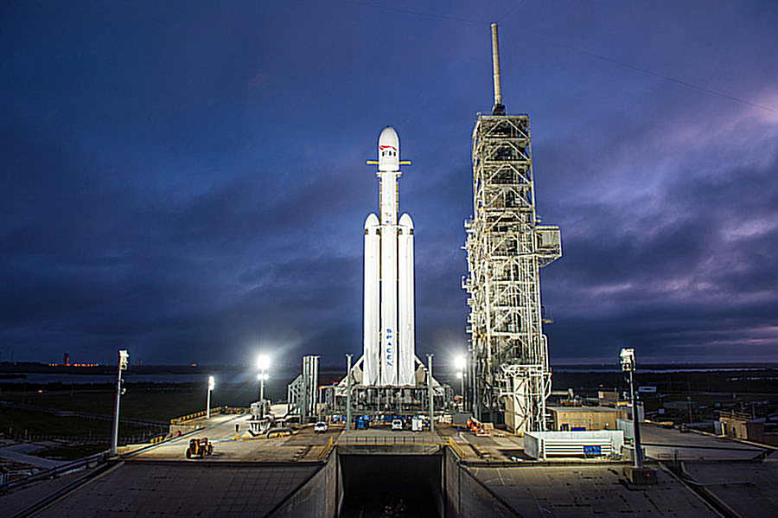
Sharpen Filter
Develop and implement a 5x5 sharpen kernel.
Kernel: [[-1,-1,-1,-1,-1],[-1,2,2,2,-1],[-1,2,8,2,-1],[-1,2,2,2,-1],[-1,-1,-1,-1,-1]]
Implementation:
kernel = np.float32([[-1,-1,-1,-1,-1],[-1,2,2,2,-1],[-1,2,8,2,-1],[-1,2,2,2,-1],[-1,-1,-1,-1,-1]])
return cv2.filter2D(img, -1, kernel * (1/8))

