Slide 1
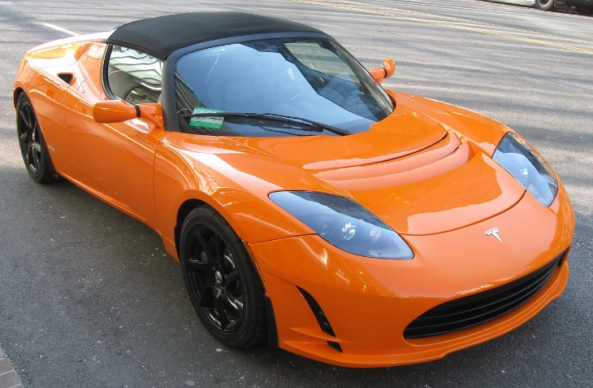
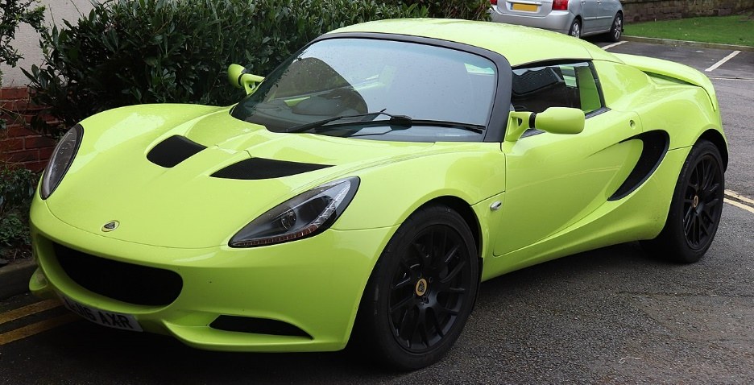
Vehicle Model Identifier | R Noah Padilla | CV Final Project Proposal
Picture of a vehicle
Make + Model
Get Data
Extract data and filter it (CHOG) from STANFORD car dataset (16,185 images of 196 classes of cars)
Identify Vehicle type
Train RFC or MLP model to identify vehicle type (car and truck for now)
Identify Make+Model
Use ORB+RANSAC to identify make and model for that vehicle type
Function

