Slide 1
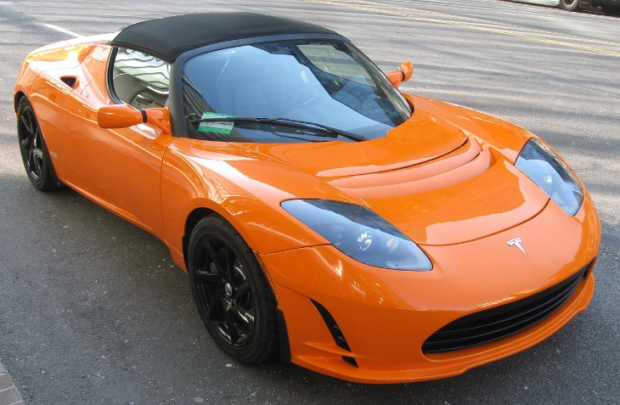
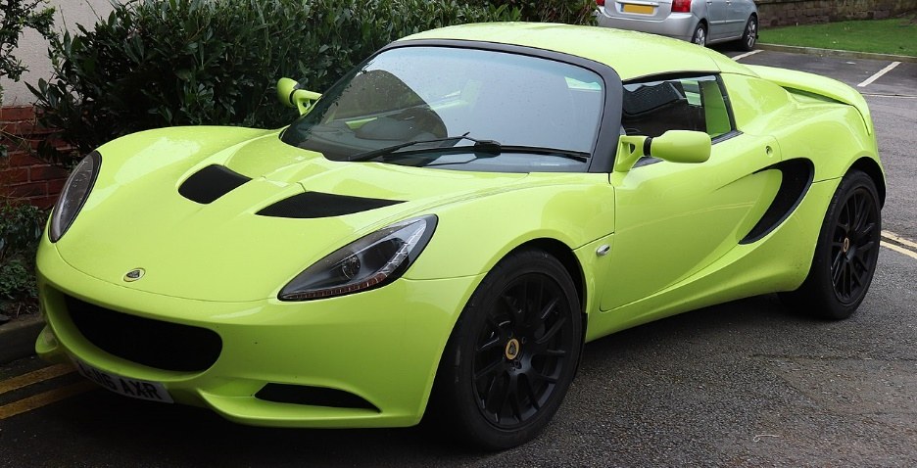
Vehicle Model Identifier | R Noah Padilla | CV Final Project Proposal

Slide 2
Vehicle Model Identifier | R Noah Padilla | CV Final Project Proposal
Picture of a vehicle
Make + Model
Get Data
Extract data and filter it (HOG) from STANFORD car dataset (16,185 images of 196 classes of cars)
Identify Vehicle type
Train RFC or MLP model to identify vehicle type (car and truck for now)
Identify Make+Model
Use ORB+RANSAC to identify make and model for that vehicle type
Function

Slide 3
What I have done
Replaced RFC/MLP with K Means Clustering with 2 clusters using HOG feature set
Finished clustering using a small set of training data (1/3 train images = 5398 images)
Tested the Clustering+ORB+RANSAC using 3 random test images
Filter data
Cluster using HOG
ORB+RANSAC

Slide 4
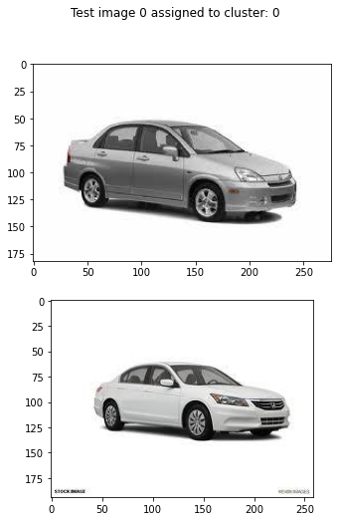
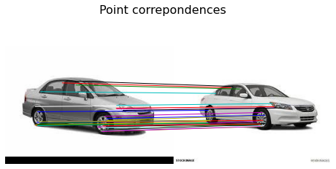
RESULT 1

Slide 5
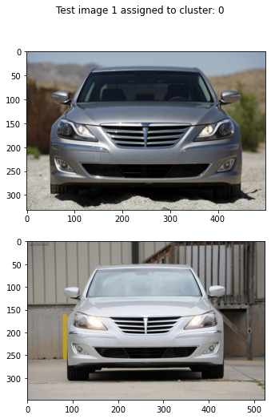
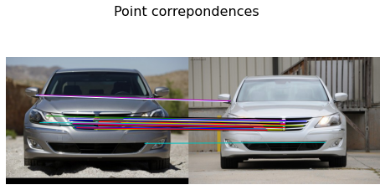
RESULT 2

Slide 6
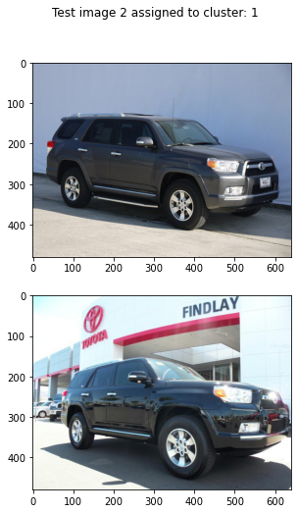
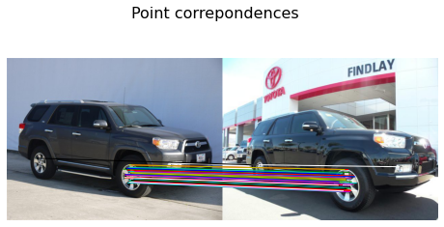
RESULT 3

Slide 7

TODO’s
Time how long my method takes
*Time a CNN approach and compare (might be on kaggle idk yet)
Time only ORB+RANSAC without clustering approach and compare
Understand and use the labeled data to notify user the make and model
Use more than 1/3 train data when clustering and test more
Questions?

