Slide 1
Comparing Barnes-Hut Tree structures with Physical and Computational Metrics

Slide 2
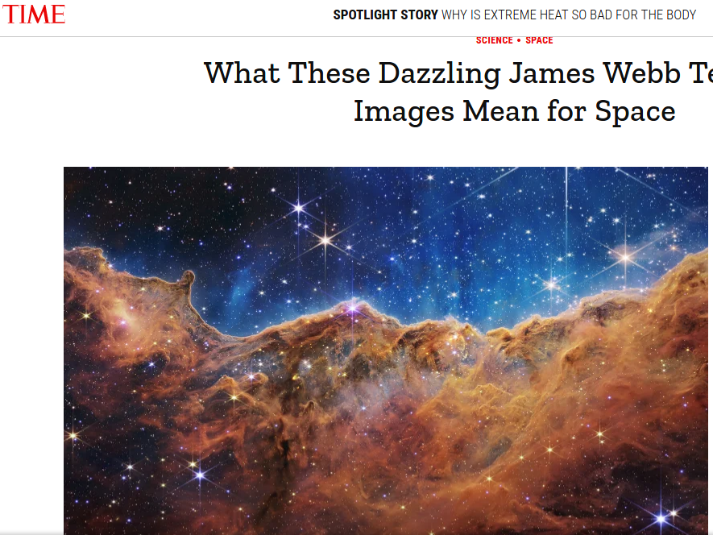

Slide 3
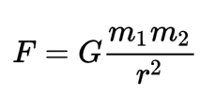
How Do We Predict the Movement of the Planets, Stars, and Galaxies?

Slide 4
Direct Summation
For every particle calculate the force between that particle and every other particle.

Slide 5
Barnes-Hut: Binary Tree
Barnes-Hut: Binary Tree
Put a box around all the particles

Slide 6
Barnes-Hut: Binary Tree
Cut it in half such that each new box has around the same amount of particles in it

Slide 7
Barnes-Hut: Binary Tree
Keep cutting up the boxes until there is one particle per box

Slide 8
Barnes-Hut: Binary Tree
For each box that a particle is in, attract it to that box’s neighbor’s center of mass

Slide 9
Barnes-Hut: Octree
Instead of cutting the boxes by particles just cut them in fourths

Slide 10
Barnes-Hut: Octree
For each box a particle is in attract that particle to all its neighbors’ centers of mass

Slide 11
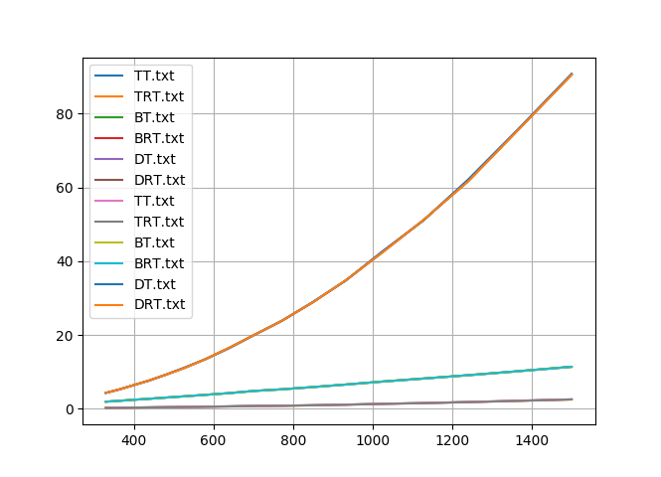
O(n^2) vs O(nlog(n))
Orange:
Direct
Summation
Purple:
Binary Tree
Blue:
Octree
Run Time of the Simulation
Number of Particles

Slide 12
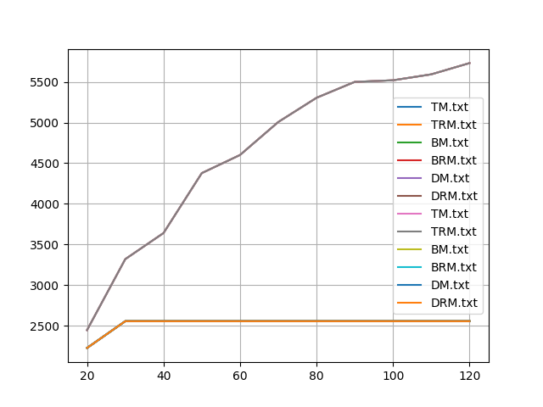
So Why not Just use the Binary tree
Orange:
Direct
Summation
+
Octree
Purple:
Binary Tree
Total Momentum
Time Steps Taken

Slide 13
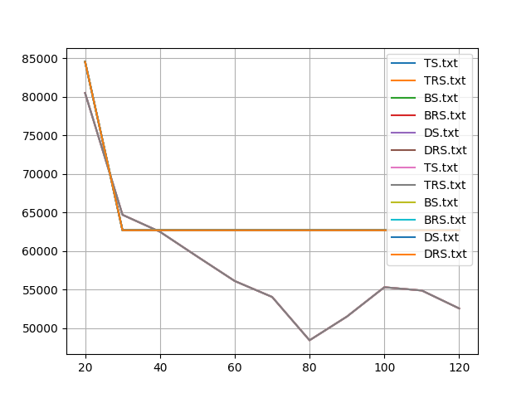
So Why not Just use the Binary tree
Orange:
Direct
Summation
+
Octree
Purple:
Binary Tree
Total Angular Momentum
Time Steps Taken

Slide 14
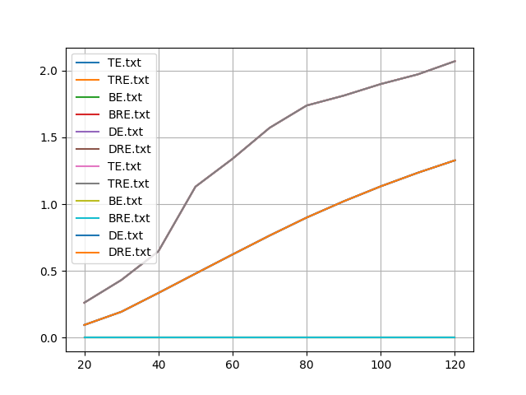
So Why not Just use the Binary tree
Orange:
Direct
Summation
Aqua:
Octree
Purple:
Binary Tree
Total Momentum
Time Steps Taken

Slide 15
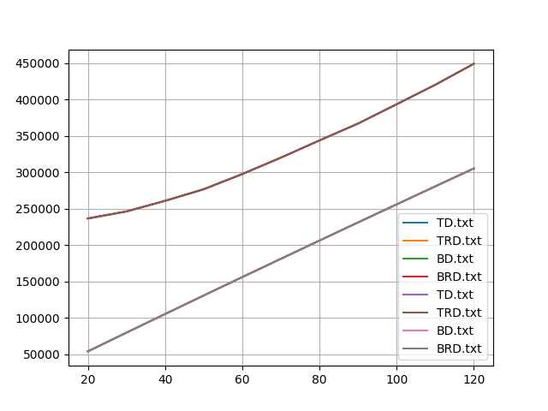
Why are There Only Two Lines?
Total Distance from Direct Summation
Magenta:
Binary Tree
Purple:
Octree
Time Steps Taken

Slide 16


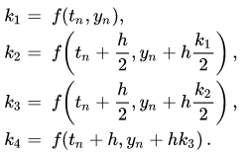

How do we use the forces to calculate the movement?
Leapfrog Integrator:
Leapfrog Integrator:
O(dt^2)
Time reversible meaning it is very stable
Runge Kutta Integrator:
O(dt^4)
Averages 4 slopes together to get very accurate integration

Slide 17
How do we use the forces to calculate the movement?
Error
Function That is Being Approximated
Time Step(dt)
Time

Slide 18
How do we use the forces to calculate the movement?
Error
Function That is Being Approximated
Time Step(dt)
Time

Slide 19
How do we use the forces to calculate the movement?
Error
Function That is Being Approximated
Time Step/2(dt/2)
Time
http://www.physics.drexel.edu/~steve/Courses/Comp_Phys/Integrators/leapfrog/

Slide 20
How do we use the forces to calculate the movement?
Error
Function That is Being Approximated
Time Step(dt)
Time

Slide 21
How do we use the forces to calculate the movement?
Error
Function That is Being Approximated
Time Step/2(dt/2)
Time
https://www.haroldserrano.com/blog/visualizing-the-runge-kutta-method

Slide 22
How do we use the forces to calculate the movement?
Error
Function That is Being Approximated
Time Step/2(dt/2)
Time
https://www.haroldserrano.com/blog/visualizing-the-runge-kutta-method

Slide 23
How do we use the forces to calculate the movement?
Leapfrog Integrator:
Leapfrog Integrator:
O(dt^2)
Time reversible meaning it is very stable
Runge Kutta Integrator:
O(dt^4)
Averages 4 slopes together to get very accurate integration

Slide 24
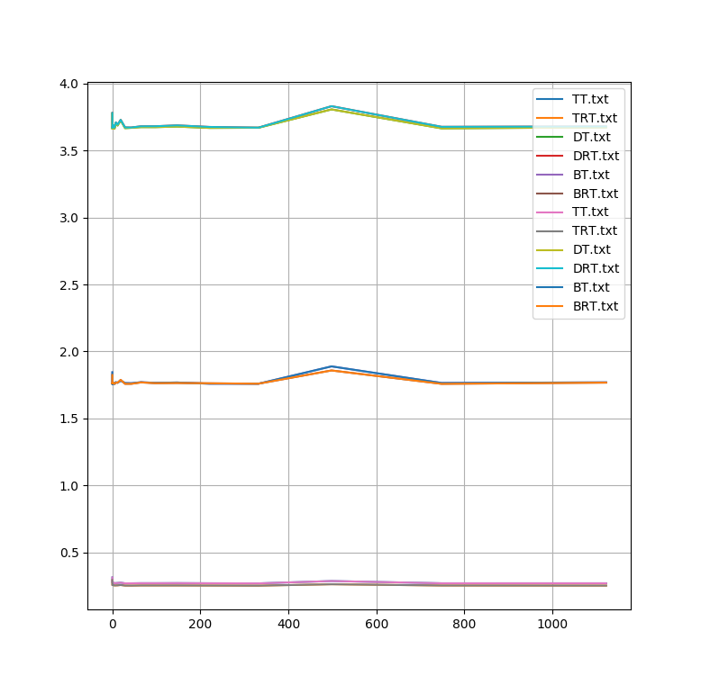
How do These Integration Methods Work in Practice?
Blue+
Green+
Pink:
Leapfrog
Integrator
Aqua+
Blue+
Purple:
Runge Kutta
Integrator
Runtime of a Single Time Step
Inverse Length of Time Steps

Slide 25
What about accuracy?
All the previous graphs have shown both integration methods but there has been no variation in accuracy

Slide 26
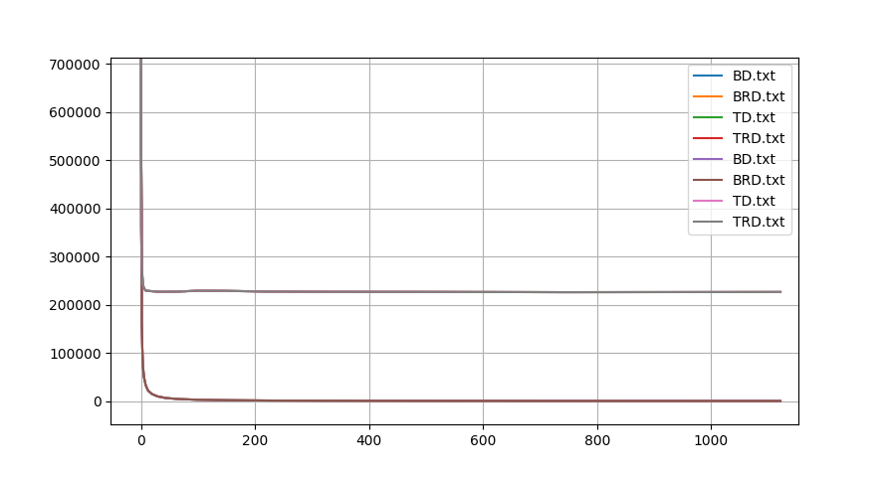
How Does Length of the Time Step Affect the Simulation?
Grey:
Binary Tree
Purple:
Binary Tree
Distance From Direct Summation
Inverse Length of Time Steps

Slide 27
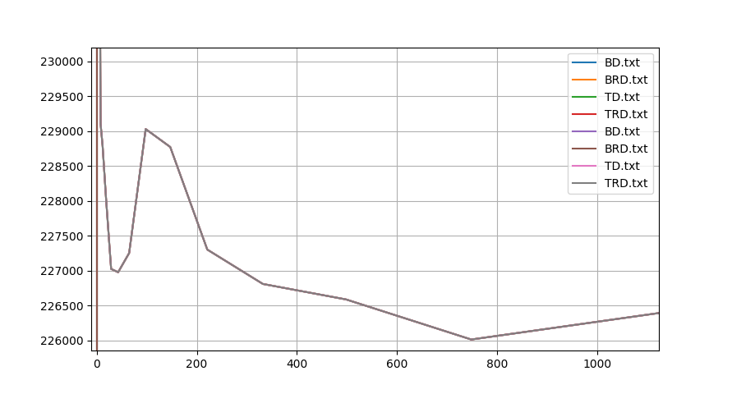
How Does Length of the Time Step Affect the Simulation?
Grey:
Binary Tree
Purple:
Binary Tree
Distance From Direct Summation
Inverse Length of Time Steps

Slide 28
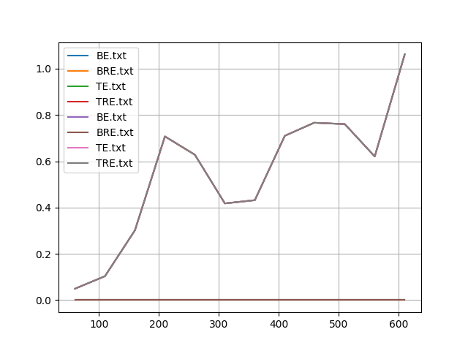
How Does Length of the Time Step Affect the Simulation?
Purple:
Binary Tree
Magenta:
Binary Tree
Energy
Length of Time Steps * 100

Slide 29
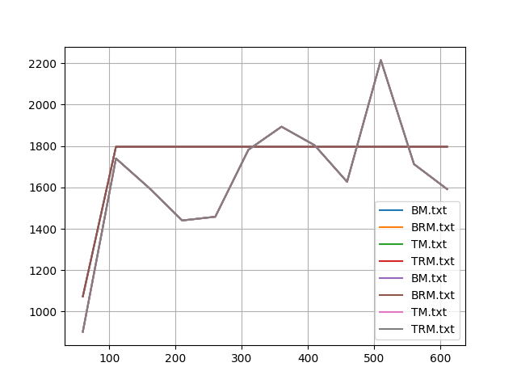
How Does Length of the Time Step Affect the Simulation?
Momentum
Purple:
Binary Tree
Magenta:
Binary Tree
Length of Time Steps

Slide 30
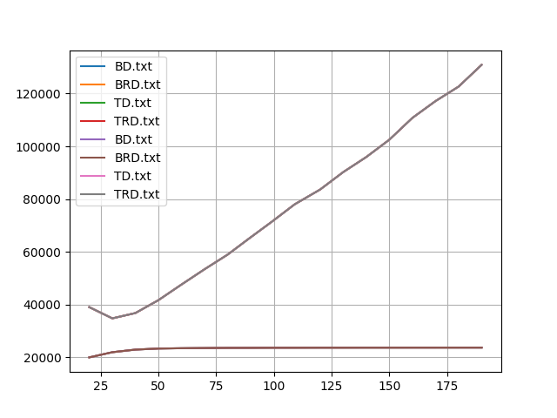
Does a Higher Initial Density of the Particles change the accuracy?
Purple:
Binary Tree
Magenta:
Binary Tree
Distance from Direct Sum
Density

Slide 31
Acknowledgements:
Owen Young
Johnny Powell

