Slide 1

Spiking Denoising Diffusion Probabilistic Models
Jiahang Cao1* Ziqing Wang2* Hanzhong Guo3 4* Hao Cheng1 Qiang Zhang1 Renjing Xu1†
From https://arxiv.org/abs/2306.17046
[Submitted on 29 Jun 2023]
Aug 25, 2023
Sungmin Yoon

Slide 2
Index
Background
Review of Attention mechanism
Model Architecture
(Experiment & Result)
Discussion

Slide 3
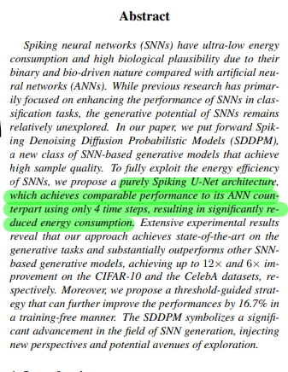
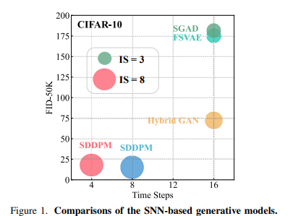
Introduction

Slide 4
Introduction : Why they choose diffusion model?
The generative potential of SNNs remains relatively unexplored.
vs GAN
Diffusion model is more stable
Easier to optimize
They said SDDPM is the first work that employs SNNs on diffusion models.

Slide 5
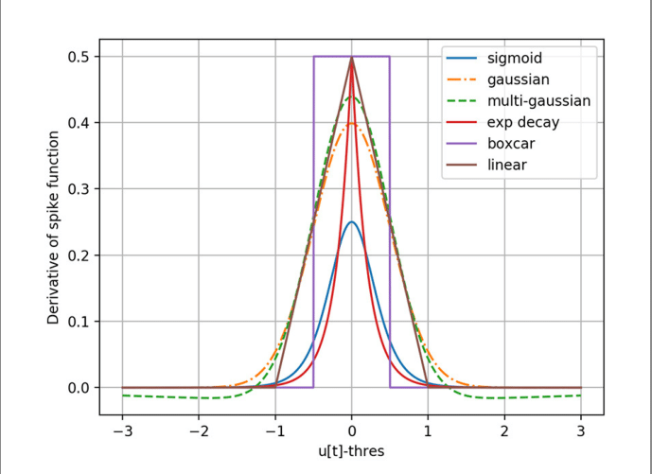
Introduction : Two ways to obtain deep SNN models
ANN-to-SNN conversion
Replacing the ReLU with spiking neurons
Direct training
Surrogate gradients for backprop.

Slide 6
Introduction :
Ann-to-SNN usually achieve higher accuracy.
But they choose Direct Training. Why?
Ann-to-SNN conversion require a longer time to train.
Ann-to-SNN conversion could not be fully deployed on neuromorphic hardware.
(i.e. to reduce power consumption)

Slide 7
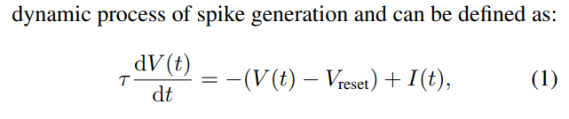
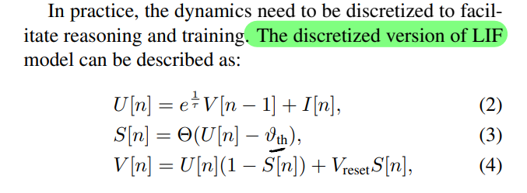
Introduction : Discretize LIF
Membrain potential
Before reset
Output spike
(formed with step func)
Membrain potential
After triggering spike

Slide 8
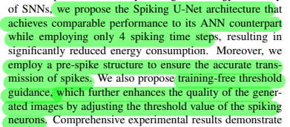
Introduction : What technics they use?
Spiking U-Net architecture
purely
Pre-spike residual structure
(first time)
Training-free
threshold guidance
(first time)

Slide 9
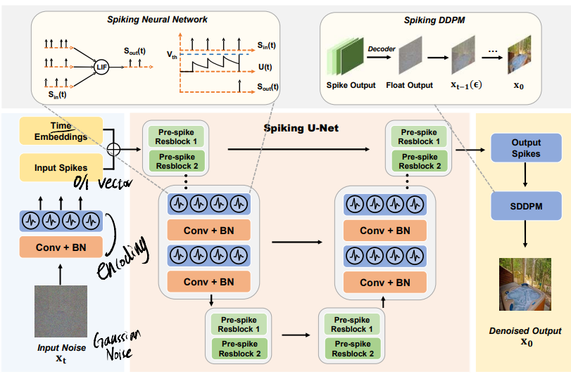
Introduction : What technics they use?
Spiking U-Net architecture
Pre-spike residual structure
Training-free threshold guidance

Slide 10
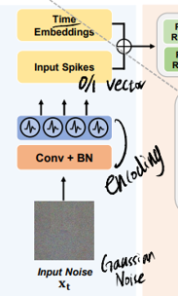
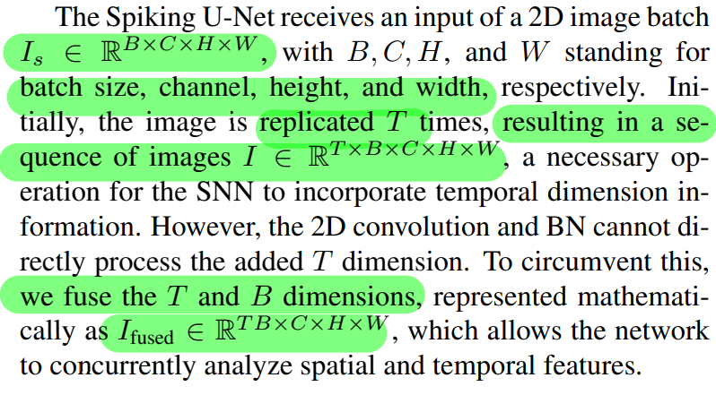
Introduction : What technics they use?
Spiking U-Net architecture
Pre-spike residual structure
Training-free threshold guidance

Slide 11
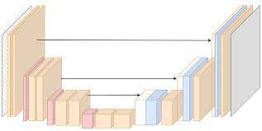
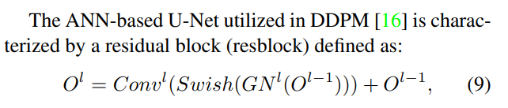
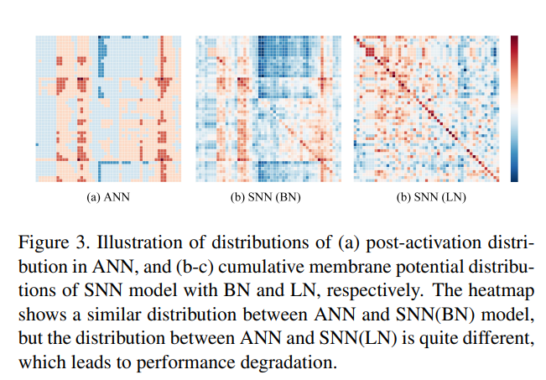
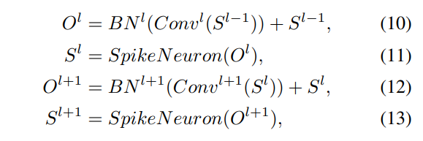
Introduction : What technics they use?
Spiking U-Net architecture
Pre-spike residual structure
Training-free threshold guidance
U-Net
Distribution Mismatch in SNN
From [42] Masked Spiking Transformer
So, they use BN -> better capture spatial feature
Notes:
distribution mismatch
ANN은 채널이 매우 많아서 괜찮은데 SNN은 채널이 적어서 값이 망가짐
스파이크의 타이밍 -> 스파이크의 패턴 **
GN은 이 패턴을 단순화 시킬 수 있음
스파이크를 convolution layer에 넣는 방법?
- time window를 input으로
- 스파이크 인코딩

Slide 12
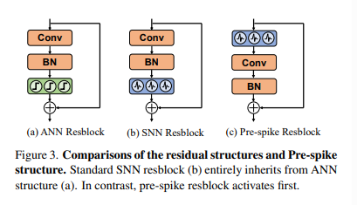
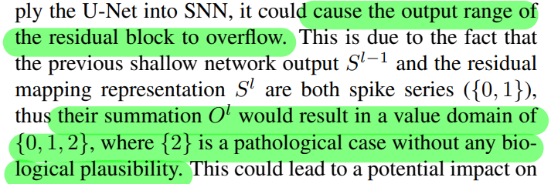

Introduction : What technics they use?
Spiking U-Net architecture
Pre-spike residual structure
Training-free threshold guidance

Slide 13
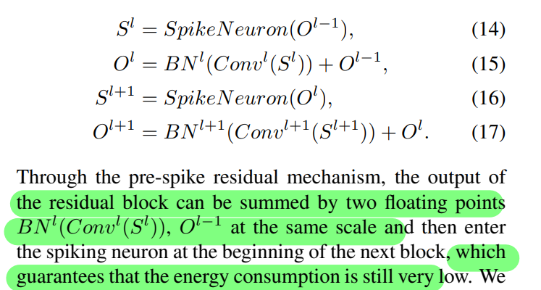
Introduction : What technics they use?
Spiking U-Net architecture
Pre-spike residual structure
Training-free threshold guidance

Slide 14
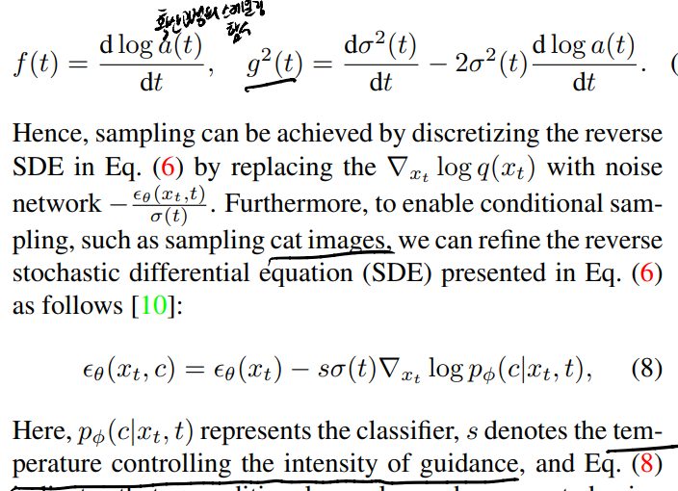
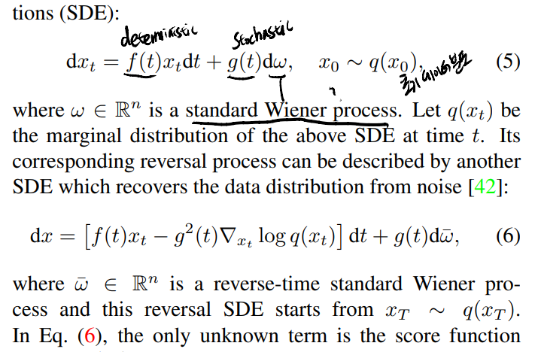
Introduction : What technics they use?
Spiking U-Net architecture
Pre-spike residual structure
Training-free threshold guidance

Slide 15
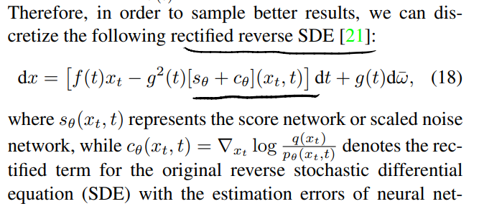
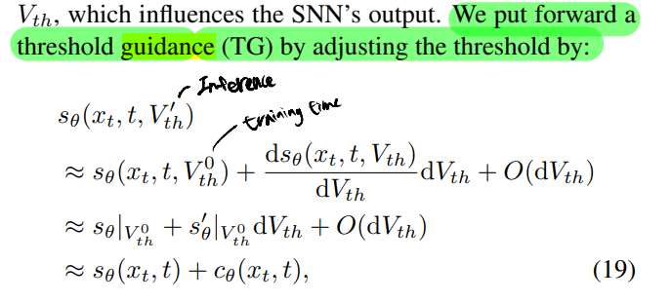
Introduction : What technics they use?
Spiking U-Net architecture
Pre-spike residual structure
Training-free threshold guidance

Slide 16
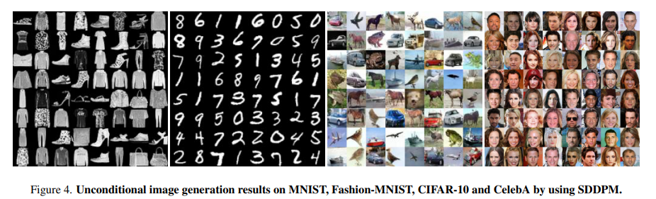
Experiment & Result

Slide 17
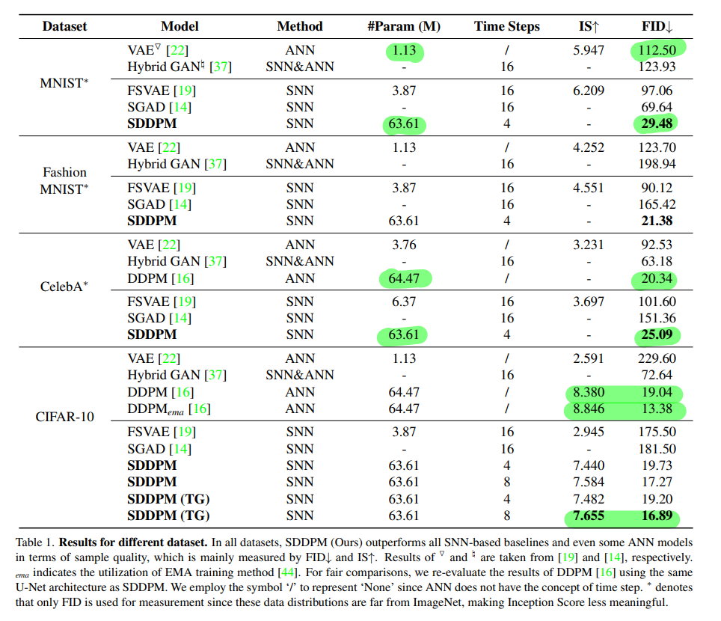
Experiment & Result

Slide 18
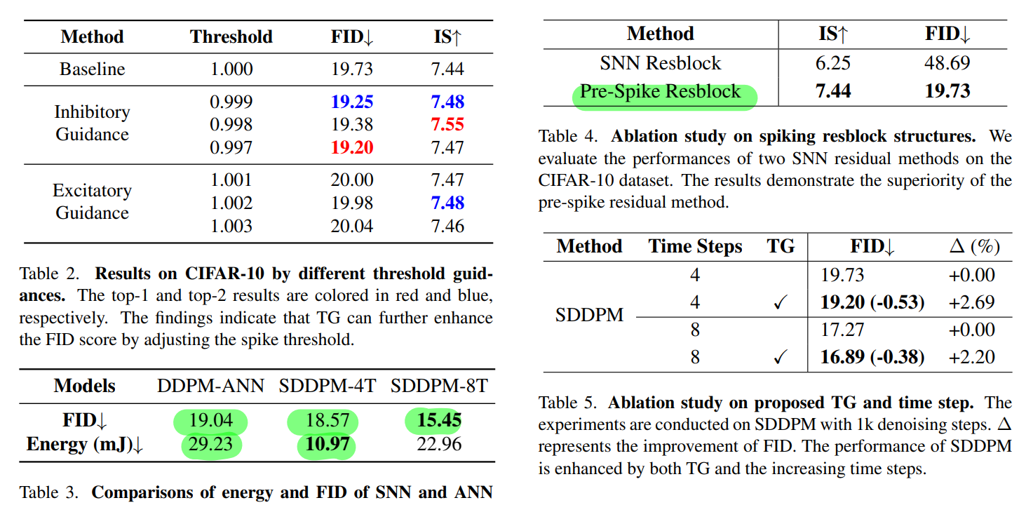
Experiment & Result

Slide 19
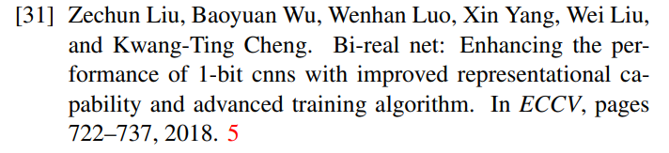
Discussion
Good point
Novel and good attempts
First time to use diffusion model in SNN, TG, pre-spike residual
Good performance with few steps
Weak point
Only low resolution-datasets
What about DDIM, Analytic-DPM
-> They plan to…

