Slide 1
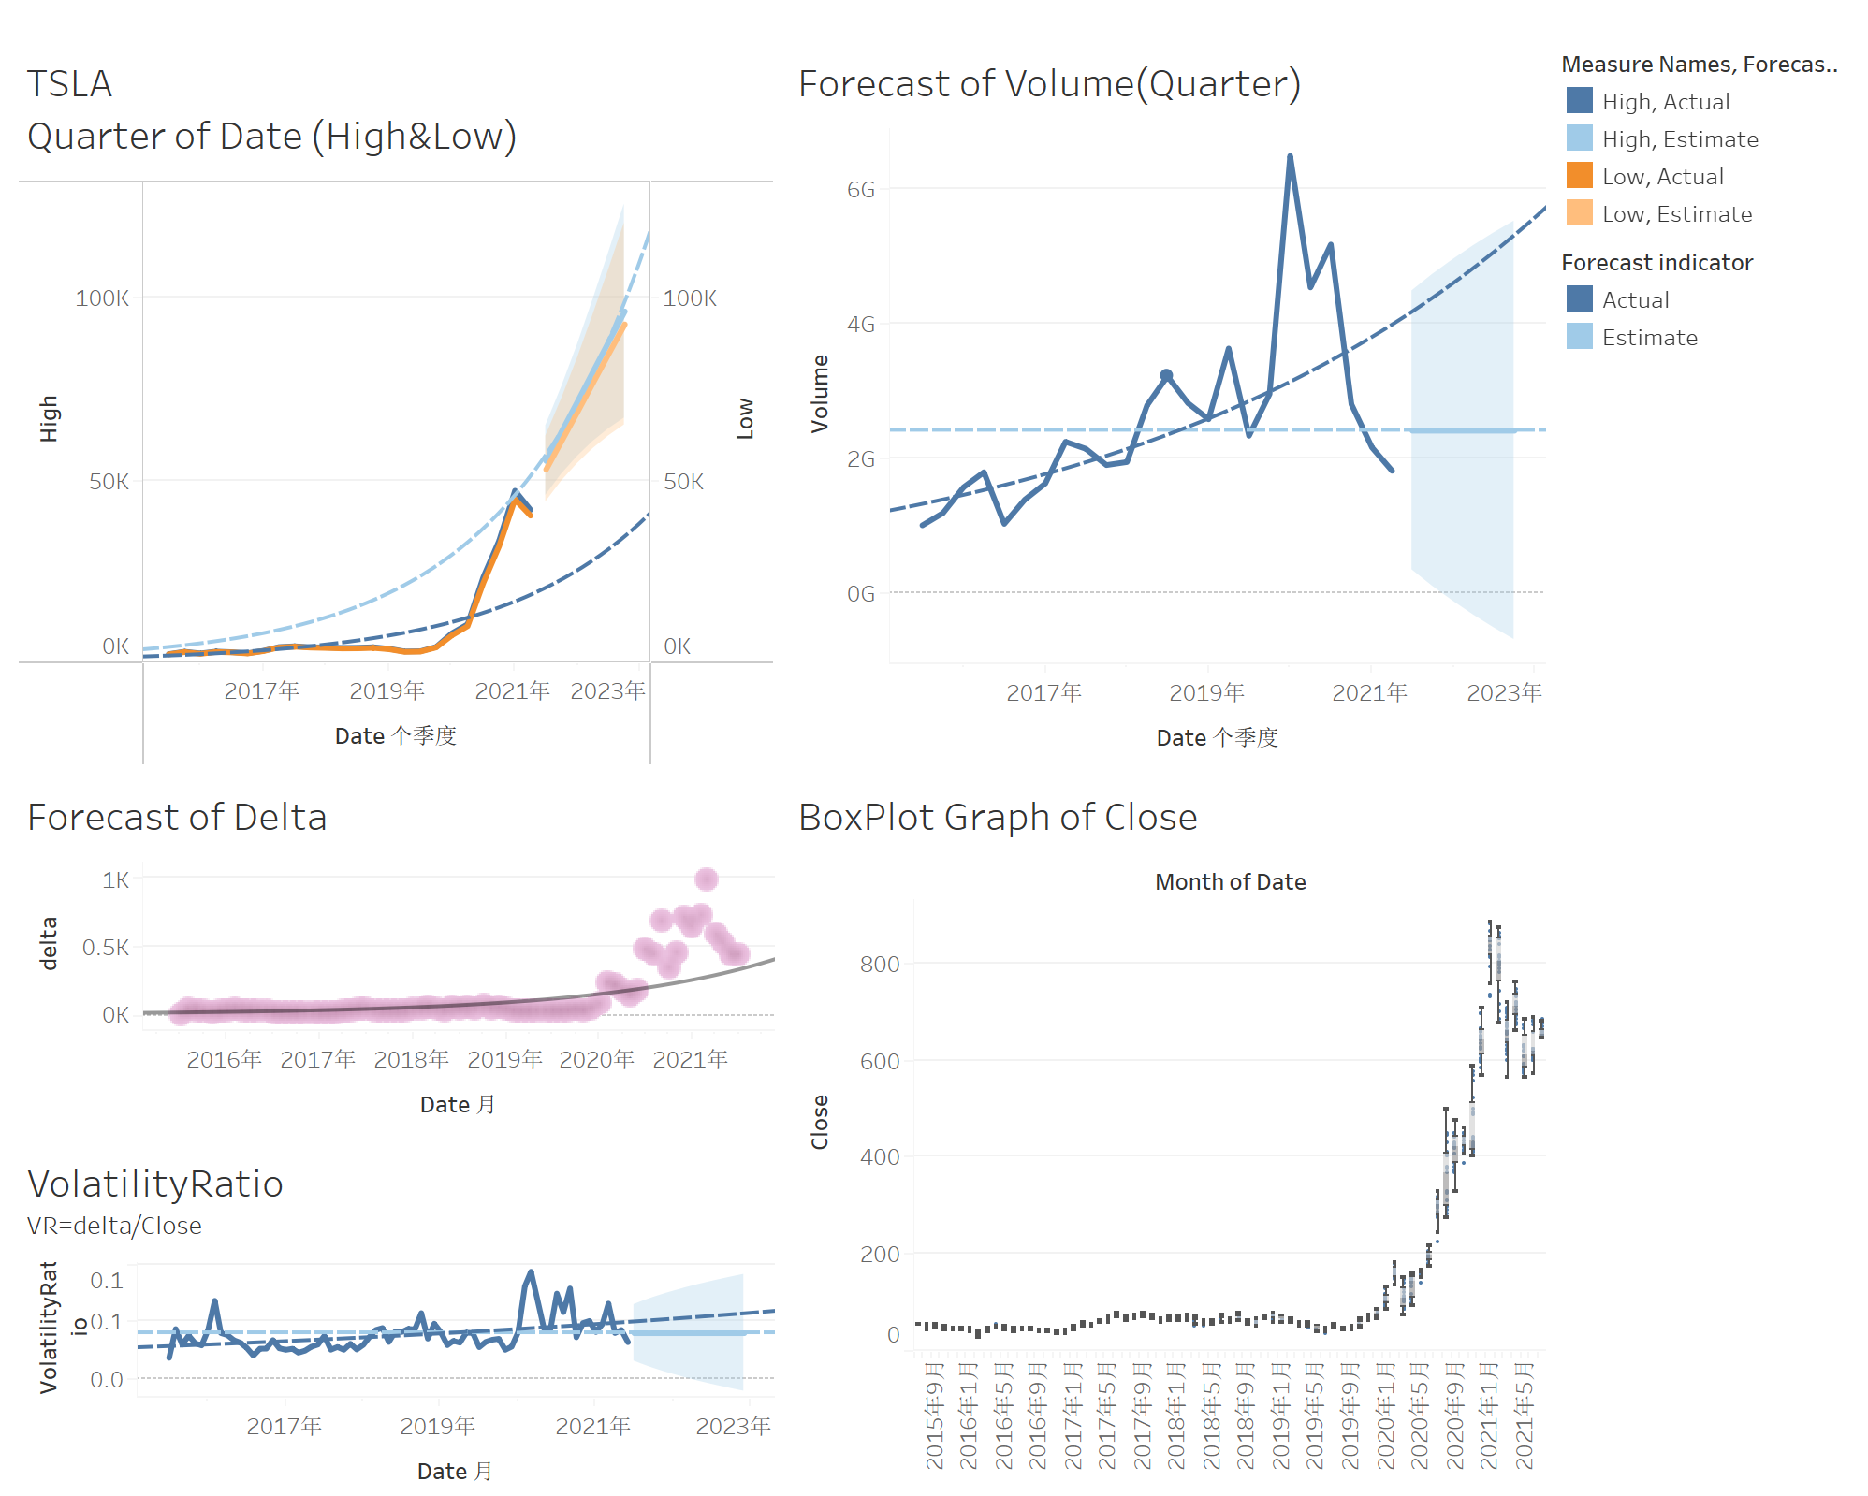
Team B Project
The Data Analysis about Tesla and Facebook Stock
Members
Dong Liu, Tianyang Liao,Zixuan Lu, Siyuan Li

Slide 2
Data Source
Data comes from https://finance.yahoo.com
Two stocks are Facebook and Tesla
Data Manipulation
No data cleaning: no null values appears in data set.
Some attributes added: max_Delta(Max Price-Low Price), Delta(Close Price-Open Price), KPI(shows if the Delta is positive).

Slide 3
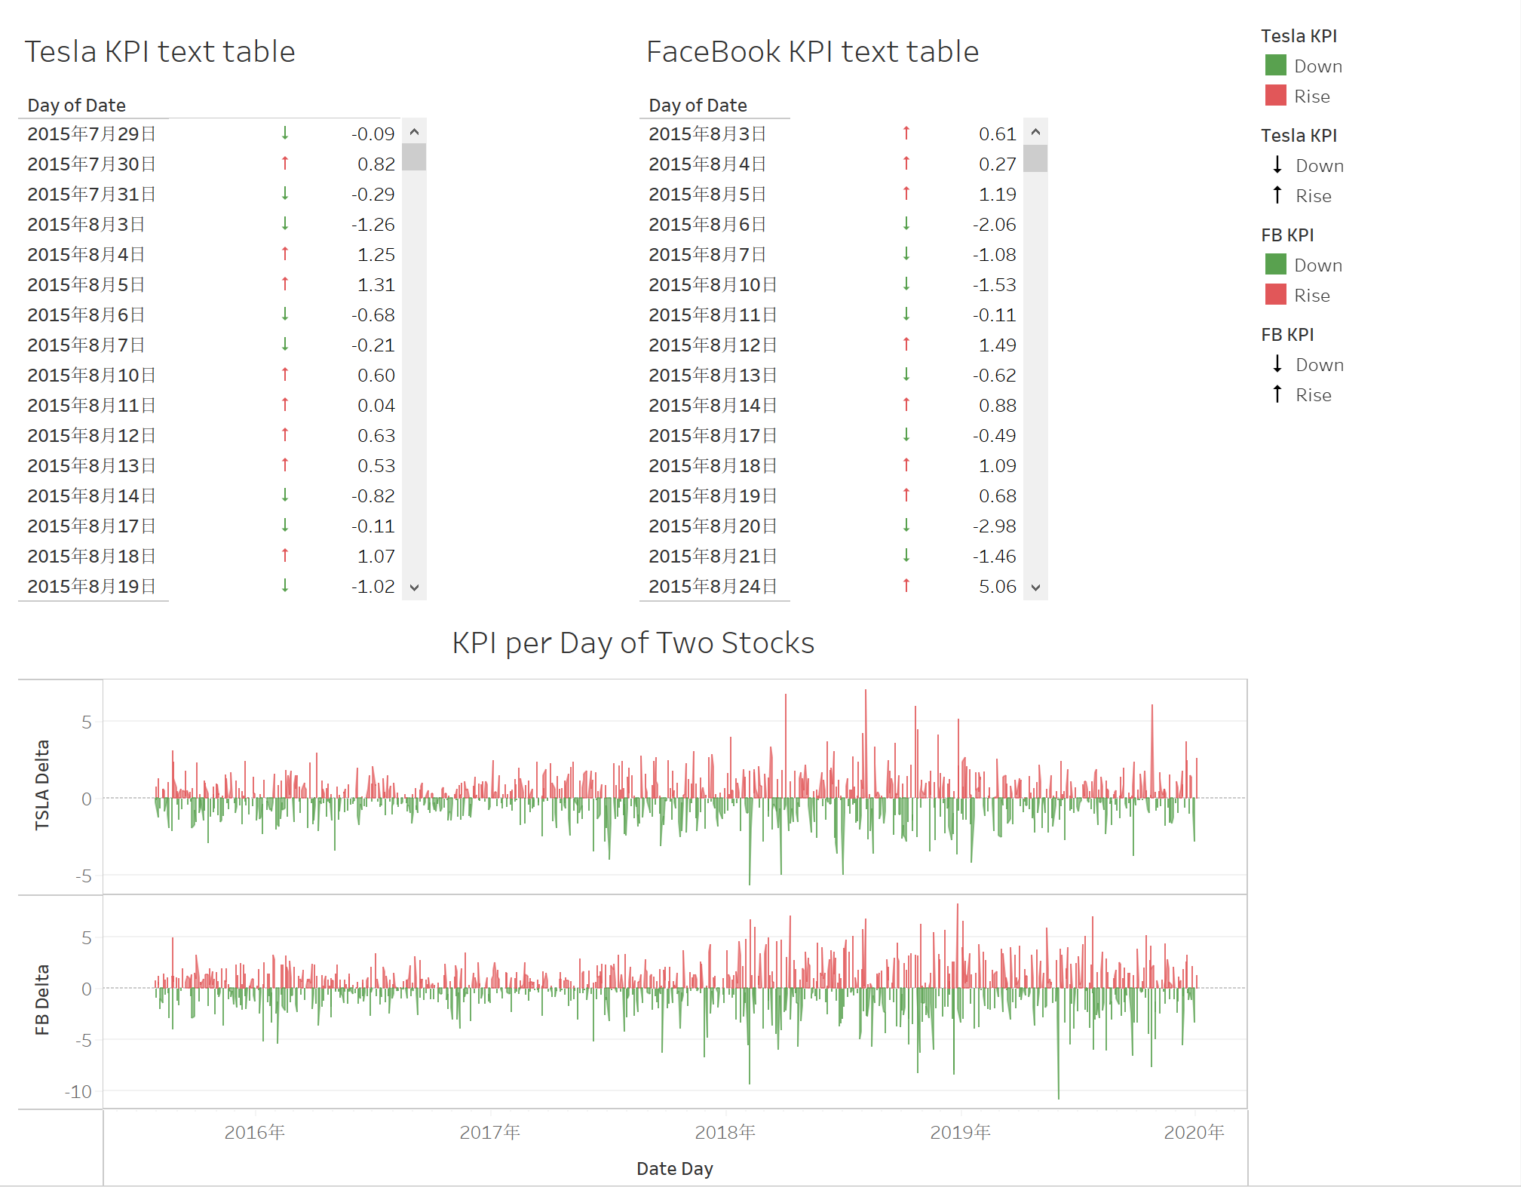
KPI(IF Delta>0 THEN "Rise“ ELSE "Down“ END)

Slide 4
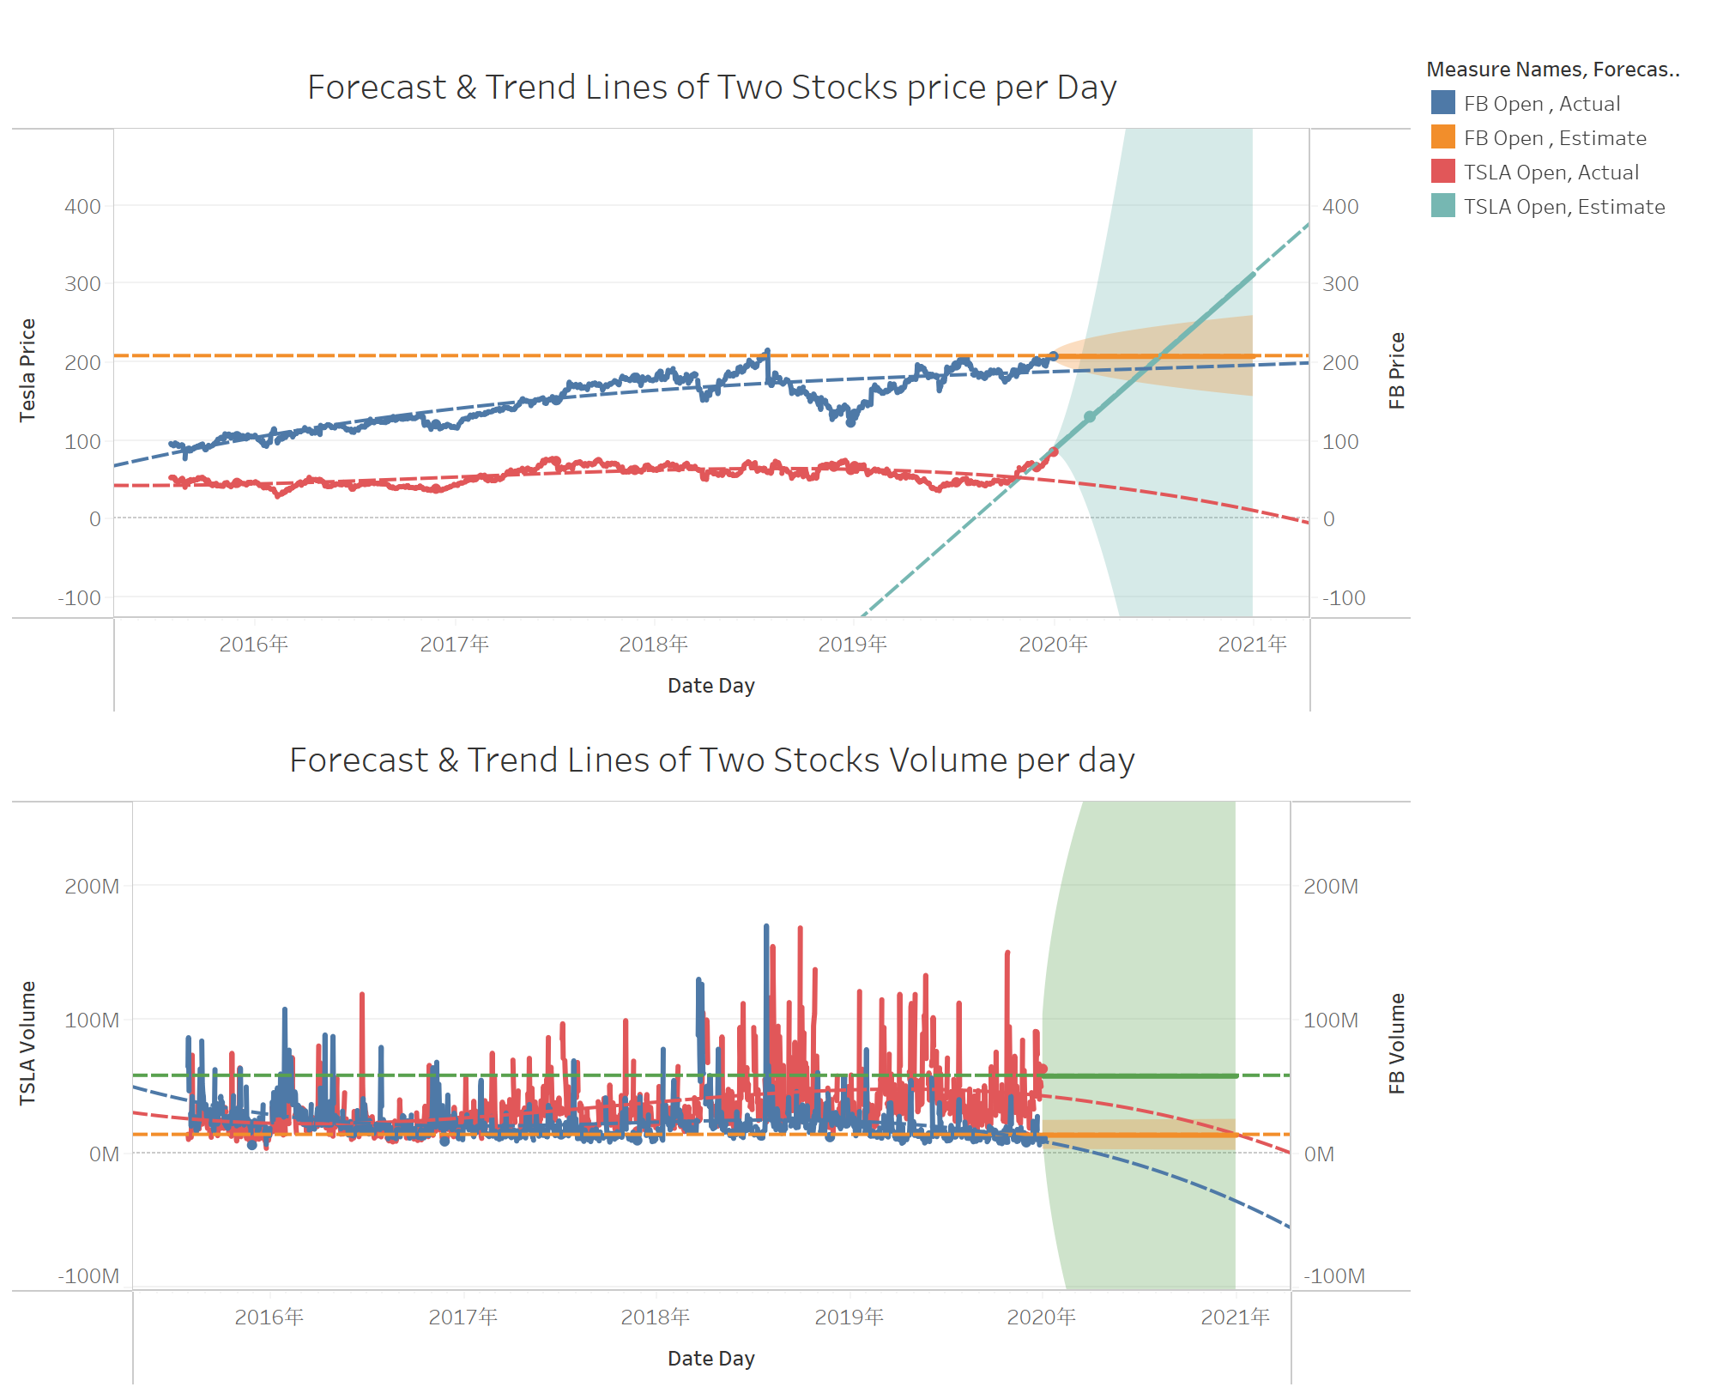
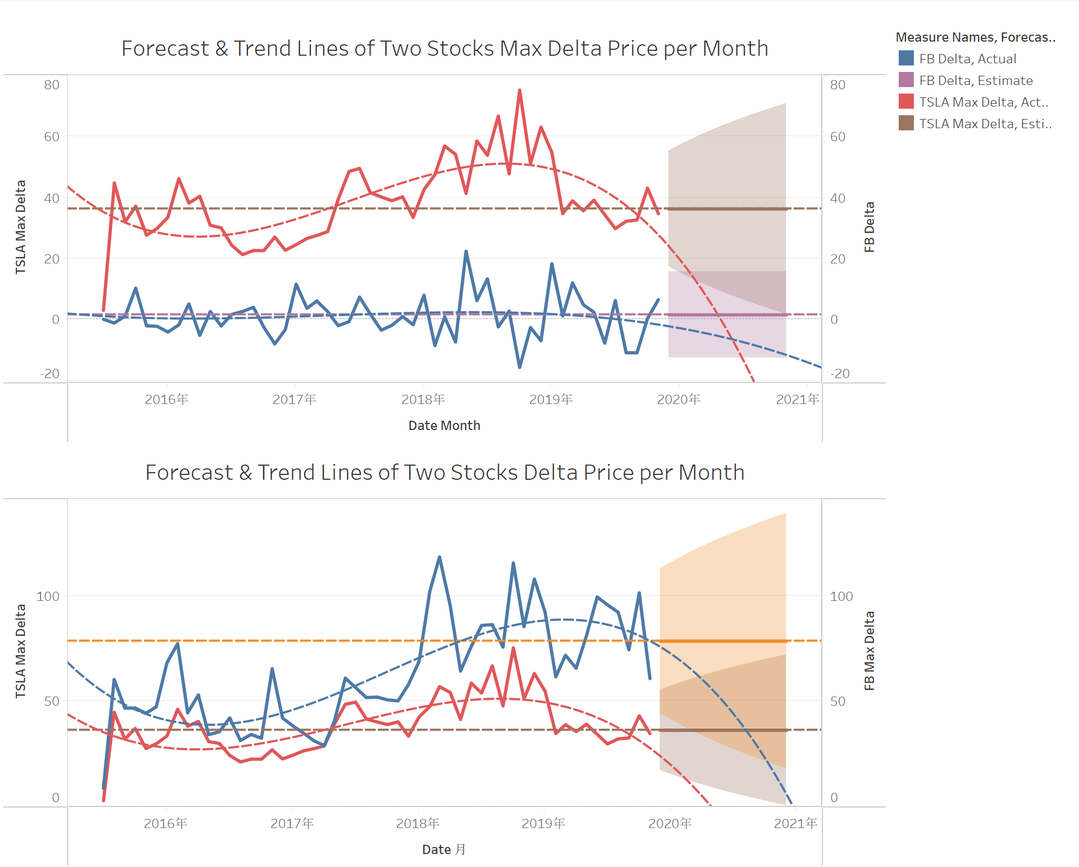
Forecast & Trend Lines of Two Stocks

Slide 5
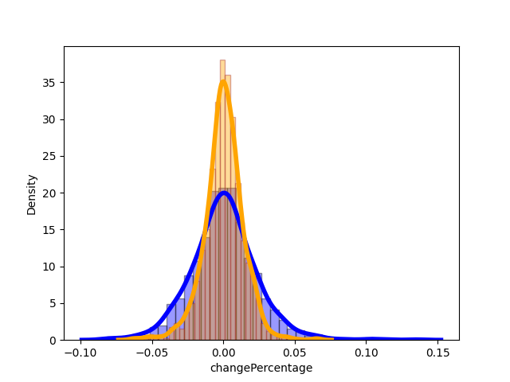
Density (frequency) Plot of Change Percentage
In order to estimate and compare this two stock’s profit rate and risk, a new type of attribute, ChangePercentage, that present daily relatively change of price, is introduced for each stock. The formula that defines ChangePercentage is shown in below:
dftsla['changePercentage'] = dftsla['Close'] / dftsla['Open'] - dftsla['Open'] / dftsla['Open']
dffb['changePercentage'] = dffb['Close'] / dffb['Open'] - dffb['Open'] / dffb['Open’]
According to the change percentage of the two stock, we made this histogram, that can conveniently present and compare their risk and profit expectation.

Slide 6
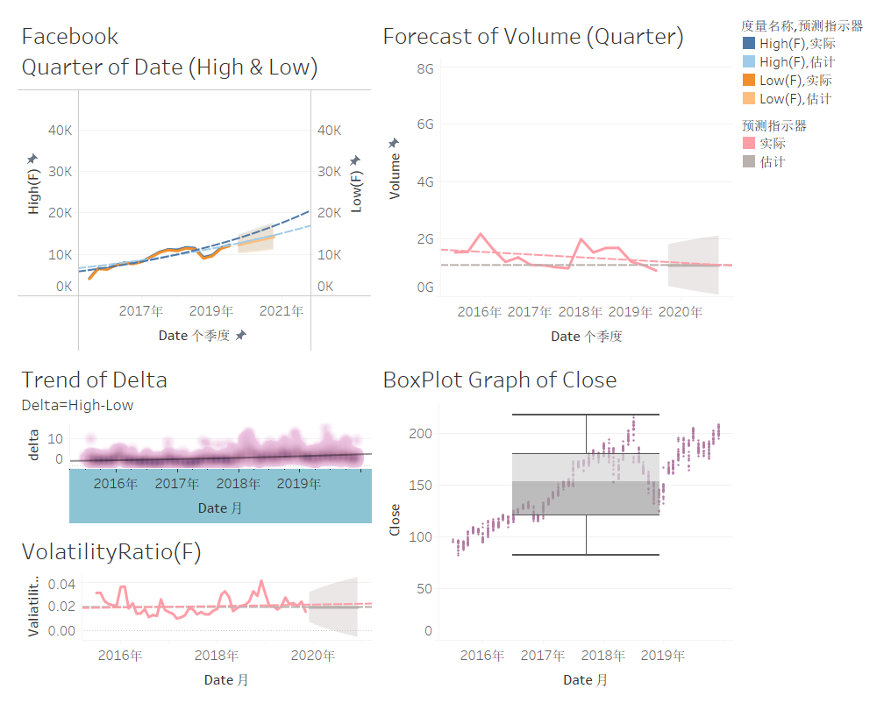
Facebook Analysis

Slide 7
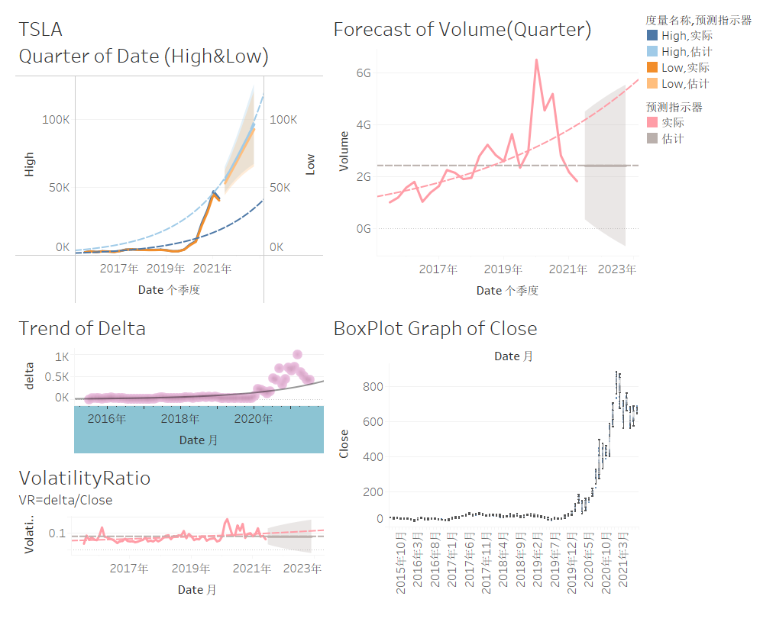
TSLA Analysis

Slide 8
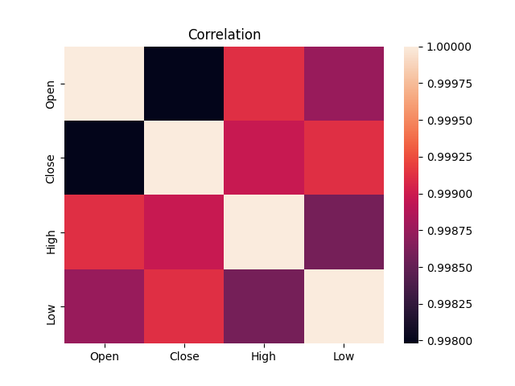
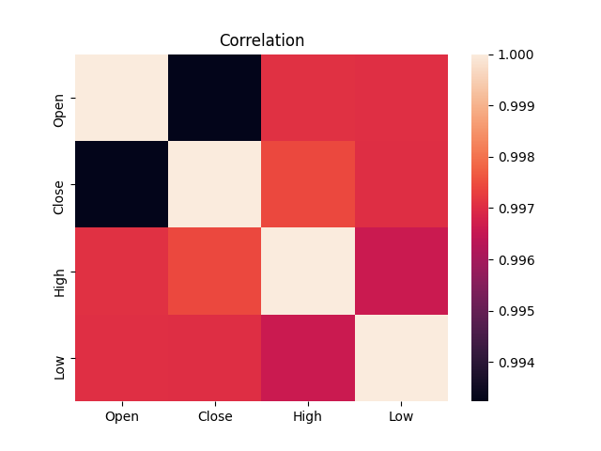
The Correlation
FB Correlation Matrix
TSLA Correlation Matrix
Strong Correlation

Slide 9
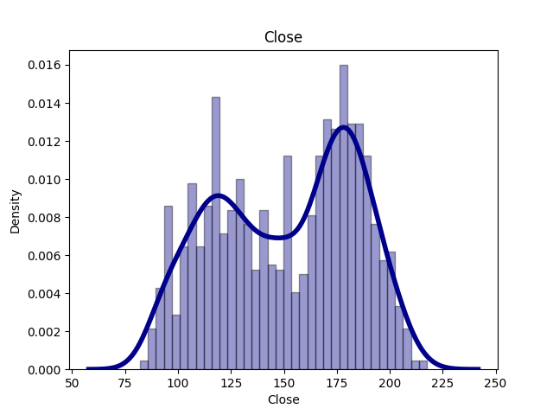
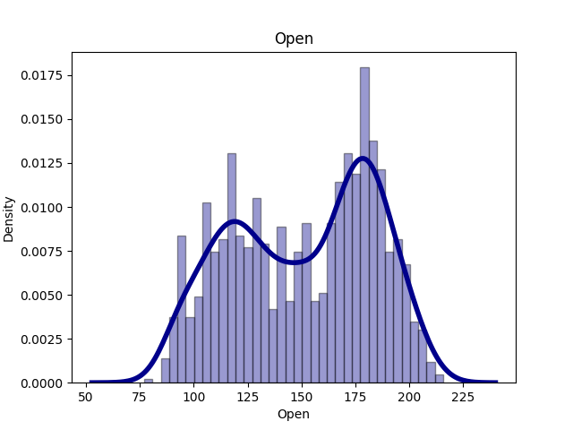
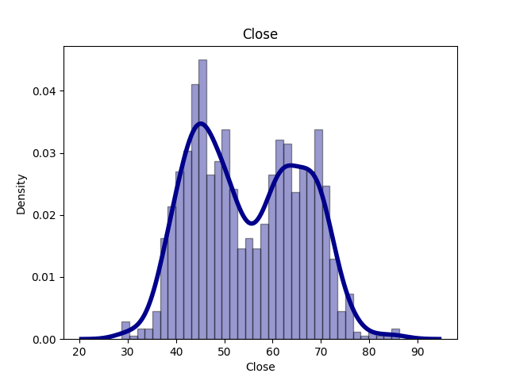
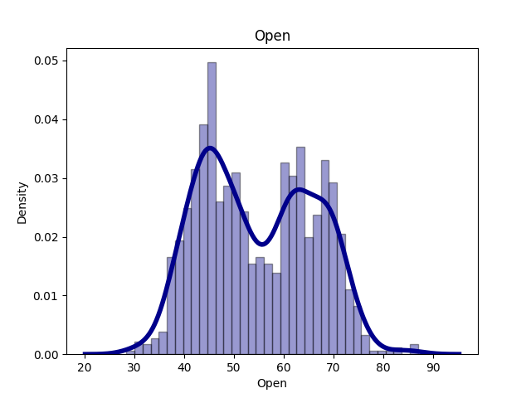
Histogram & Density Plot
The density of the open price falling in this range is the highest
Good Price
FB Close Price
FB Open Price
TSLA Close Price
TSLA Open Price
The first peak shows the consequences of the past.

Slide 10
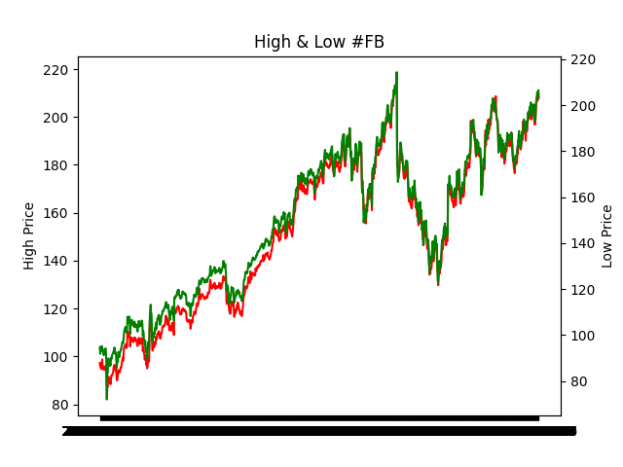
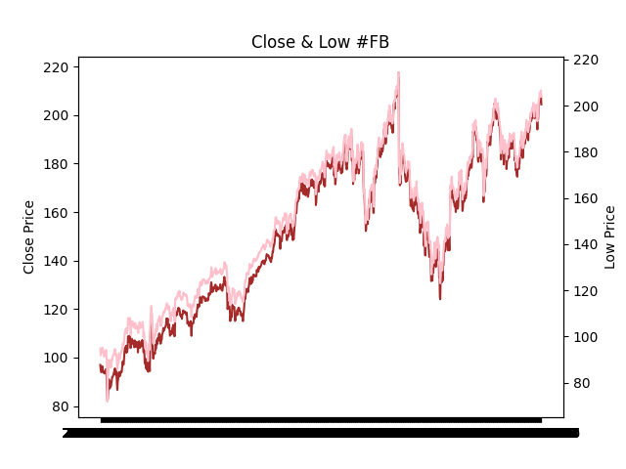
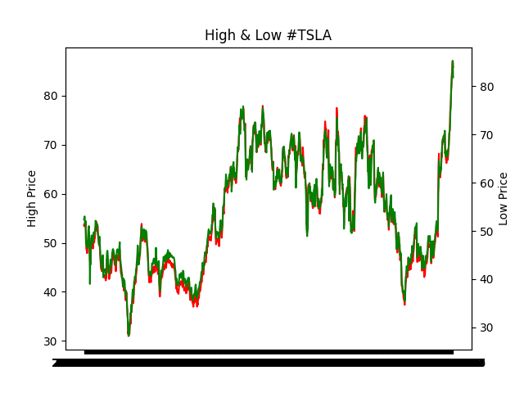
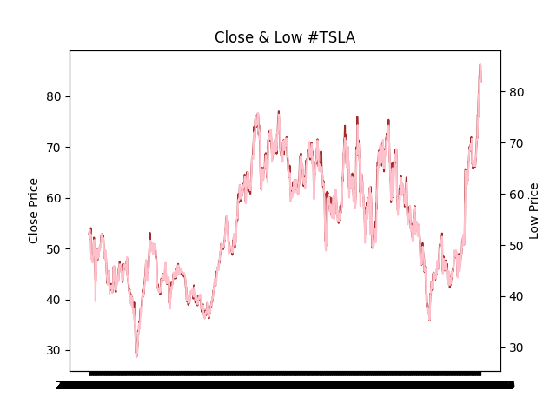
Comparison Graph about High & Low Price, High & Open Price
TSLA
FB

Slide 11
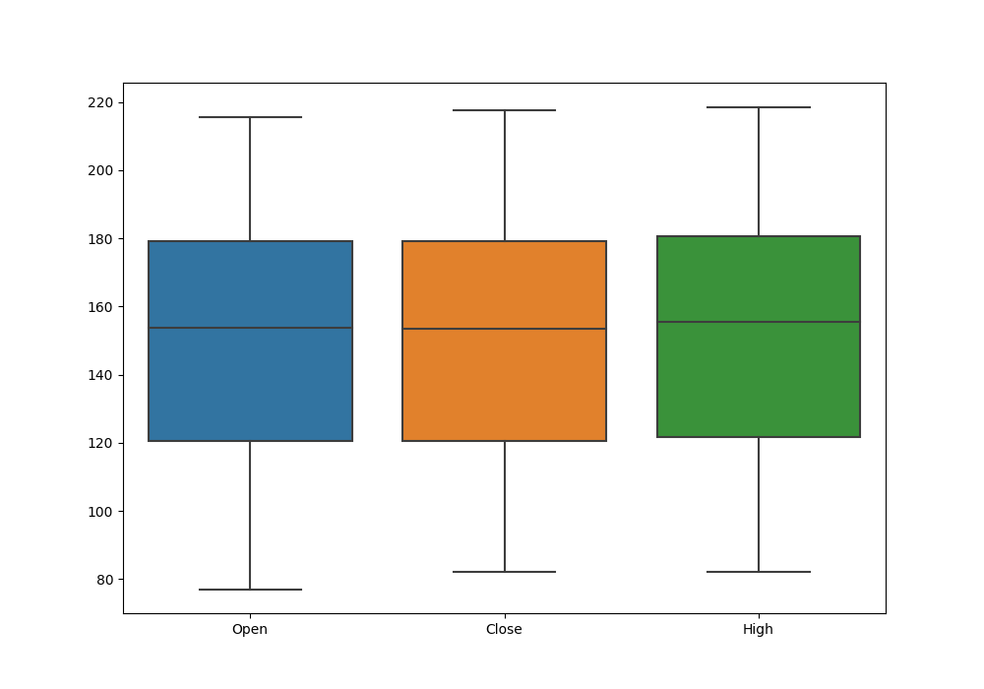
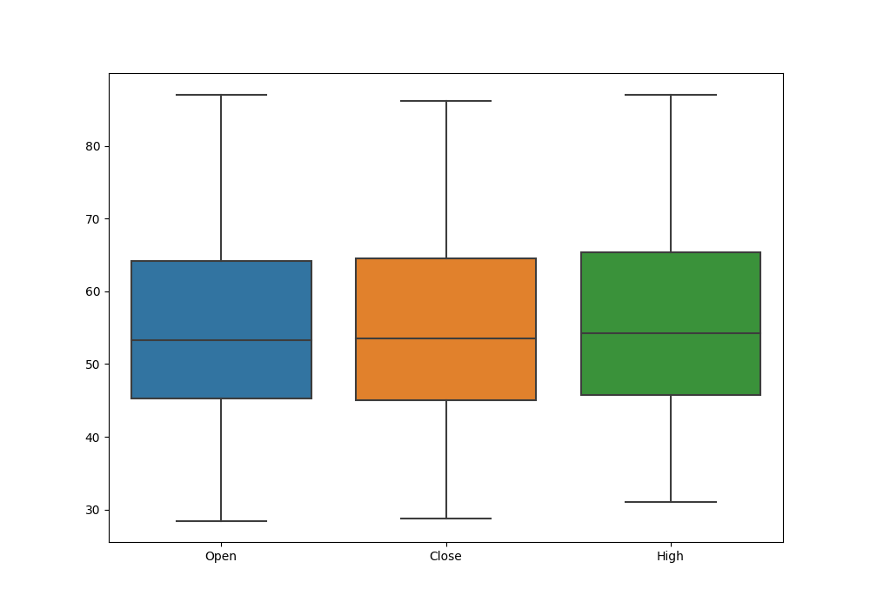
BoxPlot
FB
TSLA

Slide 12
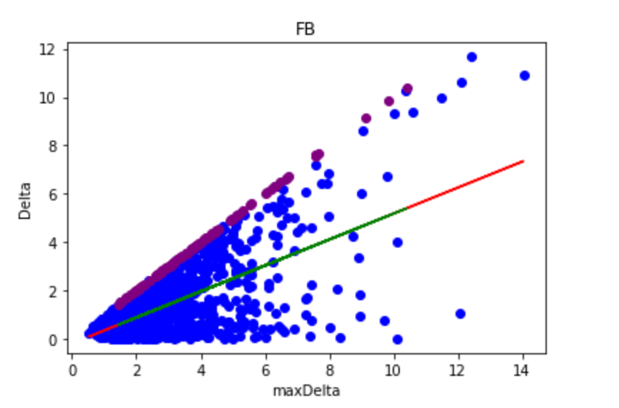
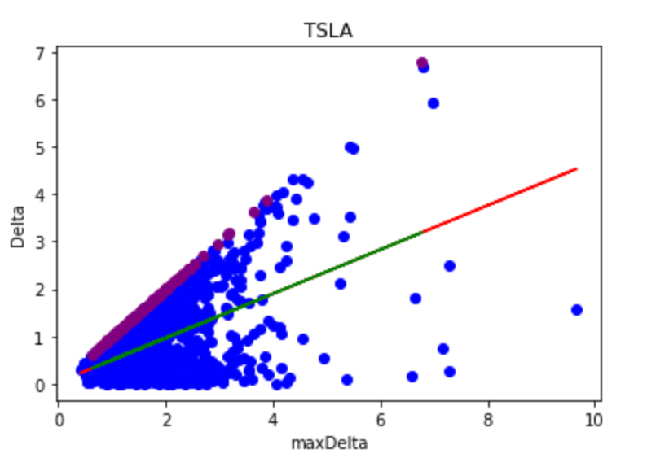
Linear Regression Model on Delta and Max Delta

Slide 13
Introduction to Lasso Regression & Elastic Net
In statistics and machine learning, lasso (least absolute shrinkage and selection operator; also Lasso or LASSO) is a regression analysis method that performs both variable selection and regularization in order to enhance the prediction accuracy and interpretability of the resulting statistical model. It was originally introduced in geophysics, and later by Robert Tibshirani, who coined the term. Lasso was originally formulated for linear regression models. This simple case reveals a substantial amount about the estimator. These include its relationship to ridge regression and best subset selection and the connections between lasso coefficient estimates and so-called soft thresholding. It also reveals that (like standard linear regression) the coefficient estimates do not need to be unique if covariates are collinear.
Reference: https://en.wikipedia.org/wiki/Lasso_(statistics)
In statistics and, in particular, in the fitting of linear or logistic regression models, the elastic net is a regularized regression method that linearly combines the L1 and L2 penalties of the lasso and ridge methods.
Reference: https://en.wikipedia.org/wiki/Elastic_net_regularization

Slide 14
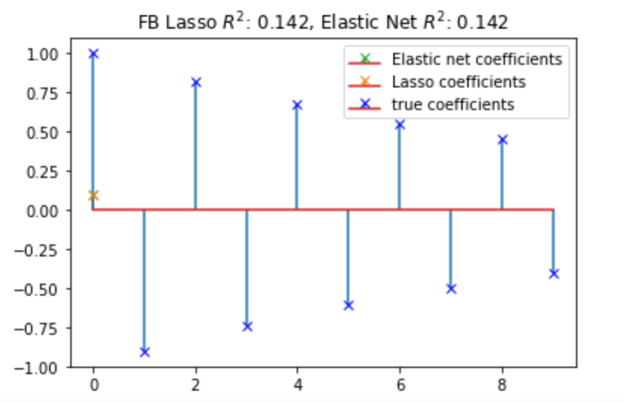
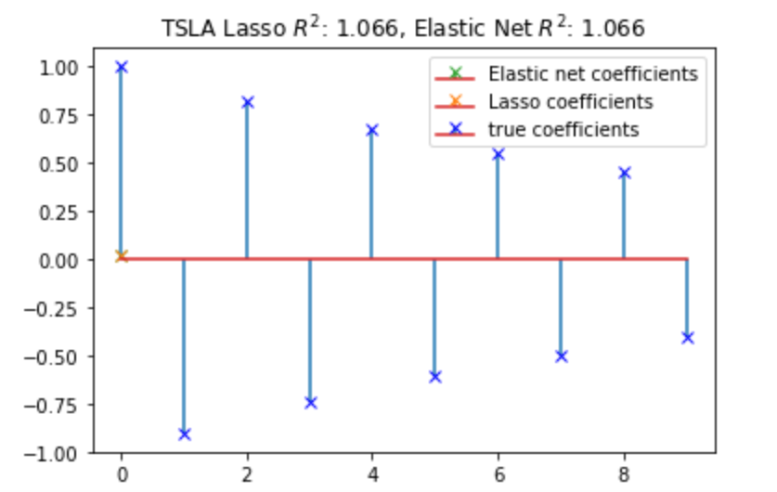
Lasso Regression & Elastic Net on Trading Days and Stocks Price

Slide 15
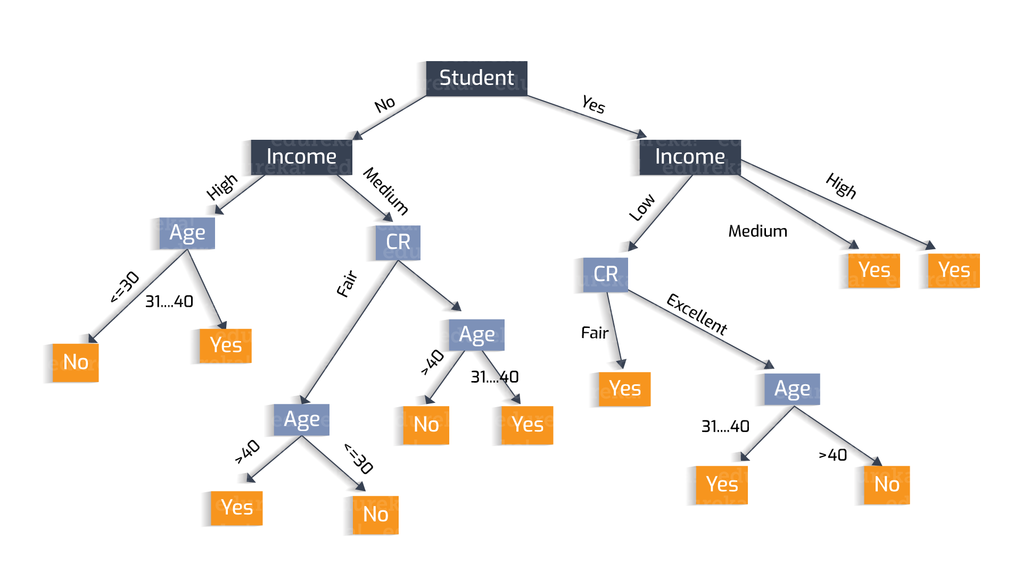
Introduction to Decision Tree
A decision tree is a decision support tool that uses a tree-like model of decisions and their possible consequences, including chance event outcomes, resource costs, and utility. It is one way to display an algorithm that only contains conditional control statements.
Decision trees are commonly used in operations research, specifically in decision analysis, to help identify a strategy most likely to reach a goal, but are also a popular tol in machine learning.
Reference: https://en.wikipedia.org/wiki/Decision_tree
Reference: https://heartbeat.fritz.ai/understanding-the-mathematics-behind-decision-trees-22d86d55906

Slide 16
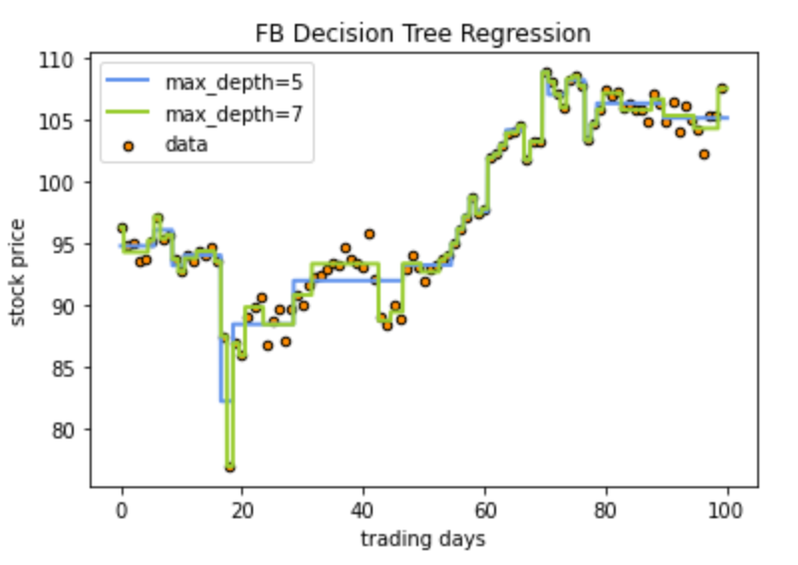
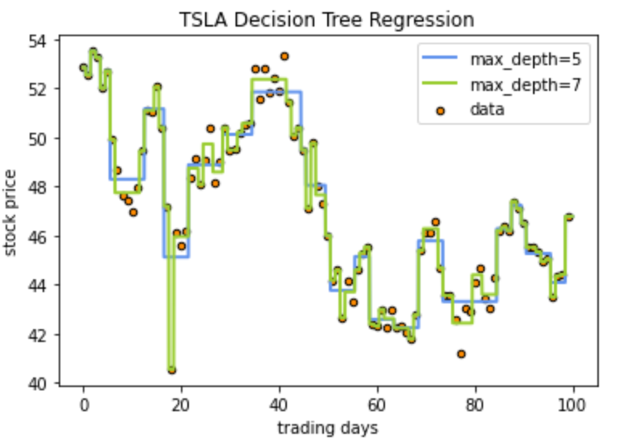
Decision Trees Regression on Trading Days and Stocks Price

Slide 17
Introduction to Polynomial Regression
In statistics, polynomial regression is a form of regression analysis in which the relationship between the independent variable x and the dependent variable y is modelled as an nth degree polynomial in x. Polynomial regression fits a nonlinear relationship between the value of x and the corresponding conditional mean of y, denoted E(y |x). Although polynomial regression fits a nonlinear model to the data, as a statistical estimation problem it is linear, in the sense that the regression function E(y | x) is linear in the unknown parameters that are estimated from the data. For this reason, polynomial regression is considered to be a special case of multiple linear regression.
Reference: https://en.wikipedia.org/wiki/Polynomial_regression

Slide 18
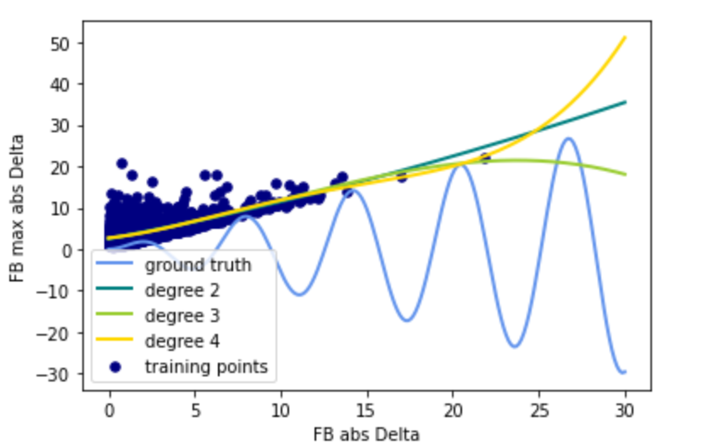
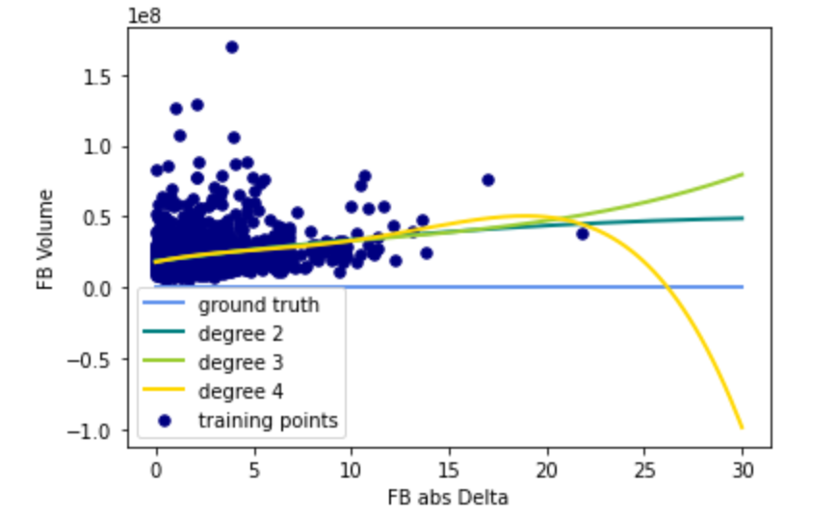
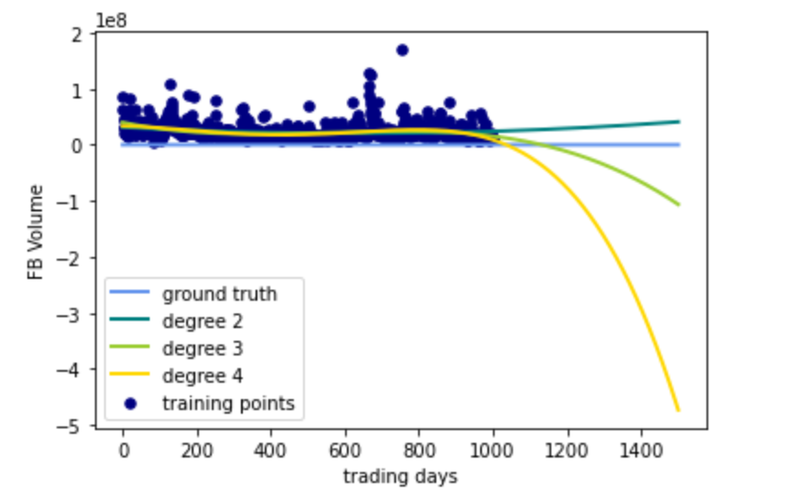
Polynomial Regression
Polynomial Regression on abs Delta Price and Max Delta Price of Facebook
Polynomial Regression on abs Delta Price and Volume of Facebook
Polynomial Regression on Trading Days and Stocks Price

Slide 19
Introduction to PCR &PLS
In statistics, principal component regression (PCR) is a regression analysis technique that is based on principal component analysis (PCA). More specifically, PCR is used for estimating the unknown regression coefficients in a standard linear regression model. In PCR, instead of regressing the dependent variable on the explanatory variables directly, the principal components of the explanatory variables are used as regressors. One typically uses only a subset of all the principal components for regression, making PCR a kind of regularized procedure and also a type of shrinkage estimator.
Reference: https://en.wikipedia.org/wiki/Principal_component_regression
Partial least squares regression (PLS regression) is a statistical method that bears some relation to principal components regression; instead of finding hyperplanes of maximum variance between the response and independent variables, it finds a linear regression model by projecting the predicted variables and the observable variables to a new space. Because both the X and Y data are projected to new spaces, the PLS family of methods are known as bilinear factor models. Partial least squares discriminant analysis (PLS-DA) is a variant used when the Y is categorical.
Reference: https://en.wikipedia.org/wiki/Partial_least_squares_regression

Slide 20
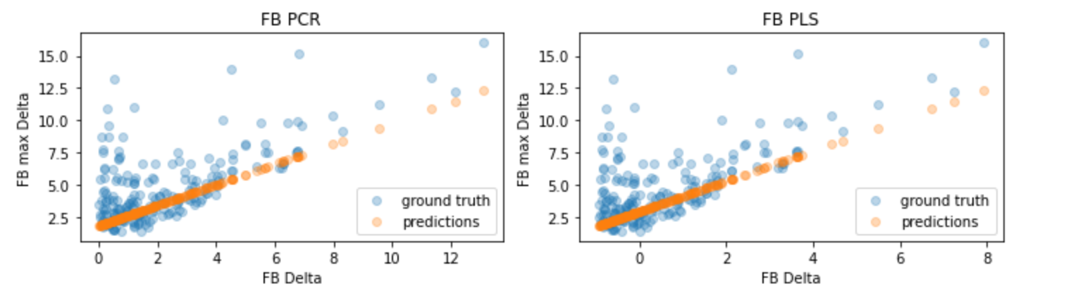
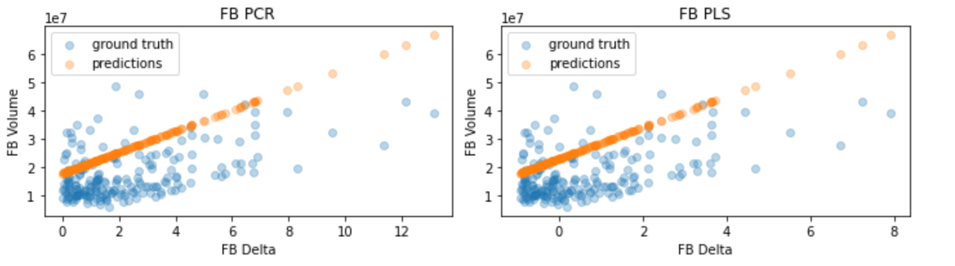
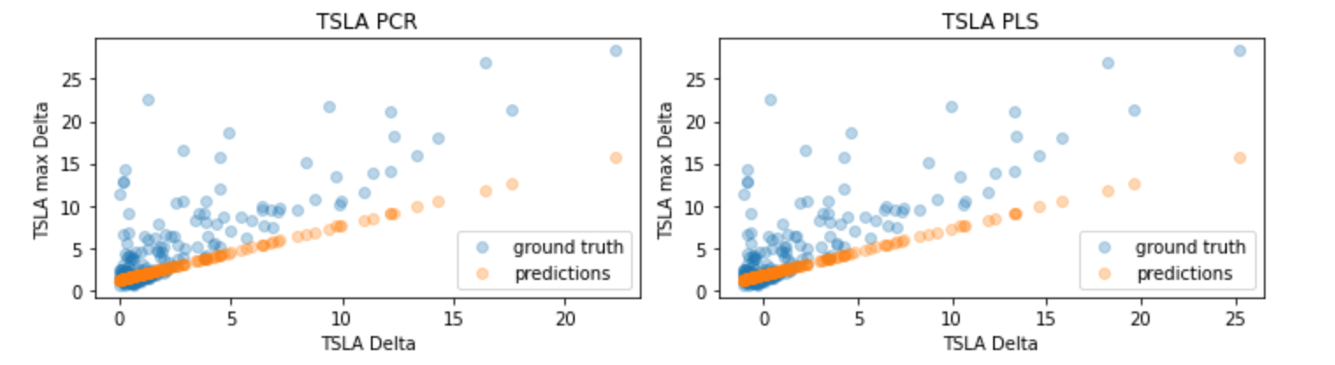
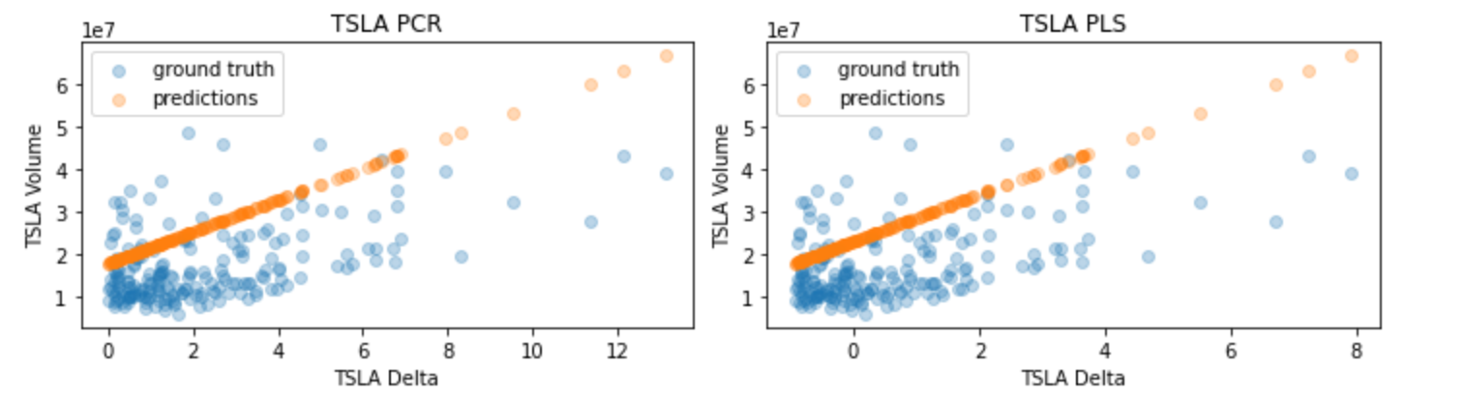
PCR & PLS

Slide 21
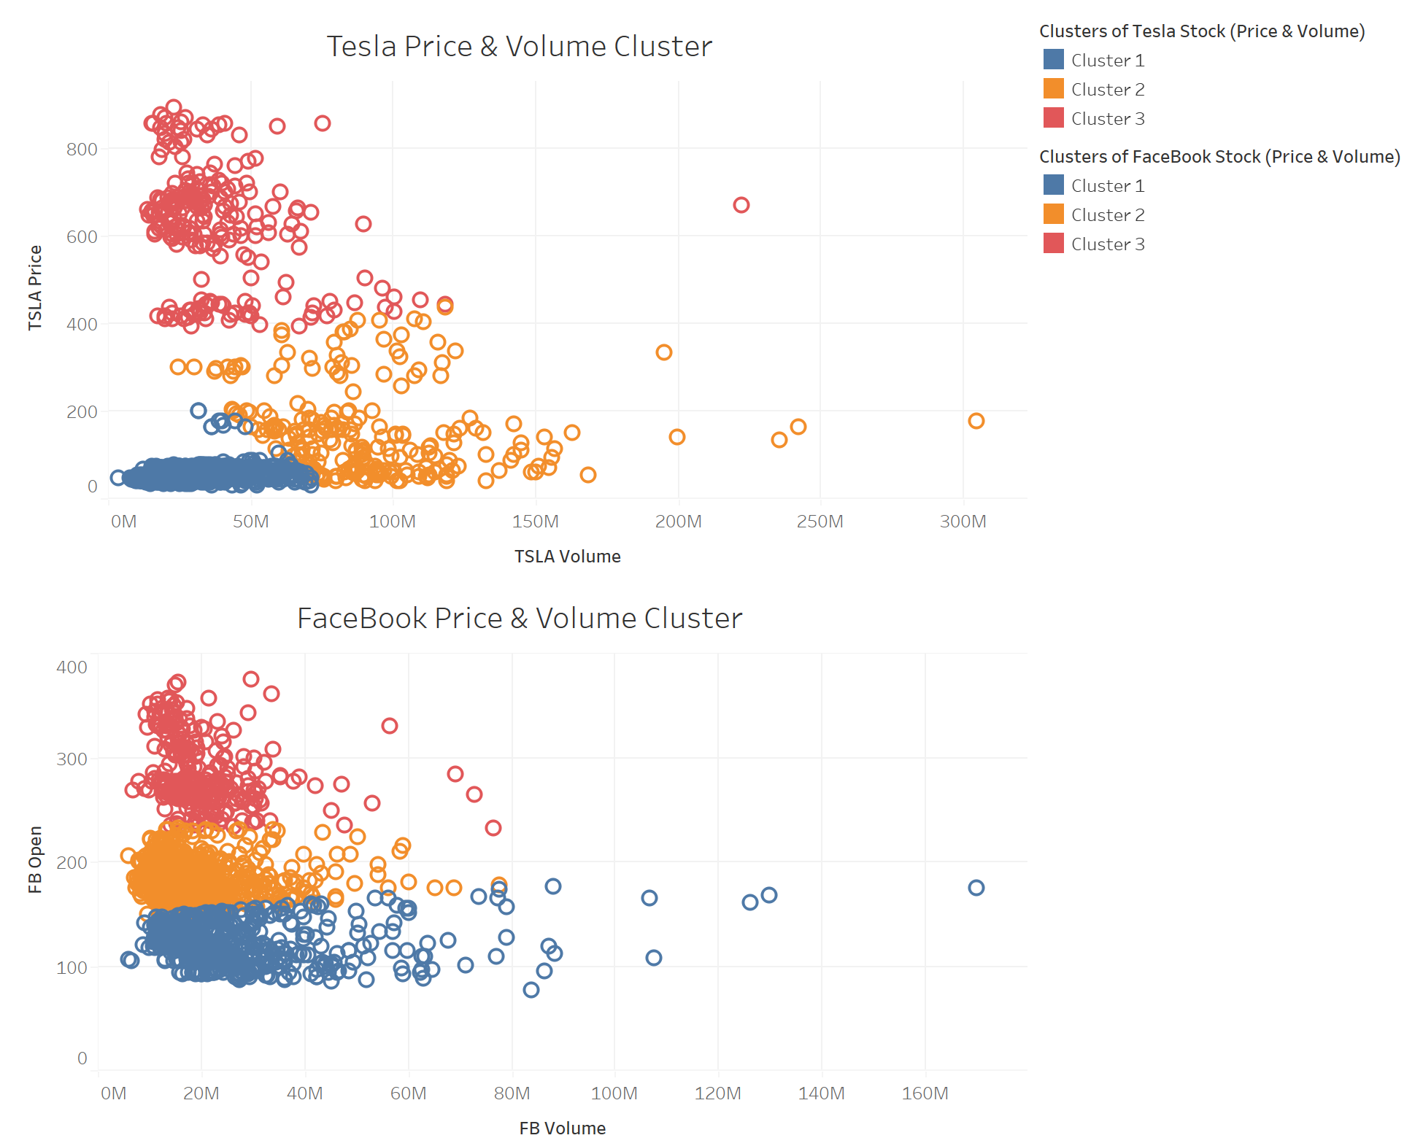
Clusters of Price and Volume of Two Stocks

Slide 22
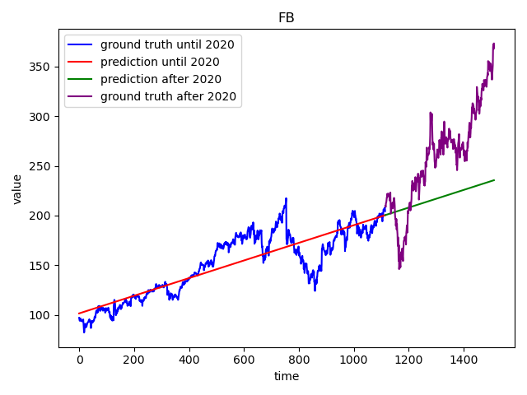
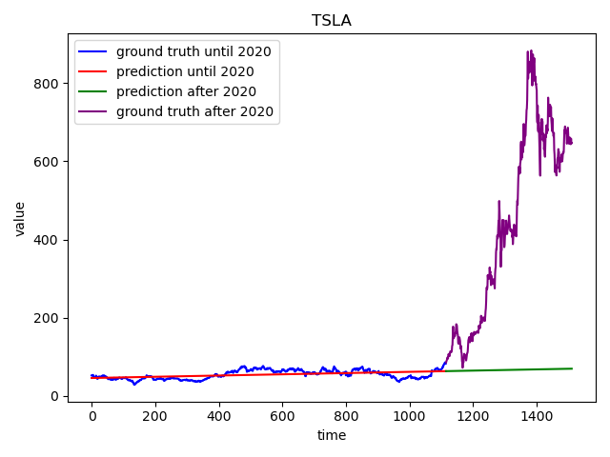
Linear Regression on Trading Days and Stocks Price

Slide 23
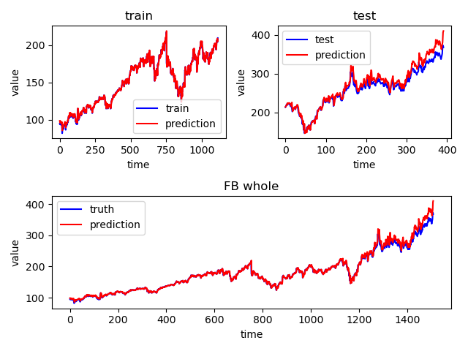
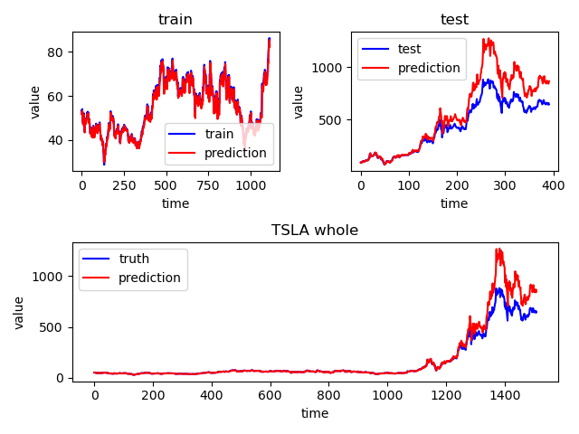
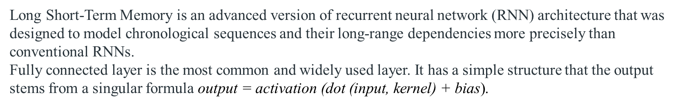
LSTM & Fully Connected Network
Long Short-Term Memory is an advanced version of recurrent neural network (RNN) architecture that was designed to model chronological sequences and their long-range dependencies more precisely than conventional RNNs.
Fully connected layer is the most common and widely used layer. It has a simple structure that the output stems from a singular formula $\text{output}\text{ = }\text{activation}\text{ (}\text{dot}\text{ (}\text{input}\text{, }\text{kernel}\text{) + }\text{bias}\text{)}$.

Slide 24
Thank you

