Slide 1



BAMdelbee
2-13
Installation
14-16
Preparing a
batch for
analysis
17-21
Tutorial
Analysis

Slide 2

If you are a Linux or a MacOS user, continue to slide 3.
If you are running Windows - bring some coffee,
we have some prerequisites to prepare.
This will take several minutes –
but with perseverance, glory awaits at slide 4!

Slide 3
Installation For Linux/macOS users
Via terminal, install needed Python 3 packages using the command line:
pip3 install pandas dash lxml html5lib
Proceed to install samtools:
🐧 Linux command > sudo apt-get install samtools
🍎 MacOS command > brew install samtools
That’s it, let’s jump to slide 14.

Slide 4

Installation For Windows users
You need Python 3 to run BAMdelbee.
If you already have it installed, jump slide 7.

Slide 5
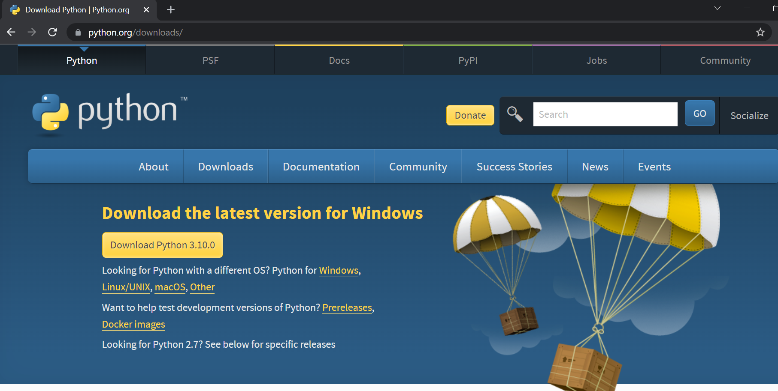
Installation For Windows users
Go to https://www.python.org/downloads/
(or google “python download”) to reach this page:

Slide 6
Installation For Windows users
Download the installation file using this button: (version may vary, that’s OK)

Slide 7
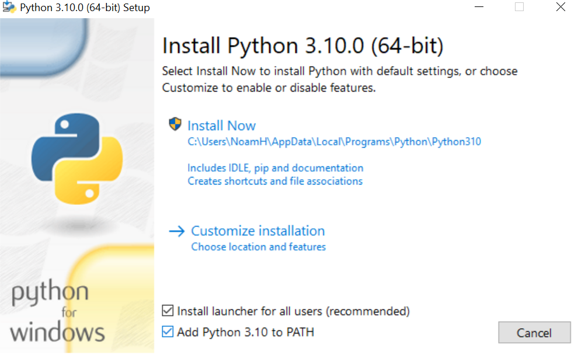
Installation For Windows users
Run the downloaded installation file, be sure to check this checkbox:

Slide 8
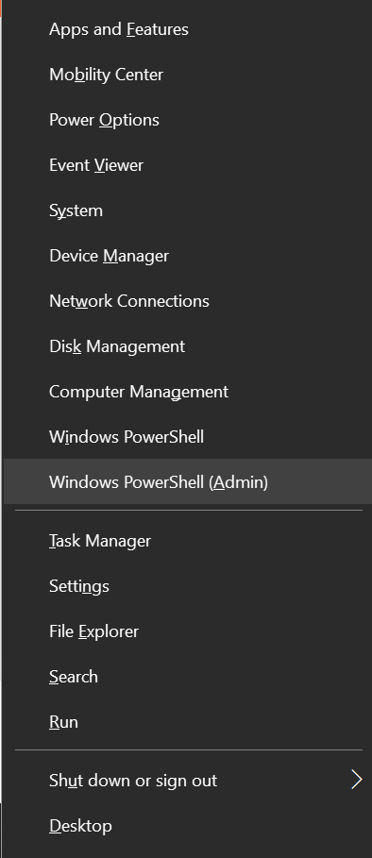
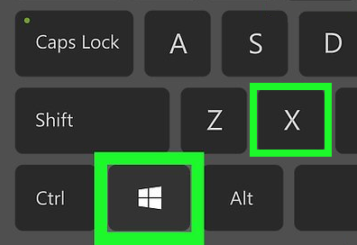
Installation For Windows users
Now we need to install Window’s subsystem for Linux.
Press the Windows key on your keyboard + the X key
Select “Windows PowerShell (Admin)”.
This will open “PowerShell” in a new blue window.

Slide 9
Installation For Windows users
Copy this line into PowerShell:
pip3 install pandas dash lxml html5lib
Then press enter. This will install needed python packages.

Slide 10
Installation For Windows users
In PowerShell, type:
wsl --install
Then press enter and install WSL (Windows Subsystem for Linux).
After installation is completed, you will need to restart your computer.
Come back to the next slide after you finished restarting, I am waiting!

Slide 11
Installation For Windows users
Now we need to install Linux and samtools.
So again:
Press the Windows key on your keyboard + the X key.
Select “Windows PowerShell (Admin)”.

Slide 12
Installation For Windows users
In PowerShell type:
ubuntu
and press Enter. That will install ubuntu, a Linux environment. You’ll be prompted to choose a username and a password – please remember them for the next step.
Then type:
sudo apt-get update
and press Enter, you’ll probably need to enter your password.

Slide 13
Installation For Windows users
Finally, type:
Sudo apt-get install samtools
and press Enter. This will install samtools, a software written for Linux that can analyze BAM files.
That’s it for installations! We are ready to start dealing with the good stuff.

Slide 14
Preparing a batch for analysis
Gather all .bam and .bai files of your input samples into a single folder.
All samples must had been sequenced by the same procedures (same sequencing machine, enrichment kit etc…) for reliable results.

Slide 15
Preparing a batch for analysis
Copy the “BAMdelbee-batch_preprocessor.py” python script into that folder, then start the script. This will prepare the batch for analysis – it can take several hours.
When the process is done, a “rename me.zip” file will be generated.

Slide 16
Preparing a batch for analysis
Name the “rename me.zip” file as you wish (probably by the name of the batch) and put it in BAMdelbee’s “assets” folder. You can then start “BAMdelbee-application.py” to analyze your batch.

Slide 17
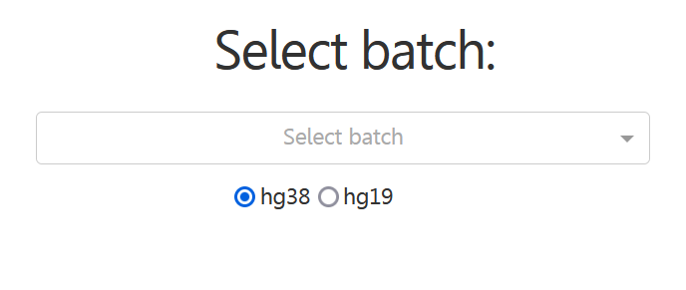
Analysis
Run “BAMdelbee-application.py” to start the application.
Remember that “rename_me.zip” file that you renamed and then moved to the assets folder? it is now an available batch for analysis.
Choose a batch for analysis using this auto-complete drop-down menu:

Slide 18
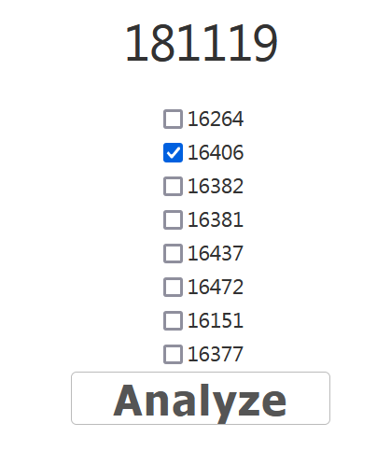
Analysis
Samples within the batch will appear. Select those you want to analyze.
The analysis will display homozygous deletions found that are found only in the selected samples, but not in the unselected ones. You can also analyze just one sample of course.

Slide 19
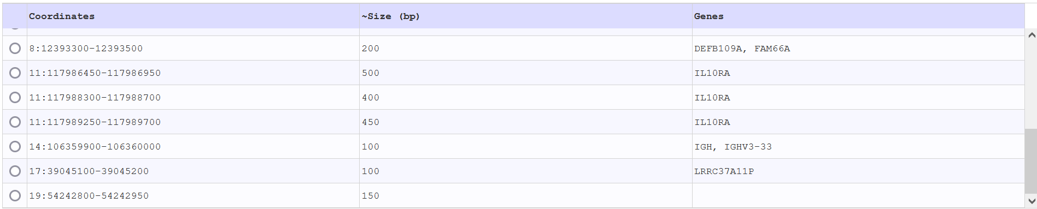
Analysis
After pressing the “Analyze” button and waiting for loading to finish, you’ll get a table with homozygous deletions, such as this:

Slide 20
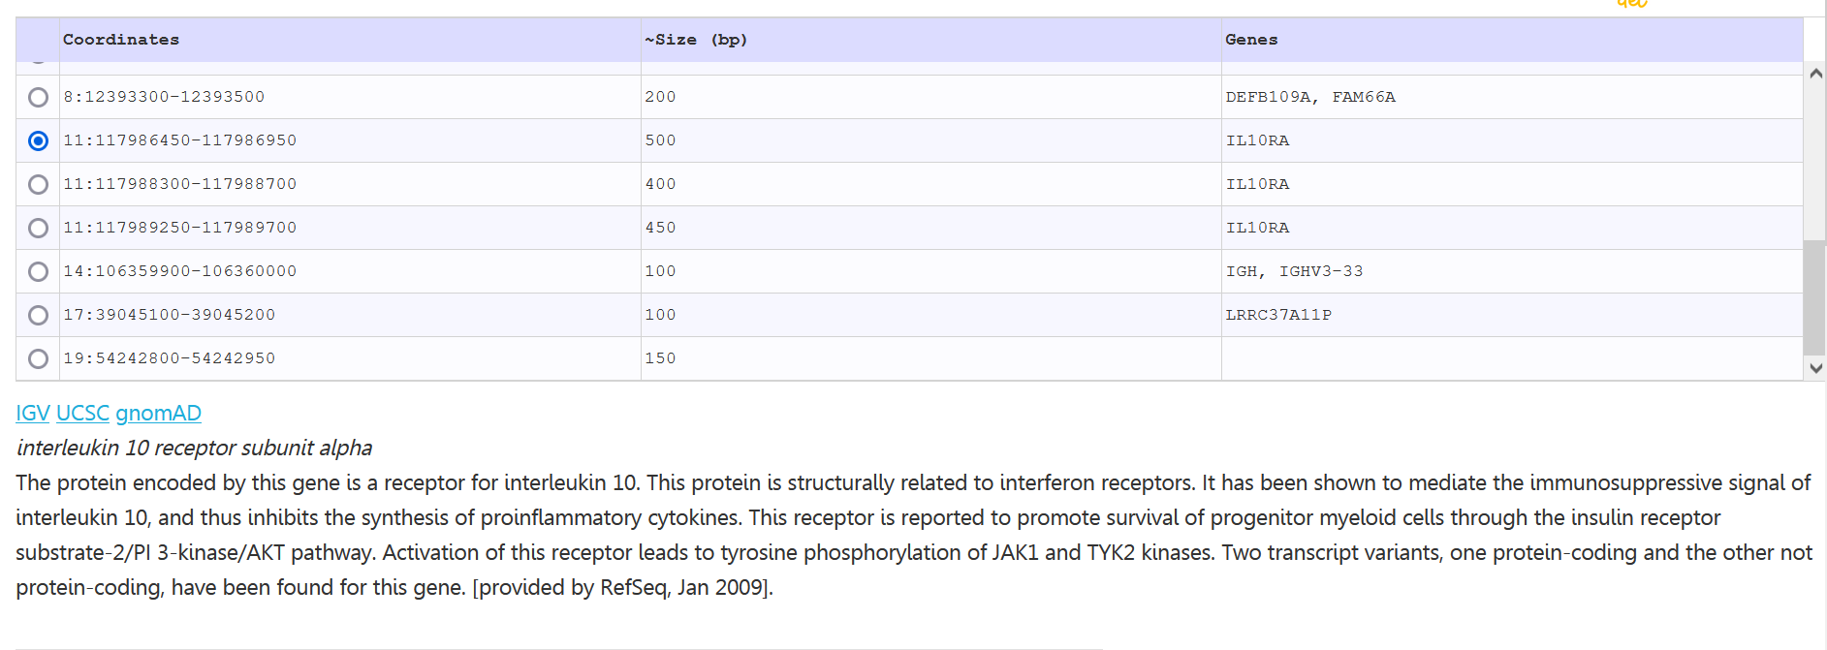
Analysis
Clicking a deletion will provide you with additional information and links about it.

Slide 21
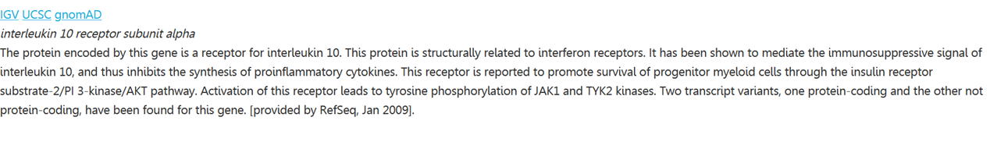
Analysis
To use the IGV link, you must have IGV installed:
https://software.broadinstitute.org/software/igv/
You should also have your BAM file loaded into IGV.

Slide 22
That’s it! We can’t wait to hear about your findings.
Contact information:
Noamhad@post.bgu.ac.il (Noam)

