Slide 1

Jetpack Joyride is an endless runner where you fly a jetpack. Collect Coins and avoid deadly obstacles. Keep going for as long as you can and pick up power-ups along the way.!
You can fly using the space button, collect different styles with different features.
If you hit an obstacle you will return to the original skin, if you already using the first character you will lose the game.
Game Tips:
Wait for the missiles to lock on before moving

Slide 2
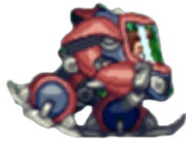



elements
Taking the power up gift will randomly allow to become a tank with the ability to be hit once. Taking the bubble gift will allow you to be protected from obstacles for 10 seconds.
You must collect as many coins as possible.

Slide 3


elements
The missile is a guided missile, you must dodge it. If the player is hit, he will die.
Before the missile is launched, an alert will appear and indicating the location from which the missile will arrive.
If the player collides with the laser, the player will be electrocuted and die.

