Slide 1
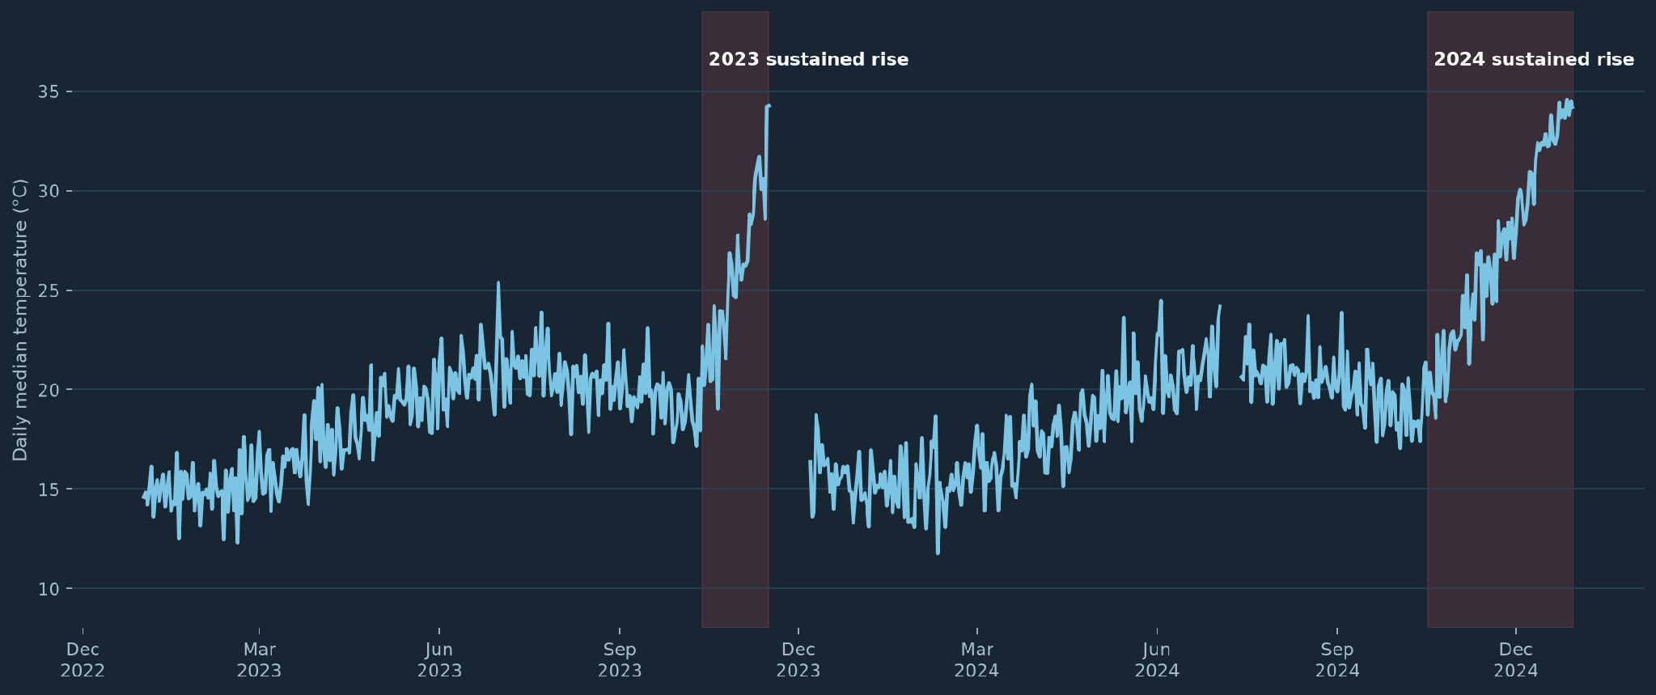
01 · WHAT THE DATA REVEALED
Target is persistent warming, not isolated spikes
6,503
700/730
measurements
observed days
8°C
73
normal daily swing
>100°C readings
WHY NOT A RAW THRESHOLD?
Normal seasonality moves temperature by several degrees, while isolated spikes reach 170–369°C.
The target behavior is an ongoing rise above recurring daily and annual patterns.
Missing data gaps are not interpolated. Extreme readings are hidden from the plot for readability but remain in both the training and validation sets. isolated spikes are not treated as gradual warming.
So the detector models expected temperature and alarms only on persistent residual elevation.
SKF DATA SCIENTIST HOME ASSIGNMENT · MODEL SELECTION
01

Slide 2
02 · MODEL SELECTION
A robust seasonal baseline isolates abnormal warming with much less bias
Timestamp
Cyclical features
Huber baseline
Residual
72h causal median
irregular samples
hour + day of year
expected temperature
observed − expected
persistent deviation
JUL–SEP 2023 VALIDATION
89%
Median absolute residual
less validation error
Daily only
3.38°C
CURRENT · 72h median selected
7-day slope: no added lead time; nuisance episode
NEXT IF SENSITIVITY / LEAD TIME FALLS SHORT
1 Add room temperature to the seasonal baseline
2 Test 24h–7d medians, EWMA/CUSUM + persistence
3 Compare GAM / quantile regression
Boosted models only with richer operating data
Daily + annual
0.37°C
JAN–JUN 2023
JUL–SEP 2023
JAN–SEP 2023
OCT–DEC 2023
2024
baseline training
model validation
reference refit
rule development
retrospective backtest
SKF DATA SCIENTIST HOME ASSIGNMENT · MODEL SELECTION
02

Slide 3
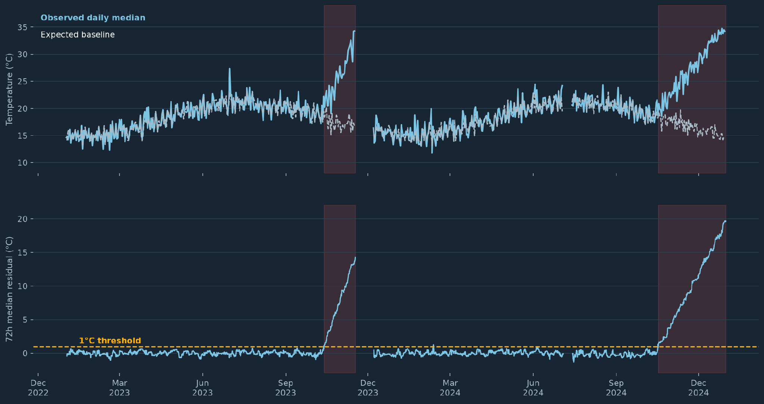
03 · FROZEN RULE & RETROSPECTIVE RESULT
The frozen rule detects both sustained rises while ignoring normal-period spikes
FINAL CAUSAL RULE
1
Build history
≥6 observations in the trailing 72 hours
2
Cross threshold
72h median residual > 1°C
3
Confirm
3 consecutive candidates within 24 hours
RESULTS
13 OCT 2023
17 OCT 2024
2 alarm starts
0
alarm episodes
Jan - Sep 2024
46 → 0
Shaded periods are confirmed alarms; isolated high readings outside them remain non-alarms.
extreme readings → alarms
in normal context periods
LIMITATION · one unlabeled machine; suspected events were identified during EDA; the reference fit covers less than a full annual cycle; validate against more machines or maintenance outcomes.
SKF DATA SCIENTIST HOME ASSIGNMENT · MODEL SELECTION
03

