Slide 1

Semester 1 Project 2023
231012700 Database Systems

Slide 2
Our Program in a nutshell
Exam Generator:
Usage: the program helps the user interact with a database of exams, allowing him to edit the data and generate exams using the stored data.
Main functionalities:
Adding questions and answers.
editing existing questions and answers.
Generating exams using user input.
Automatically generating exams.
Create Text file of tests stored in data base.

Slide 3
Our Program in a nutshell
Why do we need it?!
Creating an organized environment for managing exams.
Potential users:
Any establishment that uses tests.
(universities, colleges, high schools...)

Slide 4
The DataBase
The database consists of relations and ERD
SerialNum |  | QuestionText | QuestionType

Slide 5
Relations:
OperatingSystemModule
Question
FORGEIN KEY (moduleSerieal) REFERENCES OperatingSystemModule(moduleSerialNum)
*ModuleSerialNum | closeQuestionCounter | openQuestionCounter | testCounter | answerCounter
SerialNum |  | QuestionText | QuestionType
*SerialNum | *ModuleSerialNum | QuestionText | QuestionType

Slide 6
AmericanQuestion
FOREIGN KEY (serialNum, moduleSerialNum) REFERENCES Question(SerialNum, moduleSerialNum)
FOREIGN KEY (moduleSerialNum) REFERENCES OperatingSystemModule(moduleSerialNum)
Answer
FOREIGN KEY (QuestionID,moduleSerialNum) REFERENCES Question(SerialNum,moduleSerialNum)
FOREIGN KEY (moduleSerialNum) REFERENCES OperatingSystemModule(moduleSerialNum))
Test
FOREIGN KEY (moduleSerialNum) REFERENCES OperatingSystemModule(moduleSerialNum)
*SerialNum | *ModuleSerialNum | NumOfAnswers
*SerialNum | *ModuleSerialNum | AnswerText | AnswerCorrectness | QuestionID
SerialNum |  | QuestionText | QuestionType
*TestID | *moduleSerialNum | NumOfQuestions

Slide 7
ModulehasTestsAndQuestions
FOREIGN KEY (TestID,moduleSerialNum) REFERENCES test(TestID,moduleSerialNum),
FOREIGN KEY (QuestionID,moduleSerialNum) REFERENCES question(SerialNum,moduleSerialNum),
FOREIGN KEY (moduleSerialNum) REFERENCES OperatingSystemModule(moduleSerialNum)
ModulehasTestsAndAnswers
FOREIGN KEY (TestID,moduleSerialNum) REFERENCES test(TestID,moduleSerialNum),
FOREIGN KEY (AnswerID,moduleSerialNum) REFERENCES answer(AnswerID,moduleSerialNum),
FOREIGN KEY (QuestionID,moduleSerialNum) REFERENCES Question(QuestionID,moduleSerialNum),
FOREIGN KEY (moduleSerialNum) REFERENCES OperatingSystemModule(moduleSerialNum),
FOREIGN KEY(TestID,moduleSerialNum,questionID) REFERENCES ModulehasTestsAndQuestions(TestID,moduleSerialNum,QuestionID)
*TestID | *QuestionID | *moduleSerialNum | QuestionIndex | NumOfAnswers
*TestID | *AnswerID | *moduleSerialNum | AnswerIndex | questionID | AnswerCorrectness
SerialNum |  | QuestionText | QuestionType

Slide 8
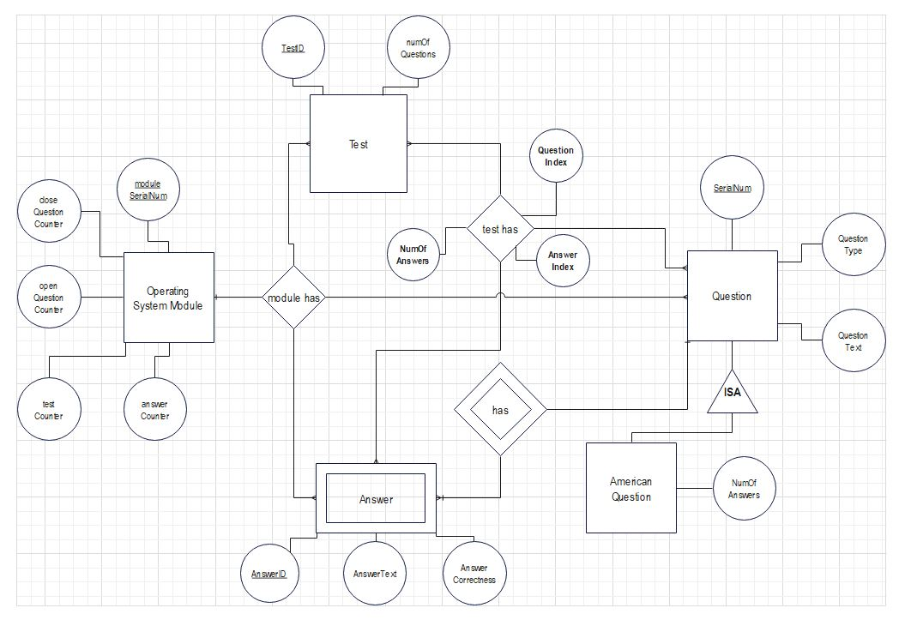
The ERD

