Slide 1

Hotel Booking Platform
CMPE 272 – Project
By: Noam Smilovich 016065699

Slide 2
Agenda
System Overview
System Model
Implementation
DEMO
References
INTRODUCTION
RESULTS
LITERATURE REVIEW

Slide 3
Introduction
Data portability between different cloud providers can be major issue in cloud computing.
Being locked into a specific cloud platform can be a common problem when developing software for the cloud.
companies may want to switch providers or use multiple clouds simultaneously. This can be difficult because different cloud providers use different storage architectures

Slide 4
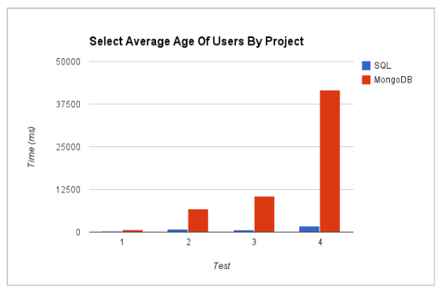
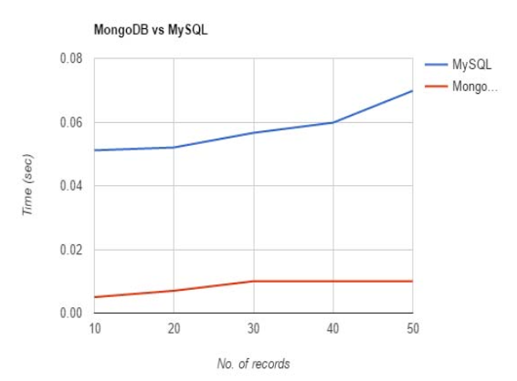
Literature Review
SQL shows better performance for aggregate functions. MongoDB does not support such functions natively. [1]
The time taken to perform the basic operations of insertion and retrieval are substantially lesser in a system with MongoDB. [2]
# of record insertions

Slide 5
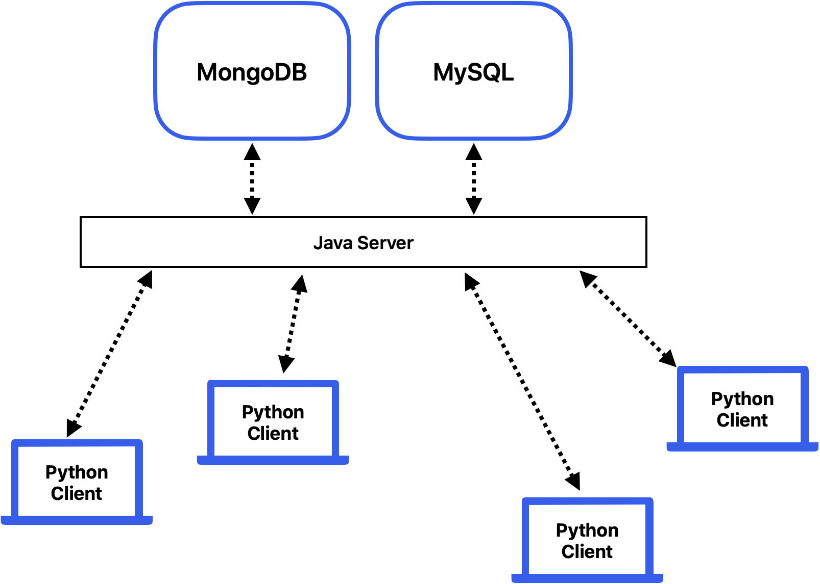
System Overview

Slide 6
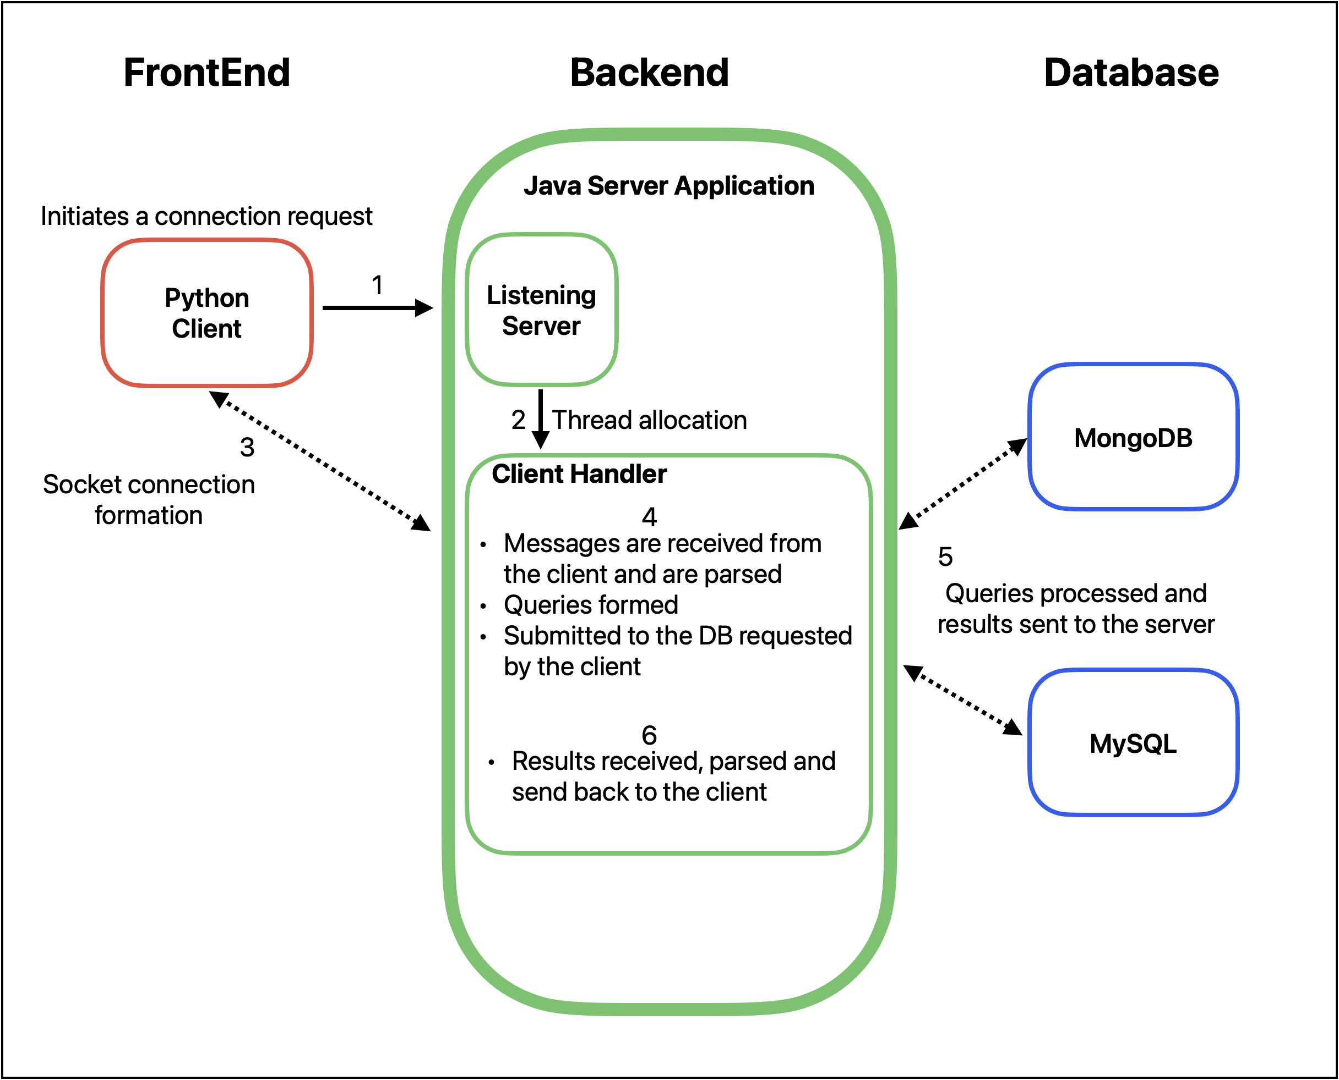
System Model
Frontend
Python 3.9.10
Backend
Java 20.0.1
Database
MongoDB
Consists of 1 primary node and 2 additional secondary nodes
MySQL
Implemented locally with MySQLWorkbench

Slide 7
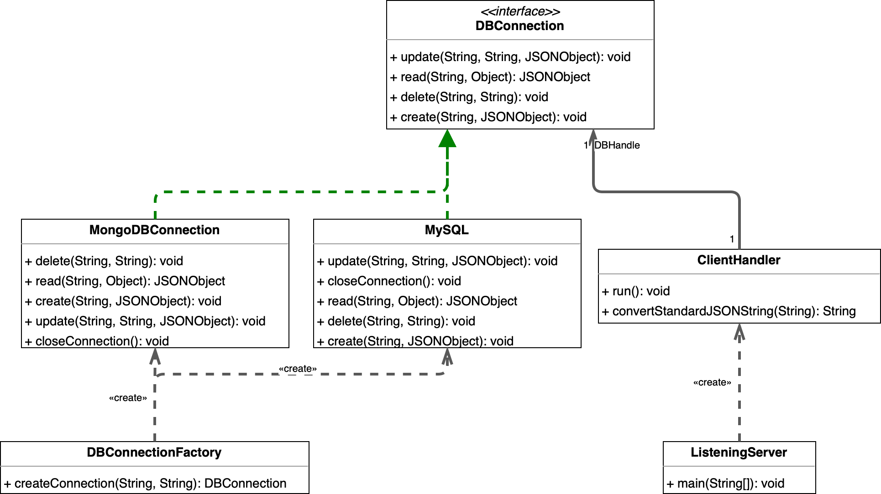
Implementation

Slide 8
Demo

Slide 9
Results

Slide 10
References
[1] Parker, Zachary, et al. “Comparing NoSQL Mongodb to an SQL DB.” Proceedings of the 51st ACM Southeast Conference, 2013, https://doi.org/10.1145/2498328.2500047.
[2] M. M. Patil, A. Hanni, C. H. Tejeshwar, and P. Patil, “A qualitative analysis of the performance of MongoDB vs MySQL database based on insertion and retriewal operations using a web/android application to explore load balancing — Sharding in MongoDB and its advantages,” 2017 International Conference on I-SMAC (IoT in Social, Mobile, Analytics and Cloud) (I-SMAC), Feb. 2017, doi: https://doi.org/10.1109/ismac.2017.8058365.
[3] Mahdi Negahi Shirazi, Ho Chin Kuan, and Hossein Rezaei Dolatabadi, “Design Patterns to Enable Data Portability between Clouds’ Databases,” International Conference on Computational Science and Its Applications, Jun. 2012, doi: https://doi.org/10.1109/iccsa.2012.29.
[4] F. Ravat, J. Song, O. Teste, and C. Trojahn, “Efficient querying of multidimensional RDF data with aggregates: Comparing NoSQL, RDF and relational data stores,” International Journal of Information Management, p. 102089, Jun. 2020, doi: https://doi.org/10.1016/j.ijinfomgt.2020.102089.
[5] B. Jose and S. Abraham, “Exploring the merits of nosql: A study based on mongodb,” IEEE Xplore, Jul. 01, 2017. https://ieeexplore.ieee.org/document/8076778 (accessed Apr. 24, 2020).
[6] M. Diogo, B. Cabral, and J. Bernardino, “Consistency Models of NoSQL Databases,” Future Internet, vol. 11, no. 2, p. 43, Feb. 2019, doi: https://doi.org/10.3390/fi11020043.

Slide 11
References
[7] R. Gunawan, A. Rahmatulloh, and I. Darmawan, “Performance Evaluation of Query Response Time in The Document Stored NoSQL Database,” IEEE Xplore, Jul. 01, 2019. https://ieeexplore.ieee.org/document/8898035 (accessed Oct. 03, 2022).
[8] S. Bradshaw, K. Chodorow, and Eoin Brazil, MongoDB : the definitive guide : powerful and scalable data storage. Sebastopol, Ca: O’reilly, 2019.
[9] A. Davoudian, L. Chen, and M. Liu, “A Survey on NoSQL Stores,” ACM Computing Surveys, vol. 51, no. 2, pp. 1–43, Apr. 2018, doi: https://doi.org/10.1145/3158661.
[10] M. Ha and Y. Shichkina, "The Query Translation from MySQL to MongoDB Taking into Account the Structure of the Database," 2021 IEEE Conference of Russian Young Researchers in Electrical and Electronic Engineering (ElConRus), St. Petersburg, Moscow, Russia, 2021, pp. 383-386, doi: 10.1109/ElConRus51938.2021.9396591.
[11] I. Mearaj, P. Maheshwari and M. J. Kaur, "Data Conversion from Traditional Relational Database to MongoDB using XAMPP and NoSQL," 2018 Fifth HCT Information Technology Trends (ITT), Dubai, United Arab Emirates, 2018, pp. 94-98, doi: 10.1109/CTIT.2018.8649513.
[12] A. Kanade, A. Gopal and S. Kanade, "A study of normalization and embedding in MongoDB," 2014 IEEE International Advance Computing Conference (IACC), Gurgaon, India, 2014, pp. 416-421, doi: 10.1109/IAdCC.2014.6779360.

