Slide 1

Hotel Booking Platform
CMPE 272 – Project Proposal
By: Noam Smilovich 016065699

Slide 2
Agenda
The goal of this project is to create a hotel booking platform using MongoDB.
This project will explore the different features and performance MongoDB offers.
Different simulations will be performed. The performance of the platform will be evaluated when it is idle, as well as when it is under heavy load.
Custom scripts will be written to increase the load on the system. These will work by utilizing multiple threads which will perform complex queries. In addition, multi-document transactions will be employed to further stress the system.

Slide 3
Introduction
The hotel booking platform is a common use case for databases, as it involves managing and organizing large amounts of data related to bookings, guests, rooms, and availability.
The ability to handle heavy loads and complex queries is critical for any hotel booking platform, as it needs to be able to handle a high volume of requests and transactions.
MongoDB's distributed architecture and horizontal scaling capabilities make it a good choice for handling large amounts of data and high concurrency workloads.
Overall, this project aims to demonstrate the benefits and capabilities of MongoDB for building scalable, high-performance hotel booking platforms.

Slide 4
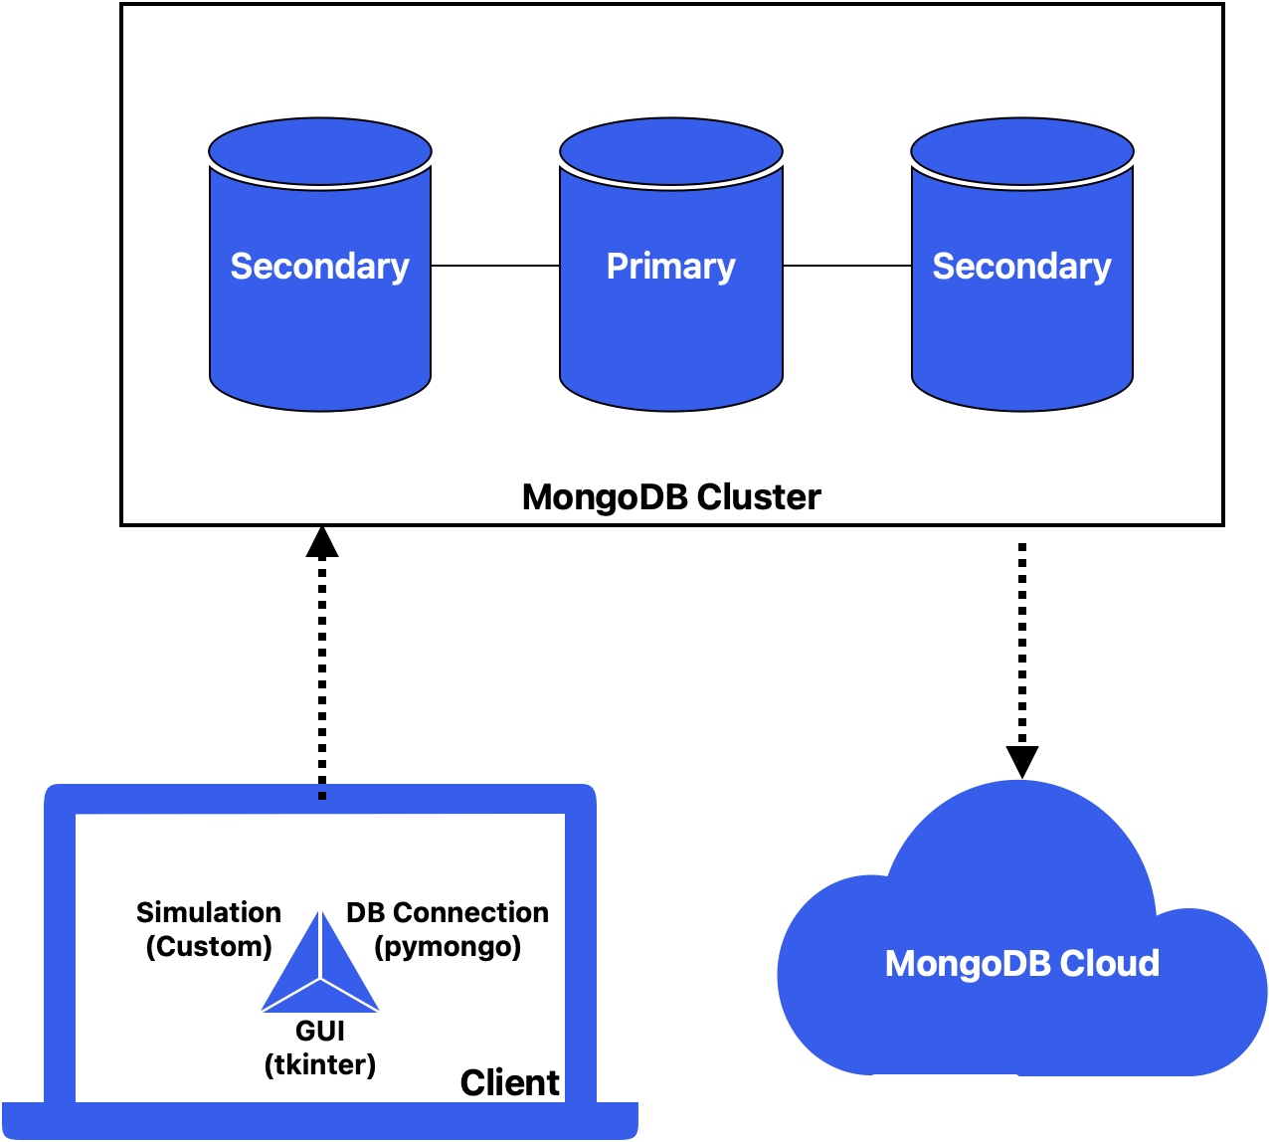
System Model

Slide 5
System Description
The system consists of three components:
MongoDB Cluster
Consists of 1 primary node and 2 additional secondary nodes (replica set)
Client
Coded in Python 3.9.10
GUI implemented using tkinter 8.6.12
DB connection using pymongo 4.3.3
Simulation using threading 3.1.0
MongoDB Cloud
MongoDB feature
Gives metrics which relate to the load on the mongoDB cluster.

Slide 6
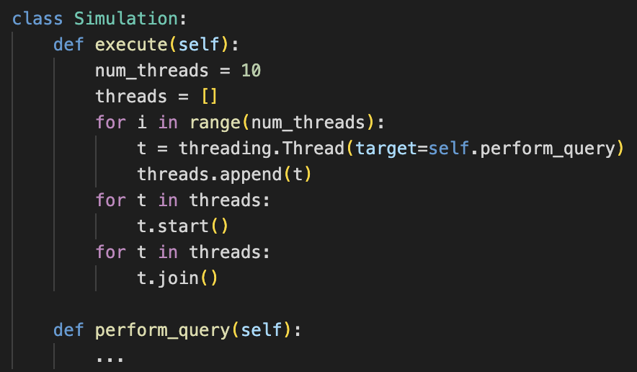
Simulation Pseudo Code

Slide 7
References
[1] Bradshaw, Shannon, et al. MongoDB : The Definitive Guide : Powerful and Scalable Data Storage. Sebastopol, Ca, O’reilly, 2019.
[2] Davoudian, Ali, et al. “A Survey on NoSQL Stores.” ACM Computing Surveys, vol. 51, no. 2, 17 Apr. 2018, pp. 1–43, dl.acm.org/citation.cfm?id=3158661, https://doi.org/10.1145/3158661.
[3] Ramez Elmasri, and Shamkant B Navathe. Fundamentals of Database Systems. Hoboken, New Jersey, Pearson, 2017.
‌

