Slide 1


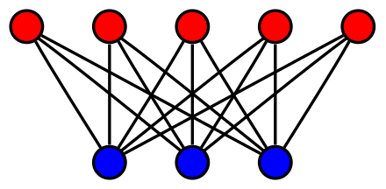
Design of error correcting codes for storage devices
Students: Dore Kleinstern, Noam Shilony
Supervisor: Rami Cohen
Semester: Winter, 2018
Date: 04/09/2019

Slide 2
Outline
Low Density Parity Check codes
Message passing algorithm
q-ary Bit Measurement Channel
Empirical and theoretical results
Approximation models for the problem

Slide 3


Linear $GF_{q}$ Block Codes
k information symbols n code symbols
Code word is generated from a generator matrix $G∈{GF}_{q}^{n×k}$
Dual matrix $H∈{GF}_{q}^{\left(n−k\right)×n}$ – Parity check matrix
k
n-k
2 | 3 | 1 | 1 | 2 | 3 | 1 | 0

Slide 4
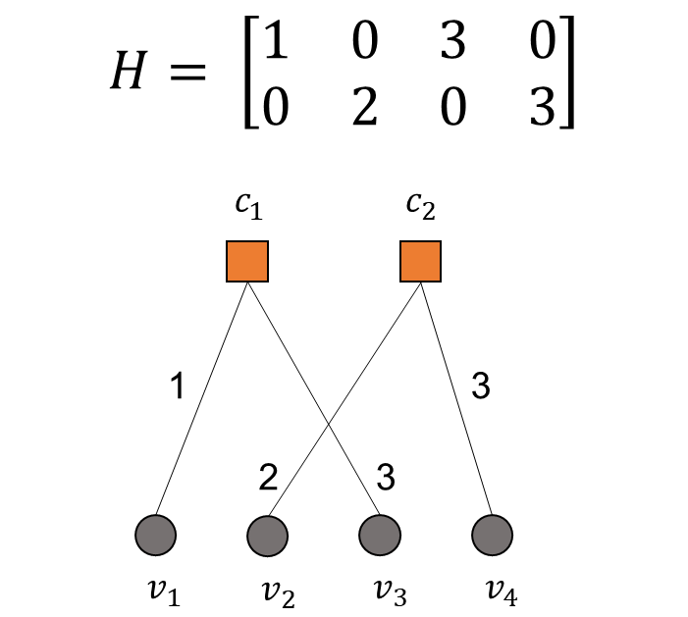


Low Density Parity Check $GF_{q}$ Codes
Sparse matrix for parity check $H$
Regular code – $d_{v}$, $d_{c}$ constants
Parity Check:
${1⋅v}_{1}+3⋅v_{3}=0$
${2⋅v}_{2}+3⋅v_{4}=0$

Slide 5
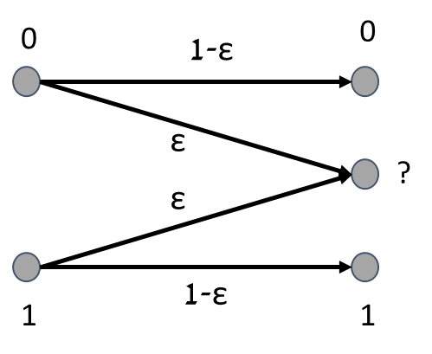

Binary Erasure Channel (BEC)
Binary Alphabet (0/1)
Symmetric erasure probability - 𝜀
Erasure (?) is an unknown state
$$\left[1 0 1 0\right]→ \left[ 1 ? ? 0\right]$$

Slide 6


Low Density Parity Check Binary Codes
Parity Check:
$v_{1}⊕v_{3}=0$
$v_{2}⊕v_{4}=0$
Iterative decoding of [? ? 1 0] –
$v_{1}=0⊕$ $1=1$
$v_{2}=0⊕0=0$

Slide 7
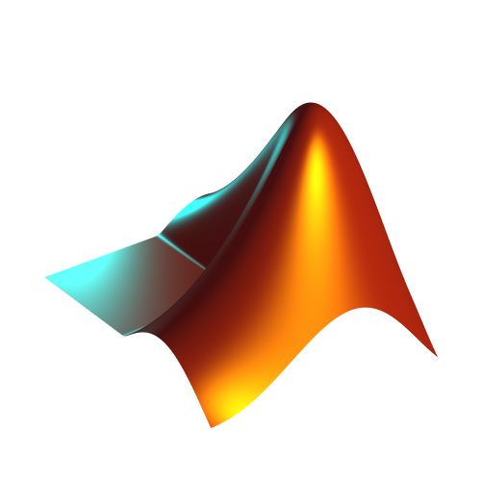



Implementation
MATLAB
Convenient matrix operations
$GF_{q}$ add-on for calculations
Concurrent simulations

Slide 8

Running Time $≈$ 1 hour
BEC - Results
Code length = 1002
Code length = 2004

Slide 9
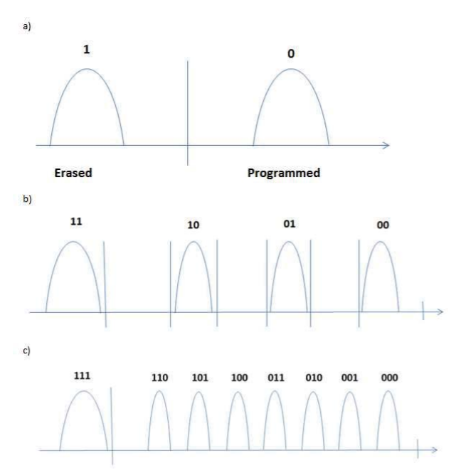
Reading from Flash Storage Device
Stored word in cell 011
Reading MSB to LSB

Slide 10

q-ary Bit-Measurement Channel (QBMC)
$q=2^{s}$symbols, each represented by s bits
Partial erasure = some of the bits are unknown
Each partial erasure has its probability
$\underset{3 bits erasure}{\underbrace{\left[1 0 1 0\right]→ \left[ 1 ? ? ?\right]}}$ $\underset{1 bits erasure}{\underbrace{\left[1 0 1 0\right]→ \left[ 1 0 1 ?\right]}}$

Slide 11

Message Passing for LDPC over QBMC
Generalized binary iterative decoding of BEC to q elements from $GF_{q}$
Two main operations –
Sumset: $sumset\left(\left\{x,y\right\},\left\{a,b\right\}\right)=\{x+a,x+b,y+a,y+b\}$
Intersection: $intersection\left(\left\{x,y,z\right\},\left\{x,a,b\right\}\right)=\{x\}$

Slide 12

Running Time $≈$ 10 hours
Message Passing over QBMC - Results

Slide 13
Analytic Performance (Density Evolution)
Tracking the probability of partial erasures as a function of the decoding iteration
Evolution of distribution at each iteration of message passing considering labels distribution
Threshold determined by probability of erasure at output

Slide 14

Running Time $≈$ 10 hours
Density Evolution - Results

Slide 15
Approximation methods
Tracking the exact probabilities is difficult as there are multiple messages
Instead, we track the probabilities of certain subgroup sizes
Non erasure subgroup size is 1
Using probabilistic models for uniform label distribution –
Balls and Bins
Union Model

Slide 16
Balls and Bins Model
Throwing balls independently and uniformly to bins
Number of balls – product of the subgroups' sizes
Number of bins – q
Number of non-empty bins is the size of the subgroup at output

Slide 17
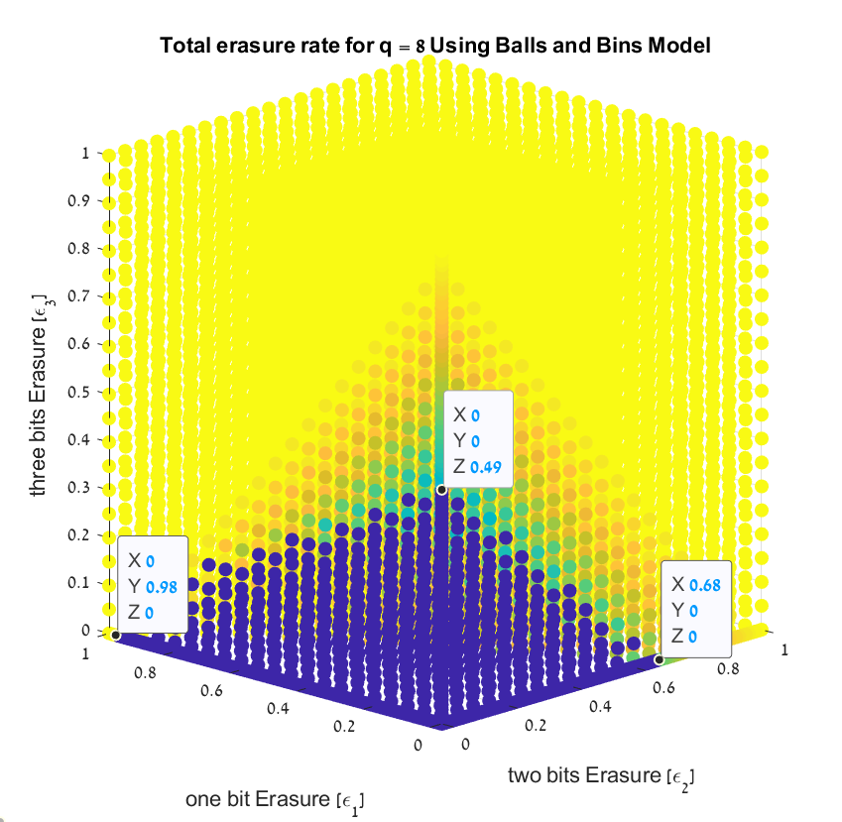


Balls and Bins - Results
Running Time $≈$ 15 hours
Running Time $≈$ 10 hours

Slide 18

Union Model
Similar to balls and bins, except independence assumption
Given 3 elements $x,y,z∈GF_{q}$ such that $y≠z$ $→x+y≠x+z$
Different elements in the same subgroup must go to different bins

Slide 19
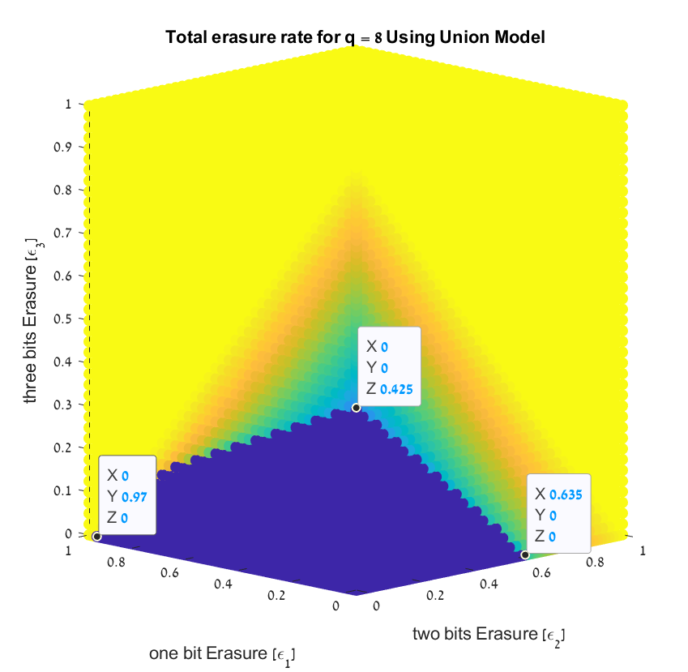


Union Model - Results
Running Time $≈$ 20 hours
Running Time $≈$ 10 hours

Slide 20

Summary
$GF_{q}$ LDPC codes show good results under iterative decoding
Better iterative-decoding performance as q increase
The iterative method of “Message Passing” is fast, but empirical and analytical calculations are complex
The Union model is a good approximation of the problem that can help us compute the thresholds efficiently

Slide 21
Future Research
Optimize the precise algorithm for faster results
Find a more accurate threshold by using higher resolution
Better approximations than the Union Model with different label distribution

Slide 22
References

Slide 23
Thank you for listening

