Slide 1
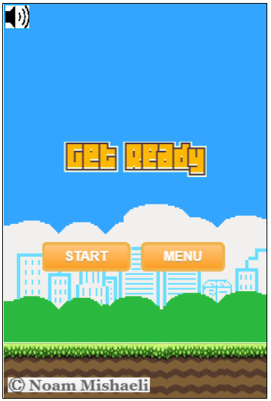
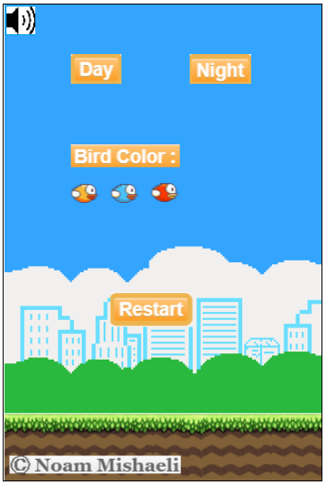
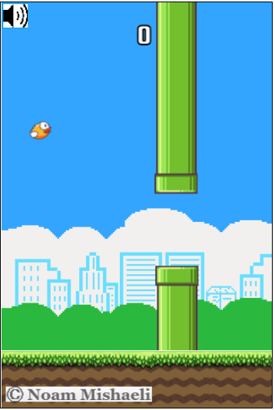
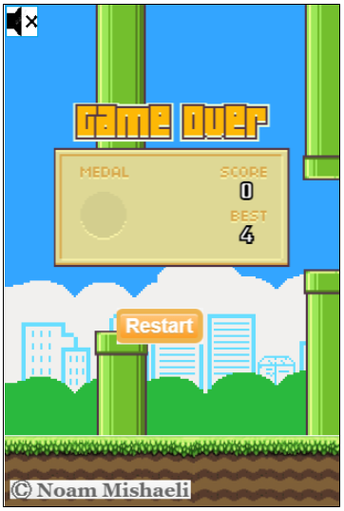
First Screen:
Two buttons for starting the game or to see the menu and a turn on/off sound at the top left corner of the screen
Menu Screen:
Two buttons on top for changing background from day to night and so..
In addition, you can change your bird’s color and to turn on/off the sound
Game Screen:
Just click on mouse for jumping the bird trough the pipes
Game Over Screen:
Shows best and current score.
In addition, you can restart your game

Slide 2
Sprite – one image combining all the images that will display on the program.
The idea is to take specific coordinates for every use in canvas while updating it.
I used few tools in order to create a sprite PNG file and to get the coordinates of each element.
# Backgrounds, figures and sounds downloaded from google
# Create CSS btns style:
https://www.bestcssbuttongenerator.com/#/35
# Sprite creation:
https://www.toptal.com/developers/css/sprite-generator/
# Get XY coordinates from an image:
https://getspritexy.netlify.app/

