Slide 1



Introduction to Sockets in C
Sockets are the fundamental building blocks for network communication in C programming. They allow applications to establish connections and exchange data across networks.
Yoram Biberman
Yaniv Gabay

Slide 2

Understanding Socket Fundamentals
Understanding the code
We will try to understand the steps in setting up a client and a server, we will go over each system call and try to give a nice analogy to make it simpler and understandable.

Slide 3
System Calls Table
System Call - Server
Description
System Call - Client
Description
socket()
Creates a new socket
socket()
Creates a new socket
bind()
Assigns an address to a socket
connect()
Establishes a connection to a server
listen()
Makes a socket listen for incoming connections
select()
Can be used, not usually not
Getaddrinfo()
accept()
Accepts an incoming connection
Given a port and ip, get the necc
Info to connect (linked list of options)
select()
Monitor multiple file descriptors

Slide 4
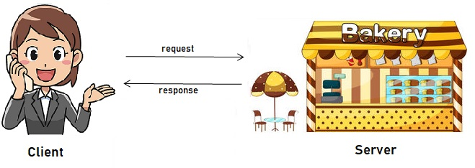

Socket()
System Call
Description
socket() – we use sockets both on
The client and on the server
Creates a new socket
Server Analogy
Client Analogy
Setting up a new telephone line, that can accept multiply calls
Setting up my personal telephone in order to make calls

Slide 5

Bind()
System Call
Description
Bind() – we use this ONLY on the server
Assigns a specific address and port
To the socket we created
Server Analogy
After we setup a new socket, we need to give it its own unique number
The socket is our cellphone, and the binding is the sim card.

Slide 6
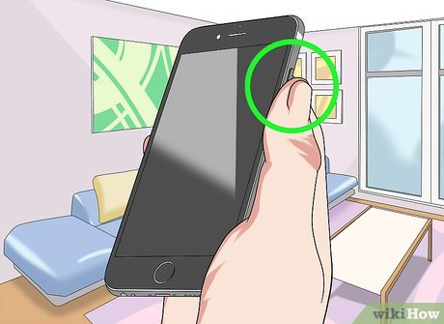
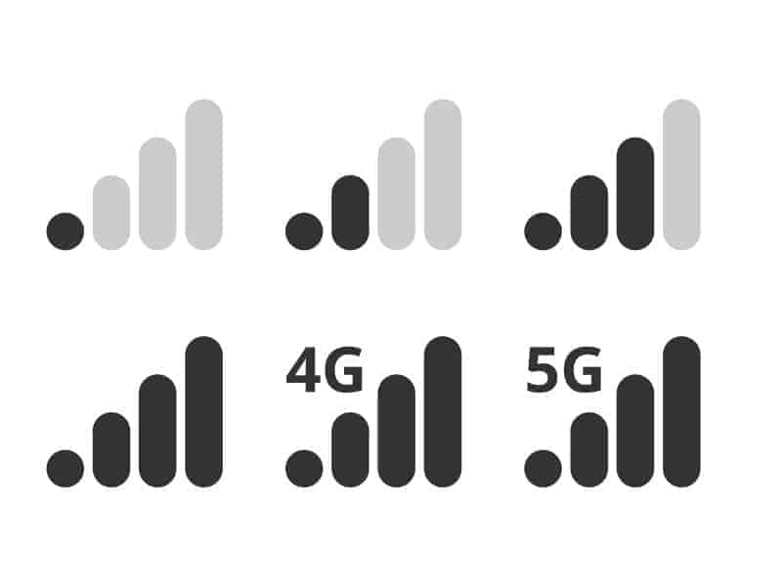
Listen()
System Call
Description
Listen() – tell the socket, start listing,
Only the server does it
Mark the socket to listen for incoming
connection
Server Analogy
We need to turn on the phone, and take it out of airplane mode right?
We need to make sure we have good reception.

Slide 7
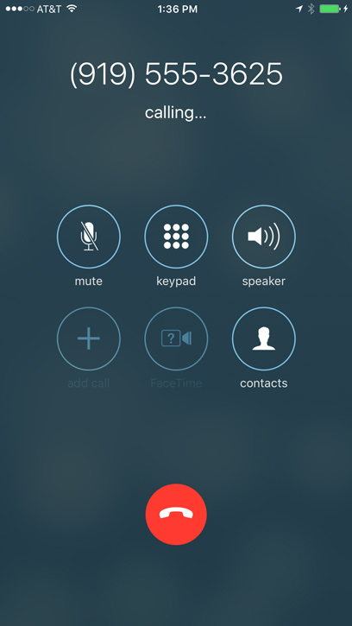
Connect()
System Call
Description
Connect() – only the on the client \
The side that connecting
We dial the phone number in order
To call it
Client Analogy
Just calling the specific number and port that we know the server is located.
The server of course can לסנן us.

Slide 8
Select()
System Call
Description
Select() – Monitor multiply
File descriptors
Like a controller, watching multiply
Areas at the same time.
Client Analogy - The client can use it as well, but not in our context
Its like a “watcher” , its keep looking at the given file descriptors, like a
Monitor , that wait for activity on any socket.
fd_set rfd; // a set containing all active file descriptors (connections)
fd_set c_rfd; // Temporary set for select()
think of select like a traffic controller, it will tell the server which of the telephone lines in the group rfd has a call

Slide 9

Configure Adresses Structs
Create Socket()
Bind the Socket – give the sockets the addresses struct we created
Listen() – listen for new clients
Init File descriptors sets – we manage active connections using them – FD_ZERO FD_SET
Declare select() – wait for activity on any socket
Accept() – accept and add new clients
Server-side Socket Programming
Read
Write

Slide 10
Configure Adresses Structs
Create Socket()
GetAddrInfo- obtain the server address information (linked list)
Connect to the server
Client-side Socket Programming
Read
Write

Slide 11
Some tips
Always run the linked list of addr_info_res
Will help prevent cases where the first results isn’t the right connection methods (on the client)
Don’t use gettablesize()
Just in my experience it gives errors, use FD_SETSIZE instead, or keep track of the max FD (will show in code examples)

Slide 12
Let's see some code

