Slide 1
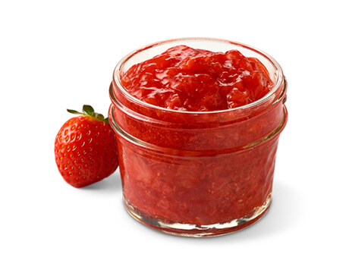
LABEL

Slide 2
Label Jam
January 24, 2025
Primary Goals
Test new labeling deconfliction engine in the JavaScript Maps SDK
Look for bugs or issues with new labels using PR branch and test-apps
Look for regressions from other SDK versions [Label PR vs 4.31 (prod) and 4.32 (dev)]

Slide 3
Label Jam
January 24, 2025
Primary Goals
Test new labeling deconfliction engine in the JavaScript Maps SDK
Look for bugs or issues with new labels using PR branch and test-apps
Look for regressions from other SDK versions [Label PR vs 4.31 (prod) and 4.32 (dev)]
Secondary Goals
Solicit feedback and thoughts and feelings about labeling in general
Introduce JavaScript Maps SDK labeling people to a wider group

Slide 4
Secondary Goals

Slide 5
Hannes (Yaron, Matt)
Developers
ArcGIS Maps SDK for JavaScript

Slide 6
Noah Sager
Product Engineer
ArcGIS Maps SDK for JavaScript
https://confluencewikidev.esri.com/display/AGO/JSAPI+areas+of+responsibility

Slide 7
Primary Goals
Label Jam Test Apps
https://jsapi.esri.com/people/noah/LabelJam/LabelJamTestApps.pdf

Slide 8
Questions?
LABEL

