Slide 1
Artificial Intelligence
Lecture 3
Knowledge and Reasoning (知识与推理)
巢文涵
chaowenhan@buaa.edu.cn G1001
Institute of Intelligent Information Processing, BUAA
Sunday, November 8, 2026

Slide 2
Outline
Knowledge-based agents
Wumpus world
Propositional (Boolean) logic
First-Order Logic
Inference in First-Order Logic

Slide 3
Knowledge-based Agent
（基于知识的智能体）
Motivation
  问题求解智能体的问题
    知识特定
    缺少灵活性：知识是固定的
    环境： 完全可观察的（？）、静态的
  基于知识的智能体的优势
    常识知识 + 当前感知 => 新知识 ，隐藏的知识
      可以用有限的知识来应付无限的变化
      灵活性：通过知识的变化来适应环境

Slide 4

Model-based reflex agents
A reflex agent with internal state works by finding a rule whose condition matches the current situation (as defined by the percept and the stored internal state) and then doing the action associated with that rule.

Slide 5
Example: Pangu System!
Knowledge-based Q-A system
  Common Sense Knowledge
  Reasoning
  Example:
    中国的首都在哪里？
    北京明天的天气如何？
作业- 基于本体的自动问答系统??

Slide 6
Knowledge-Based Agent
Knowledge base（知识库）
  = set of sentences in a formal language
  Declarative approach（陈述性方法） to building an agent (or other system):
    Tell it what it needs to know
Inference engine（推理引擎）
  Then it can Ask itself what to do - answers should follow from the KB
  Agent can use inference to deduce new facts from TELLed facts
Domain independent algorithms
ASK
Inference engine
TELL
Knowledge Base
Domain specific content

Slide 7

A simple knowledge-based agent
The agent must be able to:
  Maintain the KB
    Represent states, actions, etc.
    Update internal representations of the world
  Inference from the KB
    Deduce hidden properties of the world
    Deduce appropriate actions

Slide 8

Wumpus World
Performance measure
  gold +1000, death -1000
  -1 per step, -10 for using the arrow
Environment
  Squares adjacent to wumpus are smelly
  Squares adjacent to pit（坑） are breezy
  Shooting kills wumpus if you are facing it
  Shooting uses up the only arrow
  Grabbing picks up gold if in same square
  Releasing drops the gold in same square
Sensors: Stench(臭), Breeze(风), Glitter(发光),Scream(尖叫)
Actuators: Left turn, Right turn, Forward, Grab, Release, Shoot
  Glitter iff gold is in the same square

Slide 9
Wumpus world characterization
Fully Observable No – only local perception
Deterministic Yes – outcomes exactly specified
Episodic(片段式）No – sequential at the level of actions
Static Yes – Wumpus and Pits do not move
Discrete Yes
Single-agent? Yes – Wumpus is essentially a natural feature

Slide 10

Exploring a wumpus world

Slide 11

Exploring a wumpus world

Slide 12

Exploring a wumpus world

Slide 13

Exploring a wumpus world

Slide 14

Exploring a wumpus world

Slide 15

Exploring a wumpus world

Slide 16

Exploring a wumpus world

Slide 17

Exploring a wumpus world
In each case where the agent draws a conclusion from the available information, that conclusion is guaranteed to be correct if the available information is correct.

Slide 18
Question: how to represent the knowledge?
Knowledge Representation
  表示方法
    逻辑, 语义网 , 框架 , 产生式规则
  表示方法的评价
    表现力、效率（推理）
  方法论
    认识论：存在性
    本体论：构造性
    知识工程论：实现性

Slide 19
Logic（逻辑）
Knowledge base = set of sentences（语句） in a formal language（形式化语言）
Logics are formal languages for representing information such that conclusions can be drawn
  Syntax （语法）defines the sentences in the language
    x+y = 4 or + x y = 4
  Semantics （语义）define the “meaning” （含义）of sentences;
    i.e., define truth（真值） of a sentence in a (possible) world（世界）
    When x=2 and y=2 , x+y=4 is true

Slide 20
Model and Entailment
（模型和蕴含）
Model define the possible world
  formally structured worlds in which truth can be evaluated
  m is a model of a sentence α if α is true in m
  M(α) is the set of all models of α
Entailment means that one thing follows from another
KB ╞ α
  Knowledge base KB entails sentence α if and only if α is true in all worlds where KB is true
    i.e. KB ╞ α iff M(KB) ⊆ M(α)
  Entailment is a relationship between sentences (i.e., syntax) that is based on semantics

Slide 21

Entailment in the wumpus world
Situation
  after detecting nothing in [1,1], moving right, breeze in [2,1]
Consider possible models for KB assuming only pits
  KB = wumpus-world rules + observations（常识+感知）

Slide 22

Wumpus models
3 Boolean choices ⇒ 8 possible models

Slide 23

Wumpus models
KB’s model

Slide 24

Wumpus models
α₁ = “[1,2] is safe”, KB ╞ α₁, proved by model checking（模型检验）
enumerating all possible models to check that a is true in all models in which KB is true

Slide 25
Wumpus models

Slide 26

Wumpus models
α₂ = "[2,2] is safe", KB ╞ α₂

Slide 27
Inference（推理）
KB ├_{i} α
  sentence α can be derived from （导出）KB by procedure i
Soundness （可靠性）
  i is sound if whenever KB ├_{i} α, it is also true that KB╞ α
  Make sure that it will not derive “false” sentence
Completeness （完备性）
  i is complete if whenever KB╞ α, it is also true that KB ├_{i} α

Slide 28
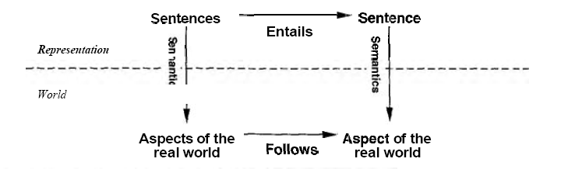
Real world & Inference
KB is true in the real world, then any sentence ol derived frorn KB by a sound inference procedure is also true in the real world.
Grounding
  Where does the knowledge of the real world come from?

Slide 29
Proposition Logic（命题逻辑）
Syntax
Semantics
Inference

Slide 30
Proposition Logic - Syntax
Atomic Sentences（原子语句）
  Proposition symbol P; Q;R, which can be TRUE or FALSE
Complex sentences（复合句）
  Logical Connectives: （逻辑连接符）
    ¬ not, negation 非
      Literal 文字： 原子 或者 否定的原子（负文字） : P , ¬P
    ∧ and 与
      conjunction 合取式 : P ∧ Q
    ∨ or 或
      disjunction 析取式 : P ∨ Q
    ⇒ implies 蕴含
      P ∨ Q ⇒ ¬ R
    ⇔ biconditional, iff 当前仅当
  Priority of the connectives
    ¬ ∧ ∨ ⇒ ⇔

Slide 31
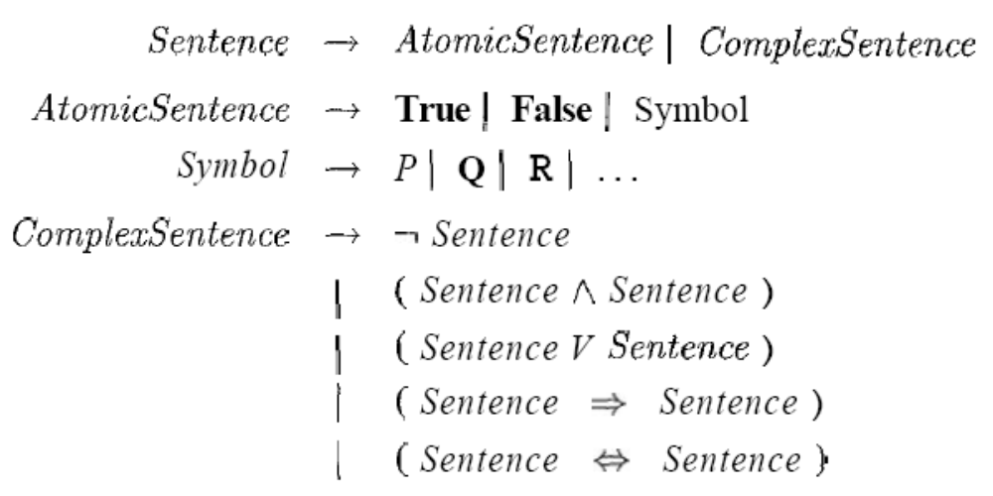
Formal grammar

Slide 32
Proposition Logic - Semantics
The semantics defines the rules for determining the truth of a sentence with respect to a particular model
  Each model specifies true/false for each proposition symbol
    With these symbols, all possible models, can be enumerated automatically

Slide 33

Semantics
Truth tables for connectives

Slide 34

Some Concepts:
Logical equivalence
Two sentences are logically equivalent iff true in same models: α ≡ ß iff α╞ β and β╞ α

Slide 35
Some Concepts:
Validity and satisfiability
Valid（合法性）
  A sentence is valid if it is true in all models
    also called tautology(重言式)
    e.g., True, A ∨¬A, A ⇒ A,
  Validity is connected to inference via the Deduction Theorem(演绎定理):
  KB ╞ α if and only if (KB ⇒ α) is valid
Satisfiability（可满足性）
  A sentence is satisfiable if it is true in some model
  A sentence is unsatisfiable if it is true in no models
  e.g., A∧¬A
  Satisfiability is connected to inference via the following:
  KB ╞ α if and only if (KB ∧¬α) is unsatisfiable

Slide 36
Reasoning Patterns
Model checking（模型检验）
  truth table enumeration (always exponential in n)
  improved backtracking,
  e.g., Davis--Putnam-Logemann-Loveland (DPLL)
  heuristic search in model space (sound but incomplete)
  e.g., min-conflicts-like hill-climbing algorithms
Application of inference rules
  Proof = a sequence of inference rule applications
    Can use inference rules as operators in a standard search algorithm
  Typically require transformation of sentences into a normal form

Slide 37


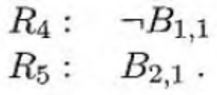
Inference by enumeration
A simple KB
  First, choose our vocabulary of proposition symbols, here, we only consider pits
    For each [i,j]
      Let Pi,j be true if there is a pit in [i, j]
      Let Bi,j be true if there is a breeze in [i, j]
  Sentencs

Slide 38
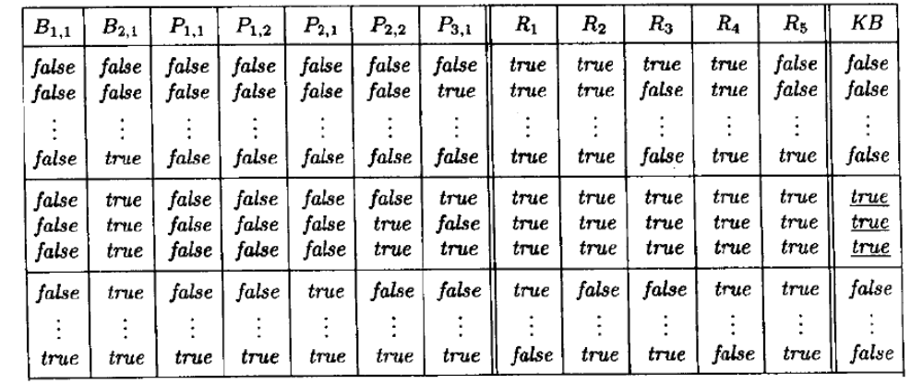
Inference by enumeration

Slide 39

Inference by enumeration
Depth-first enumeration of all models is sound and complete
For n symbols, time complexity is O(2^{n}), space complexity is O(n)

Slide 40
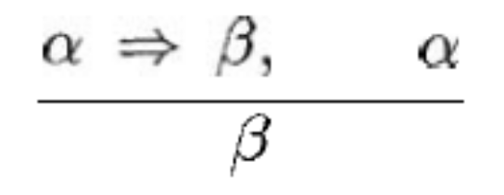
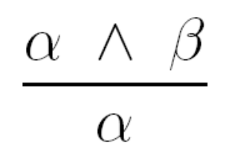
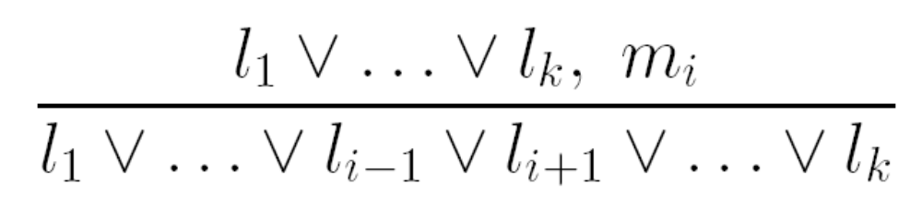
Inference Rules
Modus Ponens (分离规则)
And-Elimination(与消去)
Resolution(归结)

Slide 41
Resolution（归结）
Conjunctive Normal Form (CNF, 合取范式)
  conjunction of disjunctions of literals ( called clauses) 析取式的合取式
  E.g., (A ∨ ¬B) ∧ (B ∨ ¬C ∨ ¬D)
Resolution inference rule (for CNF):
l_{i} ∨… ∨ l_{k}, m₁ ∨ … ∨ m_{n}
l_{i} ∨ … ∨ l_{i-1} ∨ l_{i+1} ∨ … ∨ l_{k} ∨ m₁ ∨ … ∨ m_{j-1} ∨ m_{j+1} ∨... ∨ m_{n}
where l_{i} and m_{j} are complementary literals.
E.g., P_{1,3} ∨ P_{2,2}, ¬P_{2,2} ∨ P_{1,3}
Resolution is sound and complete _x000b_for propositional logic

Slide 42
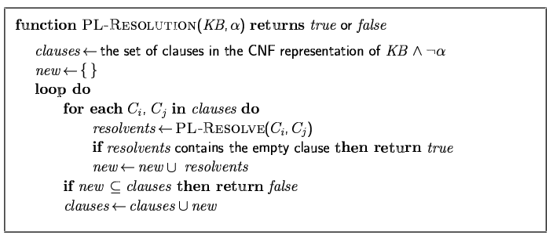
Resolution algorithm
Proof by contradiction, i.e., show KB∧¬α unsatisfiable

Slide 43

Resolution example
KB = (B_{1,1} ⇔ (P_{1,2}∨ P_{2,1})) ∧¬ B_{1,1} α = ¬P_{1,2}

Slide 44
Forward and backward chaining
（前向和后向链接）
Horn Form（霍恩形）
  KB = conjunction of Horn clauses（霍恩子句）
  Horn clause is a disjunction of literals of which at most one is positive
    E.g.,
    Head : the positive literal ,i.e. C
    Premise: 前提 A ∧ B
    definite clauses(确定子句) : have exactly one positive literal
    Fact(事实): have no negative literal
Modus Ponens (for Horn Form): complete for Horn KBs
α₁, … ,α_{n}, α₁ ∧ … ∧ α_{n} ⇒ β
β
Can be used with forward chaining or backward chaining
    ➢A V ➢ B V C ；Can be written as (A  B)  C

Slide 45
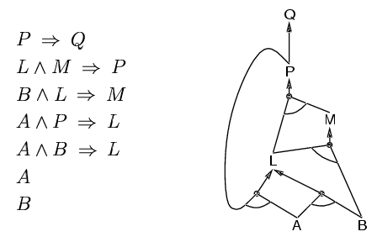
Forward chaining
Idea: fire any rule whose premises are satisfied in the KB,
  add its conclusion to the KB, until query is found

Slide 46
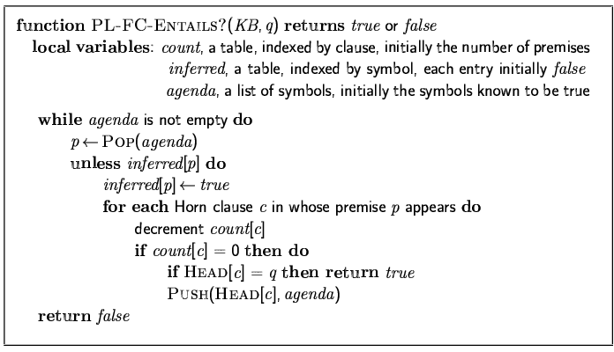
Forward chaining algorithm
Forward chaining is sound and complete for Horn KB

Slide 47
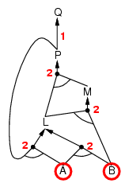
Forward chaining example

Slide 48
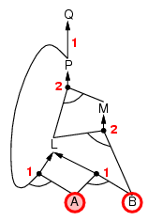
Forward chaining example

Slide 49
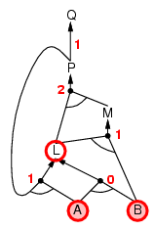
Forward chaining example

Slide 50
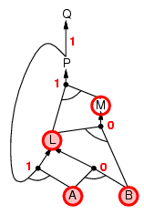
Forward chaining example

Slide 51
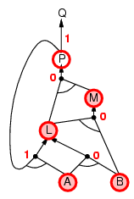
Forward chaining example

Slide 52
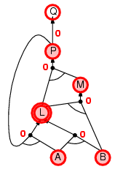
Forward chaining example

Slide 53
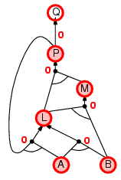
Forward chaining example

Slide 54

Forward chaining example

Slide 55
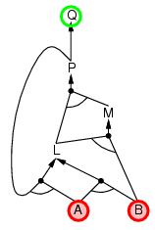
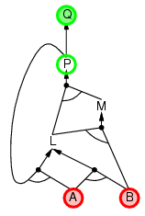
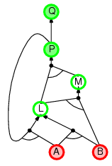
Backward chaining
Idea: work backwards from the query q:
  check if q is known already, or
  prove by BC all premises of some rule concluding q

Slide 56
Forward vs. backward chaining
FC is data-driven, automatic, unconscious processing,
  e.g., object recognition, routine decisions
  May do lots of work that is irrelevant to the goal
BC is goal-driven, appropriate for problem-solving,
  e.g., Where are my keys? How do I get into a PhD program?
  Complexity of BC can be much less than linear in size of KB

Slide 57
Efficient propositional inference
（有效的命题推理）
Determine if an input propositional logic sentence (in CNF) is satisfiable
  Complete backtracking search algorithms
    DPLL algorithm (Davis, Putnam, Logemann, Loveland)
  Incomplete local search algorithms
    WalkSAT algorithm

Slide 58
The DPLL algorithm
Improvements over truth table enumeration:
  Early termination（及早终止）
    A clause is true if any literal is true. 只要一个文字为真=>子句真
    A sentence is false if any clause is false.
  Pure symbol heuristic（纯符号启发）
    Pure symbol: always appears with the same "sign" in all clauses.
    e.g., In the three clauses (A ∨ ¬B), (¬B ∨ ¬C), (C ∨ A), A and B are pure, C is impure.
    Make a pure symbol literal true.
  Unit clause heuristic（单元子句启发）
    Unit clause: only one literal in the clause
    The only literal in a unit clause must be true.
    只要一个子句假=>语句假

Slide 59
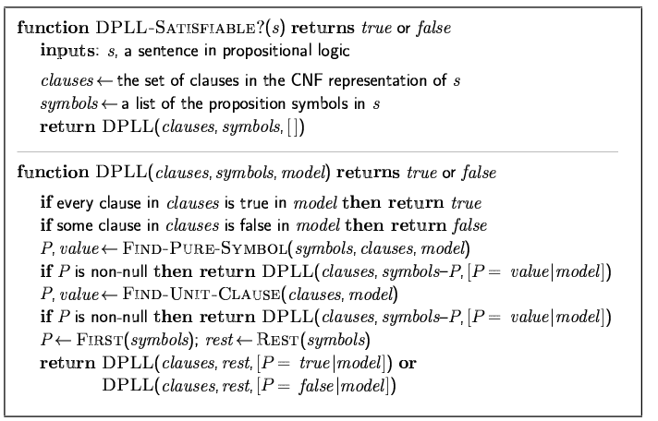
The DPLL algorithm

Slide 60
The WalkSAT algorithm
Incomplete, local search algorithm
  Evaluation function
    The min-conflict heuristic of minimizing the number of unsatisfied clauses
  Balance between greediness and randomness

Slide 61
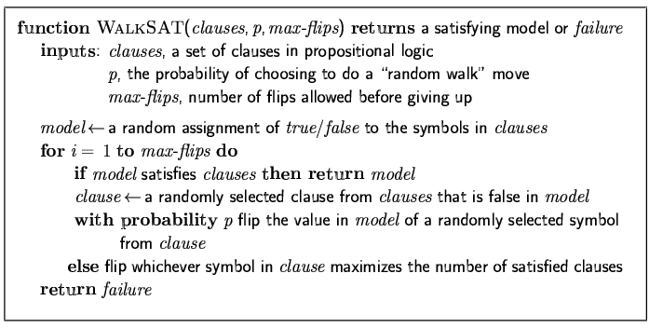
The WalkSAT algorithm

Slide 62
Inference-based agents in the wumpus world
A wumpus-world agent using propositional logic:
  ¬P_{1,1}
  ¬W_{1,1}
  B_{x,y} ⇔ (P_{x,y+1} ∨ P_{x,y-1} ∨ P_{x+1,y} ∨ P_{x-1,y})
  S_{x,y} ⇔ (W_{x,y+1} ∨ W_{x,y-1} ∨ W_{x+1,y} ∨ W_{x-1,y})
  W_{1,1} ∨ W_{1,2} ∨ … ∨ W_{4,4}
  ¬W_{1,1} ∨ ¬W_{1,2}
  ¬W_{1,1} ∨ ¬W_{1,3}
  …
⇒ 64 distinct proposition symbols, 155 sentences

Slide 63
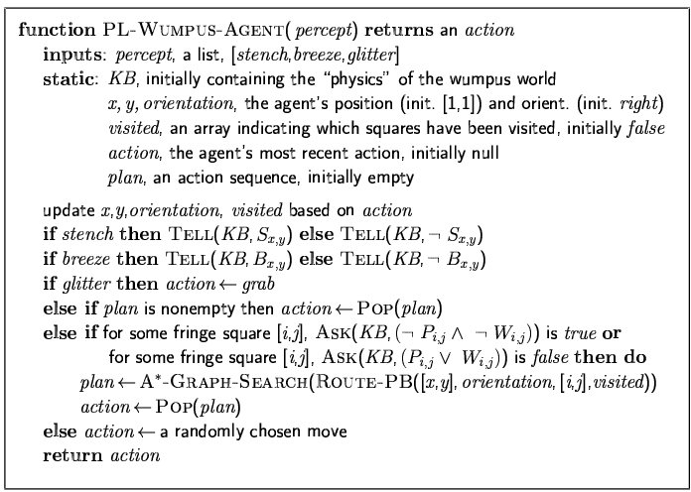

Slide 64
Expressiveness limitation of propositional logic
KB contains "physics" sentences for every single square
For every time t and every location [x,y],
L_{x,y} ∧ FacingRight^{t} ∧ Forward^{t} ⇒ L_{x+1,y}
Rapid proliferation of clauses
（子句快速繁殖）
t
t

Slide 65
First-Order Logic
Motivation
Syntax
Semantics
Inference

Slide 66
Motivation
Propositional logic has very limited expressive power
  E.g., cannot say "pits cause breezes in adjacent squares“
    except by writing one sentence for each square

Slide 67
First-order logic
Whereas propositional logic assumes the world contains facts,
first-order logic (like natural language) assumes the world contains
  Objects: people, houses, numbers, colors, baseball games, wars, …
  Relations: red, round, prime, brother of, bigger than, part of, comes between, …
  Functions: father of, best friend, one more than, plus, …

Slide 68
Syntax of FOL: Basic elements
Constants KingJohn, 2, NUS,...
Predicates Brother, >,...
Functions Sqrt, LeftLegOf,...
Variables x, y, a, b,...
Connectives ¬, ⇒, ∧, ∨, ⇔
Equality =
Quantifiers ∀, ∃

Slide 69
Sentences
Atomic sentence = predicate (term₁,...,term_{n}) or term₁ = term₂
  Term = function (term₁,...,term_{n}) or constant or variable
Complex sentences
  are made from atomic sentences using connectives
  e.g. ¬S, S1 ∧ S2, S1 ∨ S2, S1 ⇒ S2, S1 ⇔ S2

Slide 70
Semantics of FOL
Sentences are true with respect to a model and an interpretation
  Model contains objects (domain elements) and relations among them
  Interpretation specifies referents for
      constant symbols → objects
      predicate symbols → relations
      function symbols → functional relations
An atomic sentence predicate(term₁,...,term_{n}) is true
iff the objects referred to by term₁,...,term_{n}
are in the relation referred to by predicate

Slide 71
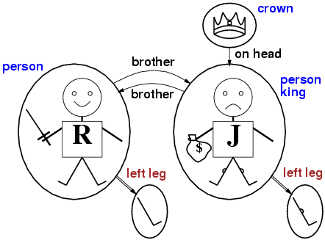
Models for FOL: Example

Slide 72
Universal quantification
∀<variables> <sentence>
  e.g. Everyone at NUS is smart:
  ∀x At(x,NUS) ⇒ Smart(x)
∀x P is true in a model m iff P is true with x being each possible object in the model
Roughly speaking, equivalent to the conjunction of instantiations of P
    At(KingJohn,NUS) ⇒ Smart(KingJohn)
    ∧ At(Richard,NUS) ⇒ Smart(Richard)
    ∧ At(NUS,NUS) ⇒ Smart(NUS)
    ∧ ...

Slide 73
A common mistake to avoid
Typically, ⇒ is the main connective with ∀
Common mistake: using ∧ as the main connective with ∀:
  ∀x At(x,NUS) ∧ Smart(x)
  means “Everyone is at NUS and everyone is smart”

Slide 74
Existential quantification
∃<variables> <sentence>
  e.g. Someone at NUS is smart:
  ∃x At(x,NUS) ∧ Smart(x)
∃x P is true in a model m iff P is true with x being some possible object in the model
Roughly speaking, equivalent to the disjunction of instantiations of P
  At(KingJohn,NUS) ∧ Smart(KingJohn)
  ∨ At(Richard,NUS) ∧ Smart(Richard)
  ∨ At(NUS,NUS) ∧ Smart(NUS)
  ∨ ...

Slide 75
Another common mistake to avoid
Typically, ∧ is the main connective with ∃
Common mistake: using ⇒ as the main connective with ∃:
∃x At(x,NUS) ⇒ Smart(x)
is true if there is anyone who is not at NUS!

Slide 76
Properties of quantifiers
∀x ∀y is the same as ∀y ∀x
∃x ∃y is the same as ∃y ∃x
∃x ∀y is not the same as ∀y ∃x
∃x ∀y Loves(x,y)
  “There is a person who loves everyone in the world”
∀y ∃x Loves(x,y)
  “Everyone in the world is loved by at least one person”
Quantifier duality: each can be expressed using the other
  ∀x P ≡ ¬∃x ¬P
    ∀x Likes(x,IceCream) ≡ ¬∃x ¬Likes(x,IceCream)
  ∃x P ≡ ¬ ∀ x ¬P
    ∃x Likes(x,Broccoli) ≡ ¬∀x ¬Likes(x,Broccoli)

Slide 77
Equality
term₁ = term₂ is true under a given interpretation if and only if term₁ and term₂ refer to the same object
  e.g. Father(John)=Henry

Slide 78
Knowledge base for the wumpus world
Perception
  ∀t,s,b Percept([s,b,Glitter],t) ⇒ Glitter(t)
Reflex
  ∀t Glitter(t) ⇒ BestAction(Grab,t)
Environment
  ∀x,y,a,b Adjacent([x,y],[a,b]) ⇔ [a,b] ∈ {[x+1,y], [x-1,y],[x,y+1],[x,y-1]}
Properties of squares
  ∀s,t At(Agent,s,t) ∧ Breeze(t) ⇒ Breezy(s)

Slide 79
Deducing hidden properties
Diagnostic rule
  infer cause from effect
  ∀s Breezy(s) ⇒ ∃ r Adjacent(r,s) ∧ Pit(r)
Causal rule
  infer effect from cause
  ∀r Pit(r) ⇒ [∀s Adjacent(r,s) ⇒ Breezy(s) ]

Slide 80
Interacting with FOL KBs
Suppose a wumpus-world agent is using an FOL KB and perceives a smell and a breeze (but no glitter) at t=5:
  Tell(KB,Percept([Smell,Breeze,None],5))
  Ask(KB,∃a BestAction(a,5))
      i.e., does the KB entail some best action at t=5?
Answer: Yes, {a/Shoot} ← substitution(置换)

Slide 81
Interacting with FOL KBs
Given a sentence S and a substitution σ, Sσ or Subst(σ, S) denotes the result of plugging σ into S; e.g.,
  S = Smarter(x,y)
  σ = {x/Hillary,y/Bill}
  Sσ = Smarter(Hillary,Bill)
Ask(KB,S) returns some/all σ such that KB╞ σ

Slide 82
Inference in FOL
Reduction to propositional inference
Generalized Modus Ponens(一般化分离规则)
Forward chaining
Backward chaining
Resolution

Slide 83
Universal instantiation (UI)
(全称实例化)
Every instantiation of a universally quantified sentence is entailed by it:
∀v α
Subst({v/g}, α)
for any variable v and ground term g
E.g., ∀x King(x) ∧ Greedy(x) ⇒ Evil(x) yields:
  King(Richard) ∧ Greedy(Richard) ⇒ Evil(Richard)
  King(Father(John)) ∧ Greedy(Father(John)) ⇒ Evil(Father(John))
King(John)  Greedy(John)  Evil(John)

Slide 84
Existential instantiation (EI)
(存在实例化)
For any sentence α, variable v, and constant symbol k that does not appear elsewhere in the knowledge base:
∃v α
Subst({v/k}, α)
E.g., ∃x Crown(x) ∧ OnHead(x,John) yields:
Crown(C₁) ∧ OnHead(C₁,John)
provided C₁ is a new constant symbol, called a Skolem constant

Slide 85
Reduction to propositional inference
Suppose the KB contains just the following:
    ∀x King(x) ∧ Greedy(x) ⇒ Evil(x)
    King(John)
    Greedy(John)
    Brother(Richard,John)
Instantiating the universal sentence in all possible ways, we have:
    King(John) ∧ Greedy(John) ⇒ Evil(John)
    King(Richard) ∧ Greedy(Richard) ⇒ Evil(Richard)
    King(John)
    Greedy(John)
    Brother(Richard,John)
The new KB is propositionalized: proposition symbols are
  King(John), Greedy(John), Evil(John), King(Richard), etc.

Slide 86
Reduction contd.
Every FOL KB can be propositionalized so as to preserve entailment
  A ground sentence is entailed by new KB iff entailed by original KB
Idea: propositionalize KB and query, apply resolution, return result

Slide 87
Problems with propositionalization
Problem : with function symbols, there are infinitely many ground terms,
  e.g., Father(Father(Father(John)))
Theorem :Herbrand (1930).
  If a sentence α is entailed by an FOL KB, it is entailed by a finite subset of the propositionalized KB
  Idea: For n = 0 to ∞ do
    create a propositional KB by instantiating with depth (n) terms
    see if α is entailed by this KB

Slide 88
Problems with propositionalization
Problem: works if α is entailed, loops if α is not entailed
Theorem: Turing (1936), Church (1936) Entailment for FOL is
  algorithms exist that say yes to every entailed sentence,but no algorithm exists that also says no to every nonentailed sentence.
  存在肯定每个蕴涵语句的算法，而不存在还能否定每个非蕴涵语句的算法。
semidecidable(半可判定)

Slide 89
Problems with propositionalization
Propositionalization seems to generate lots of irrelevant sentences.
E.g., from:
  ∀x King(x) ∧ Greedy(x) ⇒ Evil(x)
  King(John)
  ∀y Greedy(y)
  Brother(Richard,John)
it seems obvious that Evil(John), but propositionalization produces lots of facts such as Greedy(Richard) that are irrelevant

Slide 90
Unification(合一)
We can get the inference immediately if we can find a substitution θ
  such that King(x) and Greedy(x) match King(John) and Greedy(y)
θ = {x/John,y/John} works
p q θ
Knows(John,x) Knows(John,Jane) {x/Jane}
Knows(John,x) Knows(y,OJ) {x/OJ,y/John}
Knows(John,x) Knows(y,Mother(y)) {y/John,x/Mother(John)}
Knows(John,x) Knows(x,OJ) {fail}
Standardizing apart eliminates overlap of variables, e.g., Knows(z₁₇,OJ)
  Unify(α,β) = θ if SUBST(θ , α) = SUBST(θ , β)

Slide 91
Unification
To unify Knows(John,x) and Knows(y,z),
θ = {y/John, x/z } or θ = {y/John, x/John, z/John}
The first unifier is more general than the second.
There is a single most general unifier (MGU) that is unique up to renaming of variables.
  MGU = { y/John, x/z }

Slide 92
Generalized Modus Ponens (GMP)（一般化分离规则）
p₁', p₂', … , p_{n}', ( p₁ ∧ p₂ ∧ … ∧ p_{n} ⇒q)
SUBST(θ,q)
where SUBST(θ ,pi‘) = SUBST(θ , pi) for all i
p₁' is King(John) p₁ is King(x)
p₂' is Greedy(y) p₂ is Greedy(x)
θ is {x/John,y/John} q is Evil(x)
SUBST(θ , q) is Evil(John)
GMP used with KB of definite clauses (exactly one positive literal)
All variables assumed universally quantified

Slide 93
Soundness of GMP
Need to show that
p₁', …, p_{n}', (p₁ ∧ … ∧ p_{n} ⇒ q) ╞ Subst (θ,q)
provided that Subst (θ ,pi‘) = Subst (θ ,pi) for all i
Lemma: For any sentence p, we have p ╞ Subst (θ,p) by UI
(p₁ ∧ … ∧ p_{n} ⇒ q) ╞ Subst(θ,(p₁ ∧ … ∧ p_{n} ⇒ q)) = (Subst(θ ,p₁) ∧ … ∧ Subst(θ ,p_{n}) ⇒ Subst(θ ,q))
p₁', …, p_{n}' ╞ p₁' ∧ … ∧ p_{n}' ╞ Subst(θ,p₁') ∧ … ∧ Subst(θ,p_{n}')
From 1 and 2, Subst(θ ,q) follows by ordinary Modus Ponens

Slide 94
Forward chaining
Example knowledge base
  The law says that it is a crime for an American to sell weapons to hostile nations. The country Nono, an enemy of America, has some missiles, and all of its missiles were sold to it by Colonel West, who is American.
  Prove that Col. West is a criminal

Slide 95
Forward chaining
... it is a crime for an American to sell weapons to hostile nations:
  American(x) ∧ Weapon(y) ∧ Sells(x,y,z) ∧ Hostile(z) ⇒ Criminal(x)
Nono … has some missiles, i.e., ∃x Owns(Nono,x) ∧ Missile(x):
  Owns(Nono,M₁) and Missile(M₁)
… all of its missiles were sold to it by Colonel West
  Missile(x) ∧ Owns(Nono,x) ⇒ Sells(West,x,Nono)
Missiles are weapons:
  Missile(x) ⇒ Weapon(x)
An enemy of America counts as "hostile“:
  Enemy(x,America) ⇒ Hostile(x)
West, who is American …
  American(West)
The country Nono, an enemy of America …
  Enemy(Nono,America)

Slide 96
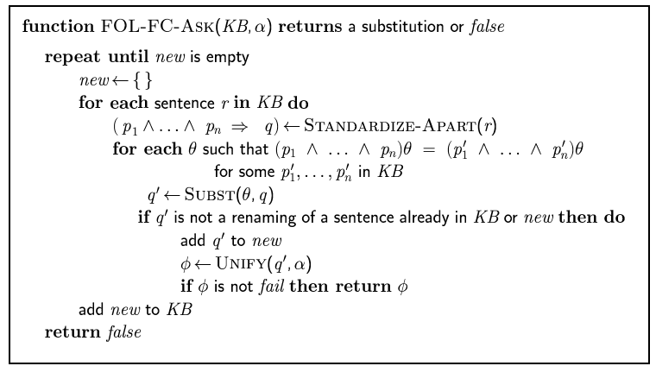
Forward chaining algorithm

Slide 97
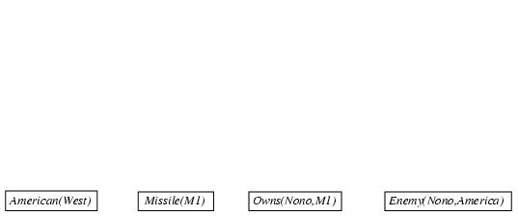
Forward chaining proof

Slide 98
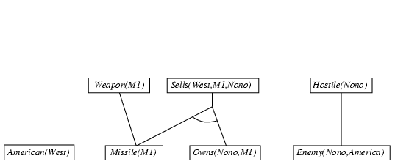
Forward chaining proof
Missile(x) ⇒ Weapon(x)
  Missile(x) ∧ Owns(Nono,x) ⇒ Sells(West,x,Nono)
  Enemy(x,America) ⇒ Hostile(x)

Slide 99
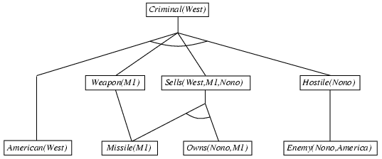
Forward chaining proof
  American(x) ∧ Weapon(y) ∧ Sells(x,y,z) ∧ Hostile(z) ⇒ Criminal(x)

Slide 100
Properties of forward chaining
Sound and complete for first-order definite clauses
Datalog = first-order definite clauses + no functions
FC terminates for Datalog in finite number of iterations
May not terminate in general if α is not entailed
  This is unavoidable: entailment with definite clauses is semidecidable

Slide 101
Efficiency of forward chaining
Matching itself can be expensive
  Database indexing allows O(1) retrieval of known facts
  e.g., query Missile(x) retrieves Missile(M₁)
Rechecks every rule on every iteration
  Incremental forward chaining: no need to match a rule on iteration k if a premise wasn't added on iteration k-1
    ⇒ match each rule whose premise contains a newly added positive literal
Generate irrelevant facts

Slide 102
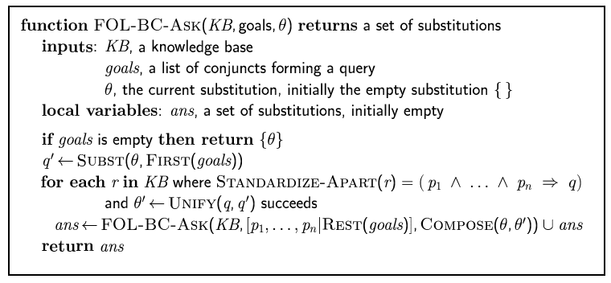
Backward chaining algorithm
SUBST(COMPOSE(θ₁, θ₂), p) = SUBST(θ₂, SUBST(θ₁, p))

Slide 103

Backward chaining example

Slide 104
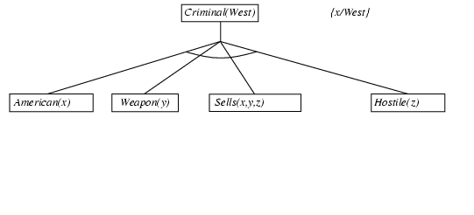
Backward chaining example

Slide 105
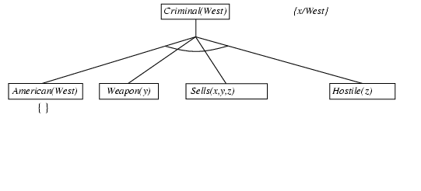
Backward chaining example

Slide 106
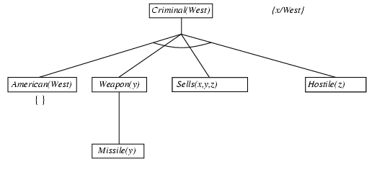
Backward chaining example

Slide 107
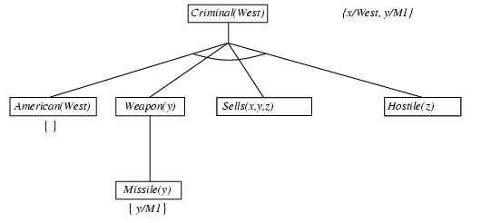
Backward chaining example

Slide 108
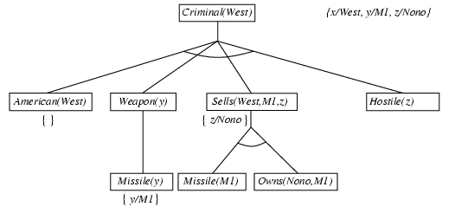
Backward chaining example

Slide 109
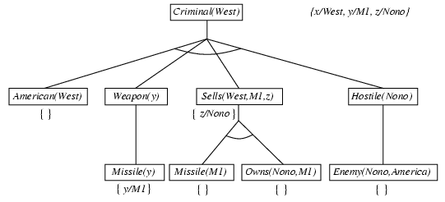
Backward chaining example

Slide 110
Properties of backward chaining
Depth-first recursive proof search: space is linear in size of proof
Incomplete due to infinite loops
  ⇒ fix by checking current goal against every goal on stack
Inefficient due to repeated subgoals (both success and failure)
  ⇒ fix using caching of previous results (extra space)
  Widely used for logic programming

Slide 111
Resolution
Full first-order version:
l₁ ∨ ··· ∨ l_{k}, m₁ ∨ ··· ∨ m_{n}
(l₁ ∨ ··· ∨ l_{i-1} ∨ l_{i+1} ∨ ··· ∨ l_{k} ∨ m₁ ∨ ··· ∨ m_{j-1} ∨ m_{j+1} ∨ ··· ∨ m_{n})θ
where Unify(l_{i}, ¬m_{j}) = θ.
For example,
¬Rich(x) ∨ Unhappy(x)
Rich(Ken)
Unhappy(Ken)
with θ = {x/Ken}
Apply resolution steps to CNF(KB ∧ ¬α); complete for FOL

Slide 112
Conversion to CNF
Everyone who loves all animals is loved by someone:
  ∀x [∀y Animal(y) ⇒ Loves(x,y)] ⇒ [∃y Loves(y,x)]
1. Eliminate biconditionals and implications
2. Move ¬ inwards: ¬∀x p ≡ ∃x ¬p, ¬ ∃x p ≡ ∀x ¬p
  ∀x [∃y ¬¬Animal(y) ∧ ¬Loves(x,y)] ∨ [∃y Loves(y,x)]
  ∀x [∃y Animal(y) ∧ ¬Loves(x,y)] ∨ [∃y Loves(y,x)]
x [y ➢(➢Animal(y)  Loves(x,y))]  [y Loves(y,x)]
x [➢y ➢Animal(y)  Loves(x,y)]  [y Loves(y,x)]

Slide 113
Conversion to CNF contd.
Standardize variables: each quantifier should use a different one
  ∀x [∃y Animal(y) ∧ ¬Loves(x,y)] ∨ [∃z Loves(z,x)]
Skolemize: a more general form of existential instantiation.
  Each existential variable is replaced by a Skolem function of the enclosing universally quantified variables:
  ∀x [Animal(F(x)) ∧ ¬Loves(x,F(x))] ∨ Loves(G(x),x)
Drop universal quantifiers:
  [Animal(F(x)) ∧ ¬Loves(x,F(x))] ∨ Loves(G(x),x)
Distribute ∨ over ∧ :
  [Animal(F(x)) ∨ Loves(G(x),x)] ∧ [¬Loves(x,F(x)) ∨ Loves(G(x),x)]

Slide 114
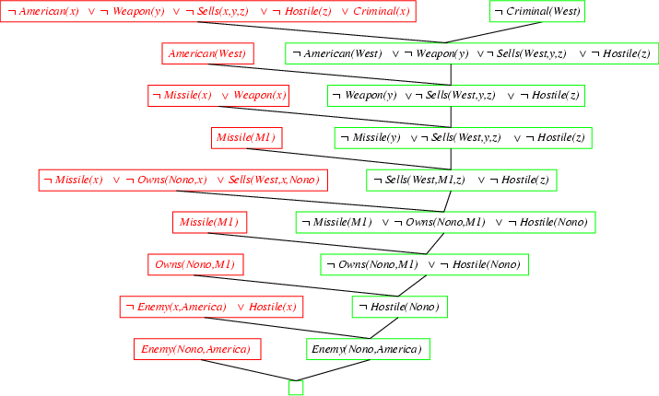
Resolution proof: definite clauses

Slide 115
Knowledge engineering in FOL
Identify the task
Assemble the relevant knowledge
Decide on a vocabulary of predicates, functions, and constants
Encode general knowledge about the domain
Encode a description of the specific problem instance
Pose queries to the inference procedure and get answers
Debug the knowledge base

Slide 116
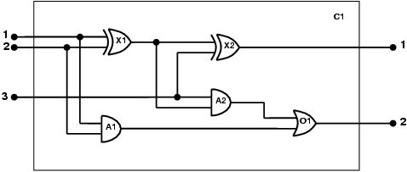
The electronic circuits domain
One-bit full adder

Slide 117
The electronic circuits domain
Identify the task
  Does the circuit actually add properly? (circuit verification)
Assemble the relevant knowledge
  Relevant
    Composed of wires and gates;
    Types of gates (AND, OR, XOR, NOT)
  Irrelevant
    size, shape, color, cost of gates
Decide on a vocabulary
  Alternatives:
    Type(X₁) = XOR
    Type(X₁, XOR)
    XOR(X₁)

Slide 118
The electronic circuits domain
Encode general knowledge of the domain
  ∀t₁,t₂ Connected(t₁, t₂) ⇒ Signal(t₁) = Signal(t₂)
  ∀t Signal(t) = 1 ∨ Signal(t) = 0
  1 ≠ 0
  ∀t₁,t₂ Connected(t₁, t₂) ⇒ Connected(t₂, t₁)
  ∀g Type(g) = OR ⇒ Signal(Out(1,g)) = 1 ⇔ ∃n Signal(In(n,g)) = 1
  ∀g Type(g) = AND ⇒ Signal(Out(1,g)) = 0 ⇔ ∃n Signal(In(n,g)) = 0
  ∀g Type(g) = XOR ⇒ Signal(Out(1,g)) = 1 ⇔ Signal(In(1,g)) ≠ Signal(In(2,g))
  ∀g Type(g) = NOT ⇒ Signal(Out(1,g)) ≠ Signal(In(1,g))

Slide 119
The electronic circuits domain
Encode the specific problem instance
  Type(X₁) = XOR Type(X₂) = XOR
  Type(A₁) = AND Type(A₂) = AND
  Type(O₁) = OR
  Connected(Out(1,X₁),In(1,X₂)) Connected(In(1,C₁),In(1,X₁))
  Connected(Out(1,X₁),In(2,A₂)) Connected(In(1,C₁),In(1,A₁))
  Connected(Out(1,A₂),In(1,O₁)) Connected(In(2,C₁),In(2,X₁))
  Connected(Out(1,A₁),In(2,O₁)) Connected(In(2,C₁),In(2,A₁))
  Connected(Out(1,X₂),Out(1,C₁)) Connected(In(3,C₁),In(2,X₂))
  Connected(Out(1,O₁),Out(2,C₁)) Connected(In(3,C₁),In(1,A₂))

Slide 120
The electronic circuits domain
Pose queries to the inference procedure
  Ask: What combinations of inputs would cause the first output of Cl (the sum bit) to be 0 and the second output of C1 (the carry bit) to be l?
  Answer:
Debug the knowledge base
  i1,i2,i3 Signal(In(1,C_1)) = i1  Signal(In(2,C1)) = i2  Signal(In(3,C1)) = i3  Signal(Out(1,C1)) = 0  Signal(Out(2,C1)) = 1

