Slide 1
《人工智能》
知识表示与推理 (II)
巢文涵
chaowenhan@buaa.edu.cn G1001
北航计算机学院智能所

Slide 2
大纲
其他表示方法
本体概述

Slide 3
非逻辑表示?
逻辑表示非常受限
  许多研究人员寻求更好的表示方法
产生式规则
语义网
  概念图
  框架

Slide 4
产生式规则（Production Rules ）
Rule set of <condition,action> pairs
  “if condition then action”
    P → Q or
    IF P THEN Q CF = [0, 1]
      CF(Certainty Factor，置信度)
Match-resolve-act cycle (匹配-消解-执行)
  Match: Agent checks if each rule’s condition holds
  Resolve:
    Multiple production rules may fire at once (conflict set)
    Agent must choose rule from set (conflict resolution)
  Act: If so, rule “fires” and the action is carried out
Working memory:
  rule can write knowledge to working memory
  knowledge may match and fire other rules

Slide 5
示例
IF (at bus stop AND bus arrives) THEN action(get on the bus)
IF (on bus AND not paid AND have oyster card) THEN action(pay with oyster) AND add(paid)
IF (on bus AND paid AND empty seat) THEN sit down
conditions and actions must be clearly defined
  can easily be expressed in first order logic!
Notes:
【注意】：谓词逻辑中的蕴涵式与产生式的基本形式相似，事实上，蕴涵式只是产生式的一种特殊情况。理由如下：
（1）蕴涵式只能表示精确知识，其值非“真”即“假”，而产生式不仅可以表示精确知识，而且还可以表示不精确知识。
（2）用产生式表示知识的系统中，“事实”与产生式的“前提”中所规定的条件进行匹配时，可以是“精确匹配”，也可以是基于相似度的“不精确匹配”，只要相似度落入某个预先设定的范围内，即可认为匹配。但对谓词逻辑的蕴涵式而言，其匹配必须是精确的。
产生式系统的优点
（1）自然性：由于产生式系统采用了人类常用的表达因果关系的知识表示形式，既直观、自然，又便于进行推理。
（2）模块性：产生式是规则库中的最基本的知识单元，形式相同，易于模块化管理。
（3）有效性：能表示确定性知识、不确定性知识、启发性知识、过程性知识等。
（4）清晰性：产生式有固定的格式，既便于规则设计，又易于对规则库中的知识进行一致性、完整性检测。
产生式系统的缺点
（1）效率不高
产生式系统求解问题的过程是一个反复进行“匹配—冲突消解—执行”的过程。由于规则库一般都比较庞大，而匹配又是一件十分费时的工作，因此，其工作效率不高。此外，在求解复杂问题时容易引起组合爆炸。
（2）不能表达具有结构性的知识
产生式系统对具有结构关系的知识无能为力，它不能把具有结构关系的事物间的区别与联系表示出来，因此，人们经常将它与其它知识表示方法（如框架表示法、语义网络表示法）相结合。
产生式系统的适用领域
（1）由许多相对独立的知识元组成的领域知识，彼此之间关系不密切，不存在结构关系。如：化学反应方面的知识。
（2）具有经验性及不确定性的知识，而且相关领域中对这些知识没有严格、统一的理论。如：医疗诊断、故障诊断等方面的知识。
（3）领域问题的求解过程可被表示为一系列相对独立的操作，而且每个操作可被表示为一条或多条产生式规则。

Slide 6
产生式规则优势
自然性：
  由于产生式系统采用了人类常用的表达因果关系的知识表示形式，既直观、自然，又便于进行推理。
模块性
  产生式是规则库中的最基本的知识单元，形式相同，易于模块化管理。
有效性
  能表示确定性知识、不确定性知识、启发性知识、过程性知识等。
清晰性
  产生式有固定的格式，既便于规则设计，又易于对规则库中的知识进行一致性、完整性检测。

Slide 7
产生式规则-缺陷
效率不高
  求解问题的过程是一个反复进行“匹配—冲突消解—执行”的过程
  复杂问题或者规则库较大时会导致组合爆炸
不能表达具有结构性的知识
  不能把具有结构关系的事物间的区别与联系表示出来
  通常将它与其它知识表示方法相结合。

Slide 8
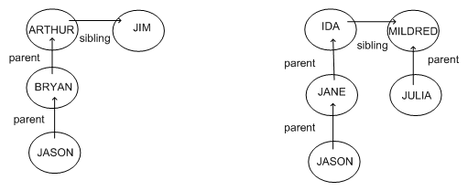
语义网（ Semantic Networks ）
图表示
  节点表示概念
  链接表示子集、成员或者关系,…

Slide 9
语义网
等价于逻辑表示（通常是FOL）
  比FOL更容易理解
  特定的SN推理算法更快
实例: 自然语言理解
  具有相同意思的句子具有相同的图

Slide 10
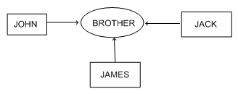
概念图
一种语义网，其中每个图表示一个命题
概念节点可以是：
  具体的：例如旅馆
  抽象的：例如生气
边上没有标签
  概念关系节点
  易于表示多个对象之间的关系

Slide 11
框架（ Frame Representation）
一种语义网，其中每个节点具有结构
  框架（Frame）包含若干槽(slot)，例如年龄、身高
  每个槽存储特定的信息条目
当智能体面临新场景时
  槽可以被填充（其值可以是另外的框架）
  填充可能触发动作
框架之间的属性可以继承
  类似于 OOP

Slide 12
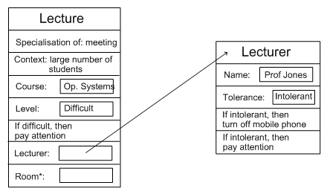
框架表示实例

Slide 13
框架的灵活性
框架中的槽可以容纳
  在特定情境下如何选择一个框架的信息
  框架之间的关系
  若干槽填充后用执行的过程
  输入缺失时的默认值
  空槽：除非任务所需，否则保留为空
  其他槽：可形成层次关系
同样可以用一阶逻辑表示

Slide 14
表示&逻辑
人工智能希望“非逻辑的表示”
  产生式
  语义网络
    概念图、框架
但是它们都可以以一阶逻辑来表示
两全其美
  逻辑保证表示是良定的
  特定于应用的表示使得推理更容易、更有意义

Slide 15
新问题?
在智能体的知识库中存入什么内容（what content）
  即如何表示世界知识

Slide 16
本体概述
Why ontology
What is ontology?
How to develop an Ontology?
Applications

Slide 17
Why Ontologies?
To share common understanding of the structure of information among people or software agents
To enable reuse of domain knowledge
To make domain assumptions explicit
To separate domain knowledge from the operational knowledge
To analyze domain knowledge

Slide 18
Why ontology: a data exchange view
Data exchange problem:
  数据格式不同
  相同的含义用词不一样，相同的词含义不一样
  一些隐含的假设，背景信息不一样
    如：TV单价2000元
Primitive method
  例子：客户发送订单系统 ，销售商处理订单系统
  N个系统交换数据：C_{n}² translators
Notes:
产品定价：

Slide 19
Ontology Approach
提供语义层次上的统一认识
  enable communication among people, software agents, software.
To make domain assumptions explicit
  Context information/assumption must be explicitly stated.

Slide 20
What is Ontology(本体论)
Ontology has been a field of philosophy
  it has been characterised as a study of existence, a compendium of all there is in the world.
In CS/AI, ontologies are viewed as a shared and common understanding of a domain
  can be communicated between people and heterogeneous and distributed application systems.

Slide 21
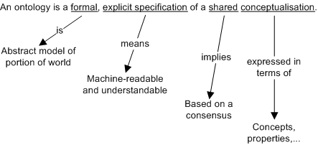
What is Ontology
Ontology是共享概念模型的明确的形式化规范说明。
Notes:
Ontology是共享的概念化的形式化的、清晰的规范

Slide 22
What is Ontology
“概念模型”：指Ontology是通过抽象出客观世界中一些现象的相关概念而得到的模型。
“明确”：指Ontology所使用的概念及概念的约束都有明确的定义。
“形式化”：指Ontology是计算机可读的（即能被计算机处理）。
“共享”：指Ontology中体现的是共同认可的知识，反映的是相关领域中公认的概念集（即Ontology针对的是团体而非个体的共识）。

Slide 23
What is Ontology
Upper ontology or general ontology
  also known as foundational or top-level ontologies, try to formalise the more general concepts in our conception of the world.
  Define general framework of concepts
    SUMO : Suggested Upper Merged Ontology
    WordNet
    CYC
domain-level ontology
  based on upper ontologies but deal with more specific domains
    Genomics and proteomics, Enterprise, Education etc.

Slide 24
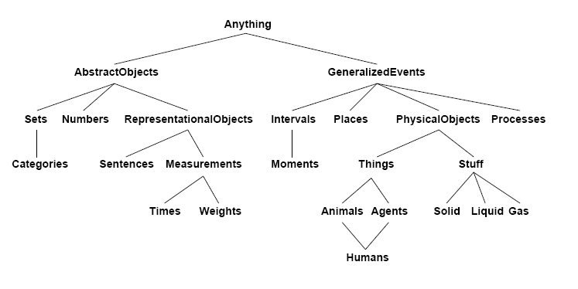
The upper ontology of the world

Slide 25
What is Ontology?
Ontology的结构是一个五元组
O：= { C, R, H^{c},rel,A^{O}}
C：概念；
R：关系；
H^{c}：概念层次，例如H^{C}（C1，C2）；
rel：概念间的关系，
例如，rel（R）＝（C1，C2）；
A^{O}：用某种逻辑语言表示的一组本体公理。
C1是C2的子概念
C1和C2具有关系R

Slide 26
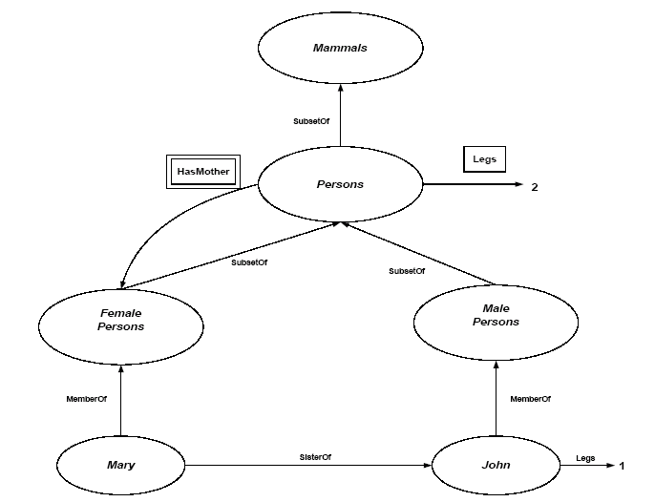

Slide 27
Ontology languages
First-order logic
  KIF
  CYCL
  Frame logic: OIL
Conceptual Graph
Others
  RDF schema：为web ontology定制
  UML

Slide 28
How to develop Ontology
Manual
  Tool: protégé 2000
  费时费力
Automatic
  Ontology learning
    Text mining method , NLP method or statistics
  Quality?
Semi-Automatical

Slide 29
Development Process: rules
(适应性)There is no one correct way to model a domain— there are always viable alternatives.
  The best solution almost always depends on the application that you have in mind and the extensions that you anticipate.
(迭代)Ontology development is necessarily an iterative process.
(重点:对象和关系)Concepts in the ontology should be close to objects (physical or logical) and relationships in your domain of interest.
  These are most likely to be nouns (objects) or verbs (relationships) in sentences that describe your domain.

Slide 30
Step1: Determine the domain and scope
What is the domain that the ontology will cover?
For what we are going to use the ontology?
For what types of questions the information in the ontology should provide answers
Who will use and maintain the ontology?

Slide 31
Step 1 Examples
Competency question
  Which wine characteristics should I consider when choosing a wine?
  Is Bordeaux a red or white wine?
  What is the best choice of wine for grilled meat(烤肉)?
  Which characteristics of a wine affect its appropriateness for a dish?
  Does a bouquet or body of a specific wine change with vintage year?
  What were good vintages for Napa Zinfandel?

Slide 32
Step2: Consider reusing existing ontologies
Ontology libararies
  DAML ontology library
  Ontolingua ontology library
  Protégé ontology library
Upper ontology
  IEEE Standard Upper Ontology
General ontology
Domain ontology

Slide 33
Step3: Enumerate Important Terms
What are the terms we need to talk about?
What are the properties of these terms?
What do we want to say about the terms?
Examples
  wine, grape, winery, location,
  a wine’s color, body, flavor and sugar content;
  different types of food, such as fish and red meat;
  subtypes of wine such as white wine, and so

Slide 34
Step4: Define Classes and the Class Hierarchy
A class
  a concept in the domain
  a collection of elements with similar properties
A class hierarchy
  is usually an IS-A hierarchy
  Classes usually constitute a taxonomic hierarchy (a subclass-superclass hierarchy)

Slide 35
Step4: Define Classes and the Class Hierarchy
Methods
  Top-down
    Food and Wine -- followed by White, Blush and Red
  Bottom-up
    define specific wine class first and the work your way up
  Combination
Result
  hierarchical arrangements of concepts
  If a class A is a superclass of class B, then every instance of B is also an instance of A
    This implies “In other words, the class B represents a concept that is a “kind of” A.”

Slide 36
Step5: Define Properties of Classes: Slots
Slots in a class definition describe attributes of instances of the class and relations to other instances
Types of properties
  “intrinsic”(内在) properties: color of wine
  “extrinsic”(外在) properties: price of wine
  Parts(部分): ingredients(材料) in a dish
  relations to other objects(关系): producer of wine (winery)

Slide 37
Step 6: Define the facets of the slots
Property constraints (facets) describe or limit the set of possible values for a slot
Common Facets
  Slot cardinality(基数) – the number of values a slot has, 0,1 or m
  Slot value type – the type of values a slot has
  Minimum and maximum value – a range of values for a numeric slot
  Default value – the value a slot has unless explicitly specified otherwise
  Domain and Range
DOMAIN
RANGE
class
slot
allowed values

Slide 38
Common Facets: Value Type
String: a string of characters (“Château Lafite”)
Number: an integer or a float (15, 4.5)
Boolean: a true/false flag
Enumerated type: a list of allowed values (high, medium, low)
Complex type: an instance of another class
  Specify the class to which the instances belong
  The Wine class is the value type for the slot “produces” at the Winery class

Slide 39
Facets and Class Inheritance
A subclass inherits all the slots from the superclass
A subclass can override the facets to “narrow” the list of allowed values
  Make the cardinality range smaller
  Replace a class in the range with a subclass
Wine
producer
Winery
is-a
is-a
French
wine
producer
French
winery

Slide 40
Step 7: Create Instances
Create an instance of a class
  The class becomes a direct type of the instance
  Any superclass of the direct type is a type of the instance
Assign slot values for the instance frame
  Slot values should conform to the facet constraints
  Knowledge-acquisition tools often check that
eg.
    Body: Light
    Color: Red
    Flavor: Delicate
    Tannin level: Low
    Grape: Gamay (instance of the Wine grape class)
    Maker: Chateau-Morgon (instance of the Winery class)
    Region: Beaujolais (instance of the Wine-Region class)
    Sugar: Dry

Slide 41
Step 8: validation
Consistency / validity / sanity checks
E.g.
  Ensuring that the class hierarchy is correct
    Transitivity of the hierarchical relations
  Evolution of a class hierarchy
    synonyms of concept name do not represent different classes
    Avoid class hierarchy cycles
    All the siblings in the hierarchy (except for the ones at the root) must be at the same level of generality.
  How many is too many and how few are too few?
  Multiple Inheritance
  When do you introduce a new class
  Limiting the scope of Ontology

Slide 42
Ontology Applications
Communication:
  need a shared understanding, common language
Inter-operability
  Different users exchange data or use different software tools
System engineering
  Specification, reliability, reuse
Notes:
网聚计算机的力量！！

Slide 43
Application Areas
Knowledge engineering & management
Information retrieval & integration
Nature language processing
Electronic commerce
Multi-agent systems
Software engineering
Semantic web / Semantic web services

Slide 44
Further topics
Ontology mapping & merging
  i.e ontology integration
Ontology evolution
Ontology evaluation
Ontology management system
  Similar to database management system

