Slide 1

C# Programming
Nobel It solutions

Slide 2
C# Programming
Brief overview of what will be covered in this
OOPS concepts(Abstraction, Encapsulation, Inheritance, Polymorphism)
C# First Program
C# Keywords
Data type, Type conversion, Variables, Constants, Operators
Condition & loops
StringBuilder, nullable types, anonymous types, dynamic types
C# Class object
Date Time, Structure, Enum
C# Interface ,Partial class, Static
C# Collections

Slide 3
What is Object Oriented Programming in C#?
Object-oriented programming is a way of developing software applications using real-world terminologies to create entities that interact with one another using objects.
Object-oriented programming makes applications flexible (easy to change or add new features), reusable, well-structured, and easy to debug and test.
Classes: A Class define the structure using methods and properties/fields that resemble real-world entity.
Methods: A method represents a particular behavior. It performs some action and might return information about an object, or update an object’s data.
Properties: Properties hold the data temporarily during the execution of an application.
Objects: Objects are instances of the class that holds different data in properties/fields and can interact with other objects.
Interfaces: An interface is a contract that defines the set of rules for a particular functionality. They are used effectively with classes using OOP principles like inheritance and polymorphism to make applications more flexible.

Slide 4
Object Oriented Design Principles
There are various object-oriented principles and techniques using which you can develop applications that are maintainable and extendable.
The followings are four main principles of object-oriented programming:
Abstraction
Encapsulation
Inheritance
Polymorphism

Slide 5
Abstracting
The process of representing the essential features without including the background details is called Abstraction. In simple words, we can say that it is a process of defining a class by providing necessary details to the external world, which are required by hiding or removing unnecessary things.
Encapsulation
The process of binding the data and functions together into a single unit (i.e., class) is called Encapsulation. In simple words, we can say that it is a process of defining a class by hiding its internal data members from outside the class and accessing those internal data members only through publicly exposed methods or properties. Data encapsulation is also called data hiding because, using this principle, we can hide the internal data from outside the class.

Slide 6
Inheritance
The process by which the members of one class are transferred to another class is called inheritance. The class from which the members are transferred is called the Parent/Base/Superclass, and the class that inherits the Parent/Base/Superclass members is called the Derived/Child/Subclass. We can achieve code extensibility through inheritance.
Polymorphism
Polymorphism is derived from the Greek word, where Poly means many and morph means faces/ behaviors. So, the word polymorphism means the ability to take more than one form. Technically, we can say that the same function/operator will show different behaviors by taking different types of values or with a different number of values, called Polymorphism. There are two types of polymorphism.
Static polymorphism/compile-time polymorphism/Early binding
Dynamic polymorphism/Run time polymorphism/Late binding

Slide 7
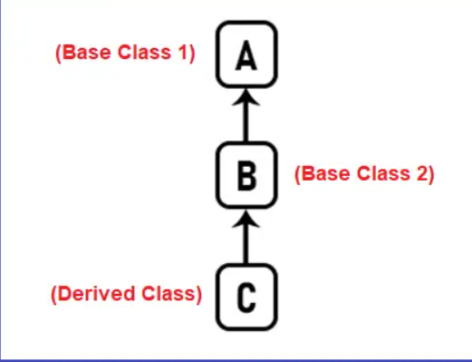
Inheritance Types
1. Single Inheritance (Single, Multilevel, and Hierarchical)

Slide 8
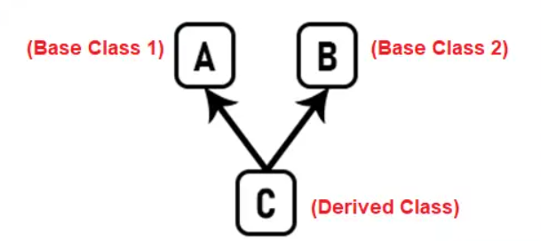
2. Multiple Inheritance (Multiple and Hybrid)

Slide 9
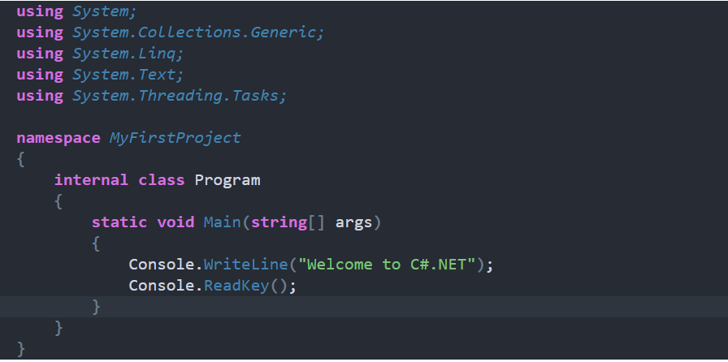
C# First Program

Slide 10
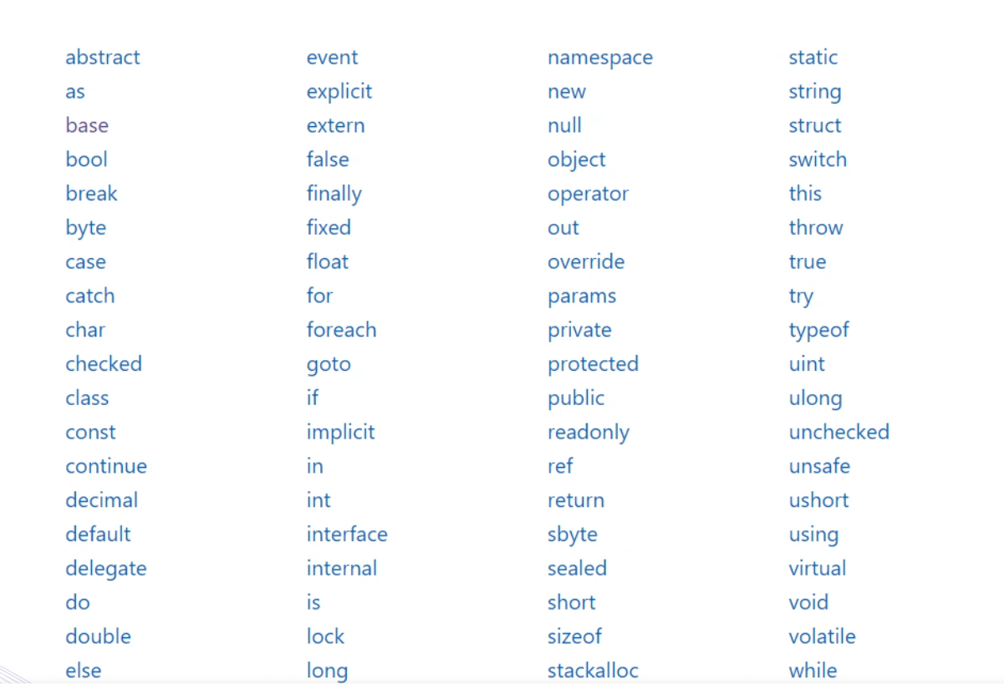
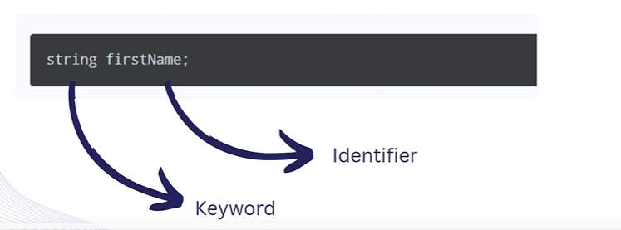
C# Keywords
C# contains reserved words that have special meaning for the compiler. These reserved words are called "keywords". Keywords cannot be used as an identifier (name of a variable, class, interface, etc.).

Slide 11
C# Variables and Assignments
C# is the strongly typed language. It means you can assign a value of the specified data type. You cannot assign an integer value to string type or vice-versa.

Slide 12
C#- Data Types
C# is a strongly-typed language. It means we must declare the type of a variable that indicates the kind of values it is going to store, such as integer, float, decimal, text, etc.
The Datatypes are something that gives information about
Size of the memory location.
The Range of data that can be stored inside that memory location
Types in C#
1. Value Type 2. Reference Type

Slide 13
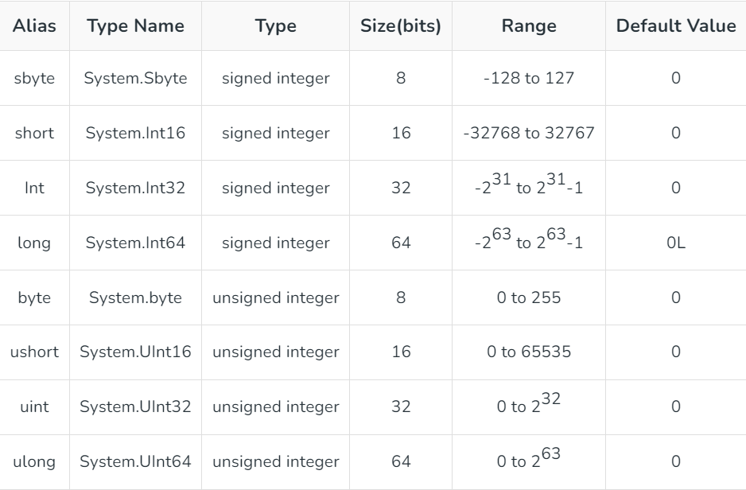
Boolean(bool)
Boolean data type has two possible values: true or false
Default value : false
Used to check and evaluate conditions
Integral Data Types

Slide 14
System.String(string)
Sequence of zero or more Unicode characters
String is reference type
Default : null
Concatenate string using + operator

Slide 15
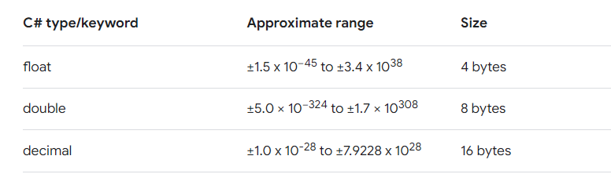
Floating Data Types

Slide 16
Value Type Vs.Reference Type
Variables of value types directly contain their data
While
Variables of reference types store references to their data(object)
With value types, each variable has its own copy of data
While
With reference types store references to their data(object)

Slide 17
C#-Operators
Operators in C# are symbols that are used to perform operations on operands.
Types of Operators in C#:
The Operators are classified based on the type of operations they perform on operands in C# language. They are as follows:
Arithmetic Operators : + - * / % ++ --
Comparison Operators: == != > < >= <=
Logical Operators: && ||
Assignment Operators : =
Ternary Operator or Conditional Operator: ?:
Null Coalescing operator: ??

Slide 18
Nullable Types
Nullable types allow values to have a value of null
Explicitly indicate when a value is undefined or missing
Use ? To indicate a nullable type
Exmaple
Int age; //Non-nullable integer
Int?age; //Nullable integer

Slide 19
DataTypes Conversion
1. Implicit Conversion
2. Explicit Conversion
Implicit Conversion:
Implicit Conversion is performed by the compiler
Between compatible data types
When there is no loss of information
If there is no possibility of exceptions

Slide 20
Array
Collection of elements of the same data type
Multiple values in a single variable
Identified by an index (Starts at 0)
Features
1. Zero-based indexing
2. Fixed Size
3.Length property

Slide 21
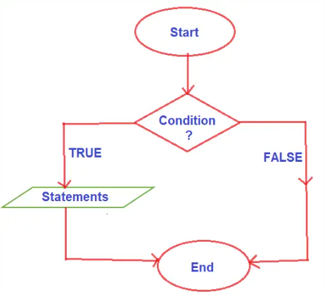
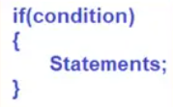
C# Condition and Loops
The Selection or Branching or Decision-Making Statements in C# allows us to control the flow of program execution based on some condition. It executes different sections of code depending on a specific condition. Selection statements can be divided into the following categories:
If-Else Statements
Switch Statements
Logical AND(&&,&) Logical(||,|)

Slide 22
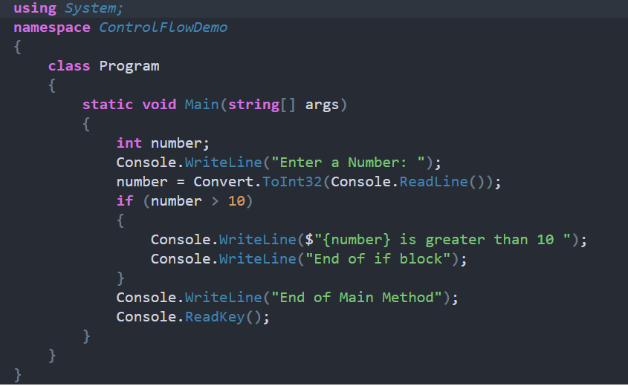
IF Condition Example

Slide 23
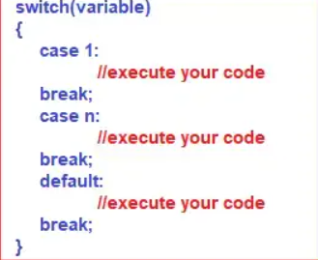
Switch Statement
The switch is a keyword in the C# language, and by using this switch keyword we can create selection statements with multiple blocks. And the Multiple blocks can be constructed by using the case keyword.
Control flow statement
Used to evaluate the value of expression against multiple possible values
Alternative to using multiple if-else statements.

Slide 24
Iteration Statements
Execute a block of code repeatedly
Iterate over collections
Execute code specific number times
While
Do-While
for
foreach

Slide 25
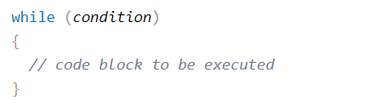
While Loop
Execute a block of code repeatedly as long as a specified condition is true
Helpful when we don’t know how many times we have to run a loop

Slide 26
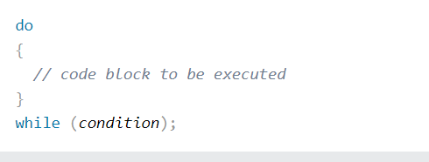
Do-While
Similar to the while loop and a control flow statement
Condition is checked after the body is executed
Will execute the code at least once

Slide 27
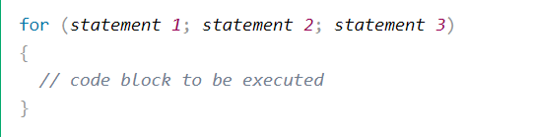
For Loop
Control flow statement
Allows you to execute a block of code repeatedly
When you know how many times you have to run a loop
Statement 1 :- initialization
Statement 2 :- condition
Statement 3 :- increment/ decrement

Slide 28
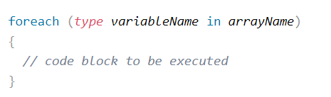
Foreach Loop
Iterate over elements in a collection
Example: iterate over all elements in an array of numbers
Loops automatically over each element
Type: specifies the type of elements
Variable : the iteration variable
Collection : collection or array
Code inside curly braces is executed for each elements in collection

Slide 29
Break and Continue Statement
We use the break statement to terminate the loop
No matter what the current condition of the loop is, the break statement will terminate the loop and move the execution to outside the loop
Continue Statement
We use the continue statement to skip the current iteration of the loop
Used in conditions when we want to skip some iterations but still want to continue with the loop

Slide 30
String function and Operations
Length
Substring
IndexOf
LastIndexOf
ToUpper/ToLower
Replace
Split
Trim
Contains
StartsWith/EndsWith
Concat

Slide 31
String Length
Length property is used to determine its length.
Return an integer

Slide 32
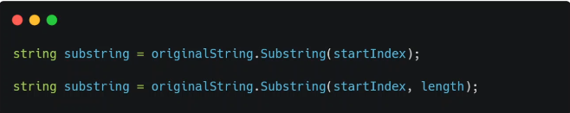
Substring
Substring method id powerful tool in C# for extracting substring from a larger string

Slide 33
IndexOf
The String IndexOf method returns the index of the first occurrence of the specified character/substring within string.

Slide 34
LastIndexOf
The LastIndexOf method returns the index position of the last occurences of a specified character or string within the given string.

Slide 35
ToUpper and ToLower
The ToUpper method returns upper characters of given string.
The ToLower method returns lower characters of given string.

Slide 36
Replace
The Replace() method returns a new string by replacing each matching character/substring in the string with the new character/substring.

Slide 37
Split
The spit method breaks up a string at specified separator and returns its substrings.

Slide 38
String.Trim ()
The Trim() method removes any leading(starting) and trailing(ending) whitespaces from the specified string.

Slide 39
StartsWith
The StartsWith method in C# is used to determine whether a string starts with a specified prefix.
Return Type: True or False(Boolean)

Slide 40
EndsWith
The EndsWith method is used to determine whether a string ends with a specified suffix.
Return Type: True or False(Boolean)

Slide 41
String.Contains(Substring)
The Contains method is used to determine whether a string contains a specified substring.
Return Type: True or False(Boolean)

Slide 42
Methods or Functions in C#
Methods are also called Functions
Methods allow you to define logic once and use it multiple times
Makes our code more organized, readable and maintainable
Features
Easier to understand and maintain
Encapsulates complex problem into manageable parts

Slide 43
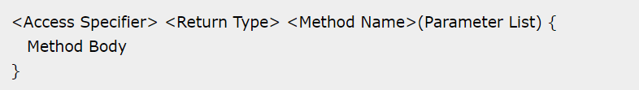
Syntax of Method
Access Modifier/Specifier will be covered in a later video
Return type is what the type of object that is returned by the method
Method name should be meaningful name
Parameters are optional
Method body is what the method has to do

Slide 44
Static Method
Static method is a method that belongs to a type itself rather than to instances of that type.
Use the static keyword to make a method static

Slide 45
Method Parameters
Method parameters are variable declared within the parentheses
Defines the data that the method expects
Return From Method
Use of return keyword to return a value of specific type
Ends the execution of the method at the return statement

Slide 46
Types of Methods Parameters
Value Parameters
Reference Parameters
Output Parameters

Slide 47
Value Parameters
Value parameters in C# are a type of method parameter
Passes data into a method by value
Any changes made to the parameter inside the method do not affect the original value outside the method

Slide 48
Reference Parameters
reference parameters in C# is another type of method parameter
Passes reference of the object
Any changes made to the parameter inside the method affect the original value outside the method

Slide 49
Output Parameters
Output parameters are used to return data from a method back to the caller
Output parameters allow methods to return multiple values to the caller
Output parameters are declared in the method signature using the out keyword.

Slide 50
Scope of Variables
The scope of variable refers to the region of code where the variable is accessible
Class
Method
Block

Slide 51
Optional Parameters
Allows you to define parameters for a method that have default values
You can omit arguments for some or all of these parameters

Slide 52
Named Parameters
Allows you to specify the arguments for a method by associating them with parameter names rather than relying on the order in which the parameters are defined
Improve readability
Benefits of Named Parameter
Improve readability
Skip optional parameters
Re-order required parameters

Slide 53
Class
Class is blueprint for creating objects
Building block for object-oriented programming
Allows you to define the structure and behaviour of object of that type
Contains data and methods that act on this data

Slide 54
Class Constructor
A constructor is a special type of method that is automatically called when an
Instance of a class is created
Its primary job is to initialize the newly created object
Constructors have the same name as the class and may or may not accept parameters

Slide 55
Types of Constructor
Default constructor doesn’t accept any parameters.
If you don’t define any constructor in your class, C# provides a default constructor automatically
It initializes member variables to their default values(null for reference types, zero for numeric types, etc.)

Slide 56
Static and Instance Class Members
Static and Instance Members refers to any field, property, method, or event defined within a class.

Slide 57
Properties Overview
Properties enable a class to expose a public way of getting and setting values,
While hiding implementation.
A get property accessor is used to return the property value, and a set property accessor is used to assign a new value.

Slide 58
Why do we need properties
Encapsulation
Access Control
Data validation and Logic
Abstraction

Slide 59
Auto implemented Properties
Shorthand syntax for defining properties in classes
Allow you to define a property with a getter and/or setter without having to write the code
Makes property-declaration more concise when no additional logic is required in the property accessors.

Slide 60
What is Inheritance?
Inheritance is fundamental concept in object oriented programming(OOP)
Allows a class to inherit Properties and behaviour from another class
Derived and Base class concept
Enables code reuse
Modularity

Slide 61
Basics
Base Class – Class from which other classes inherit properties and behaviour
Derived Class- class is the class that inherits from the base class.

Slide 62
Access Modifiers in Inheritance
Public- Public members of the base class are accessible in the derived class
Protected- Protected members of the base class are accessible within the derived class and its subclasses but not from outside.
Private- Private members of the base class are not accessible in the derived class.

Slide 63
Benefits of Inheritance
Code reusability
Modularity
Polymorphism

Slide 64
Types of Inheritance
Single Inheritance
Multilevel Inheritance

Slide 65
Method Hiding
Method Hiding – Allows a derived class to define a method with the same name as a method in the base class
This then hides the base class method
Method hiding is achieved by using the new keyword.

Slide 66
Polymorphism in C#
Polymorphism-(Many Forms) is a core concept in object-oriented programming(OOP)
Allows objects of different types to be treated as objects of a common base type
Means a single interface can represent multiple implementations.

Slide 67
Types of Polymorphism
Compile-time polymorphism
Method Overloading
Run-time Polymorphism
Method Overriding

Slide 68
Run-time Polymorphism(Method Overriding)
Allows a derived class to provide a specific implementation of a method that is already defined in its base class
Allows a sub-class to provide its own implementation of a method with the same signature
Method overriding is a form of run-time polymorphism, where the method to be invoked is determined at runtime.
virtual and override keywords

Slide 69
Method Overloading
Is a feature that allows a class to have multiple methods with the same name but with different signature
Enables developers to define multiple versions of a method, each tailored for different parameter types or number of parameters.

Slide 70
Interface in C#
An Interface is reference type similar to a class
An Interface defines a contract consisting of a set of method signature, properties , events or indexers.
It is specification
Interfaces are declared using the interface keyword.

Slide 71
Benefits of Interfaces
Abstraction- Interfaces provide a way to define abstract behaviour without specifying any implementation details, promoting code abstraction and modularity.
Polymorphism- Interfaces enable polymorphism by allowing objects of different classes to be treated uniformly if they implement the same interface, enhancing code flexibility and extensibility.
Contractual Agreements- Interfaces establish contractual agreements between components, ensuring that implementing classes adhere to a specific set of rules and requirements.
Loose coupling- Interfaces promote loose coupling between components by allowing classes to interact based on contracts rather than concrete implementation, facilitating easier maintenance and testing.
Multiple Inheritance- Interfaces allows classes to inherit behaviour from multiple sources providing a flexible alternative to single inheritance.

Slide 72
Similarities Interfaces and Abstract Classes
Abstraction- Both allows for abstraction by defining a set of methods
Inheritance- Both support inheritance, enabling derived classes to inherit and extend their functionality
Contract/ Enforce structure- Both provides contracts that have to be implemented in the derived classes.
Encapsulation- Both promotes encapsulation by hiding implementation details and expositing the public contracts.

Slide 73
Abstract Class
Code Reusability – Abstract classes allow developers to define common behaviour in a single class, which multiple subclasses can inherit or reuse.
Abstraction- Abstract classes provide a level of abstraction by hiding implementation details and defining a contract that subclasses must adhere to.
Flexibility- Abstract Classes allow for flexibility in class hierarchies , enabling subclasses to extend functionality and provide custom implementations for abstract methods.
Polymorphism- Abstract classes facilitates polymorphism, allowing objects of different subclasses to be treated uniformly through base class references.
Enforcement of structure- Abstract classes enforce a structure for subclasses to follow by defining a set of methods that must be implemented , promoting consistency and maintainability in the codebase

Slide 74
Differences
Abstract Class-
Can have fields
Can inherit from another abstract class and interfaces
A class can inherit from one abstract class
Can have access modifiers
Interfaces
Can not have fields
Can inherit from interface only
A class can implement multiple interfaces
Can not have access modifier

Slide 75
Collections in C#
Collections are majorly classified into two types.
Generic Collections
Non-Generic Collections

Slide 76
Generic Collection
A Generic collection provides the type safety without derivation from a basic collection type and the implementation of type-specific members. The Generic Collection classes are found in the namespace "System.Collections.Generics." Internally, Generic Collections store elements in arrays of their respective types.
Types of Generic Collection
1.List<T>
2.Dictionary<TKey,TValue>
3.Sorted List<TKey,TValue>
4.Stack<T>
5.Queue<T>

Slide 77
List
In Generic List, we have to specify a data type to its contents, and all elements will have the same datatype.
List<int> GenericList = new List<int>();
GenericList.Add(30);
GenericList.Add(60);
GenericList.Add(90);
GenericList.Add(120);
foreach (int x in GenericList)
{
Console.WriteLine(x);
}

Slide 78
Dictionary
Dictionaries usually store data in key-value pairs, and we have to specify both data types beforehand.
Dictionary<int, string> GenericDictionary = new Dictionary<int, string>();
GenericDictionary.Add(1, "Soda");
GenericDictionary.Add(2, "Burger");
GenericDictionary.Add(3, "Fries");
GenericDictionary.Add(4, "Onion Rings");
foreach (KeyValuePair<int, string> kvp in GenericDictionary)
{
Console.WriteLine(kvp.Key + " " + kvp.Value);
}

Slide 79
Sorted List
A sorted list also stores a key-value pair and automatically sorts its elements in ascending order based on their keys. In the generic Sorted list, we have to specify the datatypes of its content beforehand.
SortedList<string, string> GenericSortedList = new SortedList<string, string>();
GenericSortedList.Add("American", "Burger");
GenericSortedList.Add("Lime", "Soda");
GenericSortedList.Add("French", "Fries");
GenericSortedList.Add("Onion", "Rings");
foreach (KeyValuePair<string, string> kvp in GenericSortedList)
{
Console.WriteLine(kvp.Key + " " + kvp.Value);
}

Slide 80
Stack
Values are kept in Stack using LIFO (Last In First Out). It offers the Push() and Pop() & Peek() methods to add and retrieve values, respectively. In generic Stack, we have to specify the datatypes of its content beforehand.
SortedList<string, string> GenericSortedList = new SortedList<string, string>();
GenericSortedList.Add("American", "Burger");
GenericSortedList.Add("Lime", "Soda");
GenericSortedList.Add("French", "Fries");
GenericSortedList.Add("Onion", "Rings");
foreach (KeyValuePair<string, string> kvp in GenericSortedList)
{
Console.WriteLine(kvp.Key + " " + kvp.Value);
}

Slide 81
Queue
Values are kept in a queue in a FIFO fashion (First In, First Out). The sequence in which the values were inserted is preserved. It offers the Enqueue() and Dequeue() methods to add and remove values from the collection. In the generic queue, we have to specify the datatypes of its content beforehand.
Queue<string> GenericQueue = new Queue<string>();
GenericQueue.Enqueue("Mark");
GenericQueue.Enqueue("Bill");
GenericQueue.Enqueue("Xavier");
GenericQueue.Enqueue("Michael");
foreach (string s in GenericQueue)
{
Console.WriteLine(s);
}

Slide 82
Linked List
C# LinkedList<T> class uses the concept of linked list. It allows us to insert and delete elements fastly. It can have duplicate elements. It is found in System.Collections.Generic namespace.
It allows us to add and remove element at before or last index.
var names = new LinkedList<string>();
names.AddLast("Sonoo Jaiswal");
names.AddLast("Ankit");
names.AddLast("Peter");
names.AddLast("Irfan");
names.AddFirst("John");//added to first index
// Iterate list element using foreach loop
foreach (var name in names)
{
Console.WriteLine(name);
}

Slide 83
Non-Generic Collection
Non-generic collections are specialized data storage and retrieval classes that handle stacks, queues, lists, and hash tables. The "System.Collections" namespace contains the Non-generic Collection classes. Non-generic collections store elements in object arrays internally, allowing them to hold any data type.
Types of Generic Collection
1.ArrayList
2.HashTable
3.Sorted List
4.Stack
5.Queue

Slide 84
ArrayList
The array's size might change during use since it is dynamic, which implies it is not static. It offers functions that are comparable to those in the generic List class.
ArrayList NonGenericArrayList = new ArrayList();
string str = "Like, Share, Subscribe";
int x = 11;
DateTime d = DateTime.Parse("3-dec-1998");
NonGenericArrayList.Add(str);
NonGenericArrayList.Add(x);
NonGenericArrayList.Add(d);
foreach (object o in NonGenericArrayList)
{
Console.WriteLine(o);
}

Slide 85
HashTable:
A hash table data structure is made up of key-value pairs. The hash values of the keys are compared to find the values. It offers functions that are comparable to those in the generic dictionary class. Hashtable are organized based on the hash code of the key.
Hashtable NonGenericHashTable = new Hashtable();
NonGenericHashTable.Add(1, "Soda");
NonGenericHashTable.Add(2, "Burger");
NonGenericHashTable.Add(3, "Fries");
NonGenericHashTable.Add(4, "Onion Rings");
foreach (DictionaryEntry h in NonGenericHashTable)
{
Console.WriteLine (h.Key + " " + h.Value);
}

Slide 86
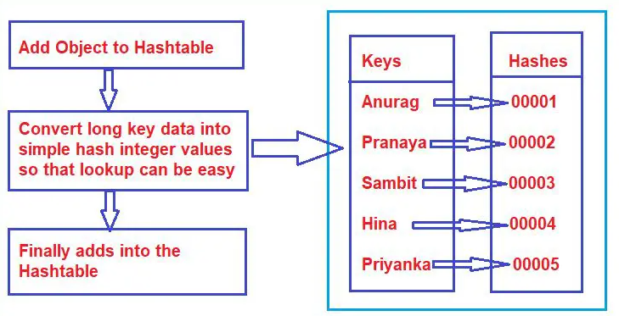
HashTable
Hashtable are organized based on the hash code of the key.

Slide 87
Sorted List:
It is similar to the generic Sorted list, except we don't have to specify specific data type.
SortedList NonGenericSortedList = new SortedList();
NonGenericSortedList.Add("American", "Burger");
NonGenericSortedList.Add("Lime", "Soda");
NonGenericSortedList.Add("French", "Fries");
NonGenericSortedList.Add("Onion", "Rings");
foreach (DictionaryEntry d in NonGenericSortedList)
{
Console.WriteLine(d.Key + " " + d.Value);
}

Slide 88
Stack
It's a FIFO (first-in, first-out) list. Hence it works similarly to the Stack class in generic collections.
Stack steak = new Stack();
steak.Push("Rare");
steak.Push("Medium Rare");
steak.Push("Medium");
steak.Push("Well done");
foreach (object o in steak)
{
Console.WriteLine(o);
}

Slide 89
Queue
A first-in, first-out collection of items is represented by it. When you require first-in, first-out access to objects, you utilize it. It offers functions that are comparable to those in the generic Queue collection.
Queue NonGenericQueue = new Queue();
NonGenericQueue.Enqueue("Mark");
NonGenericQueue.Enqueue("Bill");
NonGenericQueue.Enqueue("Xavier");
NonGenericQueue.Enqueue("Michael");
foreach (object o in NonGenericQueue)
{
Console.WriteLine(o);
}

Slide 90
Benefits Collection in C#
Generic collections work faster than non-generic ones and decrease exceptions by revealing compile-time faults.
Non-generic collection types are in "System. Collections," while generic types are in "System.Collections.Generic."
C# also has several specialized collections tuned to deal with a specific data type, which we can find in the "System.Collections.Specialized" namespace.
The Collection class supports null as a valid reference type value and enables redundant elements.

Slide 91
Exception Handling in C#
Exception handling is the method of catching and recording these errors in code so you can fix them. Usually, errors and exceptions are stored in log files or databases. In C#, the exception handling method is implemented using the try-catch and finally statement.
Try
Catch
Finally
Throw

Slide 92
Try, Catch and Finally
Try- If the exception occurs inside the try block, the control is transferred to the required catch block. There may be multiple catch blocks after the try block.
Catch- The catch block handles the exception that has occured in an appropriate manner using exception handling mechanisms.
Finally- The finally block executes some statements irrespective of whether an exception has occurred or not. If there is no exception in the try block, then control directly transfers to finally block and skips the catch block.

Slide 93
The syntax of the try, catch and finally keywords in exception handling is given as follows:
try { // Statements that cause exception } catch (ExceptionType EName) { // Statements that handle exception } finally { // Remaining statements to be executed }

Slide 94
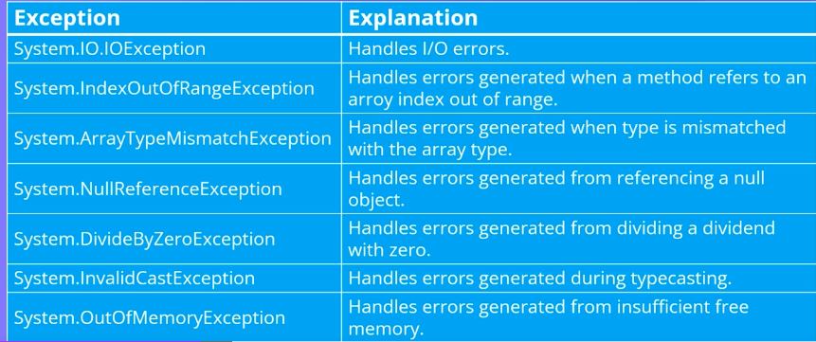
Exceptions in C#

Slide 95
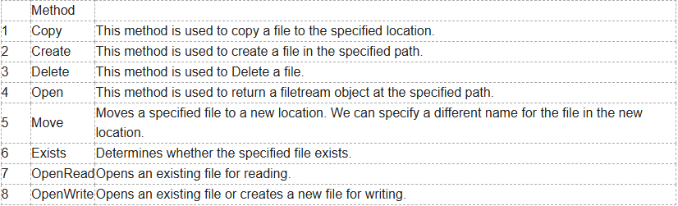
Working with files in C#
C# File Class provides static methods for most file operations, including creating a file, copying and moving a file, deleting files, and working with FileStream to read and write streams. The File class is defined in the System.IO namespace.

Slide 96
What is a File?
A file is a collection of data stored on a disk with a specific name, extension, and directory path. When you open File using C# for reading and writing purposes it becomes Stream.
What is Stream?
A stream is a sequence of bytes travelling from a source to a destination over a communication path.
Input Stream: This Stream is used to read data from a file, which is known as a read operation.
Output Stream: This Stream is used to write data into a file, which is known as a write operation.

Slide 97
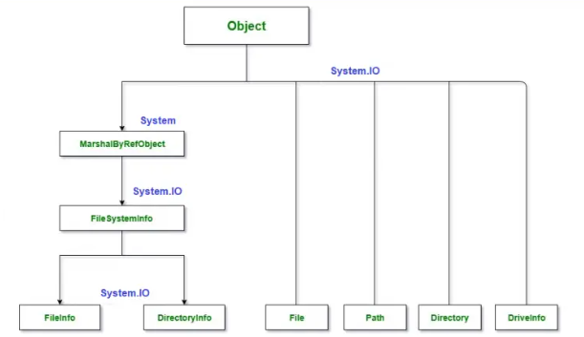
System.IO Namespace in C#

Slide 98
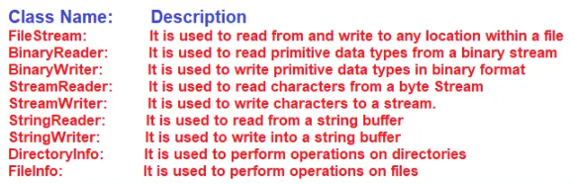

Slide 99
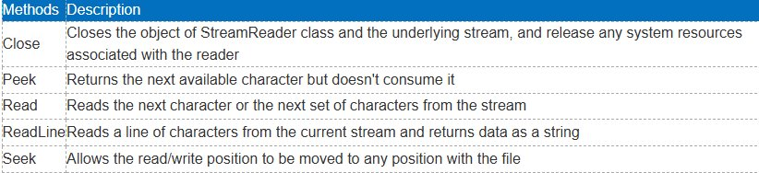
Stream Reader Class

Slide 100
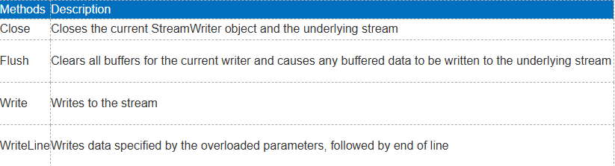
Stream Writer Class

Slide 101
String Builder
C# introduced the StringBuilder in the System.Text namespace. The StringBuilder doesn't create a new object in the memory but dynamically expands memory to accommodate the modified string.
We can create an object of the StringBuilder class using the new keyword and passing an initial string.

Slide 102
Points to remember for String Builder
StringBuilder is mutable.
StringBuilder performs faster than string when appending multiple string values.
Use StringBuilder when you need to append more than three or four strings.
Use the Append() method to add or append strings to the StringBuilder object.
Use the ToString() method to retrieve a string from the StringBuilder object.

Slide 103
Struct
In C#, struct is the value type data type that represents data structures. It can contain a parameterized constructor, static constructor, constants, fields, methods, properties, indexers, operators, events, and nested types.
A structure is declared using struct keyword. The default modifier is internal for the struct and its members.
struct Coordinate { public int x; public int y; }

Slide 104
Points to remember for Structs
struct can include constructors, constants, fields, methods, properties, indexers, operators, events & nested types.
struct cannot include a parameter less constructor or a destructor.
struct can implement interfaces, same as class.
struct cannot inherit another structure or class, and it cannot be the base of a class.
struct members cannot be specified as abstract, sealed, virtual, or protected.

Slide 105
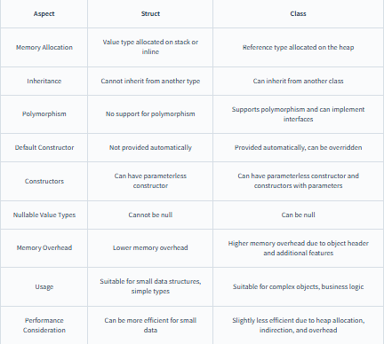
Differences in Struct and Class

Slide 106
Enum
an enum (or enumeration type) is used to assign constant names to a group of numeric integer values. It makes constant values more readable, for example, WeekDays.Monday is more readable then number 0 when referring to the day in a week.
An enum is defined using the enum keyword, directly inside a namespace, class, or structure. All the constant names can be declared inside the curly brackets and separated by a comma.

Slide 107
Points to remember
The Enums are Enumerations.
Enums are Strongly Typed Named Constants. Hence, an Explicit Cast is needed to convert them from the enum type to an integral type and vice versa. Also, an enum of one type cannot be implicitly assigned to an enum of another type even though the underlying value of their members is the same.
The default underlying type of an enum is int.
The default value for the first element of the enum is ZERO and gets incremented by 1.
The Enums are value types.
Enum keyword (all small letters) is used to create the enumerations, whereas the Enum class, contains static GetValues() and GetNames() methods which can be used to list Enum underlying type values and Names.

Slide 108
Anonymous Type
In C#, an anonymous type is a type (class) without any name that can contain public read-only properties only. It cannot contain other members, such as fields, methods, events, etc.
The properties of anonymous types are read-only and cannot be initialized with a null, anonymous function, or a pointer type. The properties can be accessed using dot (.) notation, same as object properties. However, you cannot change the values of properties as they are read-only.

Slide 109
Dynamic Type
C# 4.0 (.NET 4.5) introduced a new type called dynamic that avoids compile-time type checking. A dynamic type escapes type checking at compile-time; instead, it resolves type at run time.
The compiler compiles dynamic types into object types in most cases. However, the actual type of a dynamic type variable would be resolved at run-time.
Dynamic types change types at run-time based on the assigned value.
The dynamic type variables is converted to other types implicitly.
If you assign a class object to the dynamic type, then the compiler would not check for correct methods and properties name of a dynamic type that holds the custom class object.

Slide 110
Static Class
In C#, static means something which cannot be instantiated. You cannot create an object of a static class and cannot access static members using an object.
C# classes, variables, methods, properties, operators, events, and constructors can be defined as static using the static modifier keyword.

Slide 111
Points to remember for static class
Static classes cannot be instantiated.
All the members of a static class must be static; otherwise the compiler will give an error.
A static class can contain static variables, static methods, static properties, static operators, static events, and static constructors.
A static class cannot contain instance members and constructors.
Indexers and destructors cannot be static
var cannot be used to define static members. You must specify a type of member explicitly after the static keyword.
Static classes are sealed class and therefore, cannot be inherited.
A static class cannot inherit from other classes.
Static class members can be accessed using ClassName.MemberName.
A static class remains in memory for the lifetime of the application domain in which your program resides.

Slide 112
Static Members in Non Static Class
The normal class (non-static class) can contain one or more static methods, fields, properties, events and other non-static members.
It is more practical to define a non-static class with some static members, than to declare an entire class as static.
Static fields of a non-static class is shared across all the instances. So, changes done by one instance would reflect in others.

Slide 113
Static Method
You can define one or more static methods in a non-static class. Static methods can be called without creating an object. You cannot call static methods using an object of the non-static class.
The static methods can only call other static methods and access static members. You cannot access non-static members of the class in the static methods.

Slide 114
Points to remember for static Method
Static methods can be defined using the static keyword before a return type and after an access modifier.
Static methods can be overloaded but cannot be overridden.
Static methods can contain local static variables.
Static methods cannot access or call non-static variables unless they are explicitly passed as parameters.

Slide 115
Static Constructor
A non-static class can contain a parameter less static constructor. It can be defined with the static keyword and without access modifiers like public, private, and protected.
The static constructor is called only once whenever the static method is used or creating an instance for the first time. The following example shows that the static constructor gets called when the static method called for the first time. Calling the static method second time onwards won't call a static constructor.

Slide 116
Points to remember for Static Constructor
The static constructor is defined using the static keyword and without using access modifiers public, private, or protected.
A non-static class can contain one parameter less static constructor. Parameterized static constructors are not allowed.
Static constructor will be executed only once in the lifetime. So, you cannot determine when it will get called in an application if a class is being used at multiple places.
A static constructor can only access static members. It cannot contain or access instance members.
Static members are stored in a special area in the memory called High-Frequency Heap. Static members of non-static classes are shared across all the instances of the class. So, the changes done by one instance will be reflected in all the other instances.

Slide 117
Partial Class and Methods
In C#, you can split the implementation of a class, a struct, a method, or an interface in multiple .cs files using the partial keyword. The compiler will combine all the implementation from multiple .cs files when the program is compiled.
All the partial class definitions must be in the same assembly and namespace.
All the parts must have the same accessibility like public or private, etc.
If any part is declared abstract, sealed or base type then the whole class is declared of the same type.
Different parts can have different base types and so the final class will inherit all the base types.
The Partial modifier can only appear immediately before the keywords class, struct, or interface.
Nested partial types are allowed.

Slide 118
Partial Methods
Partial classes or structs can contain a method that split into two separate .cs files of the partial class or struct. One of the two .cs files must contain a signature of the method, and other file can contain an optional implementation of the partial method. Both declaration and implementation of a method must have the partial keyword.
Partial methods must use the partial keyword and must return void.
Partial methods can have in or ref but not out parameters.
Partial methods are implicitly private methods, so cannot be virtual.
Partial methods can be static methods.
Partial methods can be generic.

Slide 119
Delegates
Delegate is one of the base types in .NET. Delegate is a class used to create and invoke delegates at runtime.
A delegate in C# is similar to a function pointer in C or C++. It's a new type of object in C#. A delegate is a very special type of object, as mentioned earlier. The entire object we used to define contained data, but a delegate contains the details of a method.

Slide 120
Why do we need delegates in C#
C# programmers often need to pass a method as a parameter of other methods when dealing with events. For this purpose, we create and use delegates in C#.
One good way of understanding delegates is by thinking of a delegate as something that gives a name to a method signature.
In class, we create its object, which is an instance, but in delegate, when we create an instance, that is also referred to as a delegate (which means whatever you do, you will get a delegate).
Benefits: delegates are object-oriented, type-safe, and very secure, as they ensure that the signature of the method being called is correct. Delegates make event handling simple and easy.

Slide 121
Types of Delegates
Singlecast delegate: Singlecast delegate points to a single method at a time. The delegate is assigned to a single method at a time. They are derived from System.Delegate class.
Multicast Delegate: When a delegate is wrapped with more than one method, that is known as a multicast delegate.

Slide 122
Anonymous Delegates
You can create a delegate, but there is no need to declare the method associated with it. You do not have to explicitly define a method before using the delegate. Such a method is referred to as anonymous. In other words, if a delegate contains its method definition, it is an anonymous method.

Slide 123
Points to Remember
Delegates are similar to C++ function pointers but are type-safe.
The delegate gives a name to a method signature.
Delegates allow methods to be passed as parameters.
Delegates can be used to define callback methods.
Delegates can be chained together; for example, multiple methods can be called on a single event.
C# version 2.0 introduces the concept of Anonymous Methods, which permits code blocks to be passed as parameters in place of a separately defined method.
Delegate helps in code optimization.
Usage areas of delegates

Slide 124
Events
Events and delegates work together. An event is a reference to a delegate, i.e., when an event is raised, a delegate is called. In C# terms, events are a special form of delegates.
Events are used when something happens in one class or part of the code and another part needs a notification.
A C# event is a class member that is activated whenever the event it was designed for occurs.

