Slide 1
Installation of pipeline Amplicon Sequence Analysis Pipeline (ASAP)

Slide 2
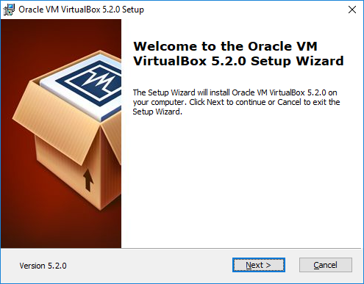
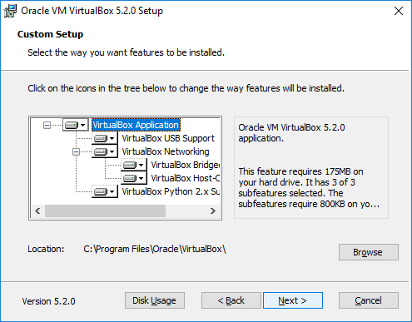
Download VirtualBox and install it
https://www.virtualbox.org/wiki/Downloads

Slide 3
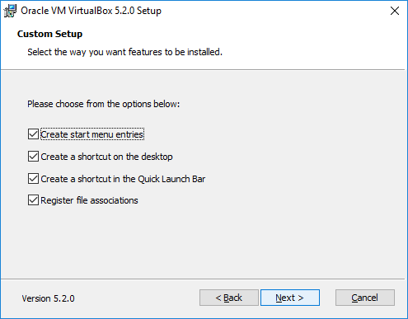
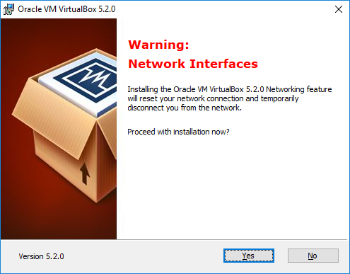
Download VirtualBox and install it

Slide 4
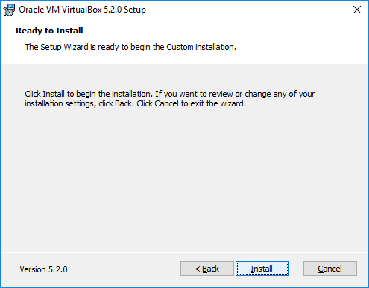
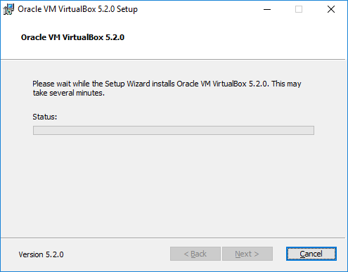
Download VirtualBox and install it

Slide 5
https://www.ubuntu.com/download/desktop/thank-you?version=16.04.3&architecture=amd64
Download Ubuntu (16.04 LTS) image

Slide 6
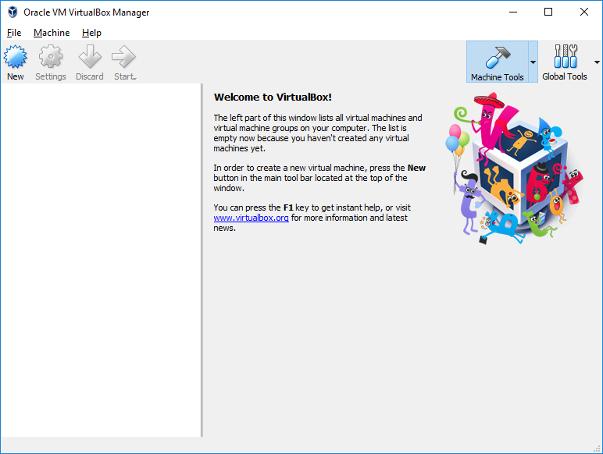
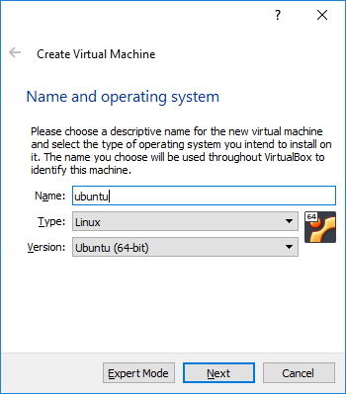
Install Ubuntu in VirtualBox

Slide 7
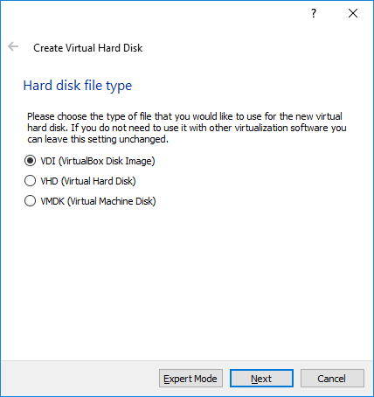
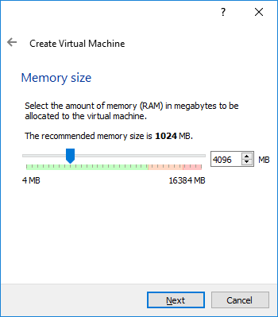
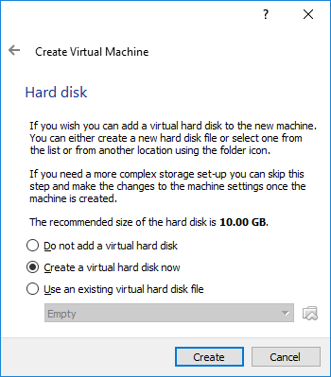
Install Ubuntu in VirtualBox
At least 4G recommended

Slide 8
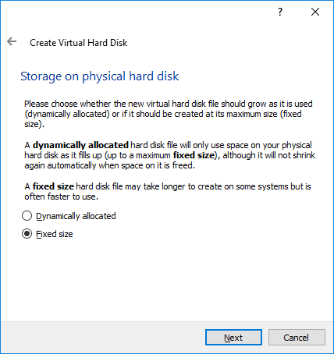
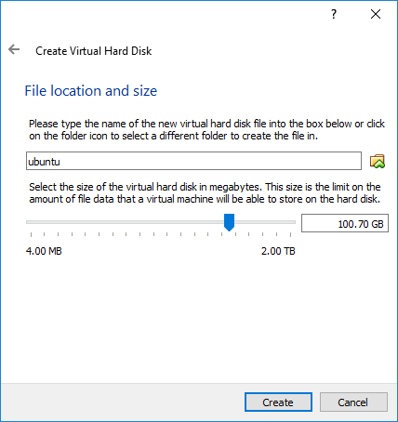
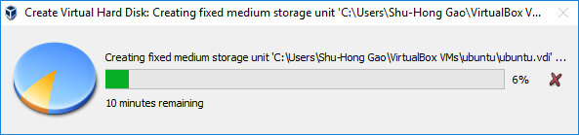
Install Ubuntu in VirtualBox
50-200G, depends on your datasize

Slide 9
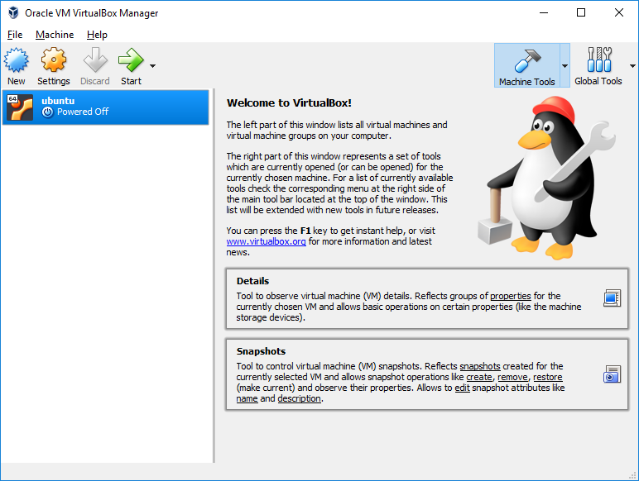
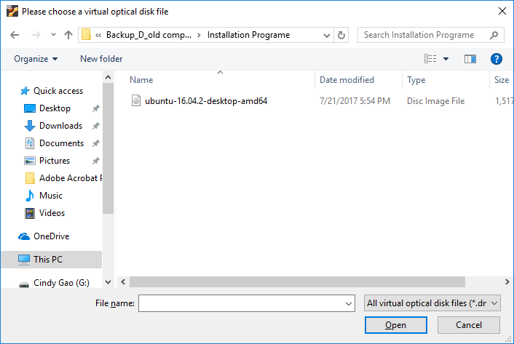
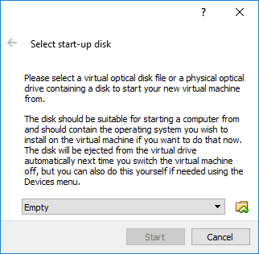
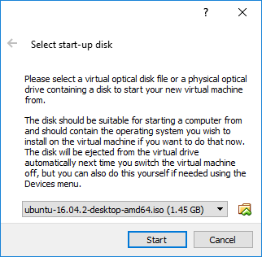
Install Ubuntu in VirtualBox

Slide 10
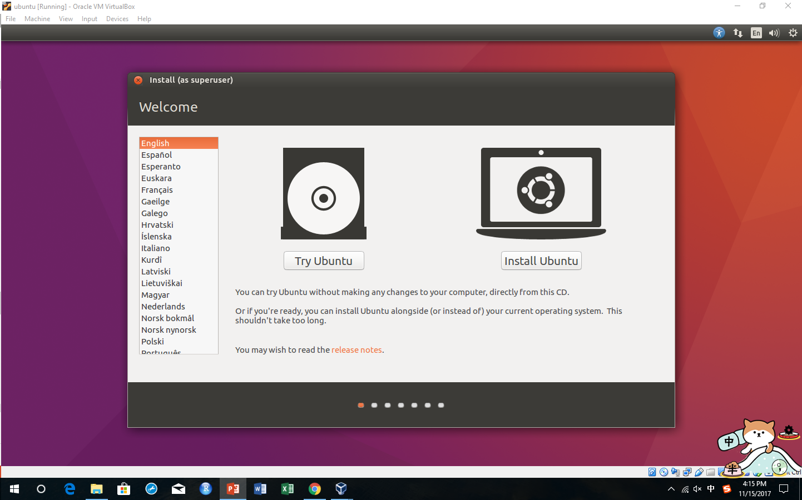
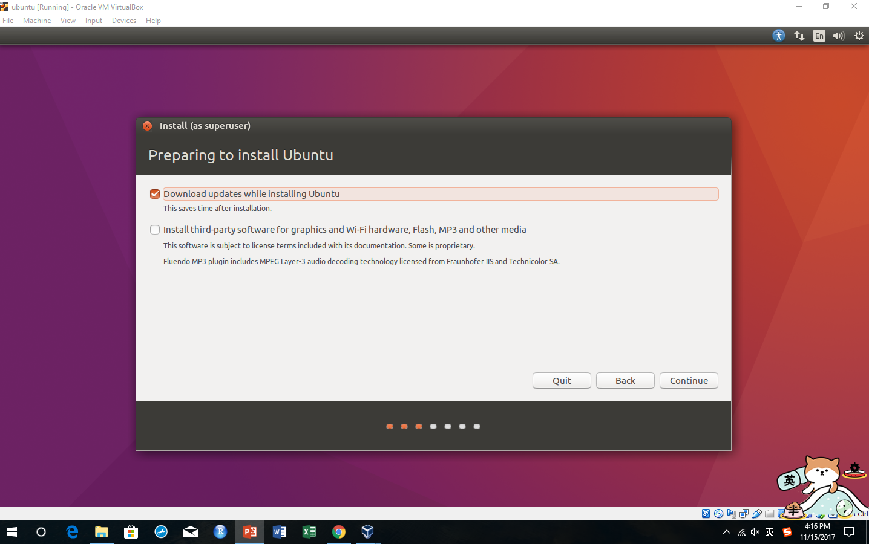
Install Ubuntu in VirtualBox
Continue, continue and continue. Be brave to continue even it says it will erase your computer!

Slide 11
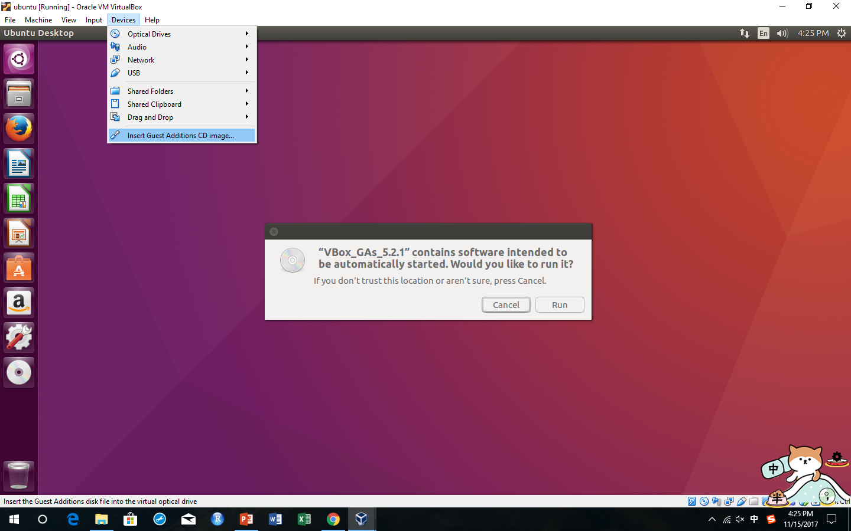
Install guest additions

Slide 12
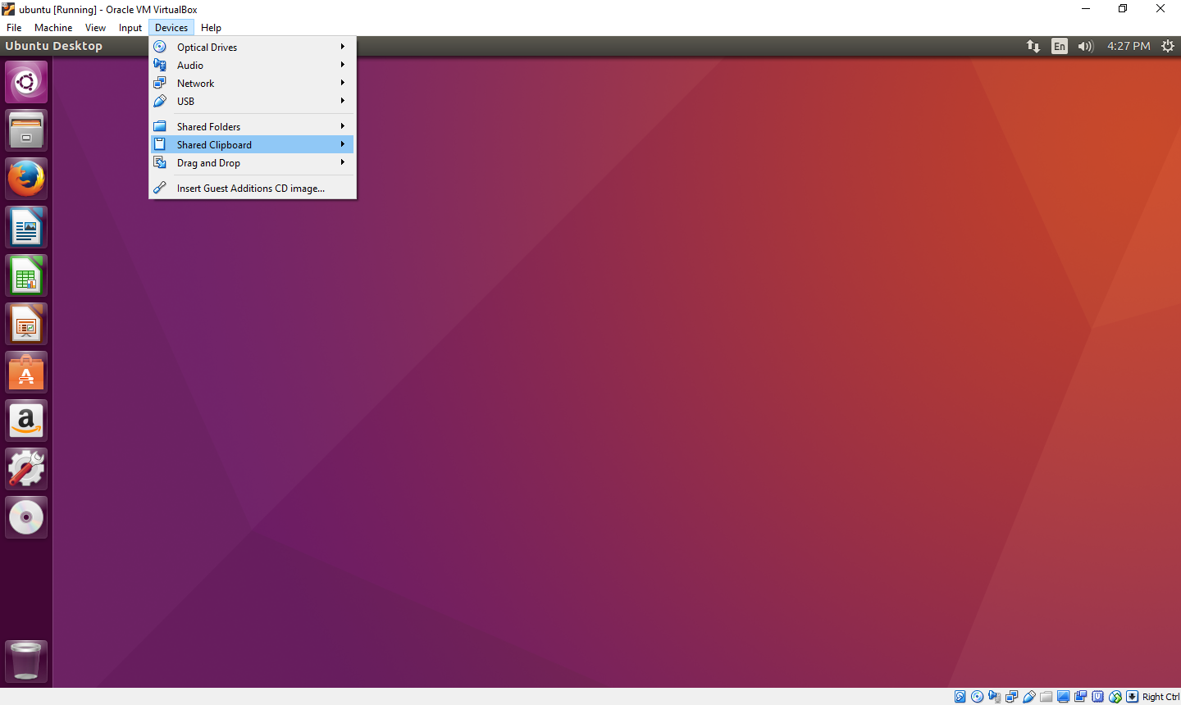
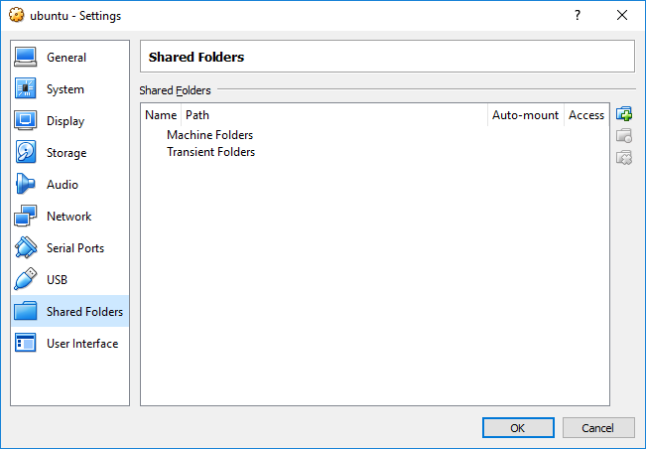
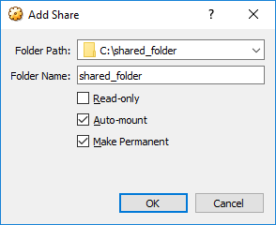
Mount Windows folder
Open terminal and run:
sudo adduser your_user_name vboxsf
Then enter your password
Then restart
The directory c:\shared_folder will be mounted as /media/sf_shared_folder and will work as a connection between Windows and Ubuntu

Slide 13
Installation of JAVA, RDP Classifier, FastQC
JAVA: sudo apt-get install default-jre
RDP Classifier:
mkdir software
cd software
wget https://sourceforge.net/projects/rdp-classifier/files/latest/download
unzip download
wget https://www.bioinformatics.babraham.ac.uk/projects/fastqc/fastqc_v0.11.5.zip
unzip fastqc_v0.11.5.zip
chmod +x FastQC/fastqc
mv FastQC ~/software

Slide 14
Install Annaconda, MAFFT, QIIME
Anaconda: makes you install programs even you have no root privilege
wget https://repo.continuum.io/archive/Anaconda2-5.0.1-Linux-x86_64.sh
bash Anaconda2-5.0.1-Linux-x86_64.sh
source ~/.bashrc
conda config --add channels bioconda
conda install mafft
Install QIIME:
conda create --yes -n qiime191 -c bioconda python=2.7 numpy=1.10 matplotlib=1.4.3 mock nose qiime
source activate qiime191 (redo this if you deactivate the environment)

Slide 15
Install and test ASAP_1.3
Download: https://drive.google.com/open?id=1yiNXDGFf7fA7q9nrlSjh9qkSIR4TgCKd
Move it to ASAP
tar -zxf ASAP_1.3.tar.gz
cd ASAP_1.3
Perl -pi -e ‘s/tianrm/your_user_name/g’ ASAP_wrapper.pl
cd test_data
rm -rf nohup.out
nohup perl ../ASAP_wrapper.pl &

