Slide 1
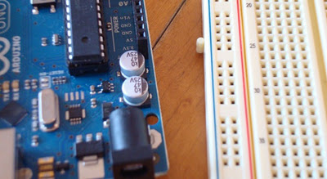
What is a Development Board
A printed circuit board designed to facilitate work with a particular microcontroller.
Typical components include:
  power circuit
  programming interface
  basic input; usually buttons and LEDs
  I/O pins

Slide 2
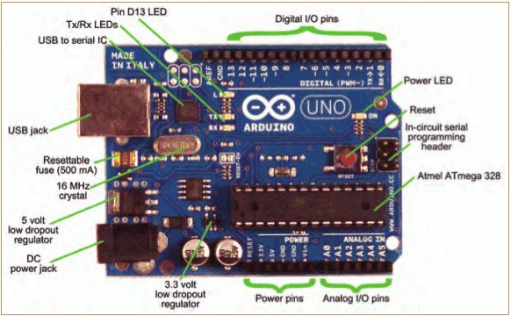
The Arduino Development Board
Making-robots-with-arduino.pdf

Slide 3
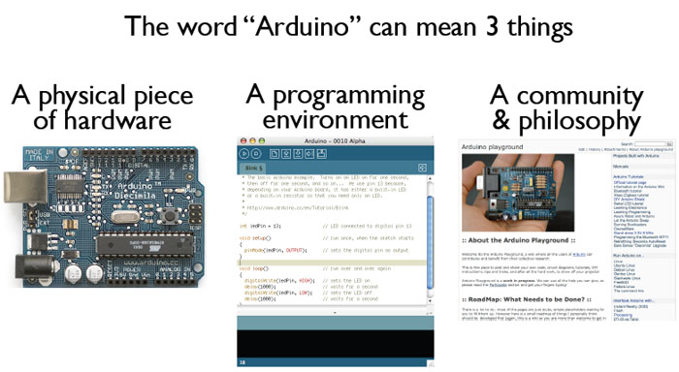
What is the Arduino
todbot.com/blog/bionicarduino

Slide 4
Getting Started
Check out: http://arduino.cc/en/Guide/HomePage
  Download & install the Arduino environment (IDE)
  Connect the board to your computer via the UBS cable
  If needed, install the drivers (not needed in lab)
  Launch the Arduino IDE
  Select your board
  Select your serial port
  Open the blink example
  Upload the program

Slide 5
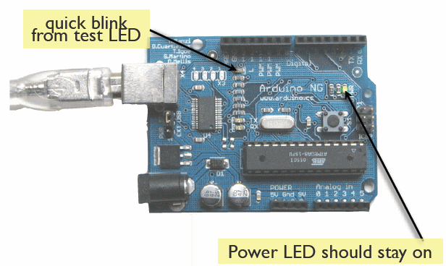
Try It: Connect the USB Cable
todbot.com/blog/bionicarduino

Slide 6
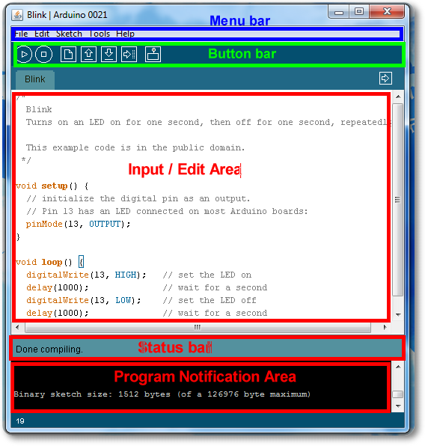
Arduino IDE
See: http://arduino.cc/en/Guide/Environment for more information

Slide 7
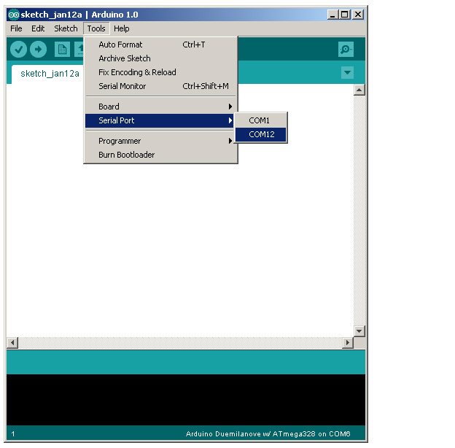
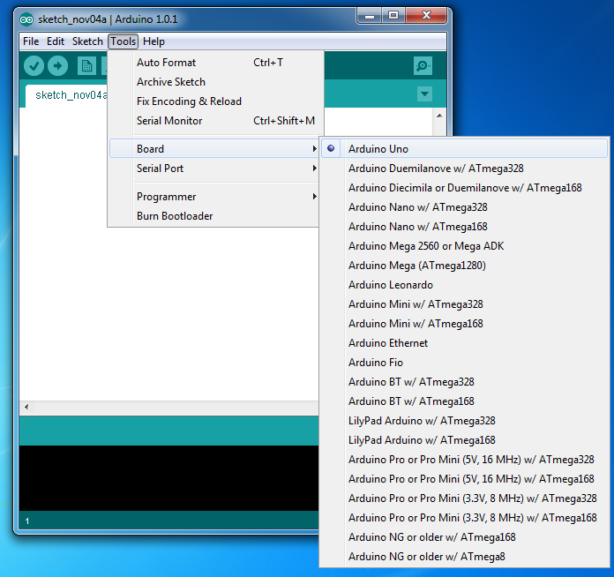
Select Serial Port and Board

Slide 8
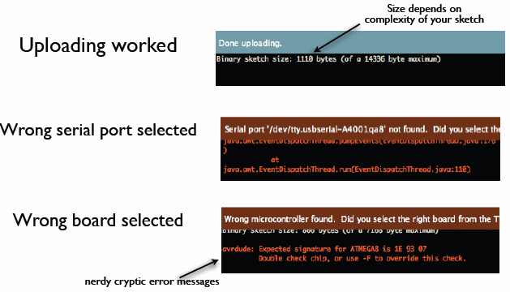
Status Messages
todbot.com/blog/bionicarduino

Slide 9
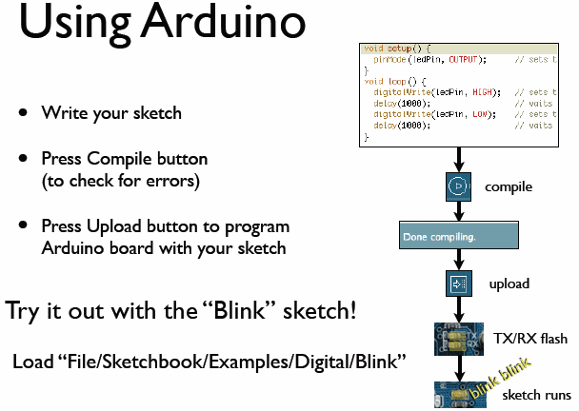
todbot.com/blog/bionicarduino

Slide 10
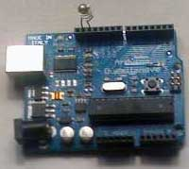
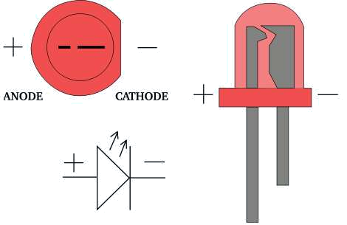
Add an External LED to pin 13
File > Examples > Digital > Blink
LED’s have polarity
  Negative indicated by flat side of the housing and a short leg
www.instructables.com

Slide 11
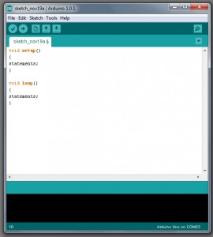
A Little Bit About Programming
Code is case sensitive
Statements are commands and must end with a semi-colon
Comments follow a // or begin with /* and end with */
loop and setup

Slide 12
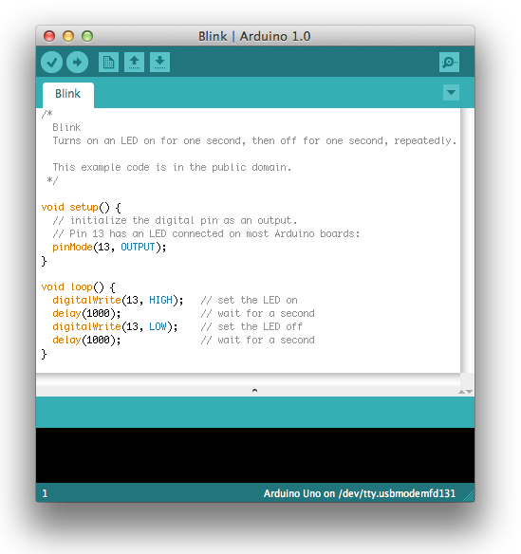
Our First Program

Slide 13
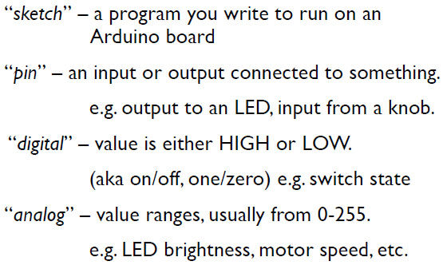
Terminology

Slide 14
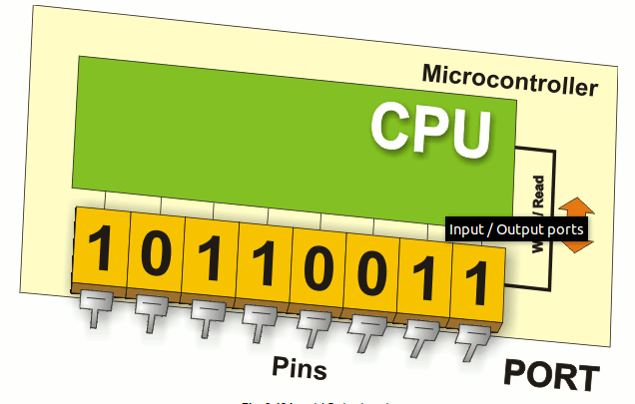
Digital I/0
www.mikroe.com/chapters/view/1
pinMode(pin, mode)
  Sets pin to either INPUT or OUTPUT
digitalRead(pin)
  Reads HIGH or LOW from a pin
digitalWrite(pin, value)
  Writes HIGH or LOW to a pin
Electronic stuff
  Output pins can provide 40 mA of current
  Writing HIGH to an input pin installs a 20KΩ pullup

Slide 15
Arduino Timing
delay(ms)
  Pauses for a few milliseconds
delayMicroseconds(us)
  Pauses for a few microseconds
More commands: arduino.cc/en/Reference/HomePage

Slide 16
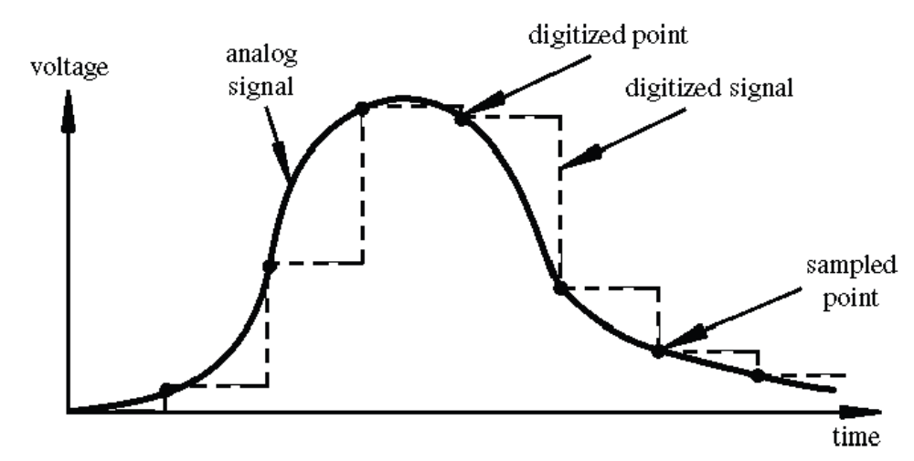
Digital? Analog?
Digital has two values: on and off
Analog has many (infinite) values
Computers don’t really do analog, they quantize
Remember the 6 analog input pins---here’s how they work
todbot.com/blog/bionicarduino

Slide 17
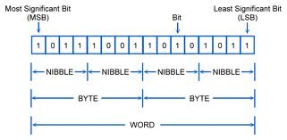
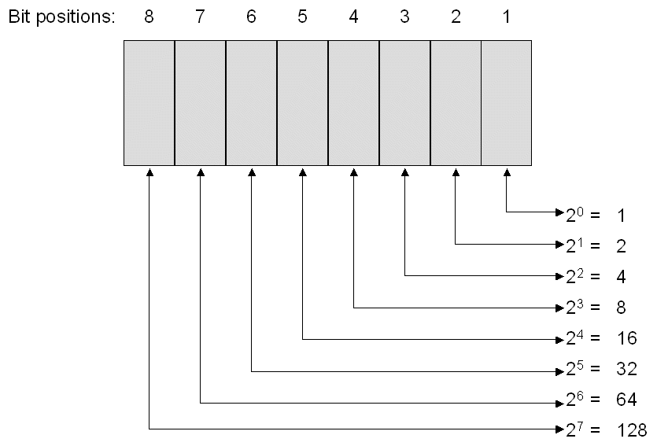
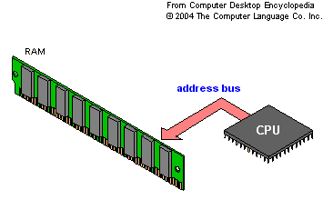
Bits and Bytes

Slide 18
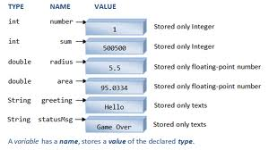
Variables
www3.ntu.edu.sg

Slide 19
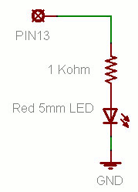
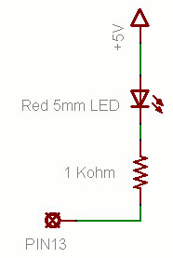
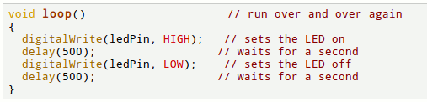
Putting It Together
Complete the sketch (program) below.
What output will be generated by this program?
What if the schematic were changed? ➔
www.ladyada.net/learn/arduino

Slide 20
Good References
www.arduino.cc
www.ladyada.net/learn/arduino
www.EarthshineElectronics.com

