Slide 1
Design

Slide 2
Decomposition diagram
Home
index.php
Navbar
Ul of links
DB
Create account
Register
register.php
Log in
Loggin.php
Contac tus
Contactus.php
Username/ email is already In use
Profile
profile.php
Login to account
Login info is incorrect

Slide 3
ER Diagram for the database

Slide 4
Data flow diagram

Slide 5
Data dictionary (table structure)

Slide 6
Data structures / variables list
Variable name | scope | Data type | Where used | Example data | Justification
Dbcursor | Global, passed as parameter | Database cursor type (Object) | Across the whole solution | n/a | This is a needed element to work with/on getting data into and out of the database

Slide 7
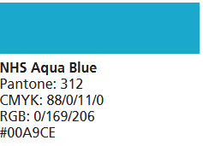
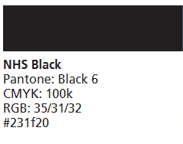
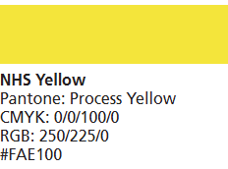
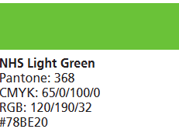
Colour scheme
For the colour scheme I will be using a colour scheme based around the government health website colour designs
The blue will be used in place of the Health Advice Group logo to identify it is about health (NHS)
Black will be used for the buttons in contrast with the white background
Yellow will be used to contrast to the black button to highlight the user is over a button
Green will be used for the buttons to complete forms and anything that may be processed (log in button, form completed button, etc)

Slide 8



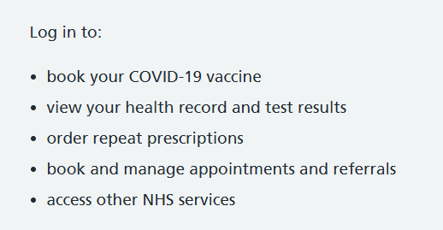
Colour scheme in context
Here is the use case to why I have chosen my colour scheme. I believe that if I follow these same guidelines to be able to follow WCAG so that the website is completely accessible to most if not all users to be able to navigate easily.

Slide 9
Interface designs

Slide 10
Algorithm designs - flowcharts

Slide 11
Algorithm designs - pseudocode

Slide 12
Test strategy
Area of testing | Component to be tested | Type of test to be carried out | Prerequisites and dependencies
Navigation system | Navbar | Blackbox – functional and integration testing

