Slide 1

Hooking up GRAMY to ITS
Noboru Matsuda
University of Pittsburgh
October 18, 2001

Slide 2
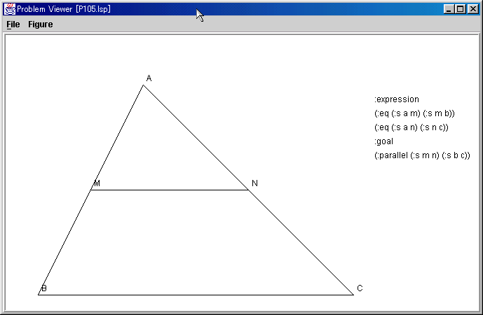
Introduction to GTP with construction
A
Given: AM = MB
AN = NC
Goal: MN//BC
M
N
B
C

Slide 3
GRAMY
An expert of GTP
  Can investigate all (most of) proofs and constructions.
Now, we wish to teach GTP

Slide 4
First Thing First
Why teach GTP?
  The NCTM standards
How to teach GTP?
  Students’ point of view
  Teachers’ point of view

Slide 5
NCTM standards
NCTM Geometry Standards for PreK-12
  K6-8 “Create and critique inductive and deductive arguments.”
  K9-12 “Establish the validity of geometric conjectures using deduction, prove theorems, and critique arguments made by others.”
Relationship between the standards and research
  “The standards could suggest what to research, and the research could suggest what should be in the standard.” (Hiebert, 1999)
NCTM. (2000). Principles and Standards for School Mathematics.
Hiebert, J. (1999). “Relationships between research and the NCTM Standards,” J. for Research in Mathematics Education, 30(1):3-19.

Slide 6
Why Students Fail
Besides the complexity of search …
Can’t appreciate a proof
  “Why bother proving what you already knew?”
Can’t write down proof, although they have logical justifications
  “I’d consider the following to be a proof.”
  (Dodge, 1998)
A bunch of Japanese literatures read long ago…
Dodge, W., Goto, K., and Mallison, P. (1998). “I Would Consider the Following to Be a Proof,” Mathematics Teacher, 91(8):652-653.

Slide 7
Pedagogical Theory
van Hiele’s model of thinking
  Developmental level of geometric concepts
    “It is important to let students argue the validity of geometric conjectures with their own words.”
    “Those argumentation should become more abstract along with their growth.”
van Hiele, P. (1986). Structure and Insight. Orlando, FL: Academic Press.
NCTM. (1988). The van Hiele Model of Thinking in Geometry Among Adolescents. Monograph No.3, Journal for Research in Mathematics Education.

Slide 8
Summary
We know why teach GTP
  Because the standards are demanding kids to have analytic skills.
We know how to teach GTP
  Empirical studies supported by theories.
But, we’ve missed one important thing…

Slide 9
The Domain
Lessons learned from GRAMY
  It has high branching factor
    200+ for construction
    Low success rate
      15.8% of constructions succeed
      not sure about the of ratio correct paths, but my guess is quite low
  It’s highly nondeterministic
    FC, BC, and backup

Slide 10
Do we have a cognitive model?
No! No one could tell which path to follow without pain.
Even a problem solver is “logical,” it must still suffer from the high branching factor (theoretically).
In sum, teachers have been maintaining a narrow view of GTP.

Slide 11
The mission:
ITS for nondeterministic search with high branching factor
No ITS has emphasized this so far…

Slide 12
Fact:
Human expert seems not to suffer from search explosion.
  They might even be unaware of how big the problem space is.
  They could either …
    Select “good” paths
    Prune garden paths
    Ignore garden (or, uncommon) paths
But, how? …

Slide 13
Bucking high branching factors
Heuristics
Abstract Planning
  Model of Prediction
  AI-planning
  Model of Transfer
Implicit Learning

Slide 14
Heuristics
Polya provided lots of heuristics for theorem proving.
  Those heuristics are not strong enough to deal with high branching factors.
No heuristics-based problem solver gets over construction.
  You would end up with having dozens of heuristics of construction.
G. Polya, How to Solve It, Princeton, 1957.

Slide 15
Abstract Planning
Model of Prediction
  DC Model
Proof Plan
  AI Planner
Model of Transfer

Slide 16
DC model
“Experts tend to skip certain steps.”
Diagrammatic Configuration Schema
  Unit of inference for GTP
    Associated with a pair of congruent triangles are ASA, SAS, SSS, etc.
  Algebraic steps can be put into a single schema, hence be abstracted.
Some schemas are labeled as “can-be-skipped.”
  Hence, they can predict experts step-skipping.
Koedinger, K., Anderson J.R. (1990). “Abstract Planning and Perceptual Chunks: Elements of Expertise in Geometry,” Cognitive Science, 14:511-550, 1990

Slide 17
Proof Plan
Application of AI-planning
  Abstract proof schema for inductive inference (Bundy, 1991)
  Generalization based planning
  (Melis, 1998; Villafiorita, 1994)
Bundy, A. (1991). “A Science of Reasoning.” in Lassez, J. L., and Plotkin, G. (Edts). Computational Logic: Essays in Honor of Alan Robinson, pp.178-198, MIT Press.
Melis, E. (1998). “AI-Techniques in Proof Planning,” in Proc. of European Conference on Artificial Intelligence, pp.494-498.
Villafiorita, A., and Sebastiani, R. (1994). “Proof Planning by Abstraction,” in Proc. ECAI-94 workshop on Interactive Systems, Amsterdam.

Slide 18
Proof Plan for GTP
To prove two elements are congruent, try to prove that two triangles that include those elements are congruent
  AB = XY ← ΔABC ≡ ΔXYZ
  ∠ABC = ∠XYZ ← ΔABC ≡ ΔXYZ
Need to know more for GTP
  Empirical study to see how human problem solvers make a plan.
  Analytic study to compose plan schema from domain principles.

Slide 19
Implicit Learning
Human problem solvers could improve their performance without knowing the reason.
GRAMY with ANN for operator selection
  Input: truth values of conditions in all postulates
  Output: a postulates should be selected
Relevance Theory
  “People have intuitions of relevance; they can consistently distinguish relevant from irrelevant information.”
  (Sperber, 1986)
Matsuda, N. (1998). “Learning Theoretical Categorization of Geometry Problems” unpublished document prepared for a term project on Machine Learning and Communication.
Sperber, D. and Wilson, D. (1986). Relevance: Communication and Cognition. Oxford: Blackwell (2nd, 1995)
Greiner, R,. Grove, A. J., Kogan, A. (1997). “Knowing what doesn’t matter: Exploiting the Omission of Irrelevant Data,” Artificial Intelligence, 97:345-380.

Slide 20
So, who wins?
Heuristics, Abstract Planning, or Implicit Learning…
Good question!
  Have been investigating on abstract planning and implicit learning.

Slide 21
Suppose we got a technology …
… to deal with the high branching factor, and also suppose we could teach it to students.
The students then become “good” problem solvers.
  Would they be happy?
  Would the teachers be happy?
  Would the standard people be happy?

Slide 22
What is a good problem solver?
Student who can find a proof quickly
  Won’t follow the garden paths.
Student who can only search logically
  Might follow the garden paths, but will recover from them.
Is this a question for educational philosophers?

Slide 23
Wonder how many of the students …
Can’t think logically
Can’t search
Can’t write down a proof
Must carry out DFA
but remember “Six months in the lab can often save an hour in the library.”

Slide 24
ERIC goes with …
Geometry, Theorem Proving, Proof, Search, Writing, van Hiele, Planning, Implicit, Heuristic, …
  “Proof writing” along “van Hiele’s model” seem to be a central issue in classroom instructions
  A few literature on “Heuristics” for “Proof”
  “Planning” correlates to political issues
  No “search” related issues in classroom instructions

Slide 25
van Hiele’s Mode in Teaching Proofs
Dozens of studies supported his model
  “Proof-writing achievement correlated significantly with van Hiele level entering geometry knowledge and geometry achievement.” (Dormolen, 1977)
  “The ability to produce a proof depends upon students’ cognitive level.” (Senk, 1989)
  A report on 1,500 students in 11 schools in 5 states showed correlation btw proof-writing and the level of reasoning. (Senk, 1982)
Van Dormolen, J. “Learning to Understand What Giving a Proof Really Means,” Educational Studies in Mathematics, 8(1):27-34, 1977.
Senk, S. L. “Achievement in Writing Geometry Proofs,” the AERA meeting, 1982.
Senk, S. L. “van Hiele Levels and Achievement in Writing Geometry Proofs,” J. for Research in Mathematics Education, 20(3):309-321, 1989.

Slide 26

Discussion

