Slide 1
Hinting Patterns in Helping Proof
Noboru Matsuda
University of Pittsburgh
May 8, 2002
Kurt Grad Meeting

Slide 2
Motivation
Learning by solving problems is known to be effective
  The more problems a student solves, the more learning gain he would get
We want students to get through as many problems as possible by themselves
  They need help when they got impasse
We need to implement effective hinting
  What does effective hint look like?
  How can we automatize hinting?

Slide 3
Type of Tutor Contribution
Feedback
  Acknowledgement: positive, negative, neutral
  Prompt: so what?
  Didactic: positive (mini lesson), negative (counter example)
Hint
  Construction
  Postulate application (a proof step)
  Strategy

Slide 4
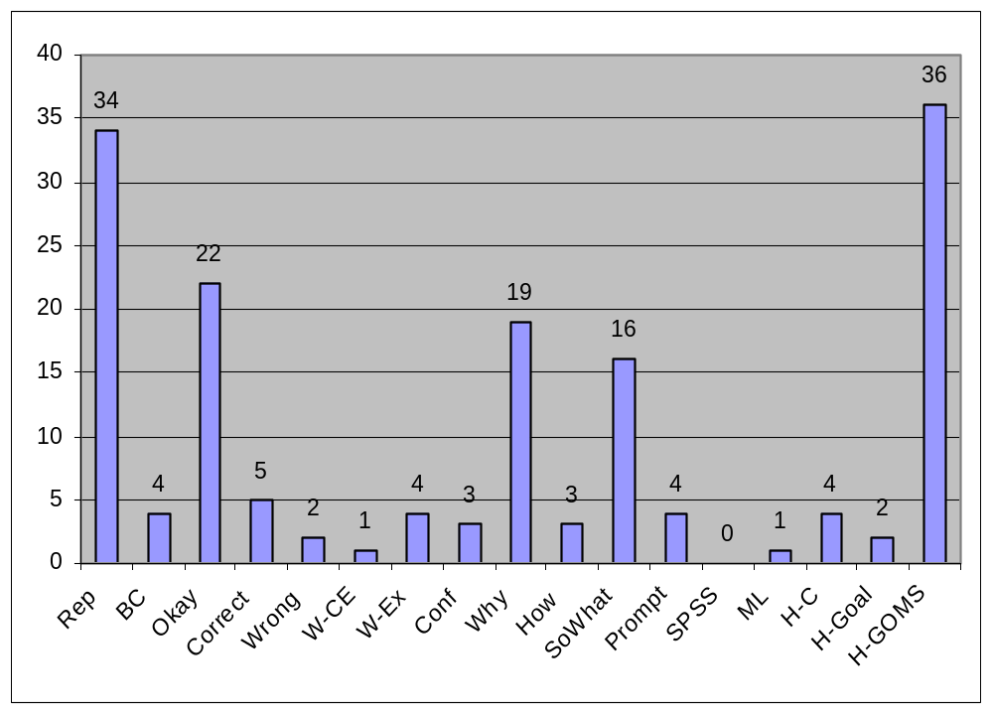
Tutor Contribution in an Experiment
N=3 who completed a proof with tutor’s guide.

Slide 5
Hinting for a Proof Step
A proof step corresponds to a postulate application
Postulate application can be broke down into sub-steps
For each substep, one can implement variety of hints from different point of view.

Slide 6
Anatomy of Hint
GOMS models a postulate application as a method and a sub-step as an operator
    Forward chain: apply X→Y onto X/a and Y/b
      Recall X as a premise of Y
      Recall Y as a consequence of X
      Realize a
      Unify a and X
      Unify b and Y
      Conclude b
Format of a hint
    Pointing – highlighting a configuration relating to a fact
    Question – asking about a fact
    Exhibit – showing a fact

Slide 7
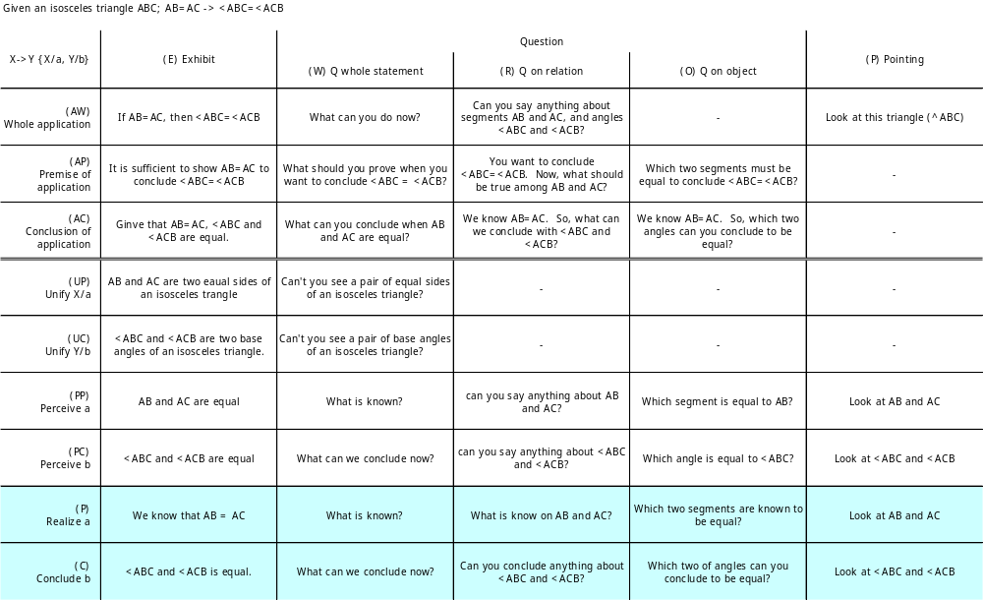
Possible Hints for a Proof Step

Slide 8
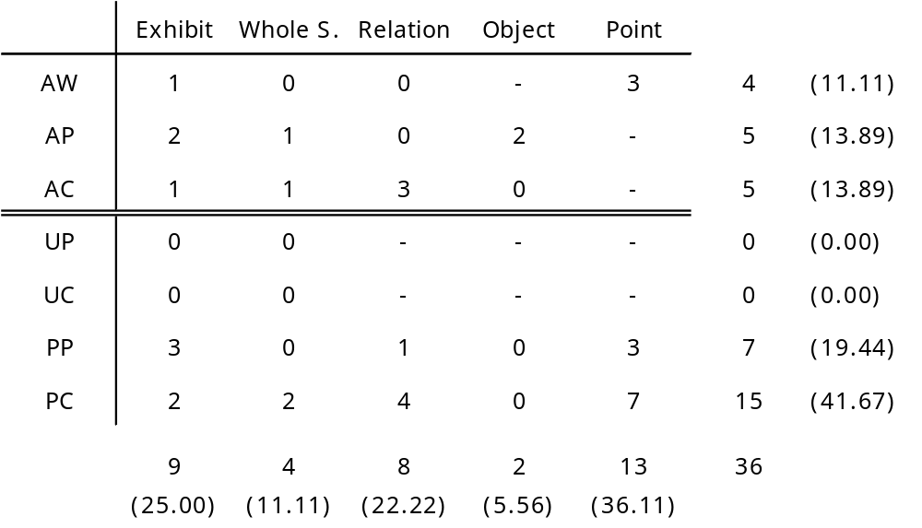
Hinting in an Experiment
N=3 who completed a proof with tutor’s guide.

Slide 9
Providing Facts Explicitly
AW-E
  (205-220) “Since the sides are equal and the angles on both side are equal, they are congruent.” – Bottom out hint for a hint request
AP-E
  (202-107) “That's because they are parallel.” – Justification given by tutor
  (205-225) “This and this are congruent.” – bottom out hint following 205-220
AC-E
  (205-226) “Then, this side (PA) and this side (Bx) are equal.” – bottom out hint following 205-225
PP-E
  (205-109) “But, it's given, here?” – tutor correcting student’s wrong justification
  (208-160) “Because, they are equal (BQ, Bx), aren't they?” – bottom out hint following 208-158
  (208-71) “Then, … Do you remember this? (M midpoint of AB)” – bottom out hint showing a given for a long pause
PC-E
  (208-149) “PA and BD are equal” – bottom out hint on a way to explain BQ=BD
  (208-158) “This triangle is actually an isosceles triangle.” – bottom out hint for a long pause

Slide 10
Summary
N=3 who completed a proof with tutor’s guide.
The tutor had an apparent preference on pointing to propositions in problem figure.
¼ of the hints (9 out of 36) were to show facts explicitly
  7 bottom out hints
  1 justifications spontaneously provided by the tutor
  1 correction for student’s error
AP-* is providing a hint on backward chaining
No hints on unification provided

Slide 11
H-GOMS fits in Other Tutoring Studies
Hume et al (1996)
  Summaries; a review of student’s contribution followed by a question toward next step.
    “Here’s what we know and agree on: CC 0; MAP I. How would that combination affect SV?”
    In H-GOMS with an operator X→Y, this is implemented as showing X and asking about Y (i.e., AC-R).
  Questions; tutor answering student’s question with a question.
    A child asked his mother what direction they are driving. The mother responded with “where is the sun?”
    Asking about X to conclude Y wrt an operator X→Y (i.e., AP-R).
Hume, G., Michael, J., Rovick, A., & Evens, M. (1995). Hinting as a tactic in one-on-one tutoring. Journal of the Learning Sciences, 5(1), 23-47.

Slide 12
Lit. Survey
Hume, G., Michael, J., Rovick, A., & Evens, M. (1996). Hinting as a tactic in one-on-one tutoring. Journal of the Learning Sciences, 5(1), 23-47.
More than 90% of the time, the hints were triggered by student's error.
Hinting quickly ceases when the student responds with anything other than correct answers.
Type of hints
  Explanations
  Summaries
  Questions
  Negative Acknowledgement
Hume, G., Michael, J., Rovick, A., & Evens, M. W. (1996). The Use of Hints by Human and Computer Tutors: the Consequences of the Tutoring Protocol. Proc. Int. Conf. on the Learning Sciences.
Local and Global student model:
Use PT (Pointing To) hint when the local assessment is high
Use CI (Conveyed Information) hint when the local assessment is low
Zhou, Y., Freedman, R., Glass, M., Michael, J. A., Rovick, A. A., & Evens, M. W. (1999). Delivering Hints in a Dialogue-Based Intelligent Tutoring System. Proc. Conf. on Artificial Intelligence, Orlando, FL.
Hinting with heuristics based on (1) correctness of students answer, (2) tutorial plan, (3) tutoring history.
Correctness of the student's answer:
  Correct, Partially correct, Near miss, "I don't know“, Grain of truth -- incorrect but indicates partial comprehension, Misconception, Other incorrect answers, Mixed answers -- a combination of answers from other categories.

Slide 13
Current Work
Trying to find out a pattern of hinting
  Which hint was provided under what situation?
  Situation might be described by …
    Student’s response,
    History of hinting (success and failure in past)
    State of a proof

