Slide 1
Modeling Hinting Strategies for Geometry Theorem Proving
Noboru Matsuda & Kurt VanLehn
University of Pittsburgh
December 4, 2002
Kurt Grad Meeting

Slide 2
The Target Clients
Intermediate learners
  Transitional to learning by problems (cf. examples)
  The learners are supposed to “know” problem-solving skills (proof strategies and geometry knowledge, in this case).
  The learners need to achieve mastery on those skills.
  Learning by problem solving would be help.
  Tutor’s help would be a must.
Kalyuga, S., Chandler, P., Tuovinen, J., & Sweller, J. (2001). When problem solving is superior to studying worked examples. Journal of Educational Psychology, 93(3), 579-588.
Notes:
We assume that our students are intermediate by which we mean the students who are transitional in the learning phase from learning by examples to learning by problem solving.
There are many studies on learning by examples and problem solving.
We won’t discuss educational and psychological theories on those learning issues, but Kalyuga’s paper is a good reference.
The bottom line is that the intermediate students need to solve many problems to achieve mastery.
However, until they become mastery, they get stuck a lot during problem solving. So, the tutor’s help is a must.

Slide 3
Some Questions
To provide a better help, we need to know ...
  How the students’ inference look like?
    Do they follow strict proof strategy?
    If not, how does their proof grow?
  How does the tutor provide a hint at impasse?
    Does he provide a strategic hint like Polya?
    Does he provide a hint on fringes?
    If not, how does he find the next step for hinting?

Slide 4
Geometry Theorem Proving Experiment
 | P1 |  | P2 |  | P4
202 | Guided | 1 | Guided | 3
203 | Guided | 4 | Time up. Only 1 hint for construction provided. |  | Time up. Only 1 hint for construction provided.
205 | Guided from the beginning, but none of the hints worked. |  | Guided | 4
207 | Guided. | 2 | Assisted | 4 | S couldn't understand a correct proof.
208 | Guided | 4 | Guided | 3
209 | Time up. No hint provided |  | Assisted | 3 | Guided | 4
Notes:
So, we analyzed protocol data of students’ doing geometry proof.
9 students were involved the experiment.
3 were too good or too bad, hence omitted.
6 students solved 15 problems.
10 complete a proof with the tutor’s help.
In 2 cases, the tutor’s help didn’t work, which means that the tutor’s hinting was actually good.

Slide 5
Students’ Typical Inference in GTP
B
∠APM = ∠BQM
X
A
The students don’t follow strict forward / backward inference.
The students’ assertion is rather opportunistic.
∠BQM = ∠BxM
∠BxM = ∠APM
C
1
X’
Isosceles Tri.
Bx // AP
2
Y
BQ = Bx
Z
5
V
AP = BQ
Bx = AP
D
ΔPAM ≡ ΔBxM
G
E
3
F
∠PAM=∠MBx
AM=MB
∠AMP=∠BMx
1
M
4
C
J
Bx // AP
M midpoint AB
Vertical Angle
Notes:
We first analyzed a pattern of students inference.
A typical grow of a proof.

Slide 6
An Empirical Question
To gain better learning, ...
  should we restrict students to follow the strict proof strategy, or
  should we allow them to employ their favorite inference?
We need to do some experiment
  Model tracing tutor vs. Exploratory tutor
  Any known theory?
Notes:
So, we know how students solve problems, and we have an empirical question to design a learning environment.
Next, we need to know the tutor’s hinting strategy.

Slide 7
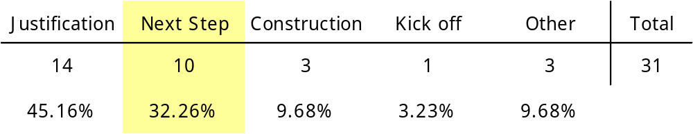
Type of Hint Events
31 hint events from 6 students worked on 12 problems.
Hint event is a sequence of hints.
Hints are differ in their focus and form.
Notes:
I’ll focus on the next-step hint later on today.

Slide 8
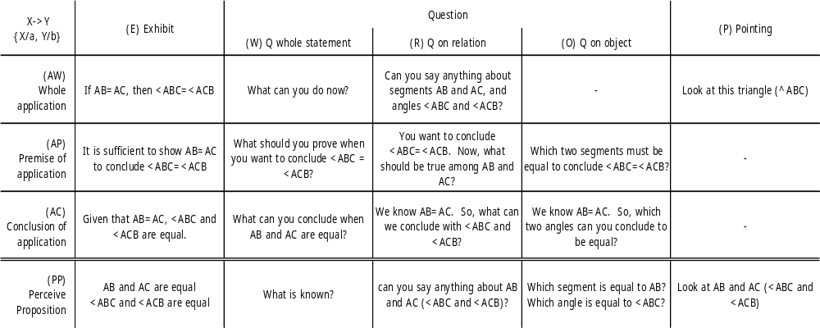
Ontology for Hinting
87 of 90 (97%) hints in the 25 hint events (next-step, justification, and kick-off) fall into the table.
Nearly all hints are targeted a single proof step.
Notes:
The big table formally known as H-GOMS.

Slide 9
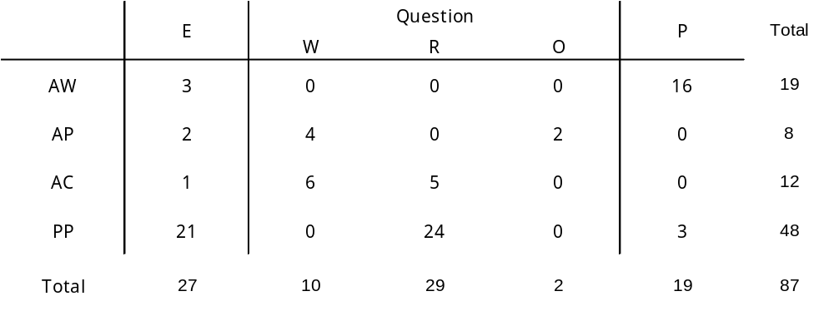
Frequency of Hints in Next-step
Notes:
We are curious about how the hints in the big table were used -- counted a number of hints in the hint events.
1. PP-R: Asking a relationship between particular geometric elements involved in the target proposition.
This type of hint often used as the first trial. When it fails, the tutor shifts the focus to a whole postulate application, or simply provides PP-E on the same postulate.
2. PP-E: Not only used for a bottom-out hint, but also for a reminder of what the student has already asserted.
3. AW-P: 7 out of 10 of the next-step hint events started with AW-P, which is simply highlighting a part of problem figure.

Slide 10
Automation of Hinting on Next-step
Select a proof step to consider next
  Coded a tutor’s motivation of the selection as a pattern of assertion on the proof tree.
Plan a hint sequence on the selected next-step
  Not fully analyzed, but observed a pattern of hierarchical planning.
Notes:
Will show you the first issue next.

Slide 11
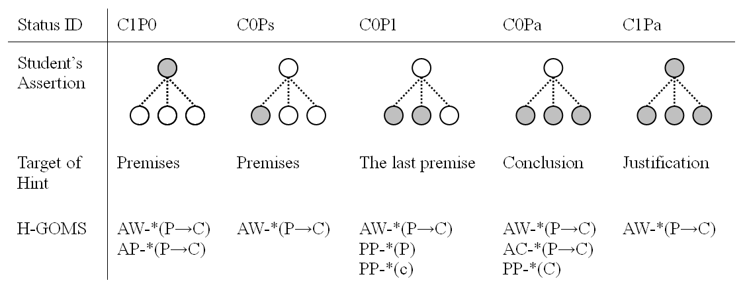
A Motivation of Next-step Selection
Notes:
To learn how the human tutor selects the next-step, we codify a subtree in a proof tree depending on the status of assertions.

Slide 12
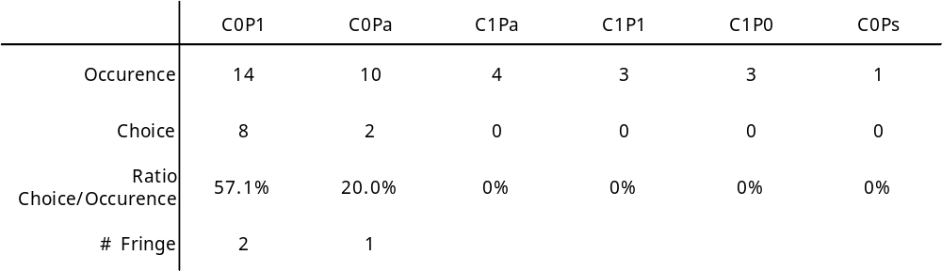
Frequency of the Motivation Used
Notes:
This table shows the number of each subtree occurred at the time the 10 next-step hint events were planned.
The second raw shows actual number of choice.
C0P1 and C0Pa dominate the selection.
C0P1 is chosen with the probability of .57.
C0Ps is rare, maybe because 90% of the all subtrees have only 1 or 2 premises, which means asserting a proposition most likely turn a subtree into C0P1 or C0Pa.
Remarkably, only three cases (30%) of hinting events were planned for the fringe.

Slide 13
Conclusion
When making a proof, ...
  The students employ opportunistic inference (cf. strict FC/BC)
When a student gets stuck, ...
  The tutor plans a hint event on next step (cf. strategic hint)
  The tutor selects most appropriate next-step for hinting (cf. hint on fringe)
Notes:
The students’ assertion can be scattered around

Slide 14
Future (Dissertation) Questions
How is the next-step hinting automated?
  Conflict resolution
  Hierarchical reactive planning
Does allowing students opportunistic inference encourage learning?
Which is better to hint on the fringes or on the best-proximal steps?
  Experiment with two versions of ITS

