Slide 1
Acquiring Intellectual Skills
Voss, J. F., Wiley, J., & Carretero, M. (1995). Acquiring intellectual skills. Annual Review of Psychology, 46, 155-181.
Noboru Matsuda
University of Pittsburgh
January 16, 2003
Kurt Lab Grad Meeting

Slide 2
Noboru’s Struggle
So many literature in Cognitive, Psychological, and Educational studies.
  Sometimes it’s really hard to figure out what those studies are for.
  Starved for a “base” on which things can be lined up.
What’s a study of hinting after all?
  If a hint works, then all of the necessary knowledge should have been acquired prior to the hint.
  Is that a matter of making the target knowledge sensitive to get fired?
Getting interests in human memory, because ...
  Viewing “memory” as the subject of learning and thinking makes me so happy.
  Phenomena around teaching/learning can be explained in terms of the memory system.

Slide 3
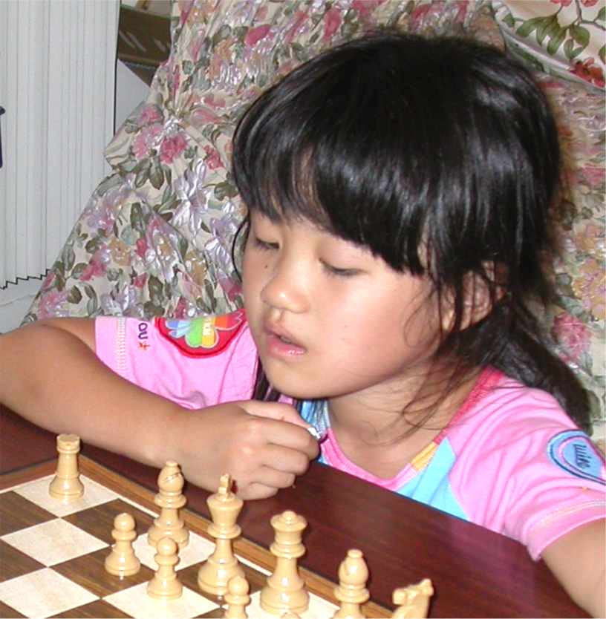
Scaffolding for Executive Control
Skilled teacher
Executive Control
Training on reasoning skills
Scaffolding for Acquisition
Metacognition
Situated Cognition
Acquisition
Scaffolding for Retrieval
Perception
Memory
Problem Solving
Retrieval
Apprenticeship
Hinting
Individual difference
Giftedness
Qualitative Analysis
Probability
Misconception
Transfer
Activation
Restructuring
Organization
Documentation
Indexing
Simple recall
Less coherent text
Inference generation
Intuitive Knowledge
Plasticity
Consolidation
Prior Knowledge
Reification
Feeling-of-Knowing
Priming
Skill Learning
Categorization
Anchored Instruction
Generalization
Proceduralization
Situated Learning
Forgetting
Collaborative Learning
Scaffolding for Organization
Feedback
Self-explanation
Inquiry for text read

Slide 4
Acquisition
Nursery learning
  Object manipulation as a basis of higher algebra (p.156)
Anchored instruction
  CTGV (p.158)
Qualitative Analysis of physical concepts (p.159)

Slide 5
Organization
Prior knowledge
  Integration of knowledge from text (Kintsch, p.168)
Piecemeal vs. coherent knowledge (p.159)
Restructuring by inconsistency (p.162)
Proceduralization
  Sensitivity to relevant information (p.157)
Causal reasoning (p.160)
Reflection
  Self-explanation (p.159)
  Inquiry for text (p.168)
Categorization
Consolidation
  Repeated Priming vs. Skill Learning
  Outside-class learning (p.157)
  By feedback (collaborative argumentation, p.158)

Slide 6
Retrieval
Situated Cognition
  Intuitive Mathematics; kids algebra based on objects manipulation (p.156)
  Coconut-vendors algebra (p.157)
  Hypothesis-evidence relationship in a context (p.163)
  Integration of science concept with everyday thinking (p.165)
Perception
  Failure of perception due to influence in language (p.157)
Naive physics
  Dissociation between naive conceptions and problem solving skills. (p.159)
Analogy
  Structure mapping model (p.164)
Generalization
  Simple recall vs. inference generation (p.168)

Slide 7
Executive Control
Experimenter vs. theorist (p.163)
Scientific thinking skills in good and poor learners (p.165)
  Learning strategy and metacognitive awareness
Role of motivation and emotion (p.172)
Ability level (p.172)
Transfer of general reasoning skills (p.173)
  Or, is just a matter of acquiring general reasoning skills?

Slide 8
Transfer
Retrieval and instantiation
  Retrieval might be highly situated.
    It might also need a highly generalized (or appropriately organized, if you will) knowledge.
  Instantiation might need a modification
Activity cued by situation vs. transfer
  (p.170; Saljo, 1990) How are they differ?

Slide 9
Towards a Theory of Hinting
Hinting as scaffolding for retrieval
  Any feedback effect for other part of memory?
Within-domain transfer
  Theorem proving with construction requires a “twist” to apply known skills
Given that hinting is effective only when necessary knowledge is in the memory, hinting ...
  Must be consistent with the student’s knowledge
  Must be situated
  Might have the priming effect
  Might enhance metacognition, too
Notes:
I’m not going to study everything around memory.
My main concern is on hinting as a scaffolding technique for memory retrieval.

