Slide 1
AGT 2004 Spring Evaluation
Analysis
Noboru Matsuda
University of Pittsburgh
July 5, 2004

Slide 2
Method
Two versions of the Intelligent Tutor
  FC teaches forward chaining
  BC teaches backward chaining
Compare learning gain btw two tutors

Slide 3
Subjects
52 subjects (completed a whole study)
  28 Male, 32 Female
  Ave. age: 23.3 (SD 5.4)
  Recruited for money

Slide 4
Procedure
Read a booklet:
  describing how to write a proof & postulates used in the study
Pre-Test:
  3 fill-in-blank items (6 postulates) & 3 proof items
  40 minutes
  Open book
Tutoring session:
  Solved 11 problems with AGT
Post-Test:
  Same format as the pre-test
  Totally different from the pre-test at the surface level, but isomorphic at the solution structure

Slide 5
Material: Booklet
BC condition provides an explanation for writing a proof backwards, whereas FC condition for writing a proof forwards
Both condition provides identical explanations for 10 postulates used in the study
9 pages

Slide 6
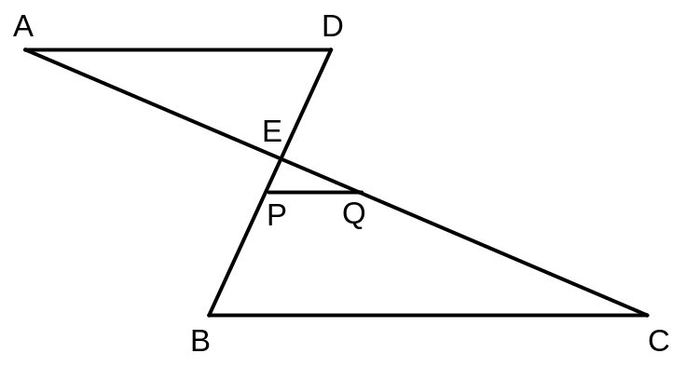
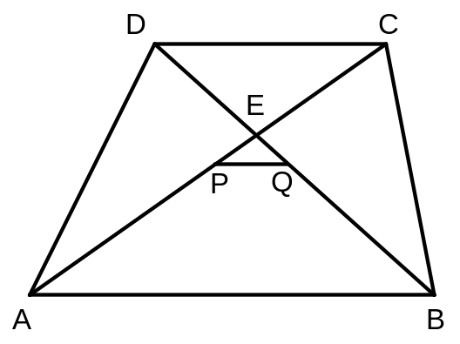
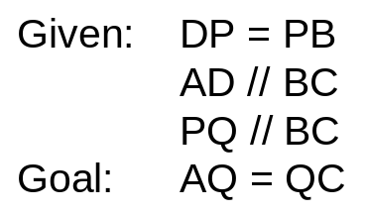
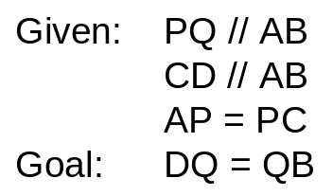
Material: Tests
Two sets of the test (Test-A and Test-B)
  Looks different, but exactly the same in the structure of solution (i.e., the same set of postulates applied in the same order)

Slide 7
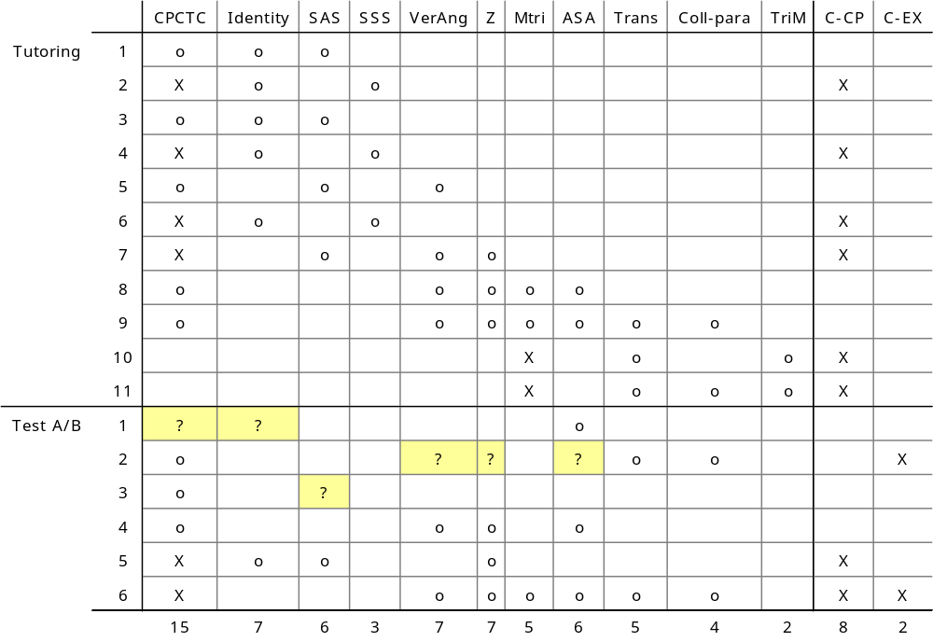
Material: Problems

Slide 8
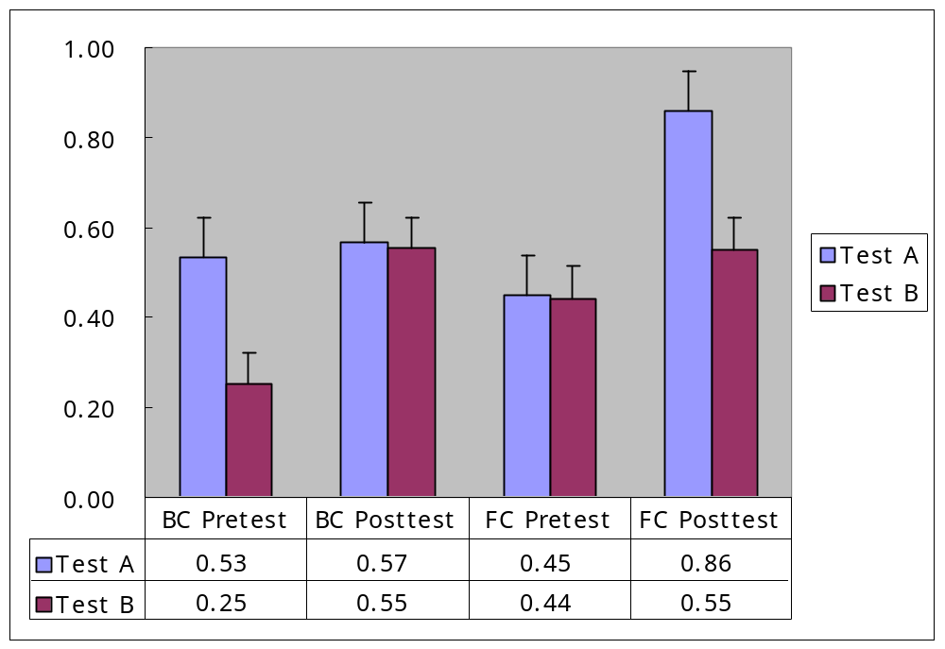
Results: Test Scores

Slide 9
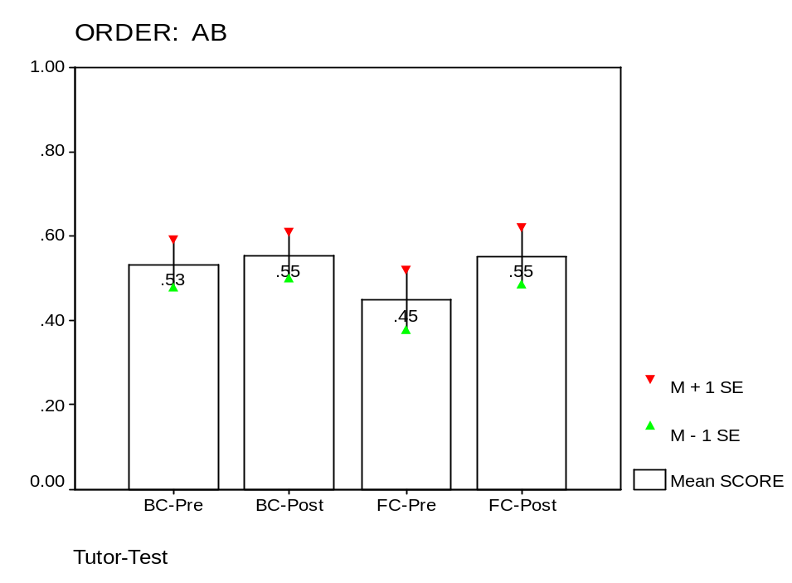
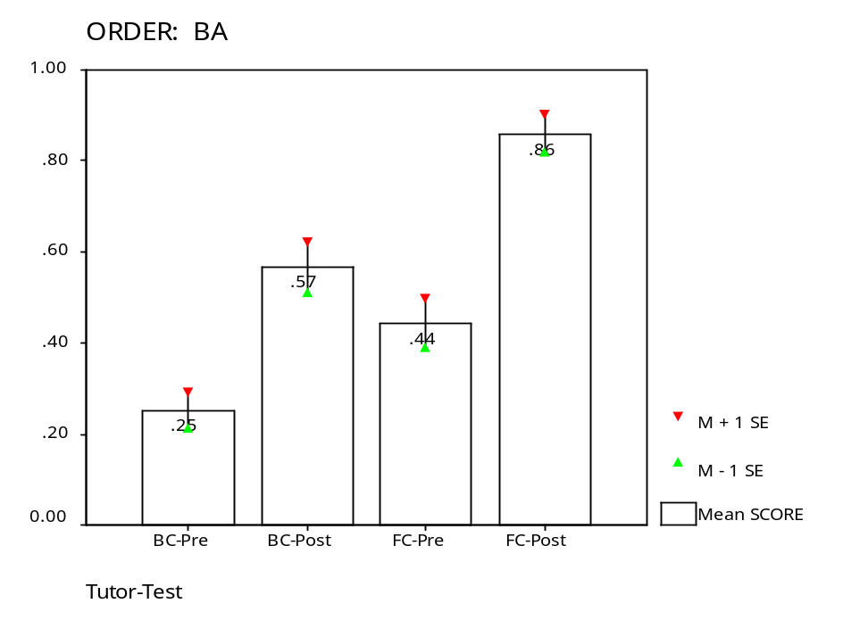
Test Scores: Order Matters?
A
B
A
B
B
A
B
A
Test-B is harder than Test-A
The booklet didn’t help Test-B in BC
FC tutor brought better learning than BC tutor
BC-BA ended up with the “bottom-line” of Test-A

Slide 10
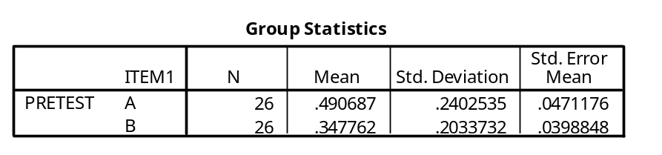
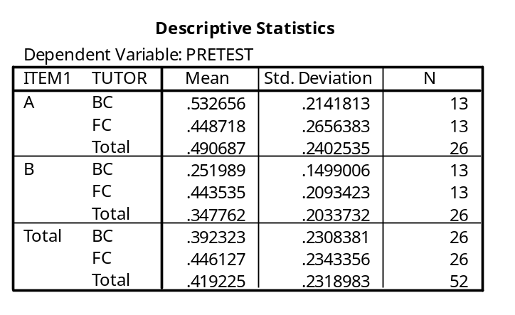
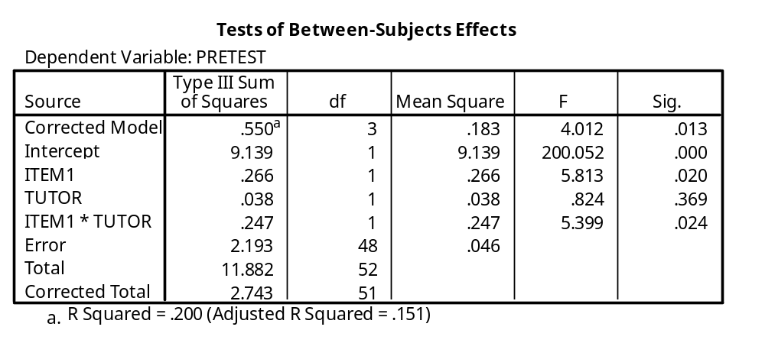
Pre-test Scores
Overall, A >> B (p=.025)
Those who took Test-B, FC >> BC

Slide 11
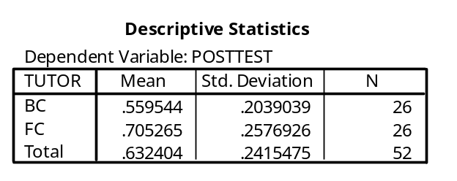
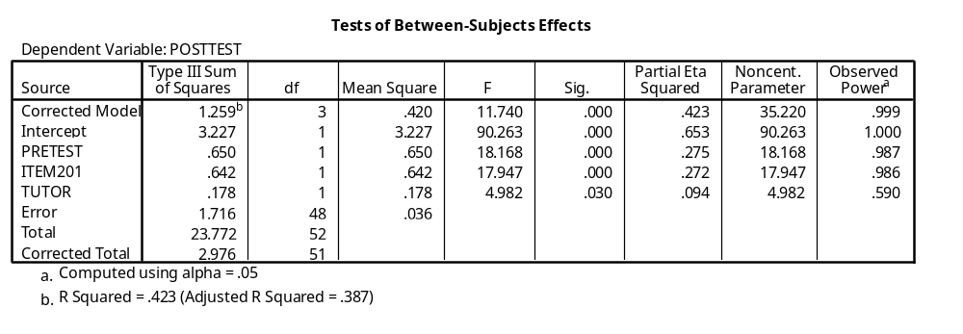
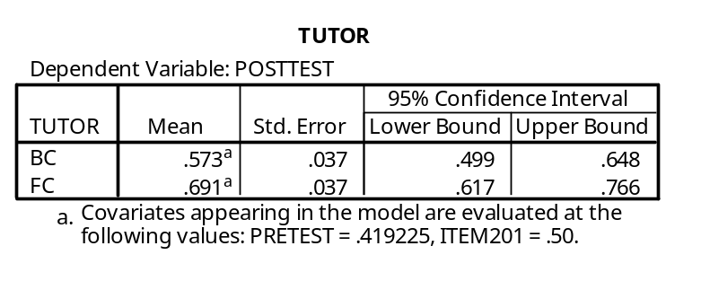
ANCOVA: Post Test Scores

Slide 12
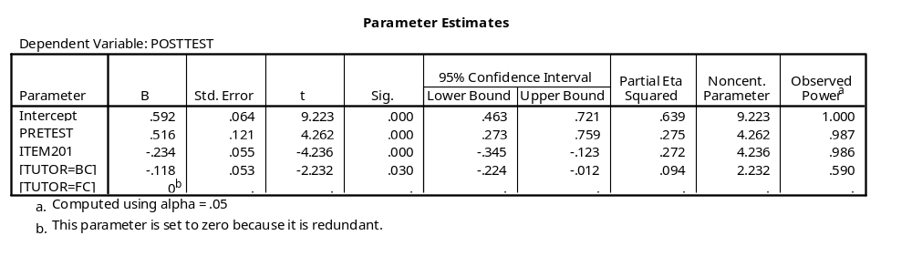
Regression Analysis
PostTest = .592 + .516*PreTest – .234 (if Test-B)
– .118 (if BC)

Slide 13
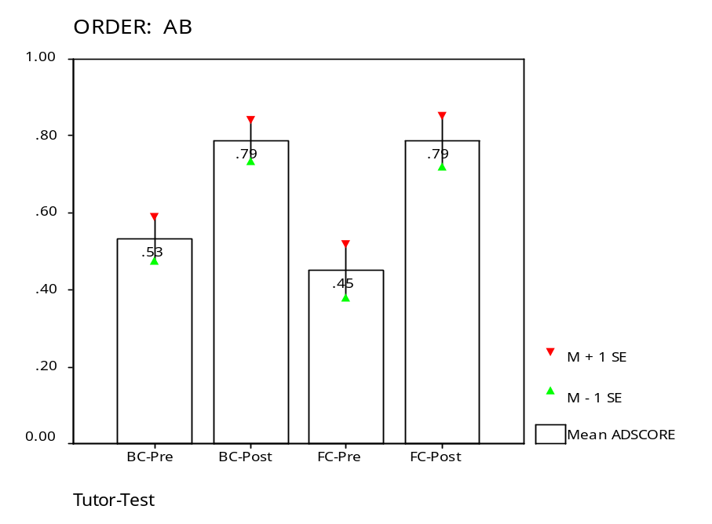
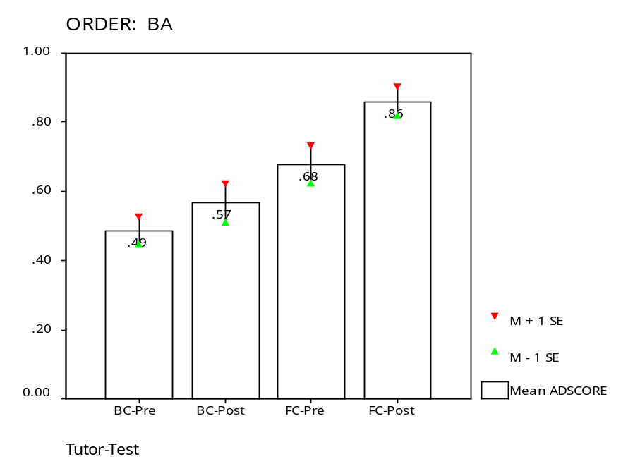
Adjusted Test Scores
A
B
A
B
B
A
B
A
Added .234 to Test-B
Added .234 to Test-B
BC and FC in AB condition learned equally well
BC-BA did not learn at all
FC-BA learned best

Slide 14
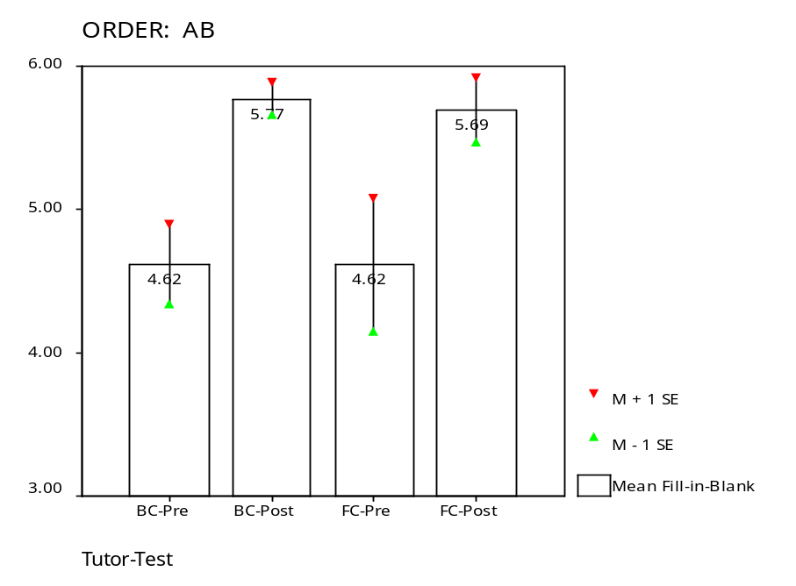
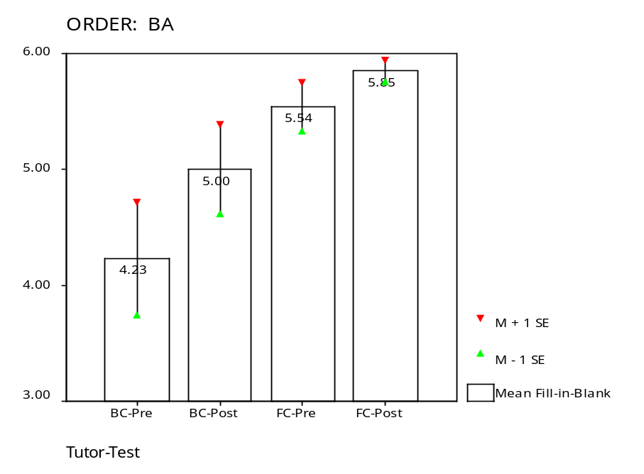
Fill-in-Blank
A
B
A
B
B
A
B
A
There is no significant difference across Tutors and Order.

Slide 15
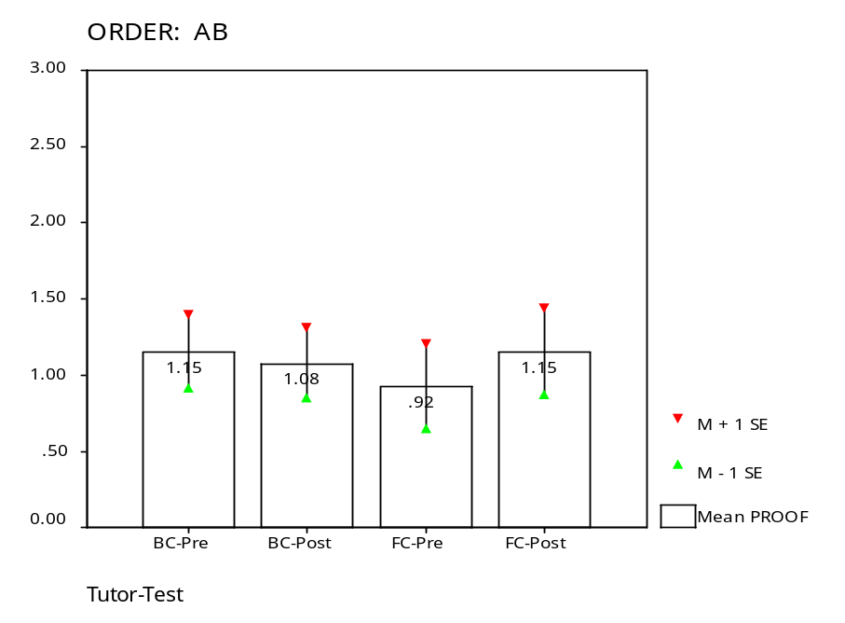
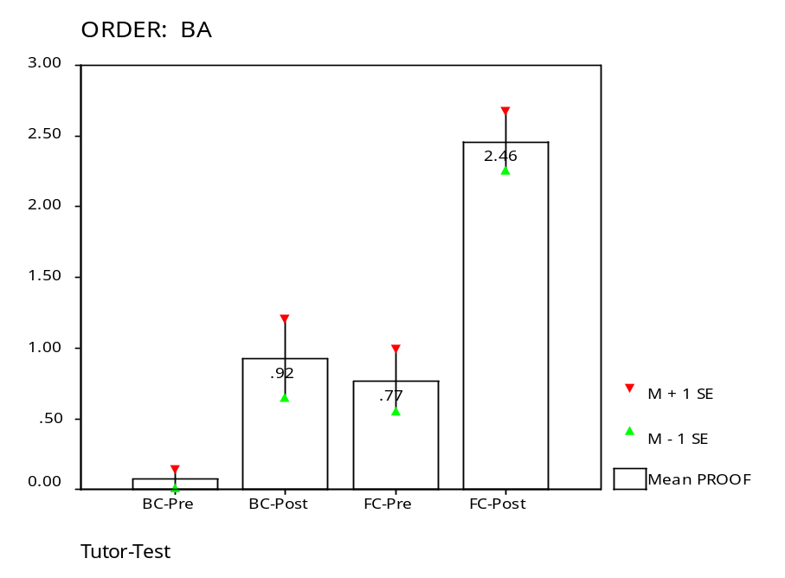
Proofs
A
B
A
B
A
B
A
Proof problems in Test-B are harder than the ones in Test-A.
BC-BA group didn’t learn at all
FC-BA showed the most learning

Slide 16
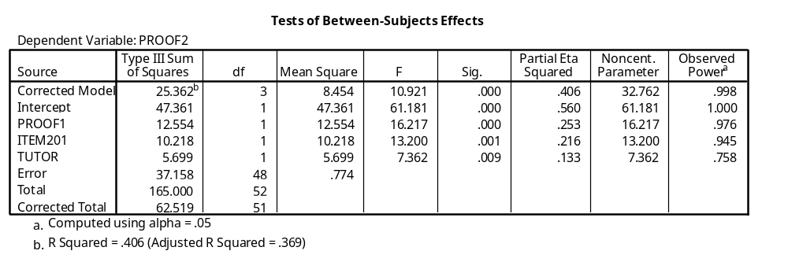

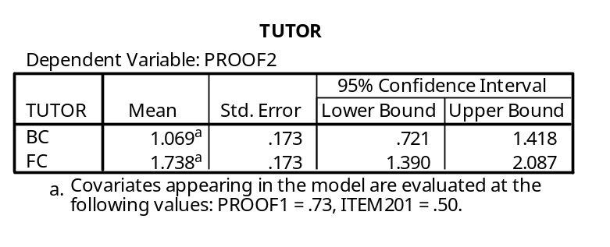
Regression Analysis on Proof Scores

Slide 17
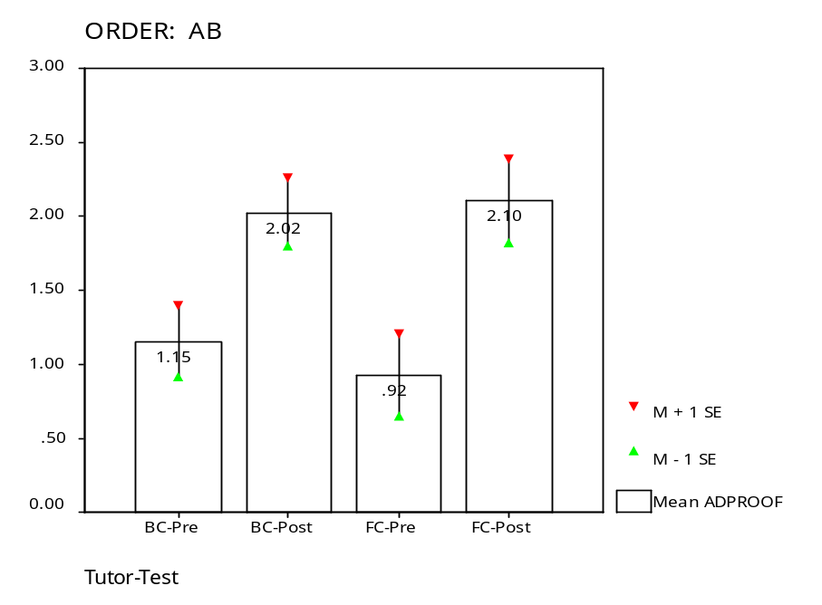
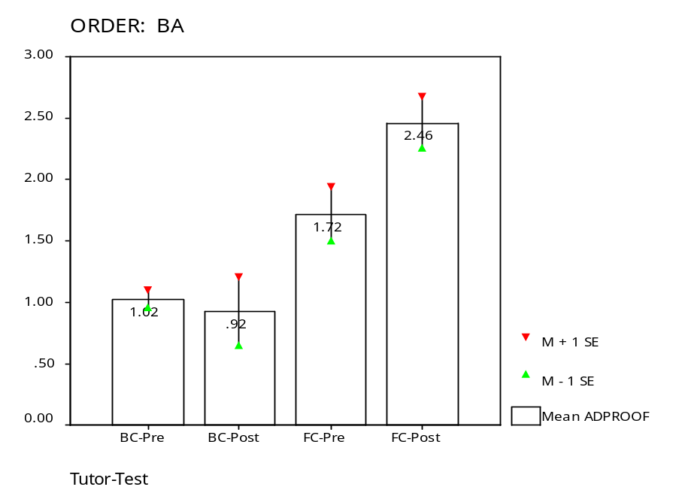
Adjusted Proof
A
B
A
B
B
A
B
A
Test-B added 0.948
Test-B added 0.948
In AB condition, both BC and FC learned equally well.
In BA condition, FC >> BC

