Slide 1
Toward a Theory of Hinting
What makes a hint effective?
Noboru Matsuda & Kurt VanLehn
Intelligent Systems Program
Learning Research and Development Center
University of Pittsburgh

Slide 2
Research Problem
How can we help students learn problem solving such as theorem proving?
  Learning by solving problems
  Learning from worked examples
How can we help students best get through problems?
  Human tutors provide a hint when students get stuck.
  “>90% of the errors triggered a hint”
Do we know a theory of hint?
  No
What would an effective hint look like?
  Let’s investigate…
Hume, G., Michael, J., Rovick, A., & Evens, M. (1996). Hinting as a tactic in one-on-one tutoring. Journal of the Learning Sciences, 5(1), 23-47.

Slide 3
Outline of This Talk
Best we could learn so far
Domain
Protocol analysis
Pattern of hint in human tutoring
(Hopefully not so) Future work

Slide 4
Hint in ITS
Classical Hinting Pattern
  Abstract hint
  More specific hint
  Bottom out hint
Virtually, we know nothing about an effective hint for ITS
Anderson, J. R., Corbett, A. T., Koedinger, K. R., & Pelletier, R. (1995). Cognitive tutors: Lessons learned. Journal of the Learning Sciences, 4(2), 167-207.

Slide 5
Domain
Geometry Theorem Proving with Construction
  Normal deduction in Euclidean elementary geometry.
  Must make constructions to complete a proof.
    compasses and straightedge

Slide 6
Example of a Theorem to Prove
X
Given
AB = CD
AE = EC
BF = FD
Goal
∠AYE = ∠CXE
Y
D
B
F
A
E
C

Slide 7
GRAMY
Automated theorem prover capable of construction.
  The world most powerful prover ever!
Diagrammatic & schematic knowledge representation does a good job.
  Each geometric postulate has a typical configuration associated.

Slide 8
Lessons Learned in GTP
In theory, …
  Construction can be made as a backward application of postulate.
Useful axiom
Given
BC = 2AB,
D midpoint BC,
E midpoint BD
Goal
∠EAD = ∠DAC
A
A
X
E
D
B
E
D
C

Slide 9
Lessons Learned in GTP
In theory, …
  Construction can be made as a backward application of postulate.
Useful axiom
Given
BC = 2AB,
D midpoint BC,
E midpoint BD
Goal
∠EAD = ∠DAC
A
A
X
E
D
B
E
D
C

Slide 10
Domain: Summary
Geometry theorem proving with construction
  Well-defined geometric postulates
    Definitions, axioms, and theorems
  Construction can be made on a way in a normal backward-chaining.
    Nothing special
Can teach them!

Slide 11
But How?
Don’t know!!

Slide 12
Protocol Analysis
9 Japanese Ss in middle school
  Worked on 2 to 3 problems with paper and pencil
The tutor rather tried to elicit student’s knowledge
  Ask more, teach less

Slide 13
Objectives of the Analysis
Digging a pattern of hinting out of the mess…
  What does a hint look like?
  What motivates a hint?
  How to chose a better hint?
  What if a hint failed?

Slide 14
A Cognitive Model in Problem Solving
GOMS (Goal-Operator-Methods-Selection)
  A model describing how human solves a well-defined problem.
In Geometry
  a postulate X→Y corresponds to a method
  X and Y could be operators
  Y is a goal
Jonassen, D. H., Tessmer, M., & Hannum, W. H. (1999). Task analysis methods for instructional design. Mahwah, NJ, US: Lawrence Erlbaum Associates, Inc., Publishers.

Slide 15
H-GOMS: An Epistemology of Hint
Can provide a hint for each step of GOMS
with a twist on a view point and a form
  Ex. Consider a method X→Y
    The twists on a view point
      Hint on whole method application
      Hint on the premise (X), or the conclusion (Y)
      Hint on a unification for X and Y
    … and on a form
      Question
      Direct exhibition
      Highlighting

Slide 16
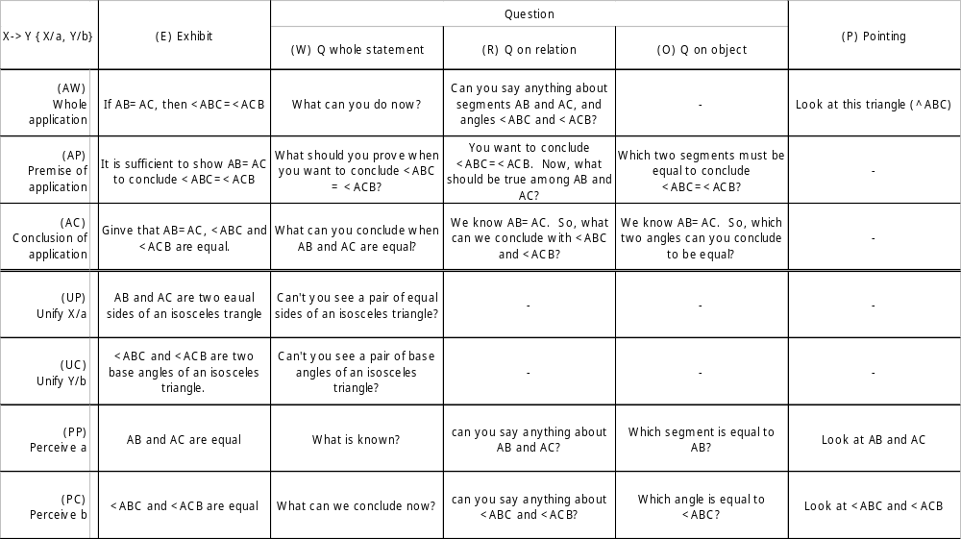
Overview of H-GOMS

Slide 17
Some Examples
Given an isosceles triangle ABC
Hints on AB=AC→ ∠ABC=∠ACB
  AW-E: Remember, if AB=BC, then ∠ABC=∠ACB
  AW-R: Can you say anything about the segments AB, AC and angles ∠ABC, ∠ACB?
  AW-P: Look at triangle ABC
  UP-W: Can’t you see a pair of equal sides of an isosceles triangle?
  PP-O: Which segment is equal to AB?

Slide 18
Generality of H-GOMS
Can explain most of the hint
  Literature
    A child asks the mother what direction they are driving. The mother respond with “where is the sun?”
      Asking about A to infer B where A→B (AP-Q)
  Empirical Data
    95.2% of the hints observed were identified as H-GOMS (N=42 from 3 Ss)

Slide 19
But we do need a pattern of hint!
We read hundreds of lines of interactions bwt T and S.
  Tried to see a pattern of effective hinting.
    Spent a half a year on the data analysis.
Representation does matter:
  Once we put S and T contributions in a line …
Chi, M. T. H. (1997). Quantifying qualitative analyses of verbal data: A practical guide. Journal of the Learning Sciences, 6(3), 271-315.

Slide 20
Dialog move in #208 on <BQM = <BzM
Top level goal has two subgoals and one of them has been justified. The help is then provided on the other subgoal (X). W is already justified.
HINT / LP
Hint on next step
Conjunctive
justifications
Hint on conjunctive justification
a1
91
Hint on X
AW-P
Y→X
Okay
Hint on X&A → B
when A is justified
a1: Help on X
a2: SoWhat?
Hint on (Y→)X
- AW-P or
- AW-R or
- Hint on Y→X
Y: BQ = Bz
X: <BQM = <BzM
P-Hint on V&Z→Y
c1 PP-P on Z with Why
if failed A-hint on Z
c2 PC-R on Y with Why
if failed S-Hint on V&Z→Y
P-Hint on V&Z→Y
118
117
LP
Why
121
120
b1
113
c1
LP
PC-P
Y(→X)
PC-Hint on Y
Hint on Y→X
AW-R
Y→X
122
PP-P
(V&)Z(→Y)
PC-Hint on Y
- PC-P on Y or
- P-Hint on V&Z→Y
Hint on Y→X
b1: PC-Hint on Y
b2: AW-P or AC-W
if failed S-Hint on Y→X
114
Y: BQ = Bz
Y: BQ = Bz
Z: PA = Bz
V: BQ = PA
165
a2
130
131
133
134
136
SoWhat?
123
Z
c2
AC-R
(W→)Z
Z
PC-R
Y
Y
Why
127
125
Wrong
Why
140
X
144
S-Hint on V&Z→Y
- PP-R on V
- PP-E/S on V
- PP-E/S on Z
- AC-R on Y
Wrong
128
PP-E
V
LP
A-Hint on Z
AW-P
W→Z
129
AC-W
X’→X
W
141
V
PP-R
V
S-Hint on V&Z→Y
A-Hint on W→Z
- AW-P
- AC-R on Z
Z: PA= Bz
W: ^PAM # ^MBz
160
V: BQ = PA
S-Hint on Y→X
- AC-E X’
- AP-E/S Y
- AC-W X’→X
AP-E/S
Y
b2
154
158
PP-E/S
V
PP-E/S
Z
AC-R
Y
Y
AW-P
Y→X
LP
S-Hint on Y→X
AC-E
X’
147
149
150
152
AC-W could be better
X’: ^BQz isosceles tri

Slide 21
A big picture on a help on ∠BQM= ∠BzM
B
Top-level Goal
X
A
∠BQM= ∠BzM
Justified correctly
Y
V
Z

Slide 22
Dialog move in #208 on <BQM = <BzM
Top level goal has two subgoals and one of them has been justified. The help is then provided on the other subgoal (X). W is already justified.
HINT / LP
Hint on next step
Conjunctive
justifications
Hint on conjunctive justification
a1
91
Hint on X
AW-P
Y→X
Okay
Hint on X&A → B
when A is justified
a1: Help on X
a2: SoWhat?
Hint on (Y→)X
- AW-P or
- AW-R or
- Hint on Y→X
Y: BQ = Bz
X: <BQM = <BzM
P-Hint on V&Z→Y
c1 PP-P on Z with Why
if failed A-hint on Z
c2 PC-R on Y with Why
if failed S-Hint on V&Z→Y
P-Hint on V&Z→Y
118
117
LP
Why
121
120
b1
113
c1
LP
PC-P
Y(→X)
PC-Hint on Y
Hint on Y→X
AW-R
Y→X
122
PP-P
(V&)Z(→Y)
PC-Hint on Y
- PC-P on Y or
- P-Hint on V&Z→Y
Hint on Y→X
b1: PC-Hint on Y
b2: AW-P or AC-W
if failed S-Hint on Y→X
114
Y: BQ = Bz
Y: BQ = Bz
Z: PA = Bz
V: BQ = PA
165
a2
130
131
133
134
136
SoWhat?
123
Z
c2
AC-R
(W→)Z
Z
PC-R
Y
Y
Why
127
125
Wrong
Why
140
X
144
S-Hint on V&Z→Y
- PP-R on V
- PP-E/S on V
- PP-E/S on Z
- AC-R on Y
Wrong
128
PP-E
V
LP
A-Hint on Z
AW-P
W→Z
129
AC-W
X’→X
W
141
V
PP-R
V
S-Hint on V&Z→Y
A-Hint on W→Z
- AW-P
- AC-R on Z
Z: PA= Bz
W: ^PAM # ^MBz
160
V: BQ = PA
S-Hint on Y→X
- AC-E X’
- AP-E/S Y
- AC-W X’→X
AP-E/S
Y
b2
154
158
PP-E/S
V
PP-E/S
Z
AC-R
Y
Y
AW-P
Y→X
LP
S-Hint on Y→X
AC-E
X’
147
149
150
152
AC-W could be better
X’: ^BQz isosceles tri

Slide 23
Example of Hinting Strategy
To provide a hint on A&B→C when B is justified, try Help on A and provide ‘What’sNext?’
To provide a hint on (A→)B, try AW-P. If it’s failed, then try AW-R. If it’s failed again then try Hint on A→B.
To provide a hint on A→B, try PC-Hint on A and provide AW-P or AC-W

Slide 24
What Motivates a Hint?
Only 3% of the hint provided spontaneously.
More than 90% of S’s error triggered a hint.
  It must be an error that initiates a hint.
  An error can be viewed as a violation of constraint that must be held in a solution.
Hume, G., Michael, J., Rovick, A., & Evens, M. (1996). Hinting as a tactic in one-on-one tutoring. Journal of the Learning Sciences, 5(1), 23-47.

Slide 25
Constraint-Based Student Modeling
A solution must hold a set of constraints
  When a student violates a constraint, the tutor may interrupt.
A set of constraints corresponds with the pedagogical objectives.
  A version of issue-based student modeling (WEST)
Mitrovic, A., & Ohlsson, S. (1999). Evaluation of a Constraint-Based Tutor for a Database Language. International Journal of Artificial Intelligence in Education, 10, 238-256.

Slide 26
Example of Constraints in GTP
A proposition must have a justification.
A proposition must be a logical consequence of its justification.
A justification must be either a given, a trivially true fact, or a proposition that has a justification.
A justification can not be circulated.
The auxiliary lines in the correct proof must be constructed.

Slide 27
Potential Hinting Schema
Hierarchical and recursive dialog move upon constraint-based student model
  If such-and-such constraints are violated under such-and-such circumstances, then provide a hint on such-and-such
  To provide a hint on such-and-such, try X, Y, and Z. If X failed then consider X’ (as a buck up plan).

Slide 28
Example of Hinting Schema
If a student asked a hint on next step &
X is the first proposition (in BF from the top-level goal) that does not have a justification,
Then given a hint on X.
When providing a hint on X
If X has a conjunctive justification A&B, &
B is already justified,
Then provide a hint on A, &
provide “What’s next?”

Slide 29
Where Would We Go Next?
Reorganize a coding schema
Implement ITS
  AdvGeo Project
Investigate research questions:
  Does H-GOMS work fine?
  Does a hierarchical dialog move help us?
  Is CBS enough for hinting?

Slide 30
Two-Folded Coding Schema
Coding schema for protocol analysis
Coding schema for hint generation
Bhaskar, R., & Simon, H. A. (1977). Problem Solving in Semantically Rich Domains: An Example from Engineering Thermodynamics. Cognitive Science, 1(2), 193-215.

Slide 31
Concluding Remarks
Exploratory study toward a theory of hint for ITS in problem solving
  H-GOMS defines epistemology of hinting
  Constraint-based student model gives rationality of hinting
  Hierarchical and recursive dialog move provides a control over hinting

