Slide 1
Problem
Backward Chaining
P
Goal:
∠APM=∠BQM
∠APM=∠BQM
Q
Tri Congruence
Given:
M midpoint AB
ΔAPD≡ΔBQE
AP = BQ
SAS
D
∠PAD=∠QBE
PD=QM
A
M
B
AD=BE
E
Postulate Browser
Forward Chaining
Tri Congruence
Tri Midpoint
Isosceles Tri
Rectangle
...
 | Conclusion | Reason | Premises
1. | AP = BQ | Given
2. | AM=MB | Mid Point | M midpoint AB
3. | ΔADM≡ΔBEM | SSS | AD = BE * DM = ME * AM = BM
Assert a statement.
Provide a postulate and premises.
Noboru Matsuda April 16, 2003

Slide 2
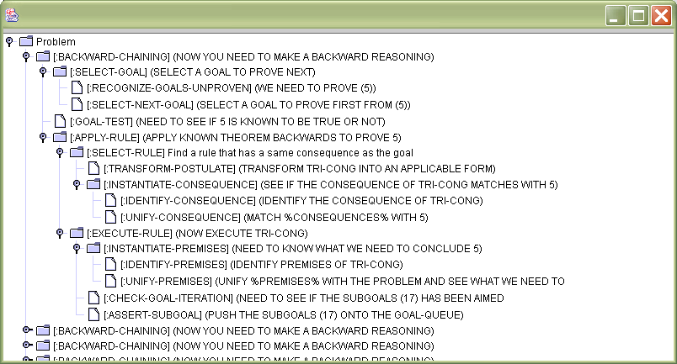
Problem Description
Equation Builder
Backward Chaining
P
Goal:
∠APM=∠BQM
=
∠
∠APM=∠BQM
Q
Δ
≡
Tri Congruence
Given:
M midpoint AB
AP = BQ
⊥
//
ΔAPD≡ΔBQE
D
A
M
B
∠ ABC=∠_
Right Tri Cong
E
Inference Tree
∠PAD=∠QBE
AP=BQ
AD=BE
Forward Chaining
 | Premises | Conclusion | Reason
1. | M midpoint AB | AM=MB | Mid Point
2. | AD = BE * DM = ME * AM = BM | ΔADM≡ΔBEM | SSS
3.
Postulate Browser
Click here to input premises
Tri Congruence
Tri Midpoint
Isosceles Tri
Rectangle
...
Message Window
You gotta be smart!
OK
Noboru Matsuda August 4, 2003

Slide 4
Problem Description
Proposition Builder
Proof
P
Goal:
∠APM=∠BQM
∠ _ = ∠_
Proposition | Justification
M midpoint AB | Premise
AP=BQ | Premise
AM=MB | Midpoint Law Premise: M midpoint AB
ΔADM≡ΔBEM
∠ APM=∠BQE | Tri Cong Premise: Δ ADM≡ΔBEM
Q
Δ _ ≡ Δ_
Given:
M midpoint AB
AP = BQ
_ // _
D
_ ⊥ _
A
M
B
E
Message Window
Inference Step
Tri Congruence is not applicable at this time.
Click here to input a proposition
[Backward Inference] Make a backward inference
[Select Goal] Select a goal to prove
[Recognize unproven goal] We need to prove ∠APM=∠BQE
[Select next goal] Prove ∠APM=∠BQE
[Apply rule] Apply Known postulate backwards to prove ∠APM=∠BQE
[Select-rule] Find a rule that has the same consequence as the goal
[Pick a rule] See if Tri-Cong would be applicable
[Transform-postulate] Transform Tri-Cong into an applicable form results in
When proving ∠abc = ∠xyz
Then prove Δabc≡Δxyz
[Match consequence] See if the consequence matches with ∠APM=∠BQE
[Identify consequence] Consequence is ∠abc = ∠xyz
[Find a match] {a/A, b/P, c/M, x/B, y/Q, z/E} make a match
[Execute a rule] Execute Tri-cong
[Instantiate premises] See how the premises of Tri-Cong matches the problem
[Identify premises] Premises are Δabc ≡ Δxyz
[Unify premises] ΔAPM ≡ ΔBQE
[Check goal iteration] ΔAPM ≡ ΔBQE has not been aimed to prove
[Assert premises as subgoals] We must prove ΔAPM ≡ ΔBQE
OK
Postulate Browser
Tri Congruence
Tri Midpoint
Isosceles Tri
Rectangle
...
Noboru Matsuda September 11, 2003

